Slide 2
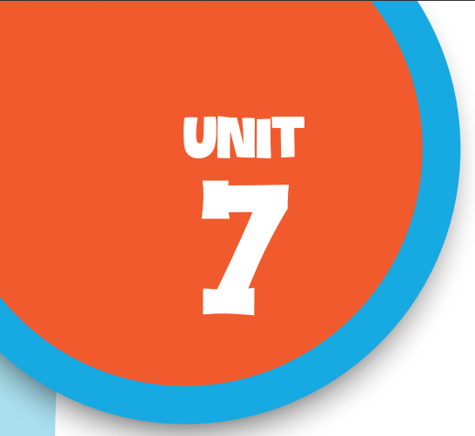

Our favourite
school activities
Lesson 3 - Period 5

Slide 3

Table of contents
01
Warm-up & Review
02
Listen and repeat.
03
Circle, listen and check.
04
Let’s chant.
05
Fun corner & Wrap-up

Slide 4


01
Warm-up
& Review

Slide 5

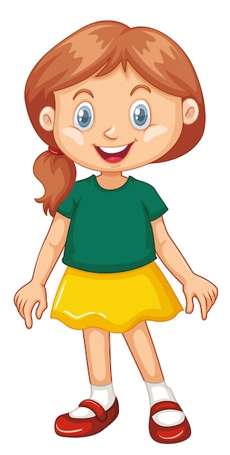
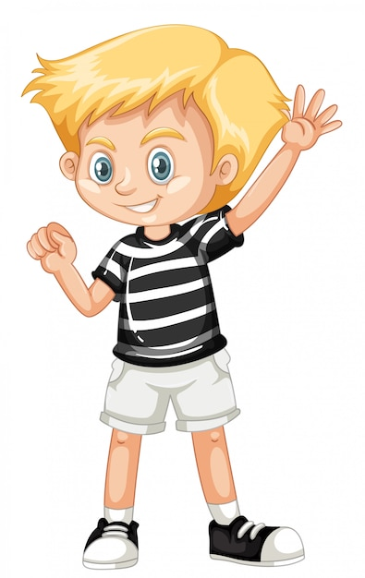
Interview
What school activity
do you like?
I like .

Slide 6
Interview
Why do you like it?
Because I think
it’s .

Slide 7
02
Listen
and repeat.

Slide 8
03
Circle, listen and check.

Slide 9
Circle the word having different stress.
1.a.solving b.downstairs c.because
2.a.goodbye b.swimming c.enjoy
3.a.before b.guitar c.writing

Slide 10
04
Let’s chant.

Slide 11
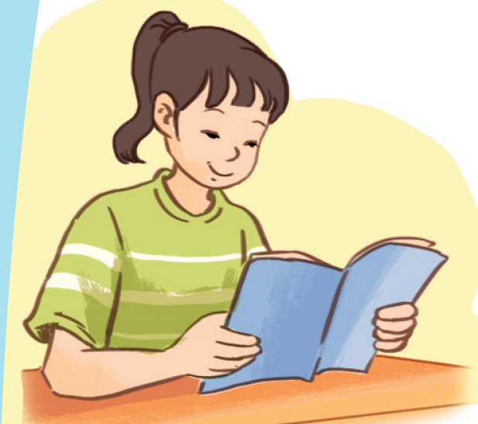
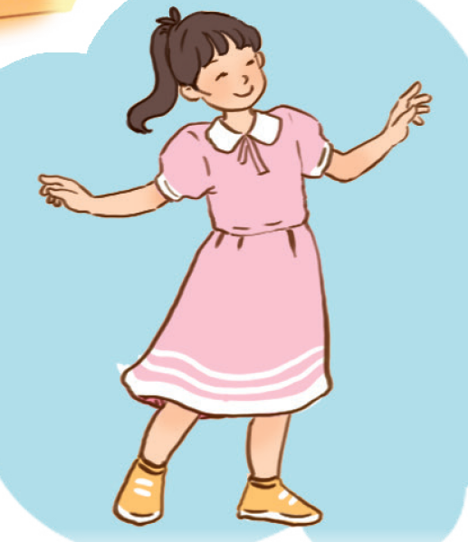

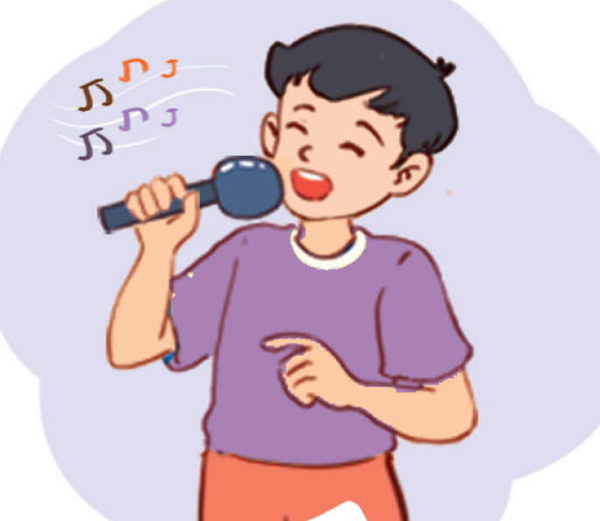
Name the school activities
reading
dancing
reading
singing

Slide 12
05
Fun corner & Wrap-up

Slide 13
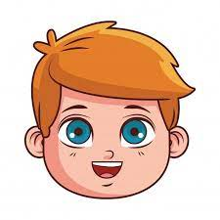
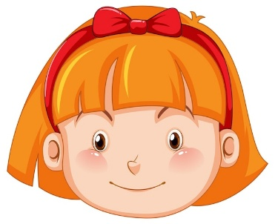










Slide 14
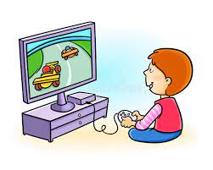

A: Does he like playing games?
Yes, he does.
B: __________

Slide 15
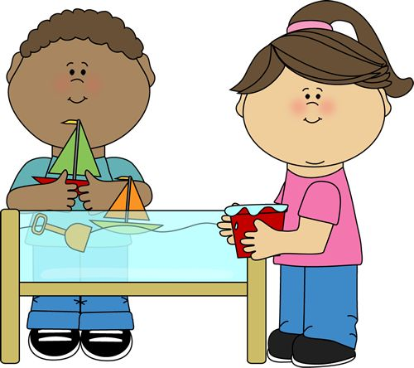
doing projects
A: Why do you like ___________?
B: Because I think
it’s good for
group work.

Slide 16
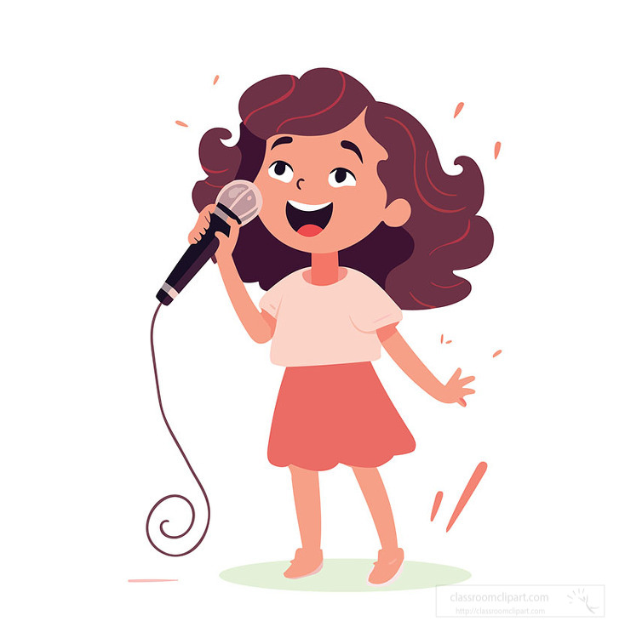
A: What school activity
do you like?
I like singing.
B: ___________

Slide 17
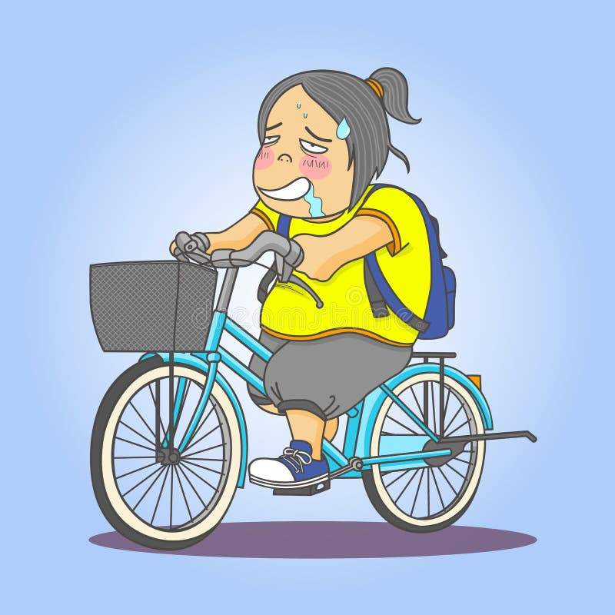
A: Why doesn’t she like
__________?
riding a bike
B: Because she thinks
it isn’t interesting.

Slide 18
Website: hoclieu.vn
Fanpage: https://www.facebook.com/tienganhglobalsuccess.vn/

