Slide 2


Our favourite
school activities
Lesson 3 - Period 6

Slide 3

Table of contents
01
Warm-up and Review
02
Read and circle.
03
Let’s write.
04
Project
Fun corner & Wrap-up
05

Slide 4


01
Warm-up and Review

Slide 5
02
Read and circle.

Slide 6
03
Let's write.

Slide 7
Favourite school activities
School activity | Reason
He / She likes
Because it's ...
solving maths problems
useful
reading stories
good for group work
doing projects
interesting
playing games
fun

Slide 8

Favourite school activities
__________________’s favourite school activity
is _____________. He / She likes ___________
because he / she thinks ___________________.
He / She doesn’t like ______________________
because he / she thinks it’s ________________.

Slide 9
04
Project

Slide 10
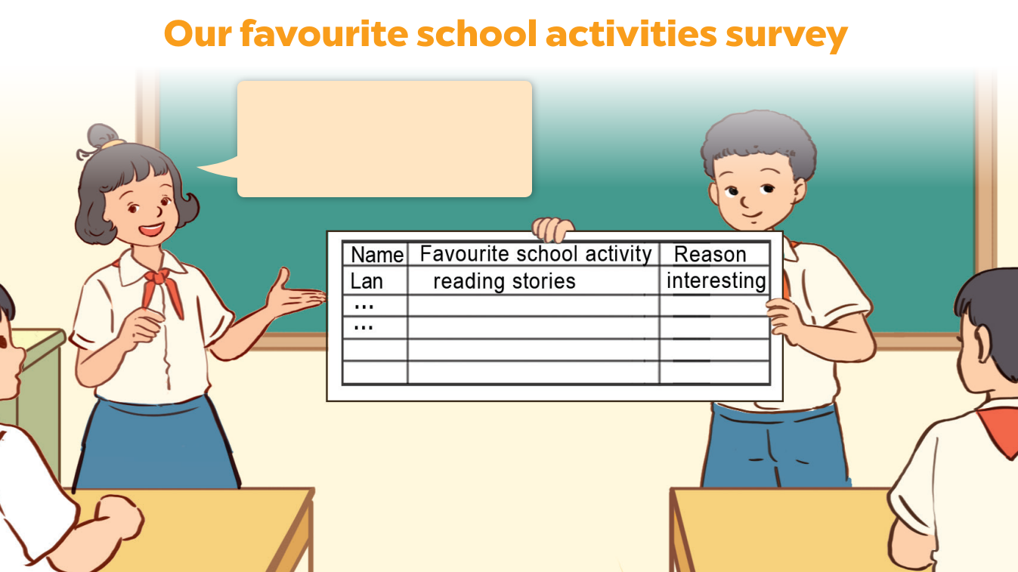
Lan likes reading stories because she thinks it’s interesting.

Slide 11
05
Fun corner
& Wrap-up

Slide 12
Website: hoclieu.vn
Fanpage: https://www.facebook.com/tienganhglobalsuccess.vn/

