Slide 2




01
Warm-up & Review

Slide 3










Slide 4
02
Read and answer.

Slide 5





Listen and read.
Trang
Lan
Hung

Slide 7
03
Look and write.

Slide 9
04
Project

Slide 10


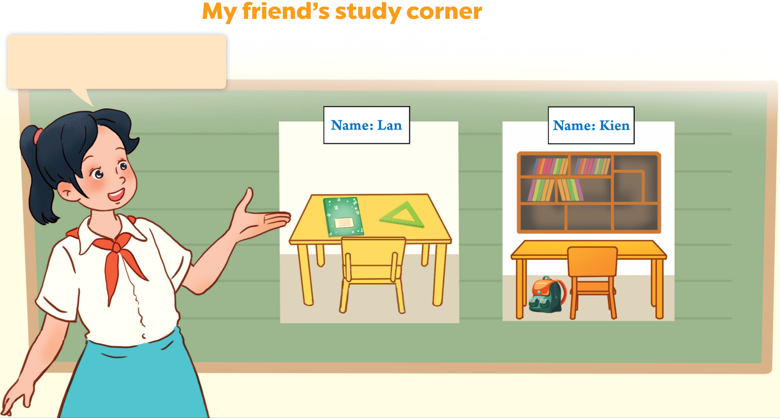


Look at your groups’ pictures!

Slide 12
Website: hoclieu.vn
Fanpage: https://www.facebook.com/tienganhglobalsuccess.vn/

