Slide 2

Unit 9 Our outdoor activities
Lesson 1 - Period 2

Slide 3

Table of contents
01
Warm-up and Review
02
Activity 4. Listen and tick or cross.
03
Activity 5. Read and complete.
04
Activity 6. Let’s play.
05
Fun corner and Wrap-up

Slide 4


01
Warm-up and Review

Slide 5
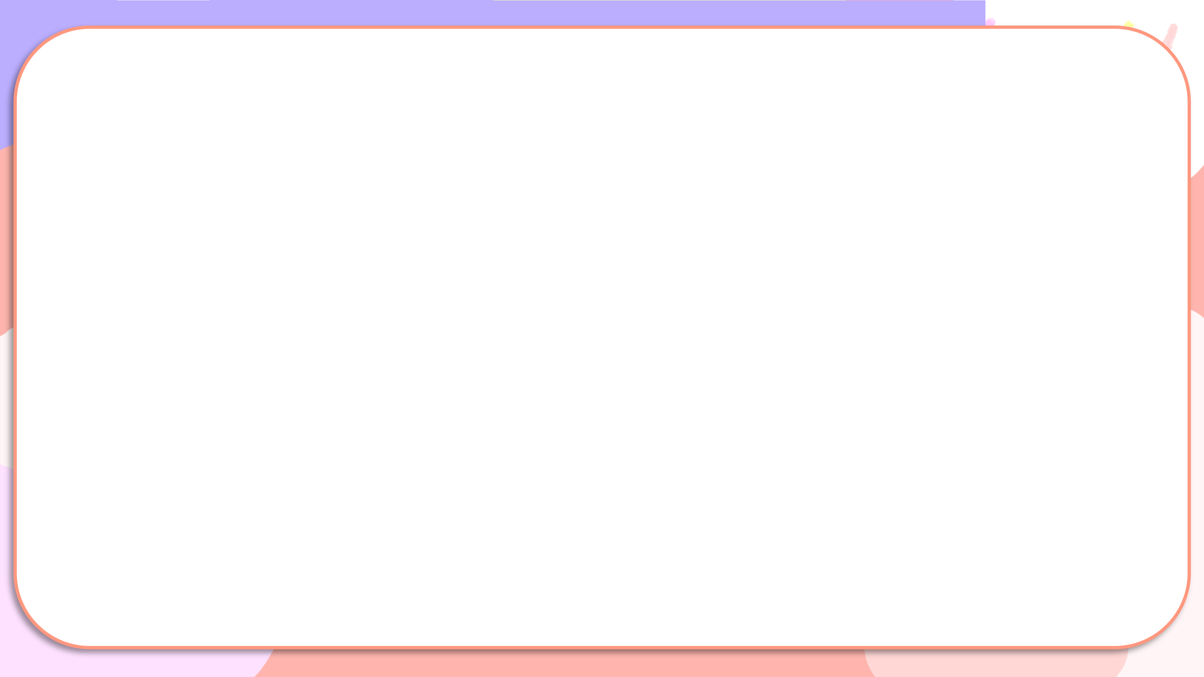

Were you at the ____ yesterday?
Yes, we were.
No, we weren’t.

Slide 6


Secret boxes
Game

Slide 7

Secret boxes
Game
Team 1
Team 2

Slide 8


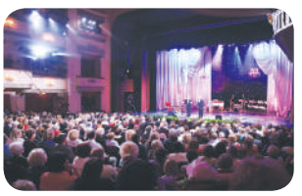
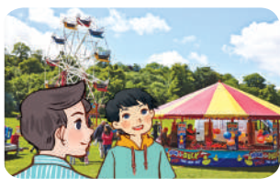
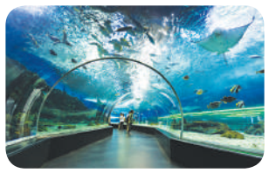


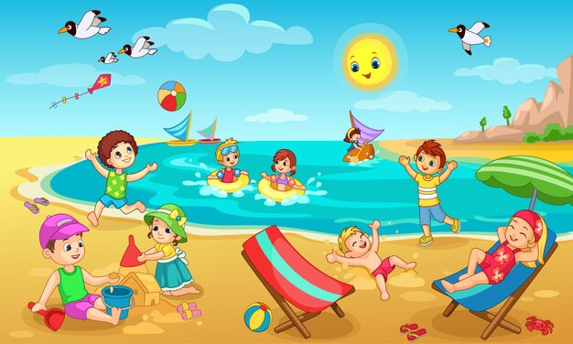
Team 1
Team 2
Notes:
Nháy choột vào hộp để xuất hiện hình ảnh, mỗi lần nháy là 1 hình ảnh hiện ra và hình ảnh trước sẽ bi biến mất.
GV ghi điểm cho HS bằng cách nháy vào tên team. Mỗi lần nháy 1 ngôi sao xuất hiện.

Slide 9

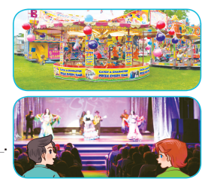

Read and complete.

Slide 10
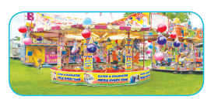
Read and complete.
1. A: Were you and Linh at the _______ last weekend?
B: Yes, ________.
funfair
we were

Slide 11

Read and complete.
2. A: Were you at the cinema last Saturday?
B: No, _________. We were at the ______.
we weren’t
theatre

Slide 12

Read and complete.
3. A: Where were you and Ben last Sunday?
B: ________ at the sports centre.
We were

Slide 13

Read and complete.
4. A: Where were you and Mary yesterday?
B: ____________________.
We were at the aquarium

Slide 14
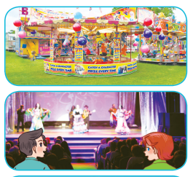

funfair
1. A: Were you and Linh at the _______ last weekend?
B: Yes, ________.
we were
2. A: Were you at the cinema last Saturday?
B: No, _________. We were at the ______.
we weren’t
theatre
3. A: Where were you and Ben last Sunday?
B: ________ at the sports centre.
We were
4. A: Where were you and Mary yesterday?
B: ____________________.
We were at the aquarium

Slide 15
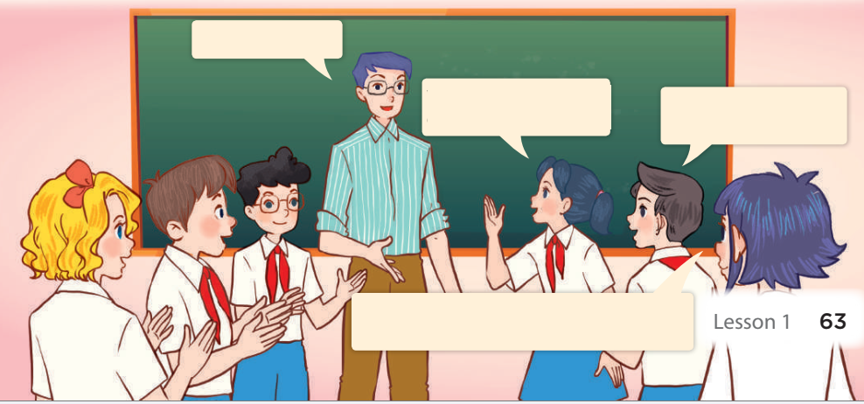
Memory game
at the campsite
We were at the campsite yesterday.
They were at the campsite yesterday.
They were at the campsite yesterday, and we were at the campsite, too.

Slide 16

Throw a dice
Game
Team 1
Team 2

Slide 17
Website: hoclieu.vn
Fanpage: https://www.facebook.com/tienganhglobalsuccess.vn/

