Slide 2

Unit 9
Our outdoor activities
Lesson 2 - Period 4

Slide 3

Table of contents
01
Warm-up and Review
02
Activity 4. Listen and circle.
03
Activity 5. Read and complete.
04
Activity 6. Let’s sing.
05
Fun corner and Wrap-up

Slide 4



What did you do yesterday?
We ____.

Slide 5
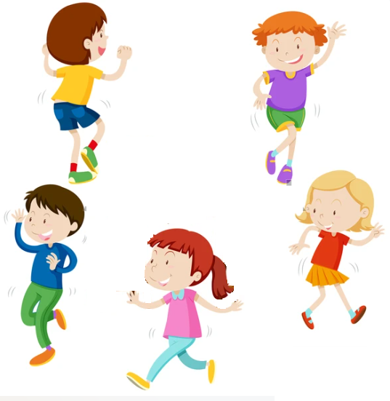
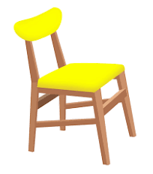
Hot Seat
Game

Slide 6

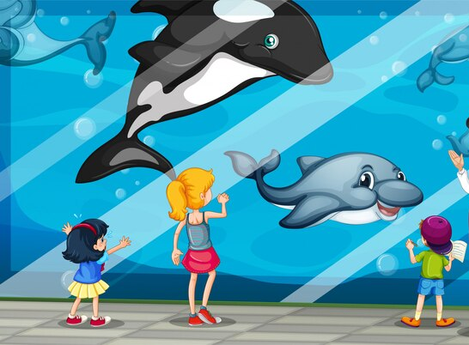
What did you do yesterday?

Slide 7
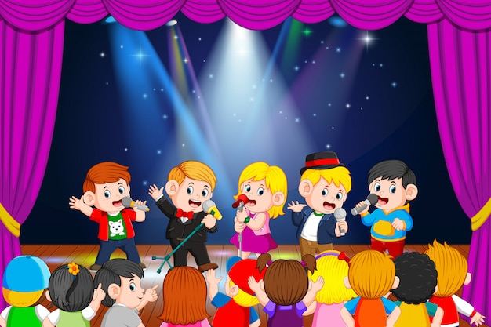
What did you do yesterday?

Slide 8

What did you do yesterday?

Slide 9

03
Activity 5.
Read and complete.

Slide 10

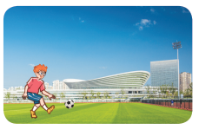
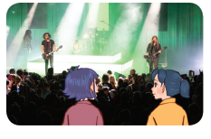
Read and complete.

Slide 11
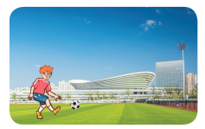
Read and complete.
1. A: Where were you last weekend?
B: I was at the ____________.
A: What did you do there?
B: I ____________.
sports centre
played football

Slide 12
Read and complete.
2. A: Were you and Mai at the theatre yesterday?
B: Yes, ________.
A: What did you ____ there?
B: We ________________.
we were
do
listened to music

Slide 13
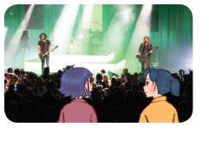
Read and complete.
1. A: Where were you last weekend?
B: I was at the ____________.
A: What did you do there?
B: I ____________.
2. A: Were you and Mai at the theatre yesterday?
B: Yes, _______.
A: What did you ___ there?
B: We ______________.
sports centre
played football
we were
do
listened to music

Slide 14


MATCHING
GAME

Slide 15
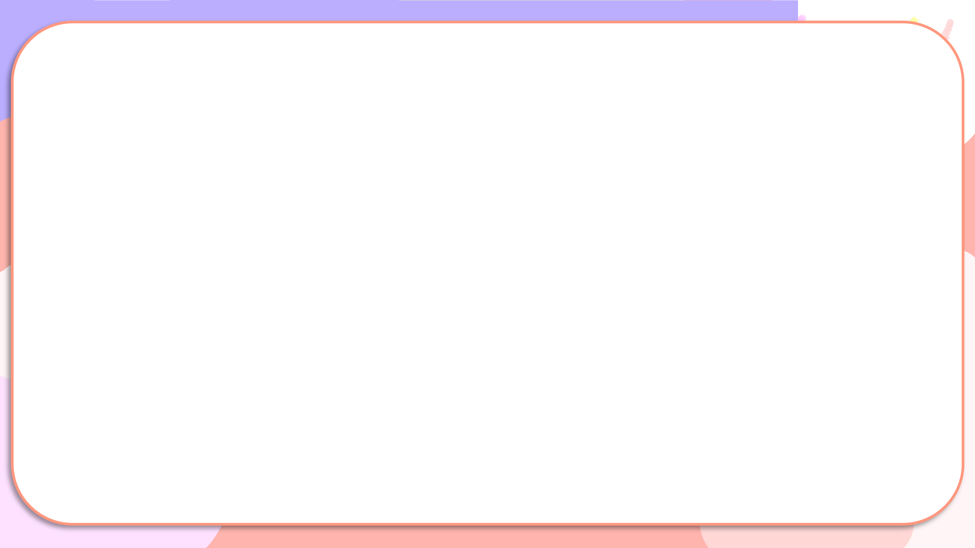
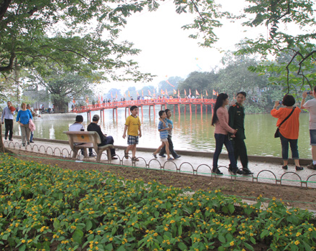
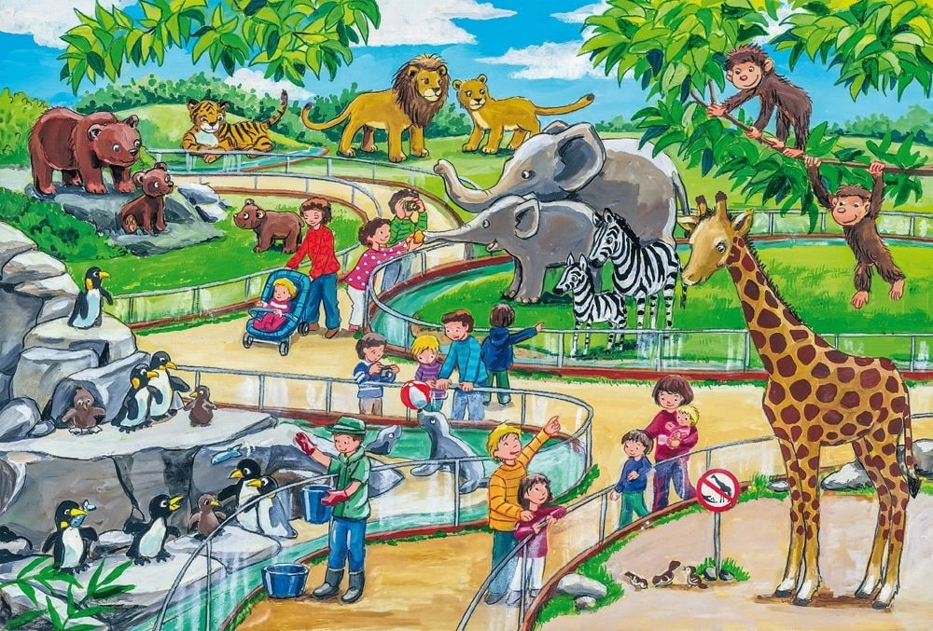
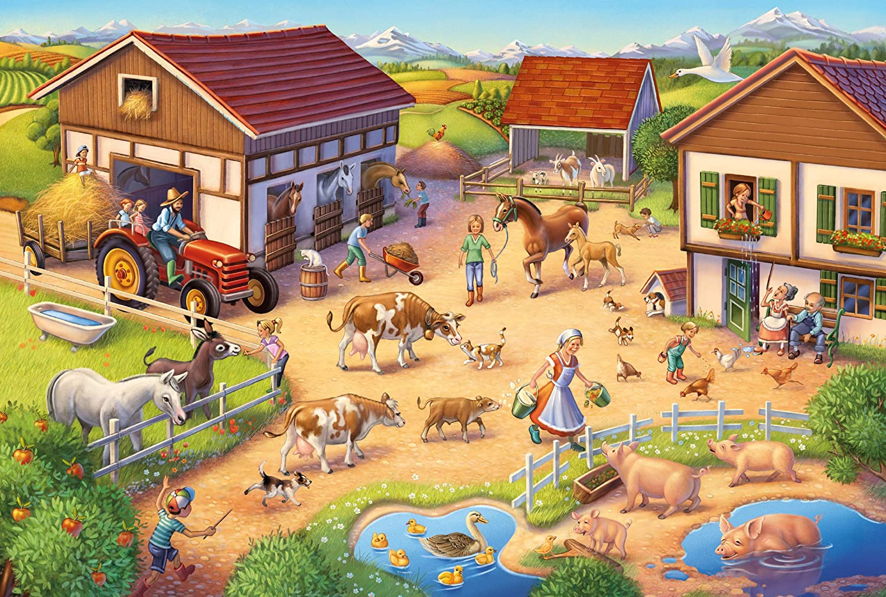
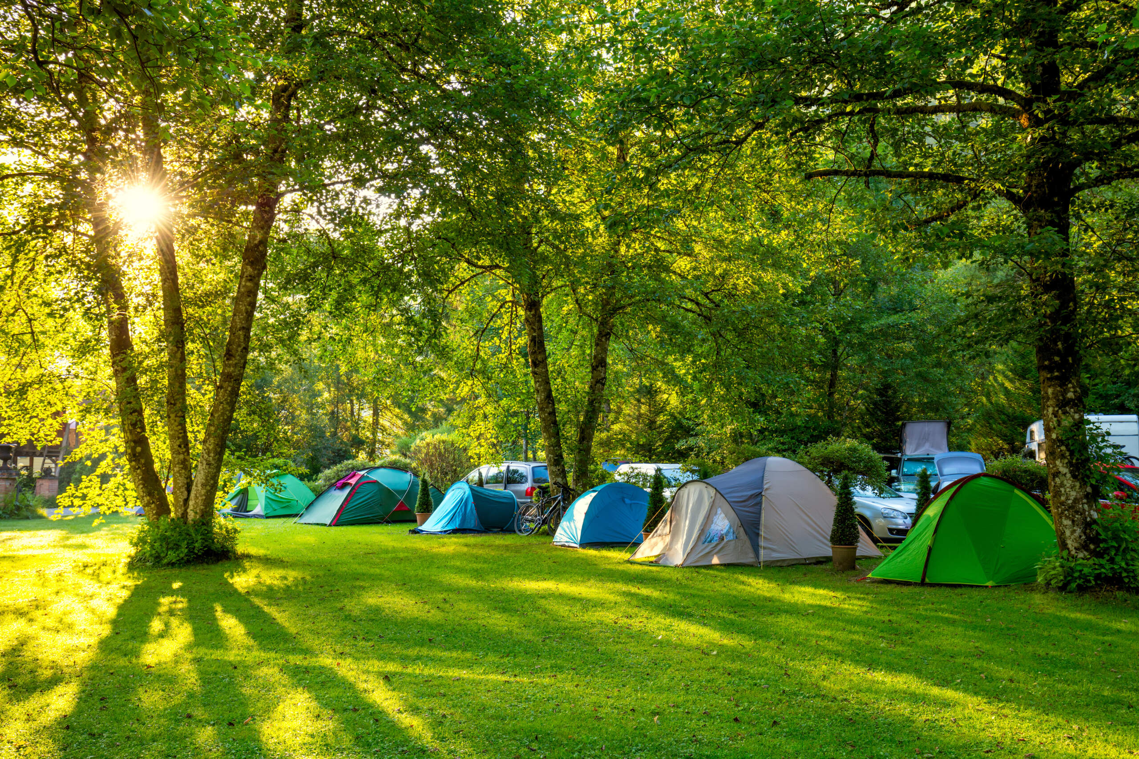
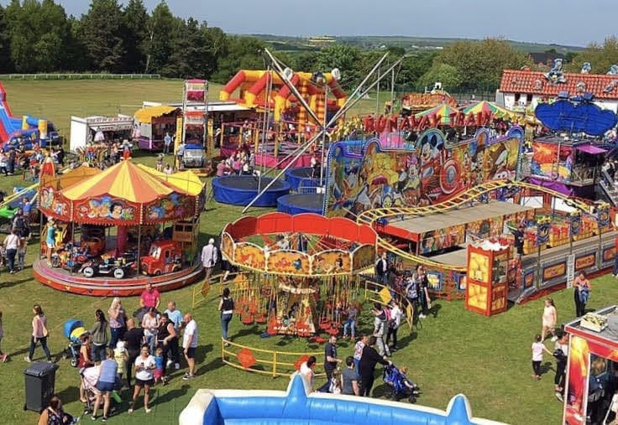
Matching
1
2
3
4
5
at the zoo
at the funfair
at the campsite
walked around the lake.
at the farm

Slide 16
Website: hoclieu.vn
Fanpage: https://www.facebook.com/tienganhglobalsuccess.vn/

