Slide 2

Review 2
Period 2

Slide 3

Table of contents
01
Warm-up and Review
02
Activity 3. Read and match.
03
Activity 4. Read and number.
04
Activity 5. Let’s write.
05
Fun corner and Wrap-up

Slide 4


01
Warm-up and Review

Slide 5
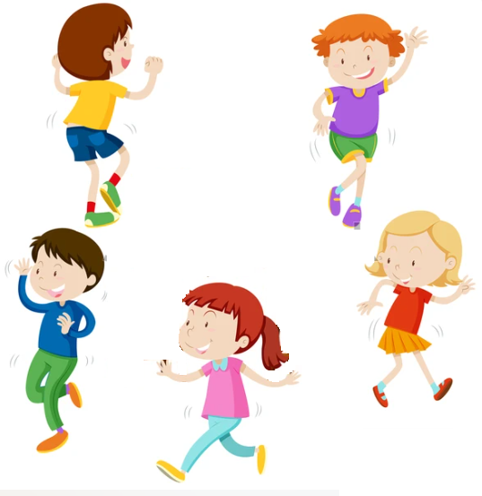

Hot seat
Game

Slide 6


What did you do yesterday?

Slide 7
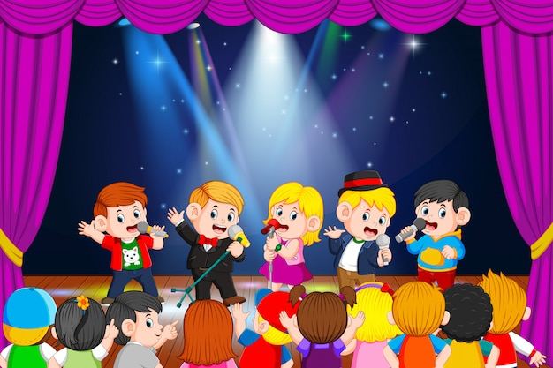
What did you do yesterday?

Slide 8
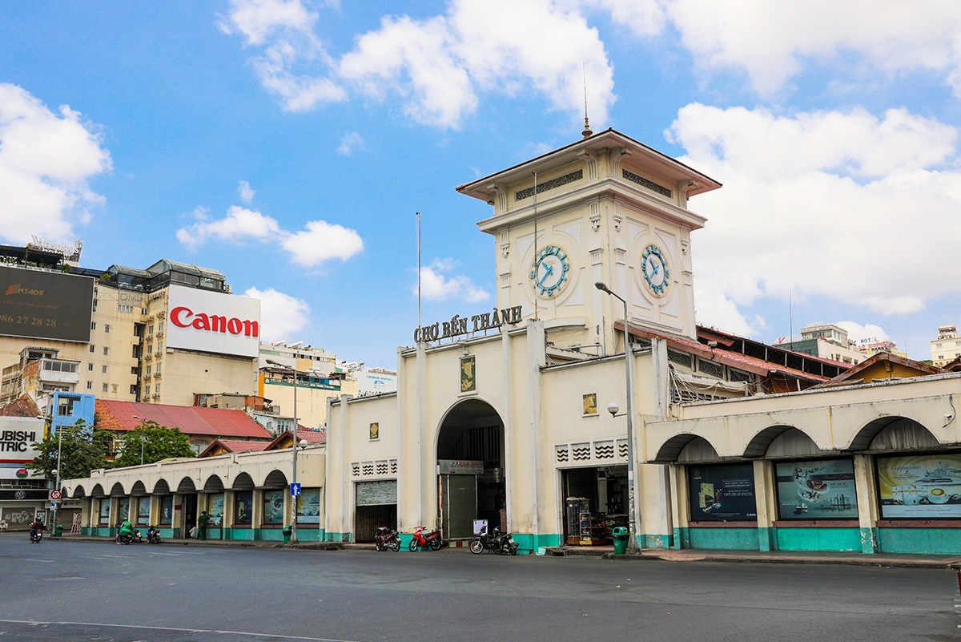
Where did you go last November?

Slide 9
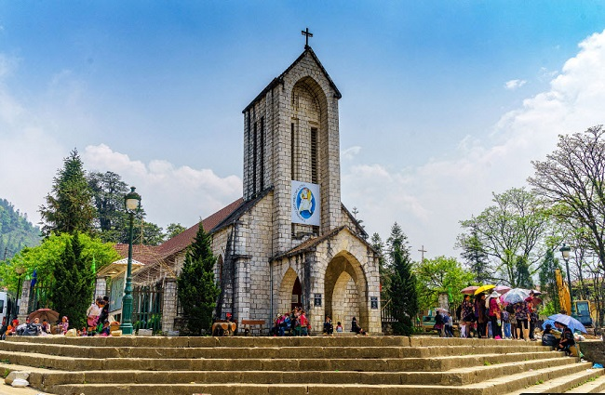
Where did you go last September?

Slide 10

Read and match.
1. Could you tell me the way to the art room?
a. It’s Lucy’s
2. What school activity does Minh like?
b. Yes, we were.
3. Whose set square is this?
c. Because she thinks it’s interesting.
4. Were you at Hoan Kiem Lake last weekend?
d. He likes doing projects.
5. Why does Lan like reading books?
e. Go upstairs. It’s on the first floor.

Slide 11

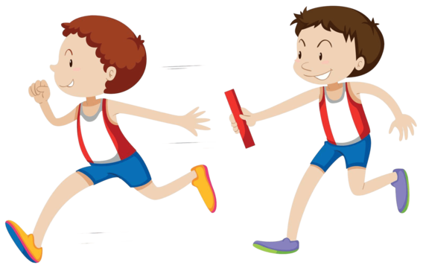
Relay Game

Slide 12
Read and match.
1. Could you tell me the way to the art room?
a. It’s Lucy’s.
2. What school activity does Minh like?
b. Yes, we were.
3. Whose set square is this?
c. Because she thinks it’s interesting.
4. Were you at Hoan Kiem Lake last weekend?
d. He likes doing projects.
5. Why does Lan like reading books?
e. Go upstairs. It’s on the first floor.

Slide 13
Read.
Last Saturday, Lan and her class went to Ba Na Hills in Da Nang. The weather was so beautiful. They arrived there early in the morning. First, they enjoyed the cable car ride. They walked over Golden Bridge. Then they visited the famous buildings and went to the wax museum. After that, they played some games at the amusement park. They had some
delicious seafood at a well-known restaurant. They went home late in the afternoon. Their trip was a lot of fun. Lan really wants to visit Ba Na Hills again next summer to see some more interesting places there.

Slide 14
Read and number.
Last Saturday, Lan and her class went to Ba Na Hills in Da Nang. The weather was so beautiful. They arrived there early in the morning. First, they enjoyed the cable car ride. They walked over Golden Bridge. Then they visited the famous buildings and went to the wax museum. After that, they played some games at the amusement park. They had some
delicious seafood at a well-known restaurant. They went home late in the afternoon. Their trip was a lot of fun. Lan really wants to visit Ba Na Hills again next summer to see some more interesting places there.
2
a. They visited the famous buildings and the wax museum.

Slide 15
Read and number.
Last Saturday, Lan and her class went to Ba Na Hills in Da Nang. The weather was so beautiful. They arrived there early in the morning. First, they enjoyed the cable car ride. They walked over Golden Bridge. Then they visited the famous buildings and went to the wax museum. After that, they played some games at the amusement park. They had some
delicious seafood at a well-known restaurant. They went home late in the afternoon. Their trip was a lot of fun. Lan really wants to visit Ba Na Hills again next summer to see some more interesting places there.
4
b. They went home late in the afternoon.

Slide 16
Read and number.
Last Saturday, Lan and her class went to Ba Na Hills in Da Nang. The weather was so beautiful. They arrived there early in the morning. First, they enjoyed the cable car ride. They walked over Golden Bridge. Then they visited the famous buildings and went to the wax museum. After that, they played some games at the amusement park. They had some
delicious seafood at a well-known restaurant. They went home late in the afternoon. Their trip was a lot of fun. Lan really wants to visit Ba Na Hills again next summer to see some more interesting places there.
1
c. Lan and her class enjoyed the cable car ride and walked over Golden Bridge.

Slide 17
Read and number.
Last Saturday, Lan and her class went to Ba Na Hills in Da Nang. The weather was so beautiful. They arrived there early in the morning. First, they enjoyed the cable car ride. They walked over Golden Bridge. Then they visited the famous buildings and went to the wax museum. After that, they played some games at the amusement park. They had some
delicious seafood at a well-known restaurant. They went home late in the afternoon. Their trip was a lot of fun. Lan really wants to visit Ba Na Hills again next summer to see some more interesting places there.
3
d. They played some games at the amusement park and had some delicious seafood at a well-known restaurant.

Slide 18
04
Activity 5. Let’s write.

Slide 19
Let’s write.
– Where did you go last Sunday?
– What did you do there in the morning?
– What did you do in the afternoon?
– How was your trip?
My trip last Sunday
Last Sunday, I went to _
__________________
__________________

Slide 20
Let’s write.
Suggestion
My trip last Sunday
Last Sunday, I went to Hoan Kiem Lake with my friends. In the morning, we walked around the lake. We visited Ngoc Son Temple. In the afternoon, we went to see the water puppet show at the waterpuppet theatre by the lake. Our trip was a lot of fun!

Slide 21
Let’s write.
– Where did you go last Sunday?
– What did you do there in the morning?
– What did you do in the afternoon?
– How was your trip?
My trip last Sunday
Last Sunday, I went to _
__________________
__________________

Slide 22


Summary
Team 1
Team 2

Slide 23
Website: hoclieu.vn
Fanpage: https://www.facebook.com/tienganhglobalsuccess.vn/

