Slide 2

Unit 10 Our school trip
Lesson 1 - Period 1

Slide 3

Table of contents
01
Warm-up and Review
02
Activity 1. Look, listen and repeat
03
Activity 2. Listen, point and say
04
Activity 3. Let’s talk
05
Fun corner and Wrap-up

Slide 4

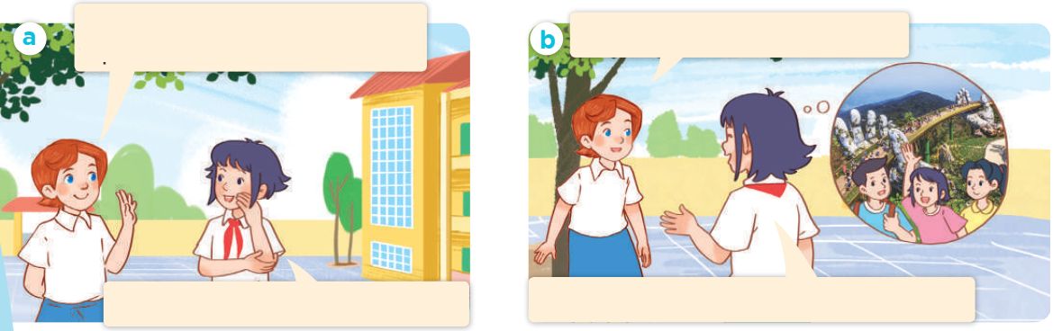
Look, listen and repeat.

Slide 5



Did they go to __?
Yes, they did.
No, they didn’t.

Slide 6
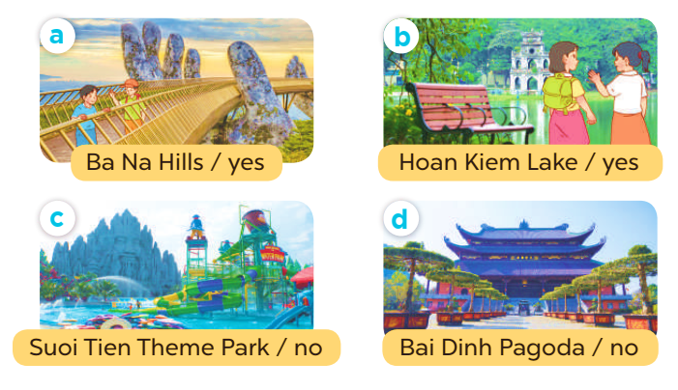
Did they go to __?
Yes, they did.
No, they didn’t.

Slide 7

Let’s talk.
Did they go to ____?
____.

Slide 8
Did they go to __?
Yes, they did.
No, they didn’t.

Slide 9

Musical pictures

Slide 10


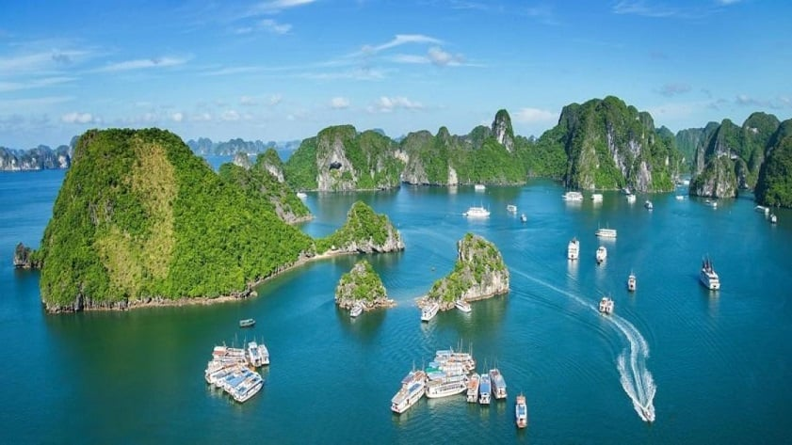
Did you go to __?
____
Notes:
Nháy choột lần 1 bật nhạc, nháy chuột lần 2 nhạc tắt hình ảnh xuất hiện, HS hỏi đáp về hình ảnh.

Slide 11


Very Good!

Slide 12
Website: hoclieu.vn
Fanpage: https://www.facebook.com/tienganhglobalsuccess.vn/

