Slide 2

Unit 10 Our school trip
Lesson 1 - Period 2

Slide 3

Table of contents
01
Warm-up and Review
02
Activity 1. Listen and tick or cross
03
Activity 2. Read and circle
04
Activity 3. Listen, complete and sing
05
Fun corner and Wrap-up

Slide 4


MATCHING
GAME

Slide 5
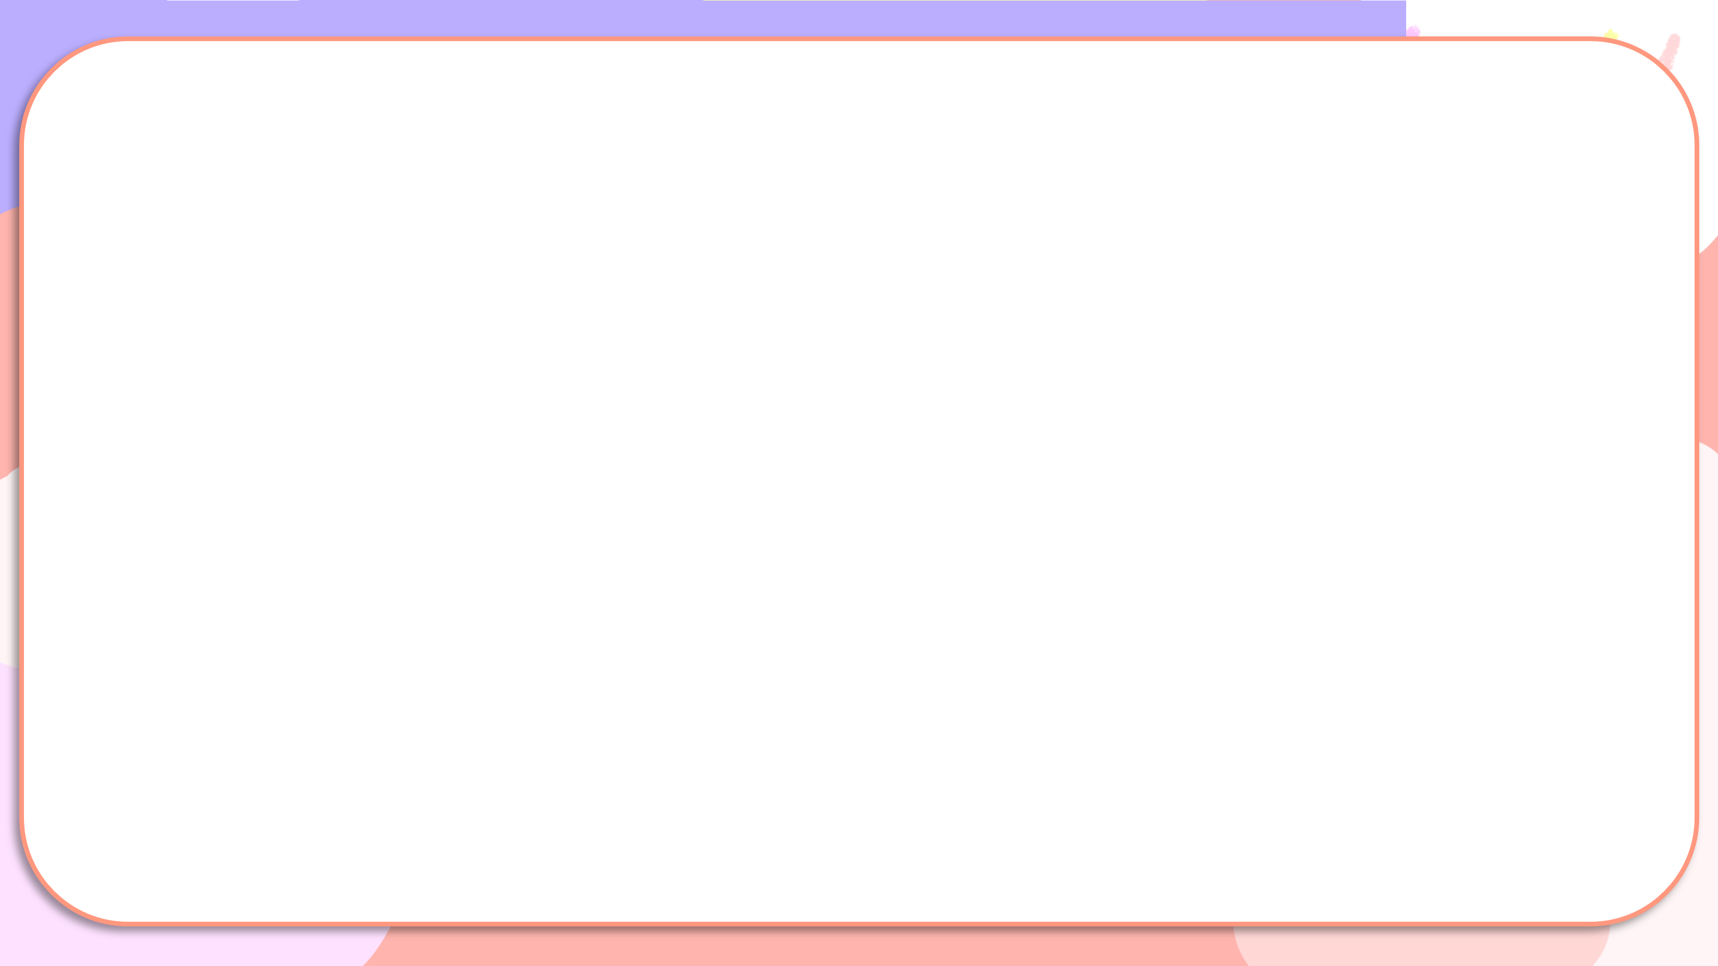
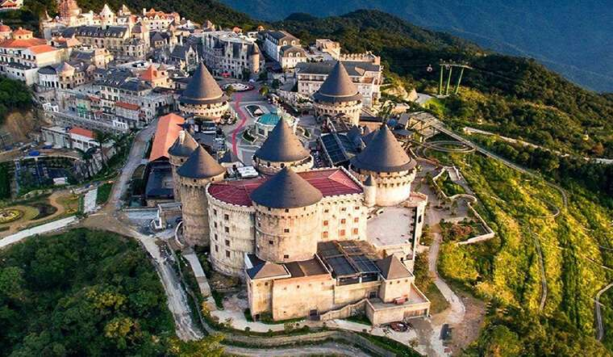
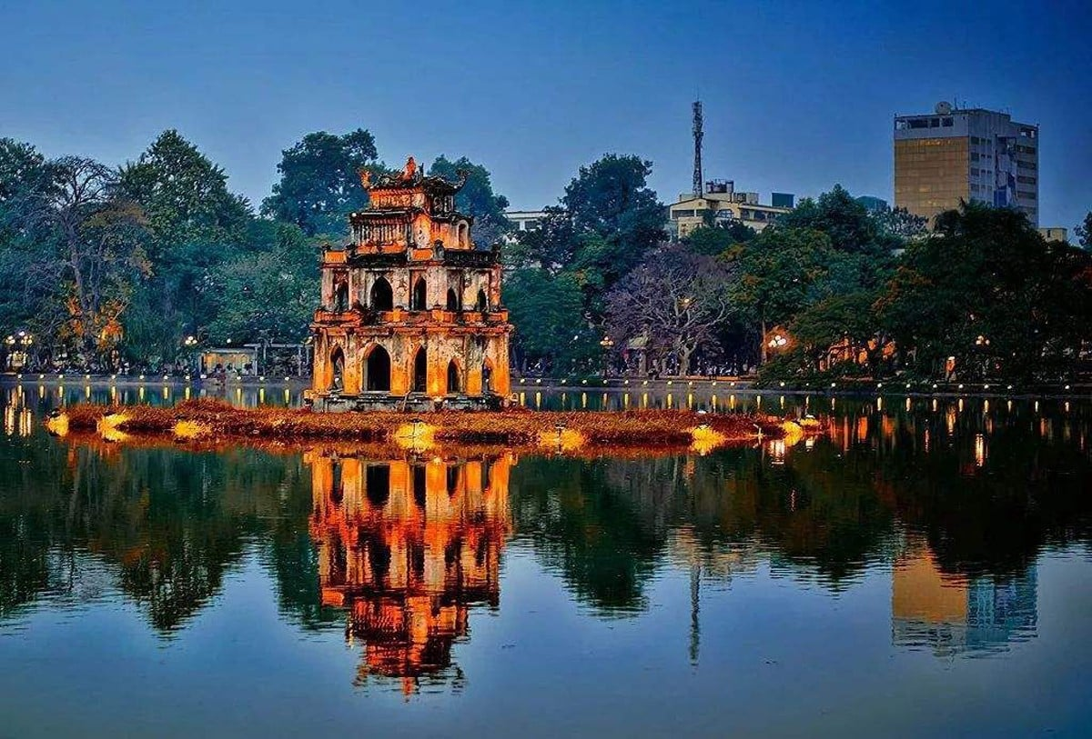
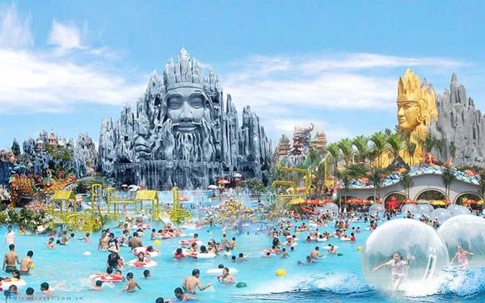
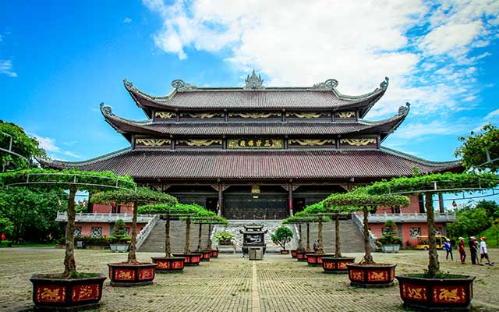
Matching
1
2
3
4
a
b
c
d
Hoan Kiem Lake
Ba Na Hills
Bai Dinh Pagoda
Suoi Tien Theme Park

Slide 6

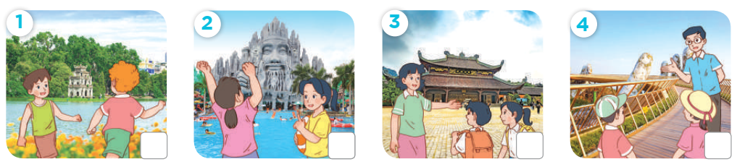
Listen and tick or cross

Slide 7
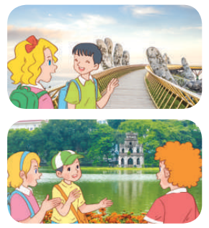
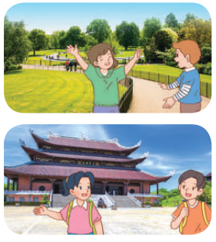
Read and circle

Slide 8
Read and complete.
1. A: Did they go to Ba Na Hills last weekend?
B: Yes, they did. / No, they didn’t. It was beautiful!

Slide 9
Read and complete.
2. A: Did your class go to Ho Tay Water Park?
B: No, we don’t / didn’t. We went to Hoan Kiem Lake / Thu Le Zoo.

Slide 10
Read and complete.
3. A: Did they go to Hyde Park on the school trip last summer?
B: Yes, they did / do. It was great!

Slide 11
Read and complete.
4. A: Did / Do they go to the Opera House on the school trip last year?
B: No, they didn’t. They went to Bai Dinh Pagoda / Ba Na Hills.

Slide 12



Flower picking
Game

Slide 13






Team 1
Team 2
Notes:
Click lần 1 vào bông hoa để tới bức tranh tương ứng. Bông hoa được chọn sẽ biến mất.
Click vào tên đội để tính điểm. Mỗi lần click một bông hoa xuất hiện để tính điểm
Click vào mũi tên đến màn hình tuyên dương

Slide 14

Did you_____?
____.
Back
Notes:
Click vào mũi tên để quay về

Slide 15
Did you_____?
____.
Back
Notes:
Click vào mũi tên để quay về

Slide 16
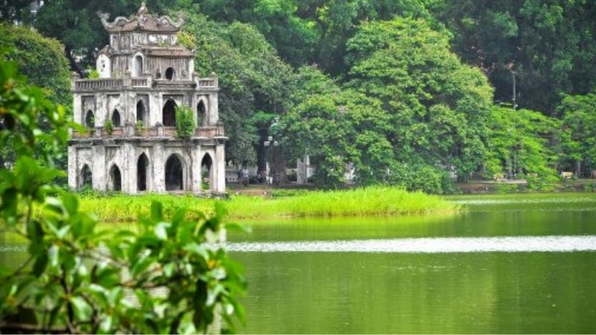
Did you_____?
____.
Back
Notes:
Click vào mũi tên để quay về

Slide 17
Did you_____?
____.
Back
Notes:
Click vào mũi tên để quay về

Slide 18




Slide 19
Website: hoclieu.vn
Fanpage: https://www.facebook.com/tienganhglobalsuccess.vn/

