Slide 2

Unit 10 Our school trip
Lesson 2 - Period 3

Slide 3

Table of content
01
Warm-up and Review
02
Activity 1. Look, listen and repeat
03
Activity 2. Listen, point and say
04
Activity 3. Let’s talk
05
Fun corner and Wrap-up

Slide 4

Secret boxes
Game

Slide 5




Secret boxes

Slide 6
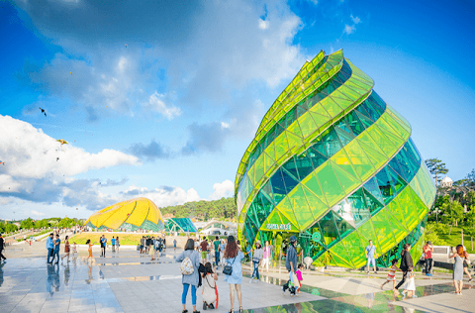
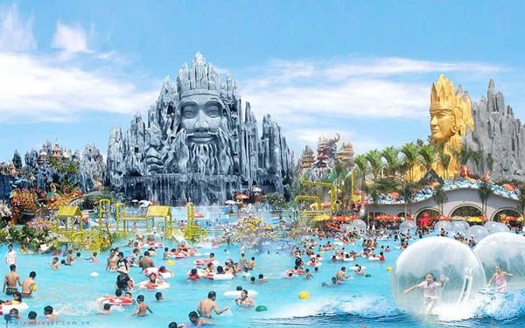
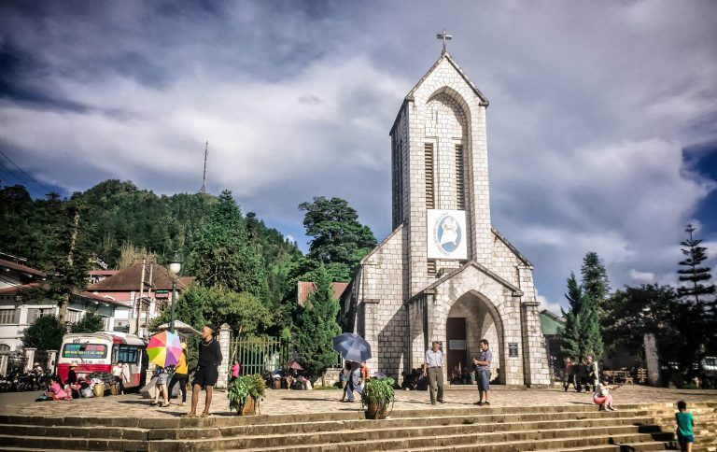
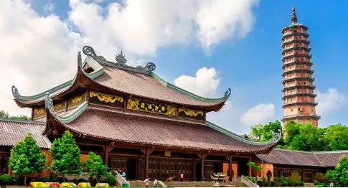

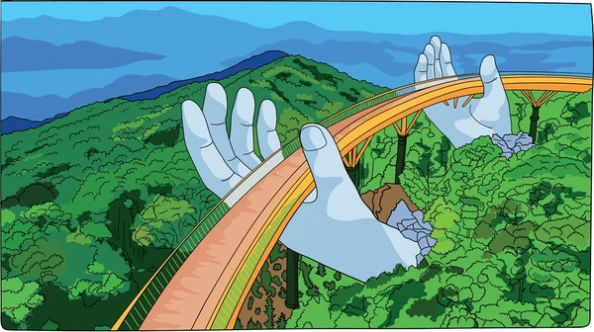








Secret boxes
Notes:
Click vào hộp quà xuất hiện bức tranh. HS hỏi đáp về bức tranh.
Click vào hình ảnh để làm biến mất nó.
Cick và tên team để hiện Stick ghi điểm

Slide 7

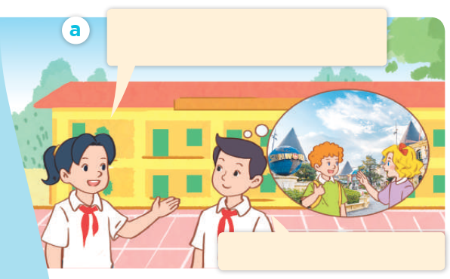
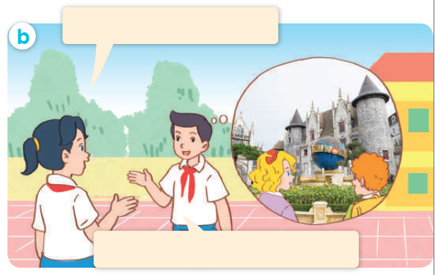
Look, listen and repeat.

Slide 8
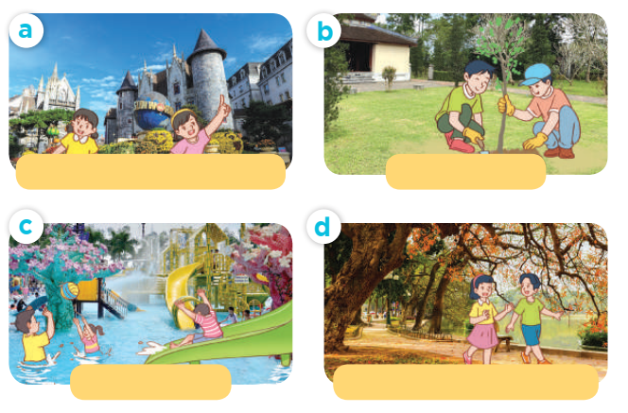
Listen, point and say.

Slide 9

What did they do there?
They _______.

Slide 10
Listen, point and say.
What did they do there?
visit the old buildings
plant trees
They ______.
play games
walk around the lake

Slide 11
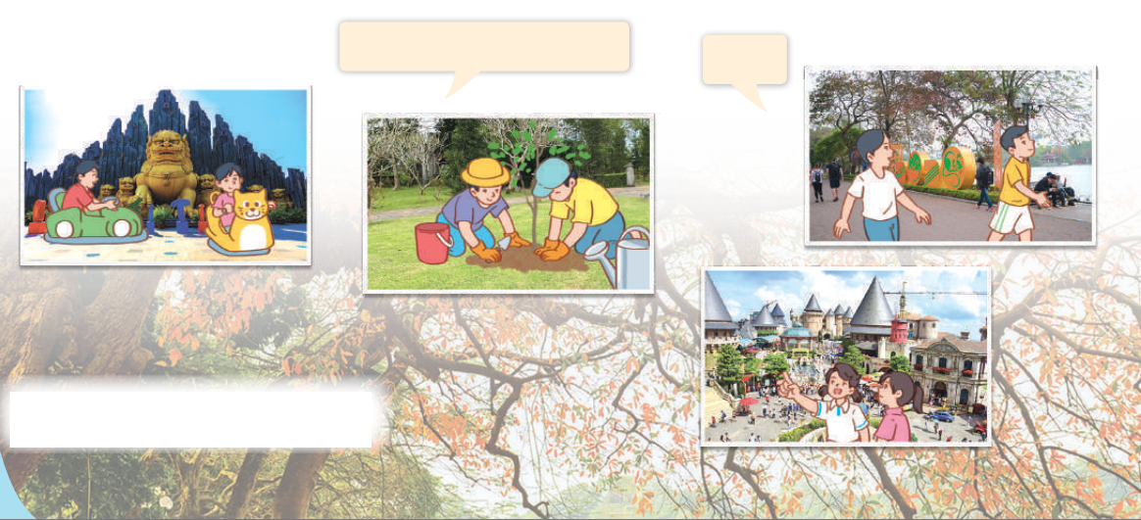
Let’s talk.
What did they do there?
___.

Slide 12

Game
Sentence puzzle

Slide 13



Very Good!

Slide 14
Website: hoclieu.vn
Fanpage: https://www.facebook.com/tienganhglobalsuccess.vn/

