Slide 2

Unit 10 Our school trip
Lesson 2 - Period 4

Slide 3

Table of contents
01
Warm-up and Review
02
Activity 1. Listen and tick.
03
Activity 2. Read and complete.
04
Activity 3. Let’s play.
05
Fun corner and Wrap-up

Slide 4



What did they do there?
They ____.

Slide 5

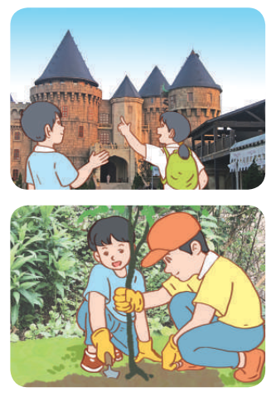
Read and complete.

Slide 6
Read and complete.
1. A: Did they ______ to Ba Na Hills last September?
B: Yes_______.
A: What did they do there?
B: They ______ the old _______ .
go
they did
visited
buidings

Slide 7
Read and complete.
2. A: ___ go to a pagoda last November?
B: No, we didn’t. We _____ to a farm.
A: What _____ you do there?
B: We___________ .
Did
went
did
planted trees

Slide 8
Read and complete.
go
1. A: Did they ______ to Ba Na Hills last September?
B: Yes_______.
A: What did they do there?
B: They ______ the old _______ .
2. A: ___ go to a pagoda last November?
B: No, we didn’t. We _____ to a farm.
A: What _____ you do there?
B: We___________ .
they did
visited
buidings
Did
went
did
planted trees

Slide 9
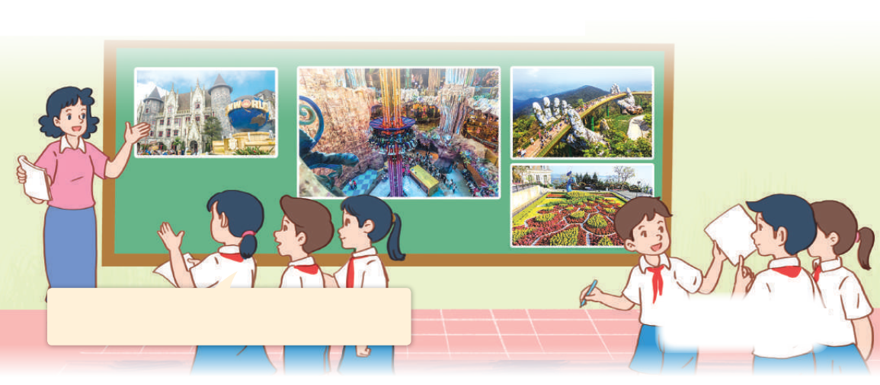
Let’s play
What did they do there?
Last weekend, they went to Ba Na Hills. They visited the famous buildings there.

Slide 10


GUESSING
GAME

Slide 11
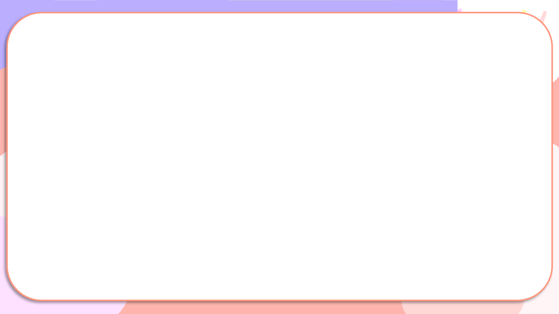

Last weekend, they went to Ba Na Hills.
They visited the famous buildings there.

Slide 12

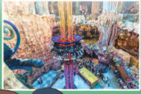




Slide 13

05
Fun corner and Wrap-up

Slide 14


Throw the dice
Game

Slide 15

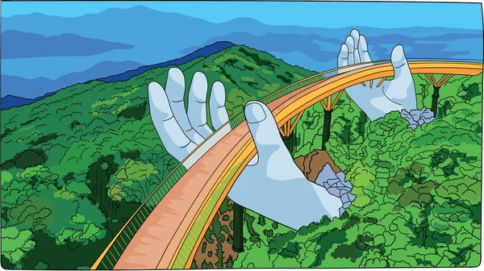
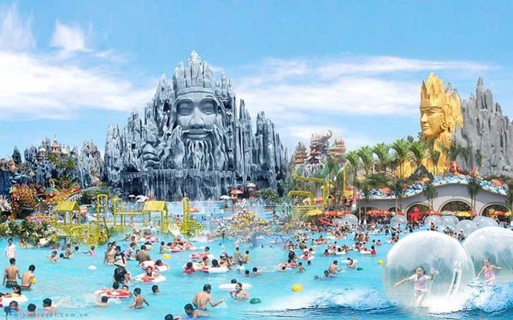
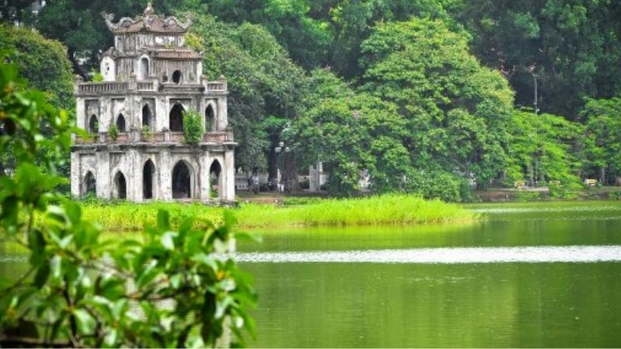
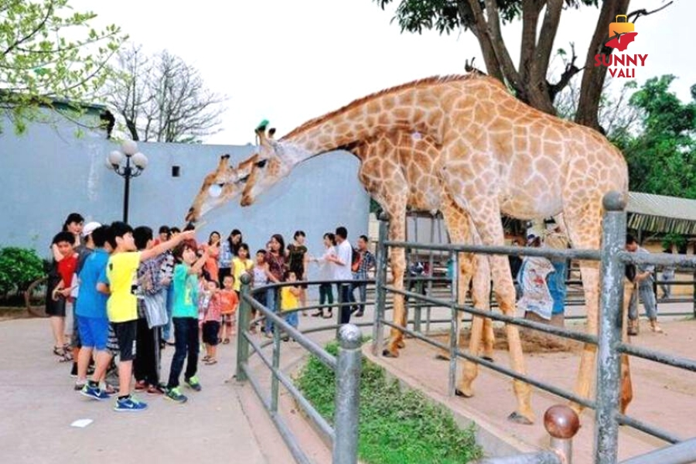
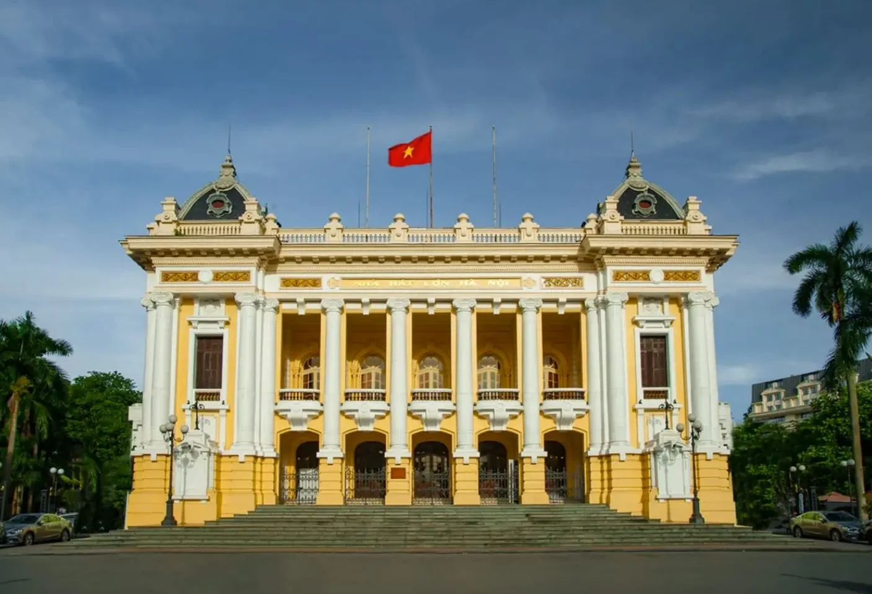
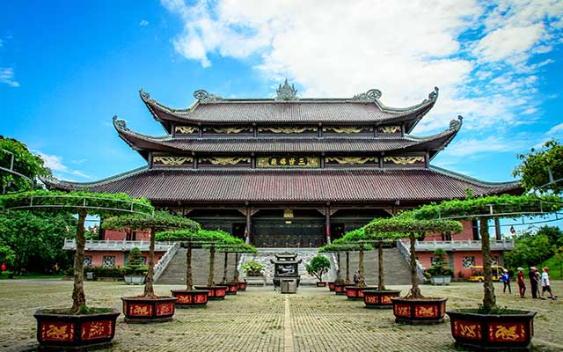

Throw the dice
Game
1
2
3
4
5
6
Notes:
Click vào tranh để làm tranh biến mất

Slide 16


Very Good!

Slide 17
Website: hoclieu.vn
Fanpage: https://www.facebook.com/tienganhglobalsuccess.vn/

