Slide 2

Unit 10
Our school trip
Lesson 3 - Period 5

Slide 3

Table of contents
01
Warm-up and Review
02
Activity 1. Listen and repeat.
03
Activity 2. Circle, listen and check.
04
Activity 3. Let’s chant.
05
Fun corner and Wrap-up

Slide 4
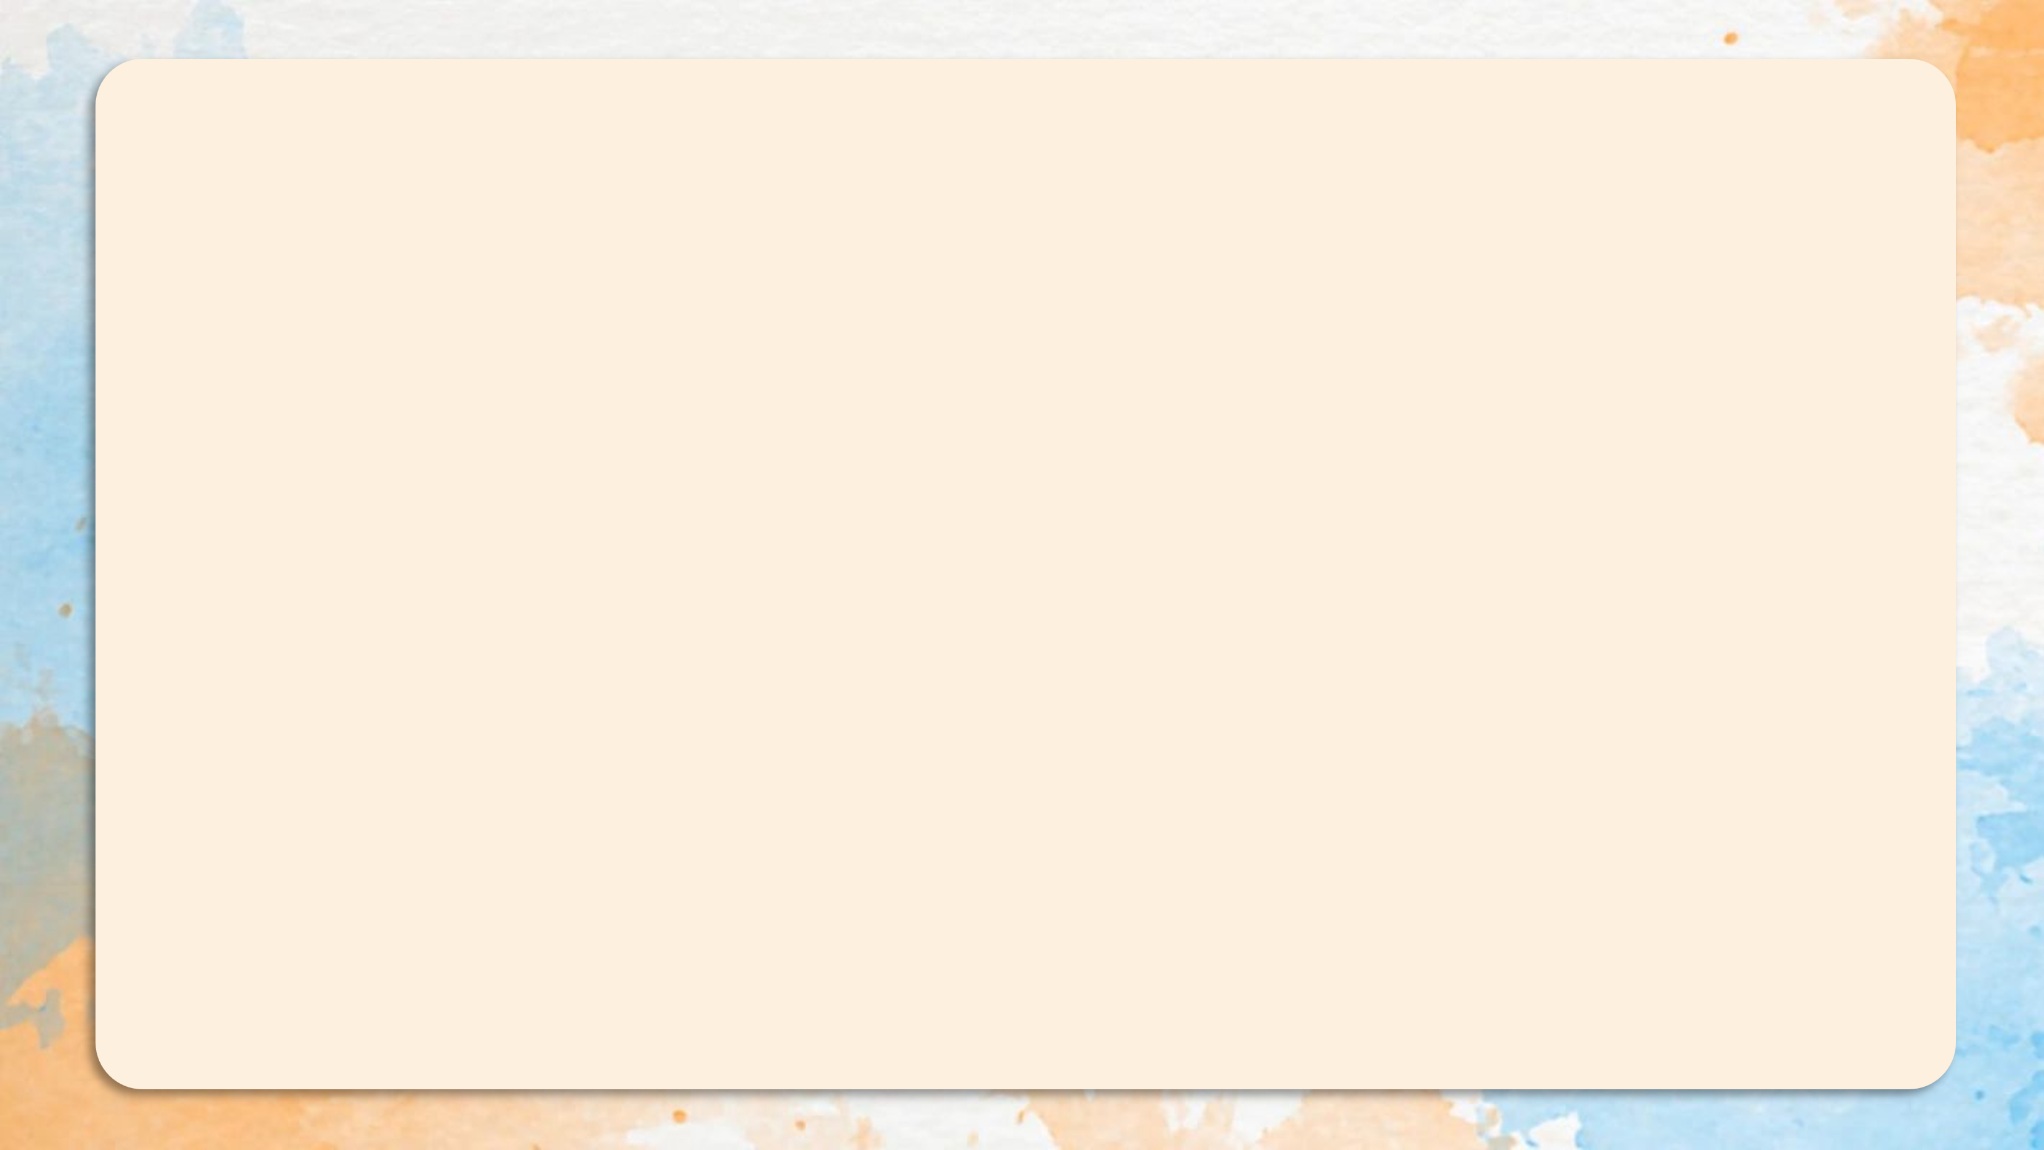
'
Sep tember
'
Saturday
ba nana
'

Slide 5


04
Activity 3. Let’s chant.

Slide 6

Musical cards

Slide 7

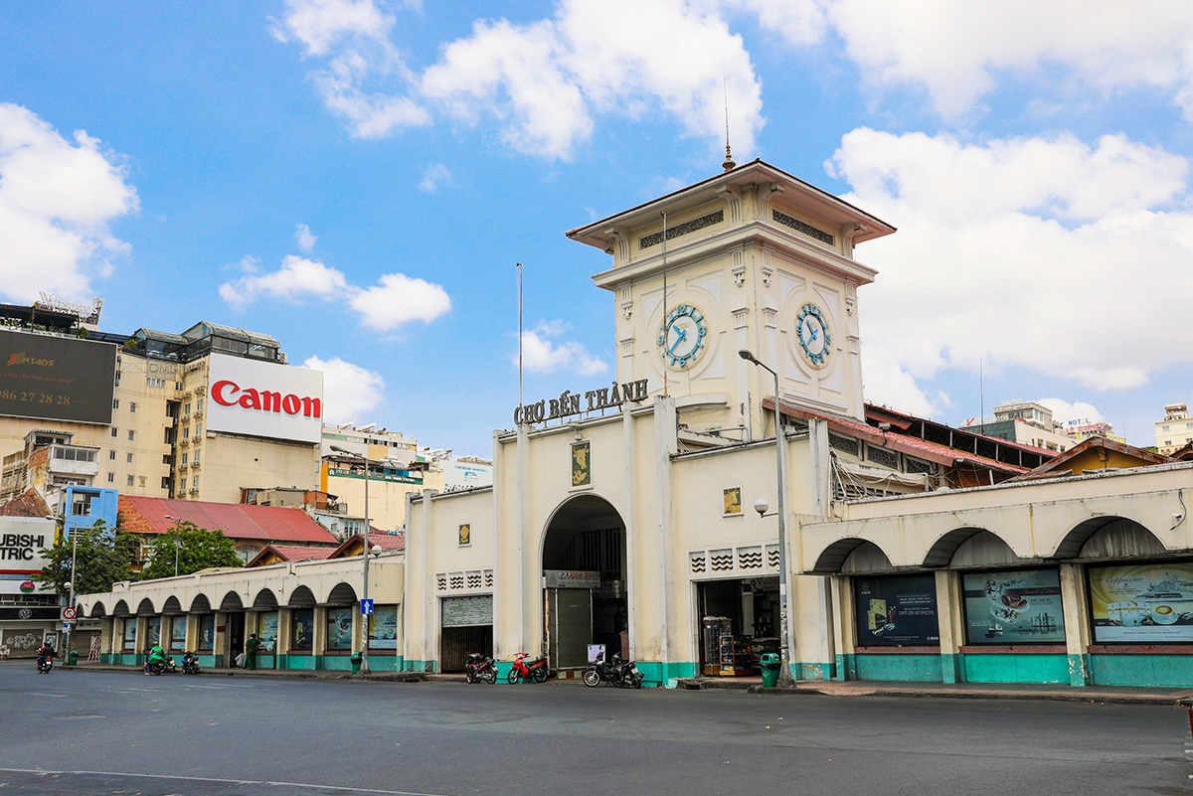
E.g
Where did you go last November?
I went to Ben Thanh Market last November.

Slide 8
Website: hoclieu.vn
Fanpage: https://www.facebook.com/tienganhglobalsuccess.vn/

