Slide 1





















Slide 2


Unit 7. My Favourite Sport
Lesson 2 . Task 7,8,9

Slide 3
01
WARM UP

Slide 4

Let’s review Game: Find the Key
Click the numbers and answer the questions so as to show the words and find the key.

Slide 5
1
B | A | S | E | B | A | L | L
2
F | 0 | 0 | T | B | A | L | L
T | E | N | N | I | S
3
4
S | P | O | R | T | S
C | A | T | C | H
5
B
A
L
L
6
NEXT PART
Notes:
CLICK TO THE NUMBERS TO GO TO THE QUESTIONS , AND IF S CAN ANSWER THE QUESTION. LET’S CLICK TO SHOW THE WORDS AND FIND THE KEY WORD OF DOWN .
Click at the key to show the image of the word : BOSABALL

Slide 6
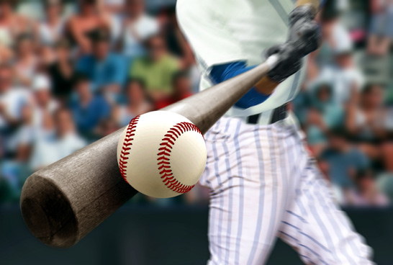
BASEBALL

Slide 7
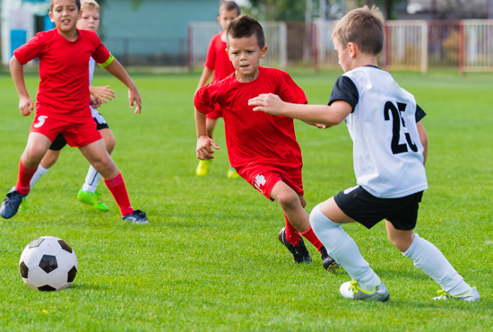
FOOTBALL

Slide 8
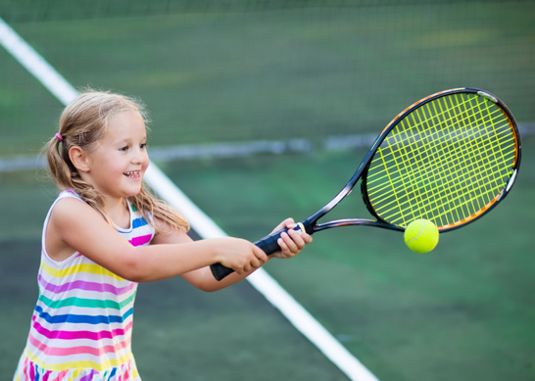
TENNIS

Slide 9

SPORTS

Slide 10
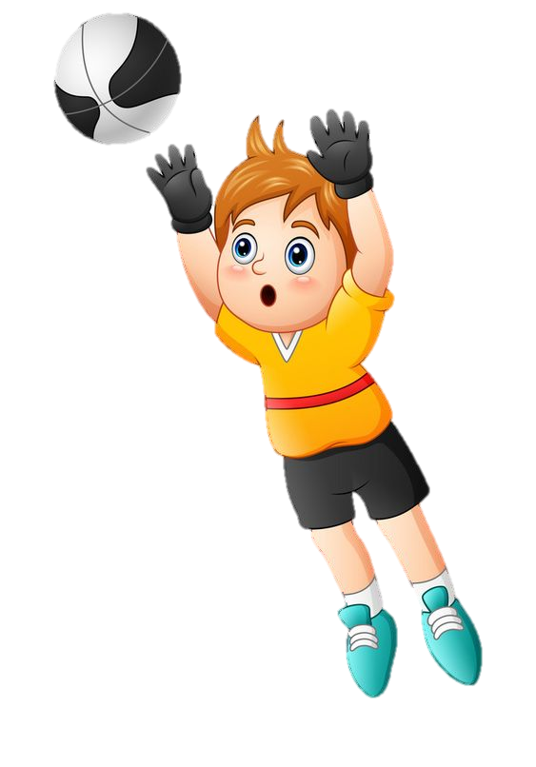
CATCH

Slide 11

BALL

Slide 12
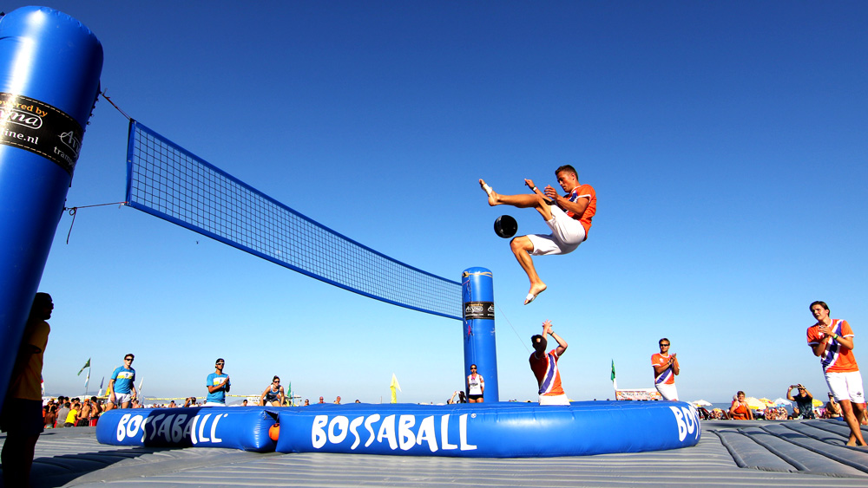
BOSSABALL

Slide 13
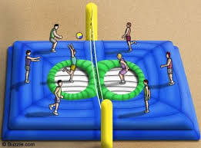
02
PRESENTATION
PRACTICE LISTENING

Slide 14
Listen and fill
new
Bossaball is a …………..sport.
Players can ………….. and hit the ball. They can also kick the ball.
jump
We’re at a game. One player ………..… jumping and kicking the ball. He ………………………..or catching it . People can play the drums and dance during the game.
is
isn’t running

Slide 15

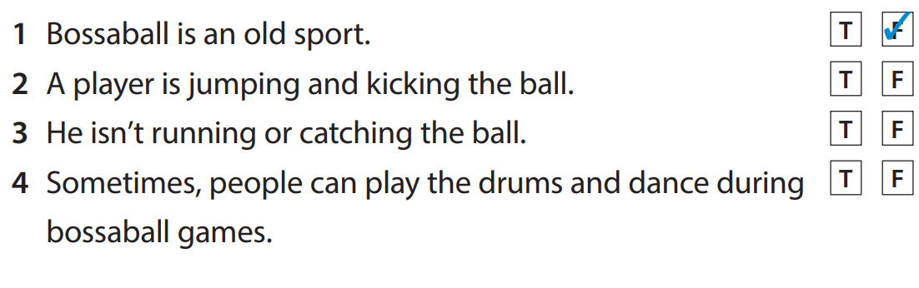

Task 7 Listen and tick

Slide 16
BOSSABALL
Bossaball is a new sport.
Players can jump and hit the ball. They can also kick the ball.
We’re at a game. One player is jumping and kicking the ball. He isn’t running or catching it. People can play the drums and dance during the game.

Slide 17
03
PRACTICE
Writing Practice

Slide 18










5. Game

Slide 19





The frog comes back home.

Slide 20












Slide 21


The player……..(jumping)
is jumping.
Notes:
Write the correct forms of verbs

Slide 22
He ………… ……. .
(not running)
isn’t running.

Slide 23
He ……..(hitting)
is hitting.

Slide 24
He ……..(not kicking)
isn’t kicking.

Slide 25
He ……..(not dancing)
isn’t dancing.

Slide 26
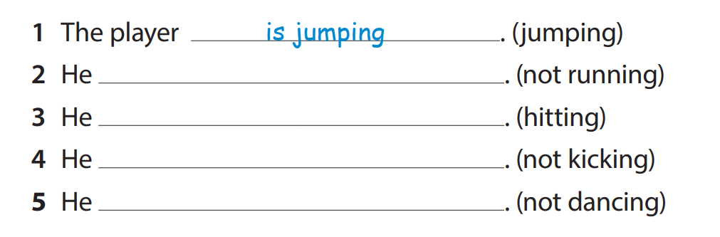
Task 8. Write
isn’t running
is hitting
isn’t kicking
isn’t dancing

Slide 27
4
PRODUCTION
TASK 9. LOOK AND SAY

Slide 28
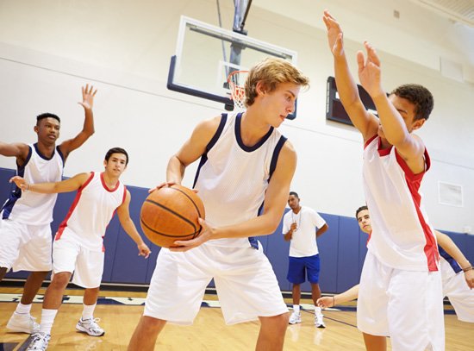


Task 9. Look and say
Look! The player is running and catching the ball.
He isn’t hitting the ball.

Slide 29
Picture 1
Look! The player is………………….…… .
She isn’t …………..
hitting the ball
kicking
the ball.

Slide 30
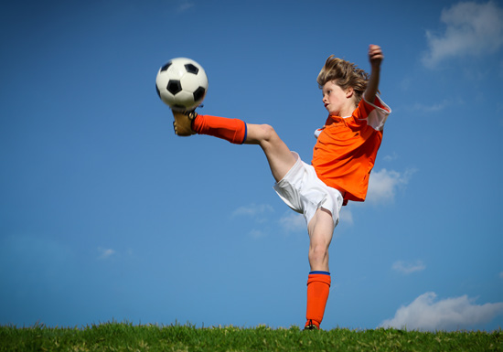
Picture 2
Look! The player is………………………….
He isn’t …………..
kicking the ball
catching
the ball.

Slide 31
Picture 3
Look! The player is…………
He isn’t …………..
running
jumping

Slide 32
5
ASSESSMENT
Tick the correct pictures

Slide 33
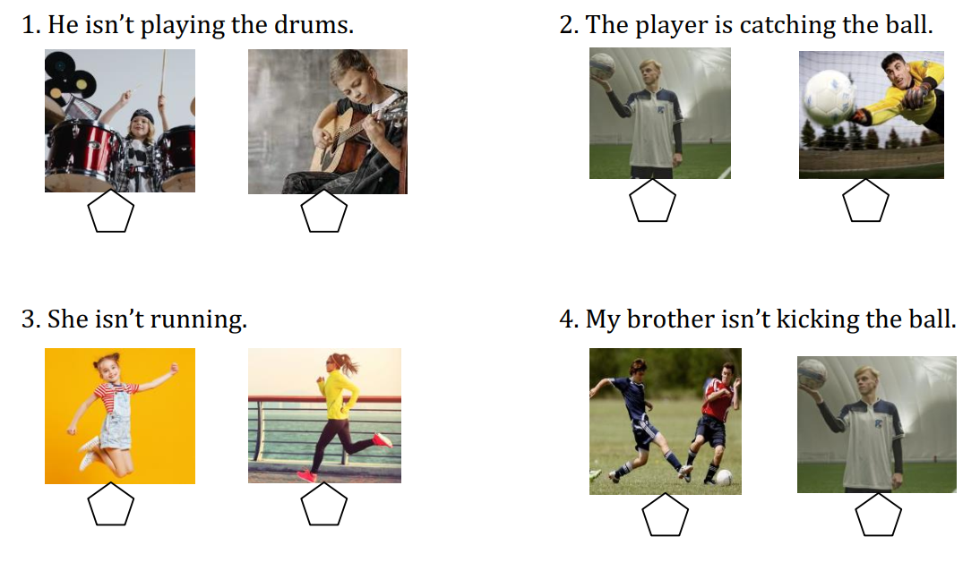
Notes:
Call two Sts come and answer the questions. Then , play rocks, papers, scissors to find the winner and get the stars.

Slide 34
THANK YOU

