Slide 1





















Notes:
Để nguyên trang bìa như này, chỉ thay đổi tên bài trong quá trình làm. Logo của sách Wonderful World

Slide 2

Unit 6: My Hobby
Lesson 1 – Task 1, 2, 3

Slide 3
1 WARM UP
Gametime!
1
2
4
3
Notes:
Cách chơi: Click vào màn hình để lần lượt từng tranh hiện ra. Sau đó click vào từng tranh để các tranh nối vào tranh gốc.

Slide 4
A
1
2
C
B
4
3
D

Slide 5
Children with musical instruments, Rio de Janeiro, Brazil
Look. Tick what you see.
hat
yellow
T-shirt
green

Slide 6
New words
2 PRESENTATION
cook

Slide 7
New words
read

Slide 8
New words
Hello!
speak English

Slide 9
New words
swim

Slide 10
New words
write

Slide 11


cook

Slide 12
write

Slide 13
speak English

Slide 14
swim

Slide 15
read

Slide 16



1 Listen and point. Repeat.

Slide 17
cook
read
swim
write
speak
English

Slide 18

2 Listen and tick.
3 PRACTICE

Slide 19


That’s my brother.
Is he in the kitchen?
Yes, he is.
And he can cook!
Oh! That’s great!
1 Is that her cousin?
Yes
No
2 Is he in the kitchen?
Yes
No
Alex
Sophie

Slide 20
3 Let’s play! Use the words in 1.

Slide 21


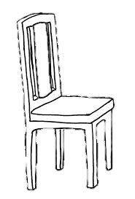
Where am I?
Cook!
Are you in the living room?
No!
Are you in the kitchen?
Yes!

Slide 22
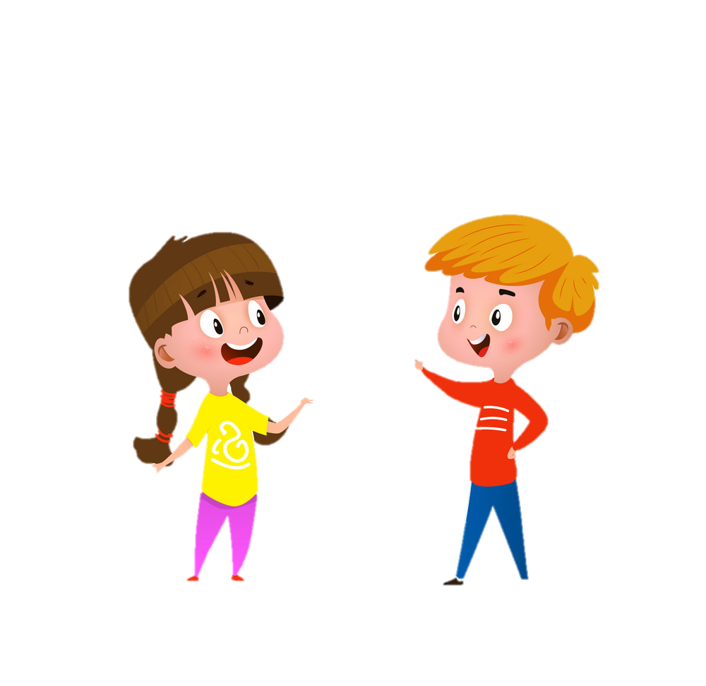
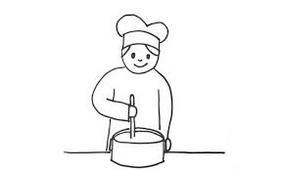
4 PRODUCTION
Draw and say
Cook

Slide 23
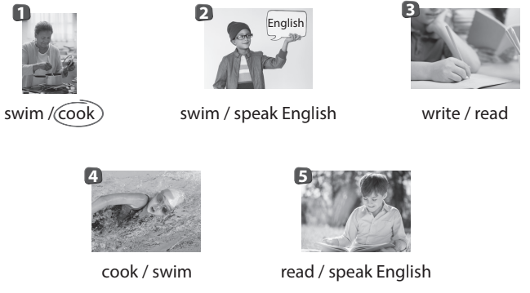
Look and circle
5 ASSESSMENT

Slide 24




Thank you & goodbye!

