Slide 1





















Notes:
Để nguyên trang bìa như này, chỉ thay đổi tên bài trong quá trình làm. Logo của sách Wonderful World

Slide 2

Unit 6: My Hobby
Lesson 1 – Task 4, 5, 6

Slide 3

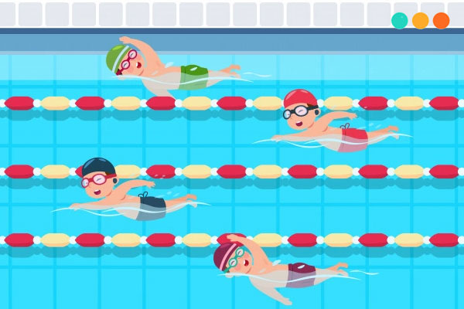
1 WARM UP
SWIMMING RACE
Notes:
(There are 5 questions. Groups choose and answer questions. Each correct answer will help the swimmers swim forward. The swimmer of the group that reaches the finish line first will be the winner.- Divide class into 4 groups - Set the game rules
- Play as a model.
- Have students play in turns.
- Award the best groups
Click vào từng chiếc phao bơi để hiện câu hỏi. Khi câu hỏi hiện ra, click vào màn hình để hiện tranh và câu trả lời. Nhấn quay lại. Đội nào trả lời được đúng câu hỏi thì click vào vận động viên của đội đó để bơi lên phía trước.

Slide 4

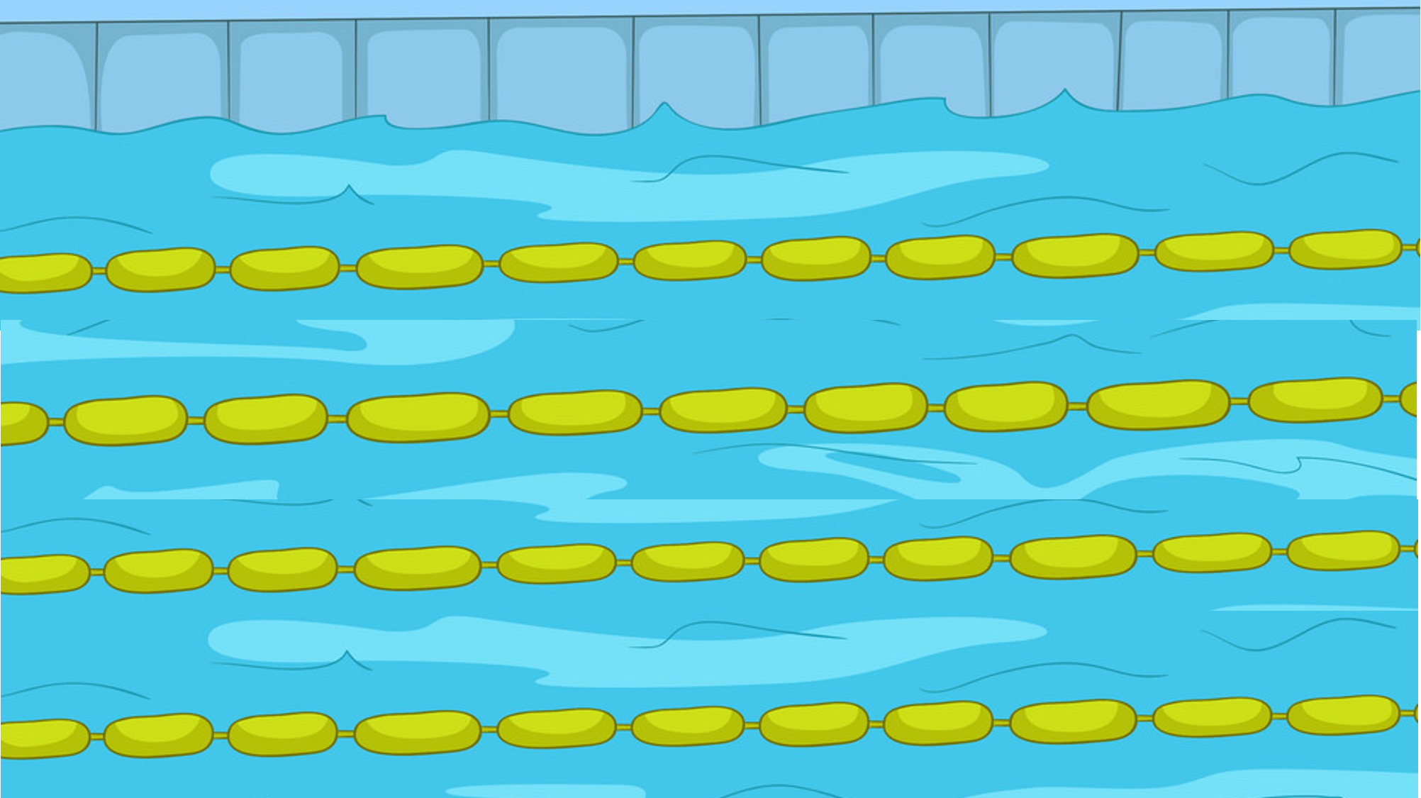






1
2
3
4
Exit
Notes:
Bấm vào hình cái phao để mở câu hỏi
Bấm vào cậu bé để tiến lên
(There are 5 questions. Groups choose and answer questions. Each correct answer will help the swimmers swim forward. The swimmer of the group that reaches the finish line first will be the winner.- Divide class into 4 groups - Set the game rules
- Play as a model.
- Have students play in turns.
- Award the best groups

Slide 5
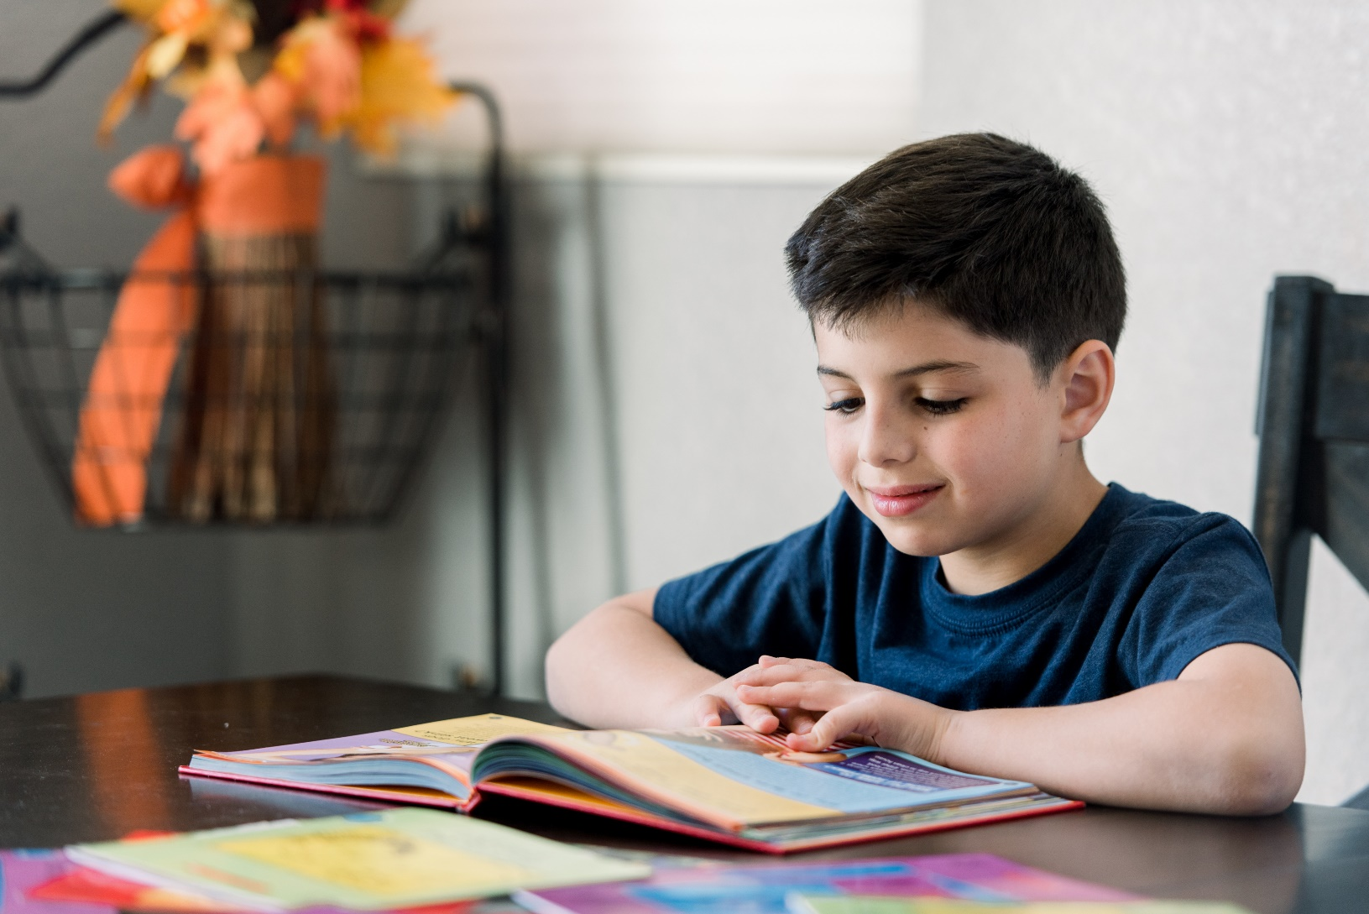

read
Back

Slide 6

Hi!
Hi!
speak English
Back
Notes:
Bấm vào hình cậu bé đang bơi để hình xuất hiện

Slide 7
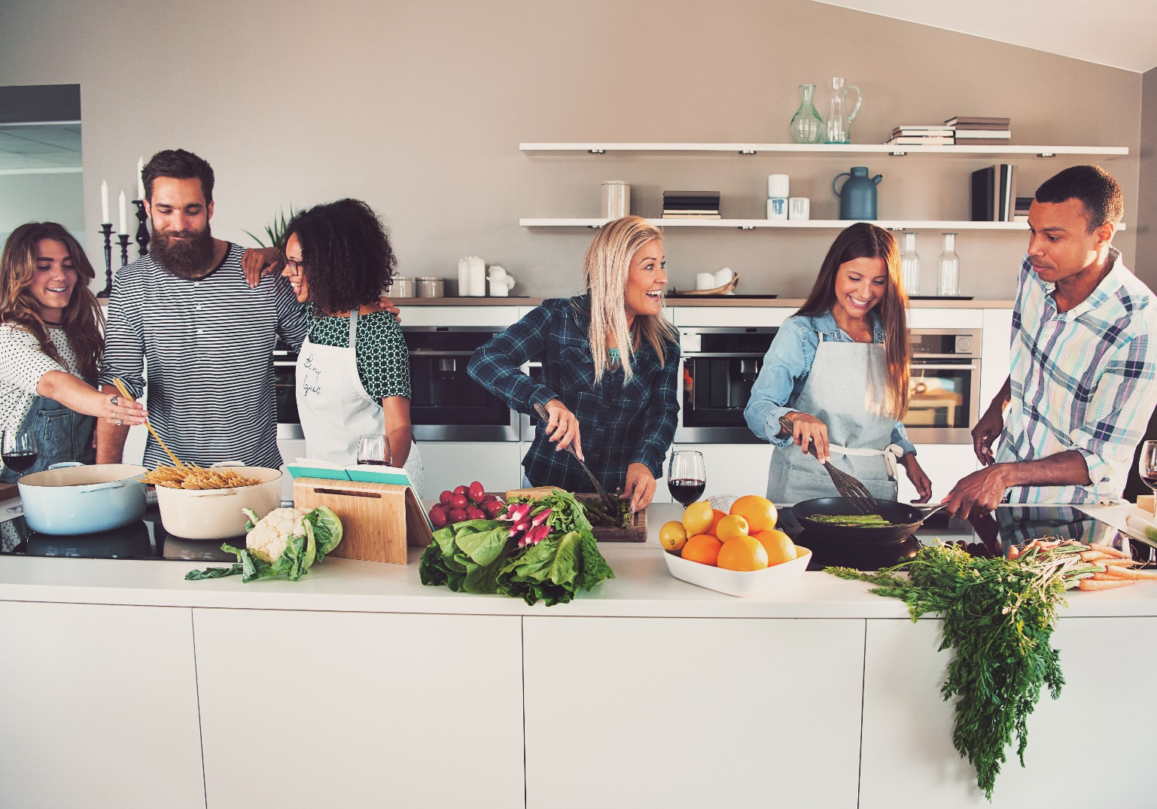
cook
Back
Notes:
Bấm vào hình chú bé đang bơi để hình xuất hiện nhanh
Bấm vào ngồi nhà để thoát

Slide 8
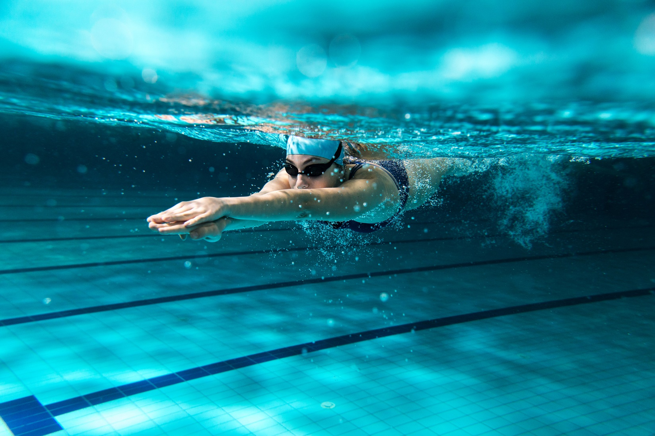
swim
Back

Slide 9

write
Back
Notes:
Bấm vào hình chú bé đang bơi để hình xuất hiên

Slide 10


2 PRESENTATION
Task 4 Listen and repeat.
Notes:
- Ask students to point and say the actions in each picture.
- Present the structure: I/she/we/they can….
- Play the track 6.3 and ask students to listen.
- Play the track 6.3 again, ask students to listen and repeat in chorus, groups.

Slide 11




Listen and repeat.
1 I can read.
2 She can swim.
Hi!
Hi!
3 We can speak English.
4 They can cook.
Notes:
Bấm vào câu để nghe từng câu
- Ask students to point and say the actions in each picture.
- Present the structure: I/she/we/they can….
- Play the track 6.3 and ask students to listen.
- Play the track 6.3 again, ask students to listen and repeat in chorus, groups.

Slide 12

Let’s check!
They
can
cook.
START
Listen and make a sentence.
2
4
6
7
1
0
3
9
5
8
10
Notes:
GV chuẩn bị các word cards I, she, he, we, they, can, cook, write, swim, speak english.
GV bấm loa cho hs nghe và yêu cầu ghép các word cards để tạo thành câu
GV bấm start để tính thời gian
GV show đáp án để hs check

Slide 13
Let’s check!
We
can
speak English.
START
Listen and make a sentence.
2
4
6
7
1
0
3
9
5
8
10

Slide 14
Let’s check!
She
can
swim.
START
Listen and make a sentence.
2
4
6
7
1
0
3
9
5
8
10

Slide 15
Let’s check!
I
can
read.
START
Listen and make a sentence.
2
4
6
7
1
0
3
9
5
8
10

Slide 16

3 PRACTICE
Task 2 Look and say.
Notes:
HOẠT ĐỘNG TƯƠNG TÁC TỪ SLIDE 17 ĐẾN 21
- Show the pictures in task 5
- Ask students to look at the picture and identify people and actions in each picture.
- Ask students to read the words under each picture.
- Have students look at the pictures, point and say in chorus, group, pairs, using … can ….

Slide 17

1 He/ read
He can read.
Notes:
- Show the pictures
- Ask students to look at the picture and identify people and actions in each picture.
- Ask students to read the words under each picture.
- Have students look at the pictures, point and say in chorus, group, pairs, using … can ….

Slide 18
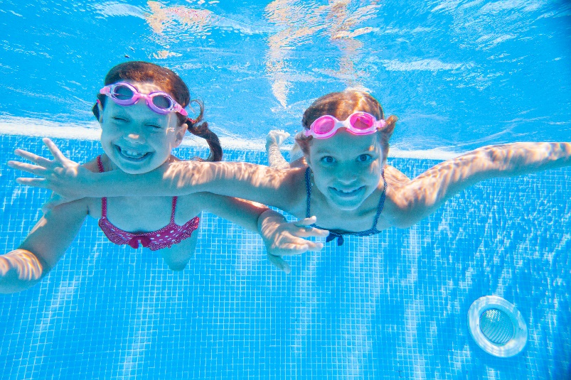
2 We/ swim
We can swim.
Notes:
- Show the pictures
- Ask students to look at the picture and identify people and actions in each picture.
- Ask students to read the words under each picture.
- Have students look at the pictures, point and say in chorus, group, pairs, using … can ….

Slide 19
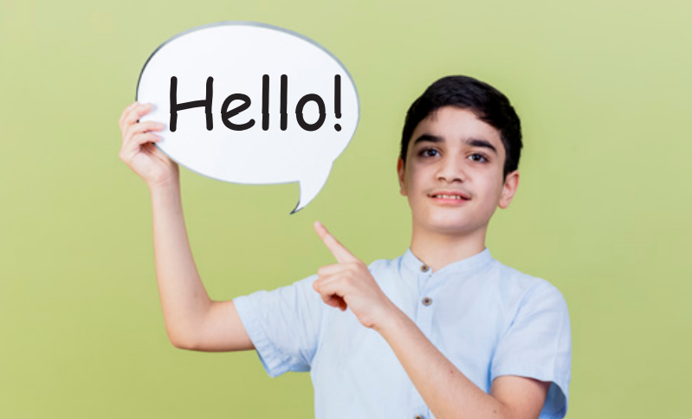
3 My brother/ speak English
My brother can speak English.
Notes:
- Show the pictures
- Ask students to look at the picture and identify people and actions in each picture.
- Ask students to read the words under each picture.
- Have students look at the pictures, point and say in chorus, group, pairs, using … can ….

Slide 20
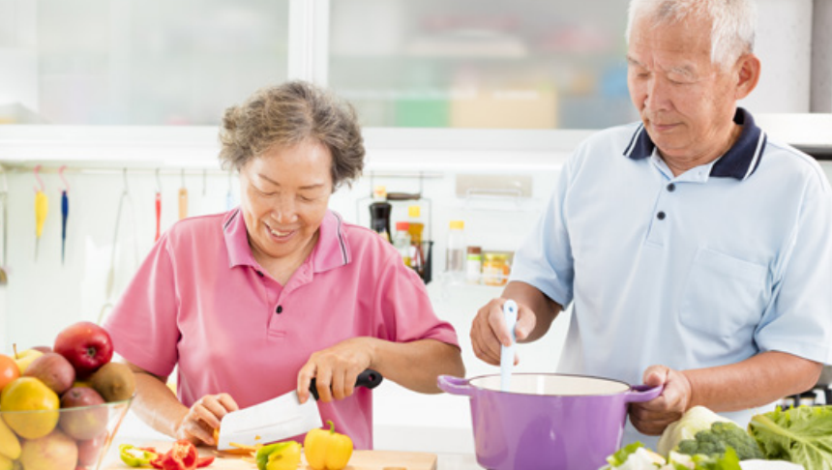
4 My grandpa and grandma/ cook
My grandpa and grandma can cook.
Notes:
- Show the pictures
- Ask students to look at the picture and identify people and actions in each picture.
- Ask students to read the words under each picture.
- Have students look at the pictures, point and say in chorus, group, pairs, using … can ….

Slide 21
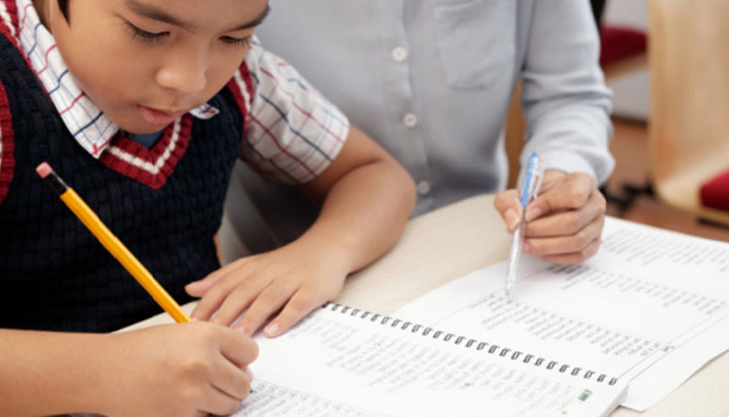
5 He/ write
He can write.
Notes:
- Show the pictures
- Ask students to look at the picture and identify people and actions in each picture.
- Ask students to read the words under each picture.
- Have students look at the pictures, point and say in chorus, group, pairs, using … can ….

Slide 22
Look and say.
1 He can read.
2 We can swim.
3 My brother can speak English.
4 My grandpa and grandma can cook.
5 He can write.
Notes:
- Have students look at the pictures, point and say in chorus, group, pairs, using … can ….

Slide 23
4 PRODUCTION
Task 6 Let’s talk.
Notes:
- Divive class in to 4 groups
- Hand each group a big paper (size A1) and ask students to decorate it to make a mind map with the topic What we can do.
- Ask students to stick the pictures that they drew in the task 3 of the previous lesson on the map.
- Ask students to show their mind map and talk about what they can do.

Slide 24
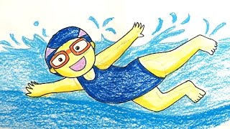
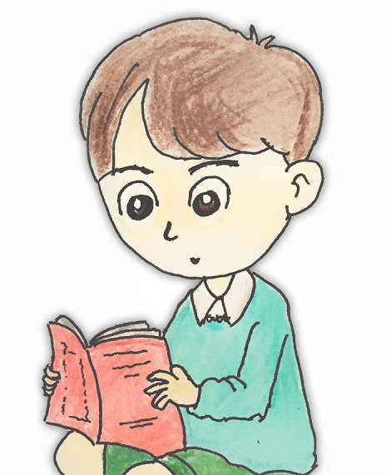
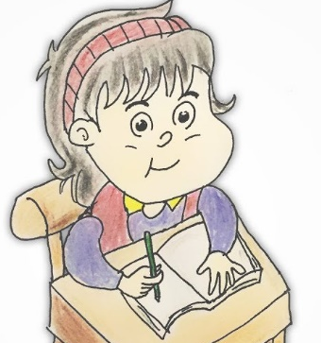
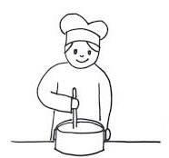

Make a mind map
Let’s talk
What we can do?
Notes:
- Divive class in to 4 groups
- Hand each group a big paper (size A1) and ask students to decorate it to make a mind map with the topic What we can do.
- Ask students to stick the pictures that they drew in the task 3 of the previous lesson on the map.
- Ask students to show their mind map and talk about what they can do.

Slide 25
5 ASSESSMENT
Choose the correct answer:
can/ write/ I/.
A. I write can. B. I can write.
swim/ he/ can/.
A. He can swim. B. Swim can he.
sister/ cook/ can/ My/.
A. Can my sister cook. B. My sister can cook.
Notes:
HOẠT ĐỘNG TƯƠNG TÁC

Slide 26




Thank you
& goodbye!

