Slide 1


Slide 2

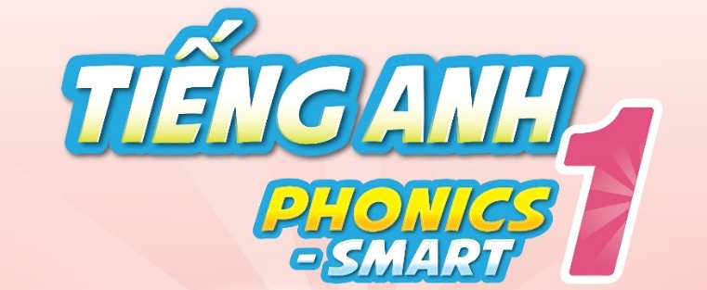

Slide 3





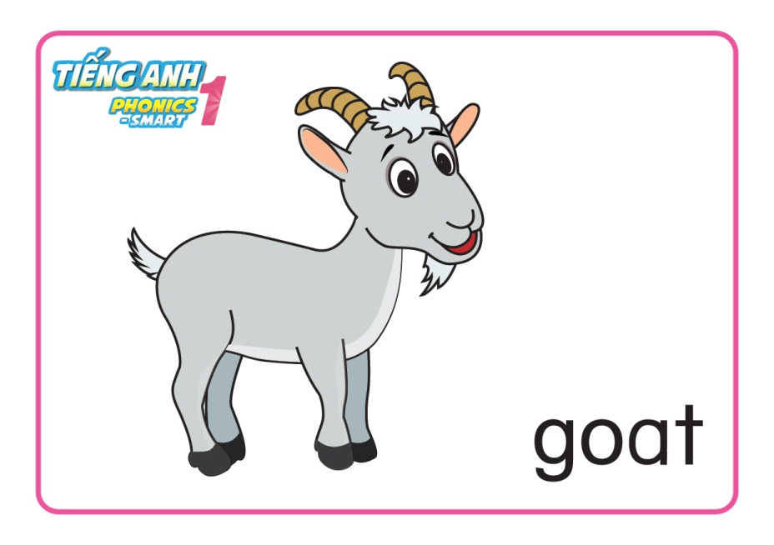
REVISION & WARM UP

Slide 4

REVISION & WARM UP
Let’s sing and do the actions

Slide 5
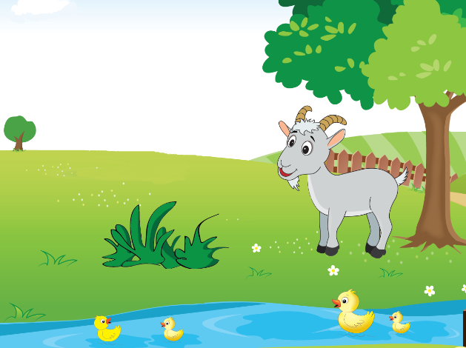

Unit 7
Lesson 2

Slide 6

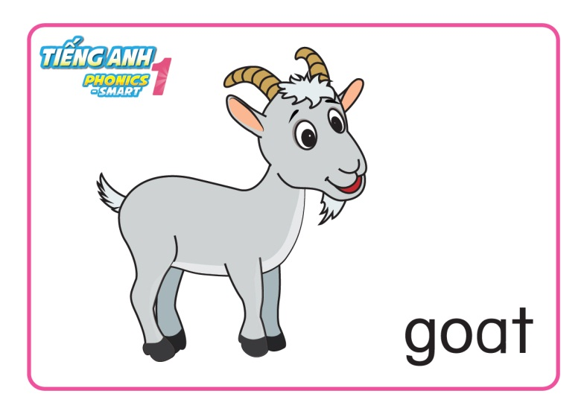
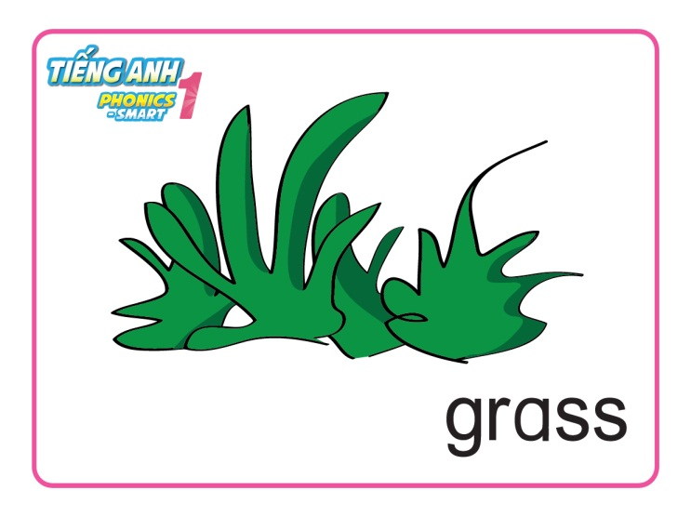
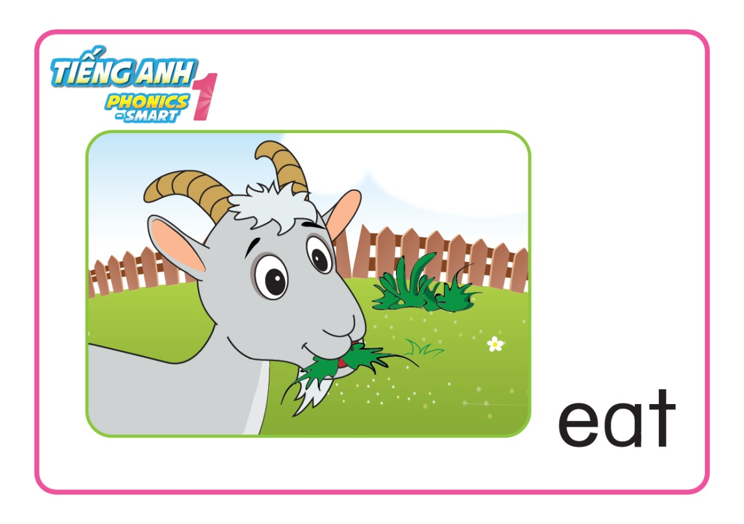
Unit 7:
Lesson 2:
G g
1. Listen and repeat.

Slide 7
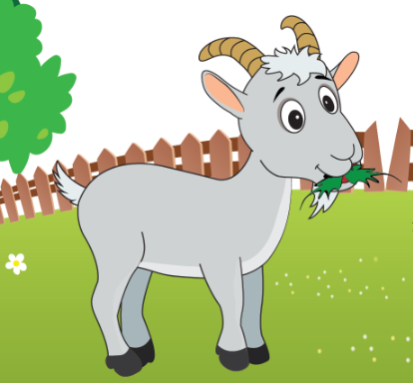
Unit 7:
Lesson 2:
G g
1. Listen and repeat.
eating grass

Slide 8
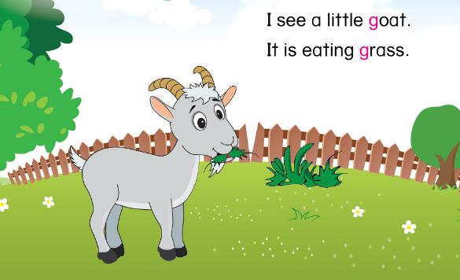
Unit 1:
Lesson 2:
G g
1. Listen and repeat.

Slide 9
Unit 7:
Lesson 2:
G g
1. Listen and repeat.
What can you see?
What can you hear?
What is the goat doing?

Slide 10
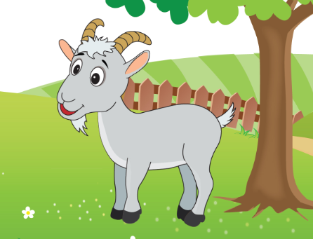
Unit 7:
Lesson 2:
G g
1. Listen and repeat.
I see a little goat.

Slide 11
Unit 7:
Lesson 2:
G g
1. Listen and repeat.
It is eating grass.

Slide 12
Unit 7:
Lesson 2:
G g
1. Listen and repeat.
Let’s say and do actions
I see a little goat.
It is eating grass.

Slide 13

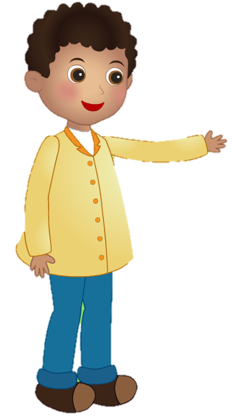
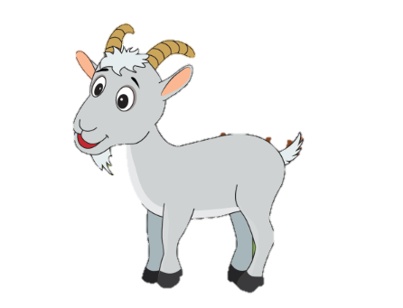
Unit 7:
Lesson 2:
G g
1. Listen and repeat.
Role-play Activity
I see a little goat.
Hello, little goat.
Hello.
Notes:
- Audio: letter A, /a/, apple, ant

Slide 14
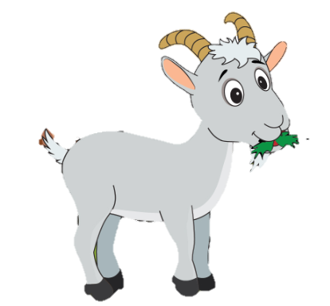

Unit 7:
Lesson 2:
G g
1. Listen and repeat.
Role-play Activity
It is eating grass.
Notes:
- Audio: letter A, /a/, apple, ant

Slide 15
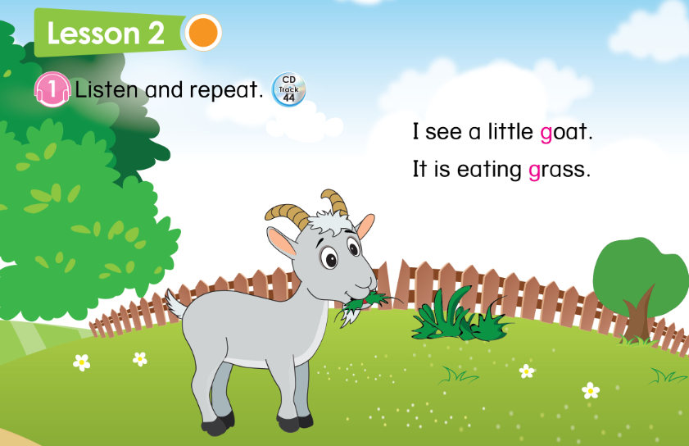

Unit 7: Lesson 2:
G g
33

Slide 16
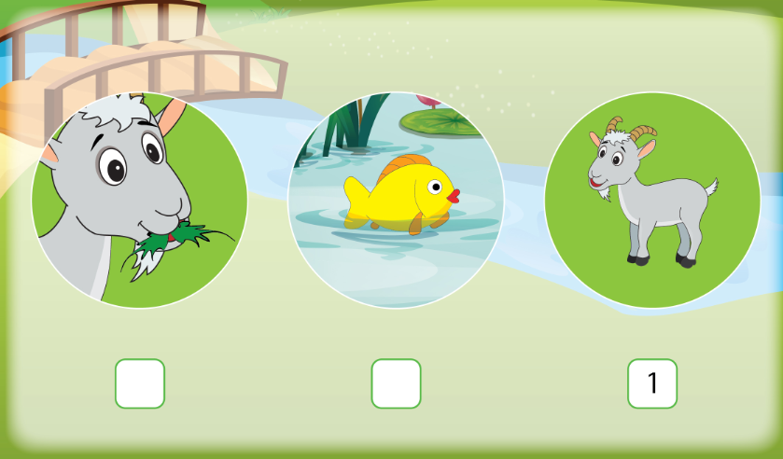
Unit 7:
Lesson 2:
G g
1. Listen and repeat.
2. Listen and number.
33

Slide 17
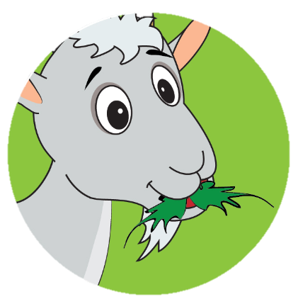
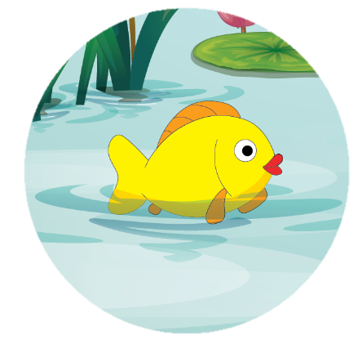
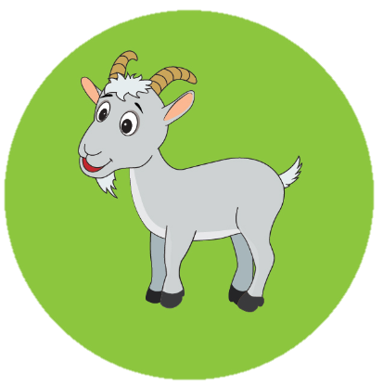


Unit 7:
Lesson 2:
G g
1. Listen and repeat.
2. Listen and number.
2
3

Slide 18

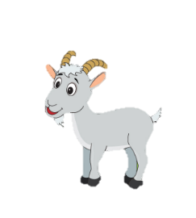
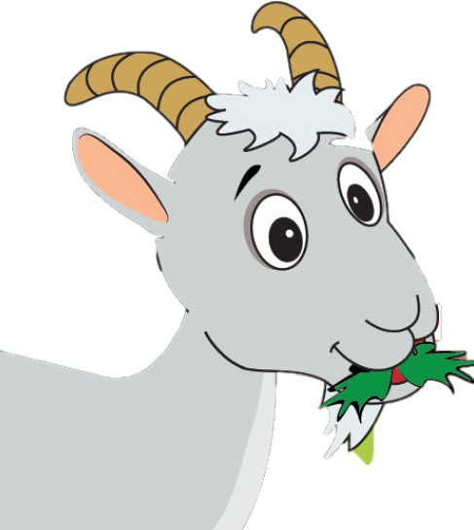
Unit 7:
Lesson 2:
G g
1. Listen and repeat.
2. Listen and number.
I see a little
.
It is
.
Notes:
- Tổng kết

Slide 19


CÔNG TY CỔ PHẦN PHÁT TRIỂN GIÁO DỤC
VIỆT NAM VPBOX
Hà Nội
Biệt thự G2&G28, Làng Quốc Tế Thăng Long,
Quận Cầu Giấy, Hà Nội.
ĐT: (024) 3 3793 2405
phonics.hanoi@vpbox.edu.vn
Thành Phố Hồ Chí Minh
Số 29 Mai Thị Lựu, Quận 1, TP. HCM.
ĐT: (028) 3 820 5934
phonics.hcm@vpbox.edu.vn
www.vpbox.edu.vn

