Slide 1
Hai Thanh Primary school
Welcome to our class !
Teacher: Mai Hong Phuong

Slide 2
Unit 11: My home
Lesson 1 - period 1

Slide 3

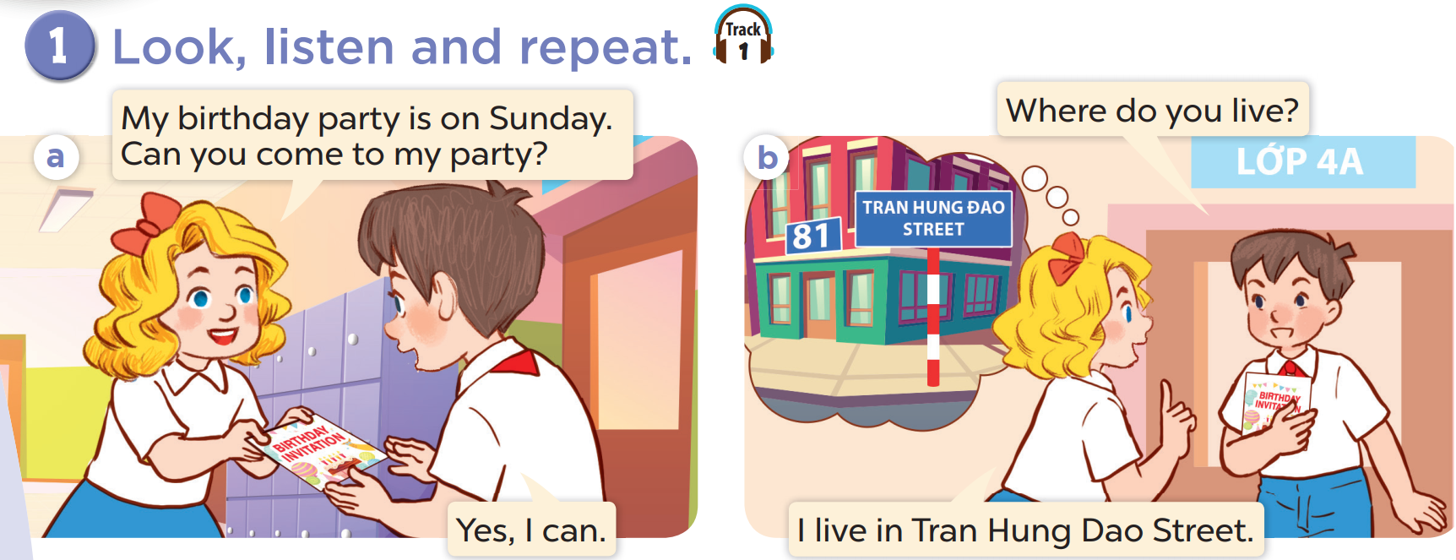

Slide 4
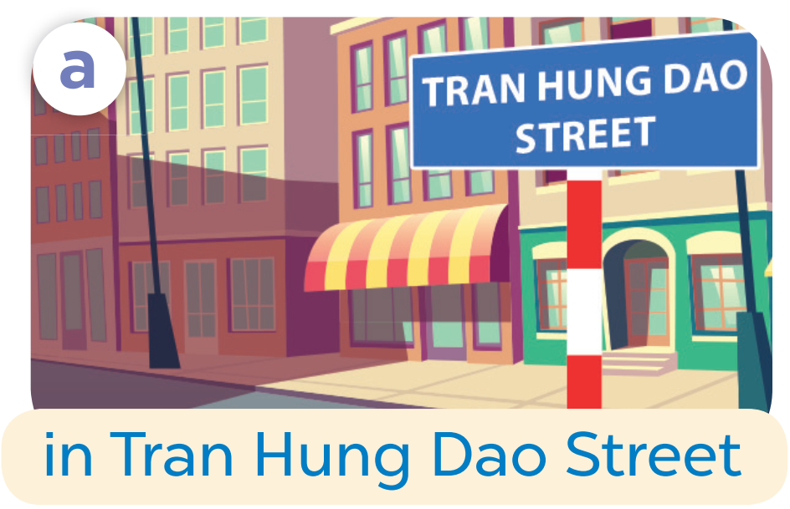

Slide 5
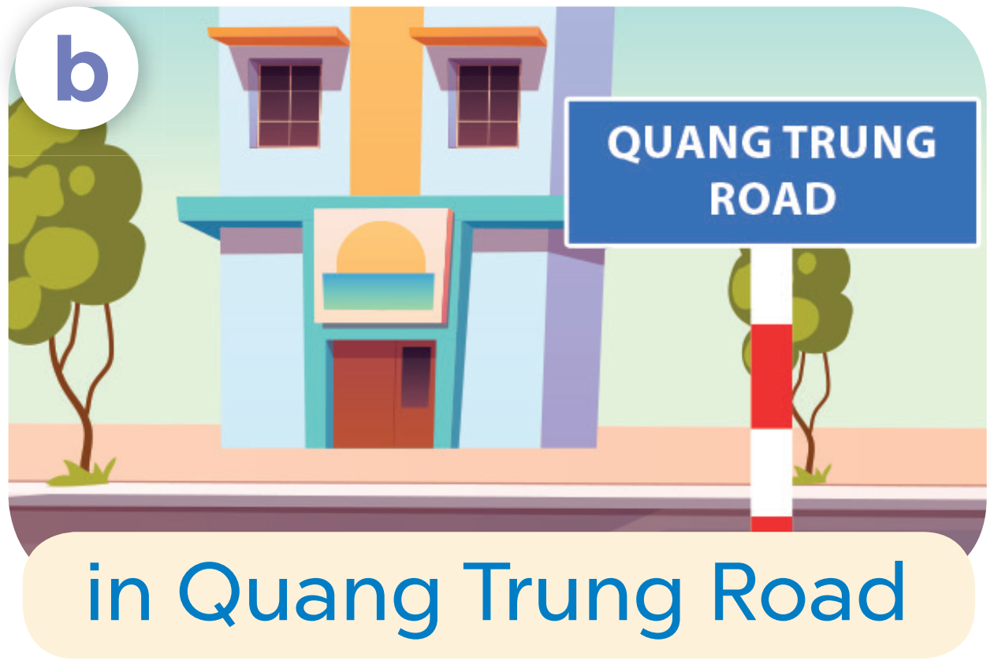

Slide 6
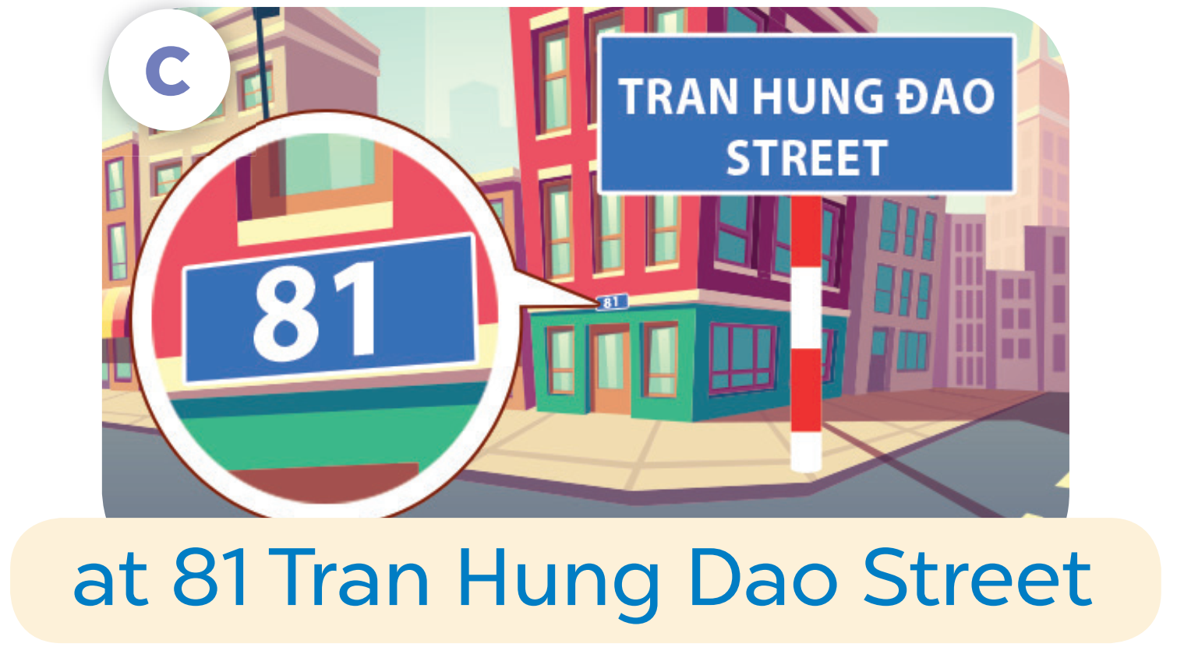

Slide 7
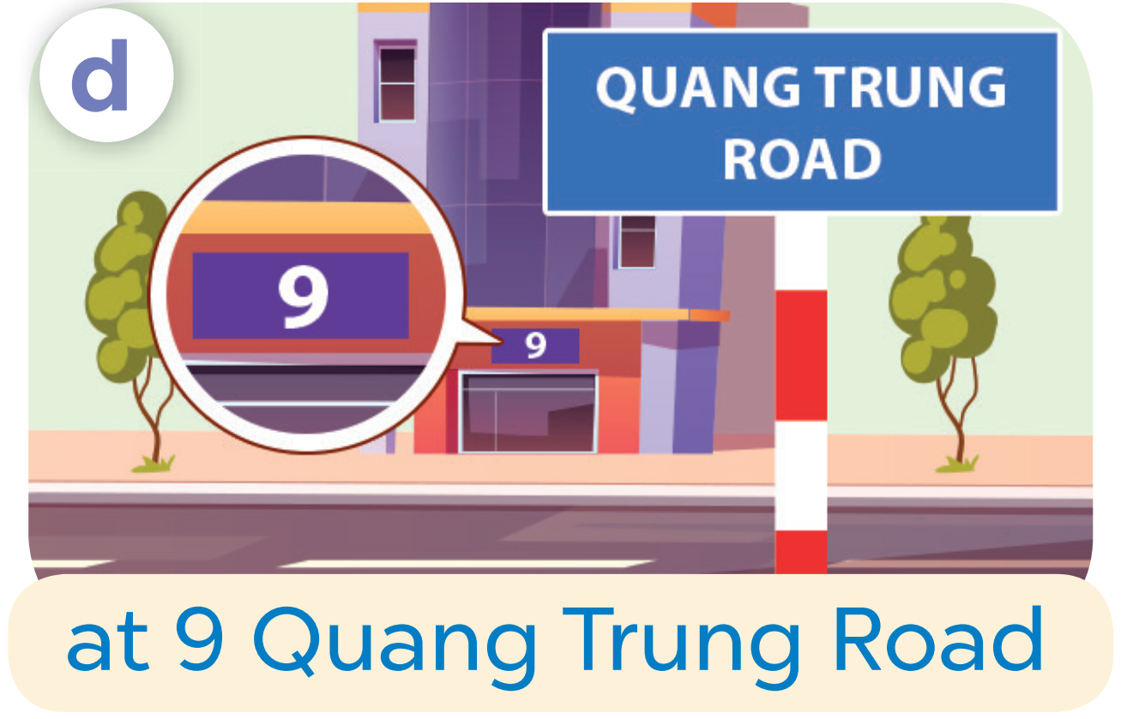

Slide 8
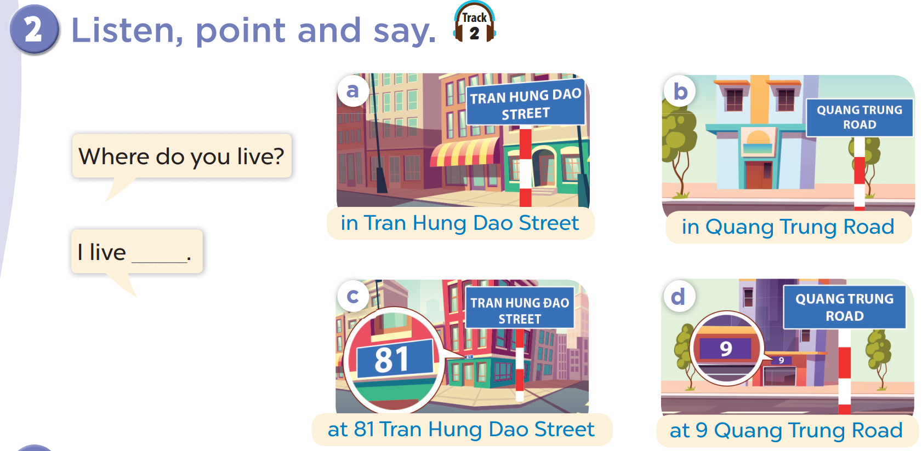

Slide 9
Where do you live?
I live in Tran Hung Dao Street.

Slide 10
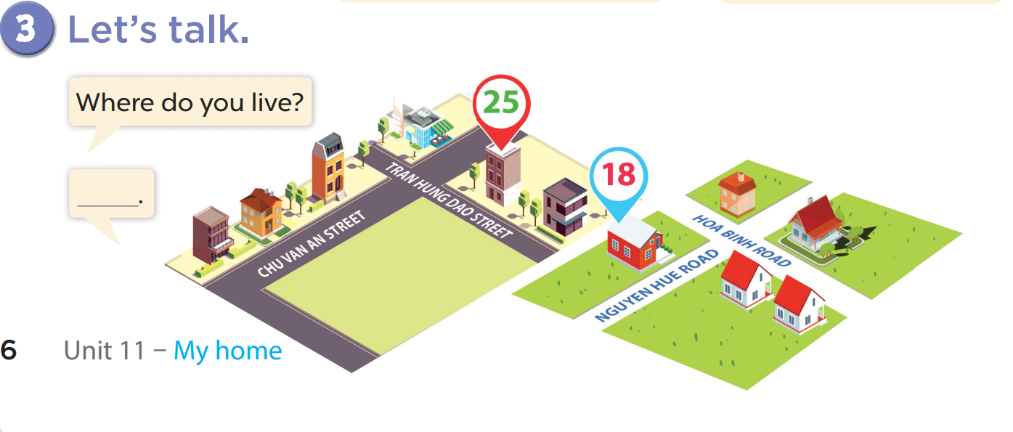

Slide 11
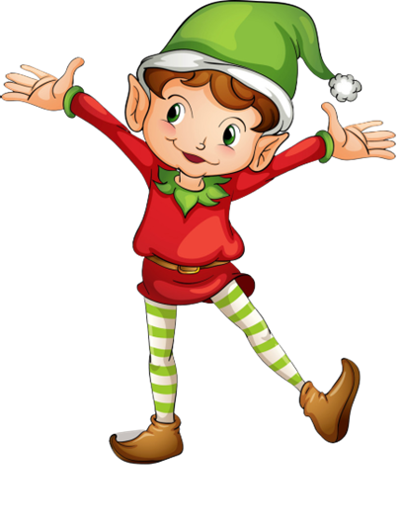
1
point
5
points
Lucky wheel!
Question
Question
Question
Question
Question
Question
SPIN
Question
3
points
2
points
10
points
End
Notes:
Click on “spin” button to spin the wheel, click again to stop

Slide 12
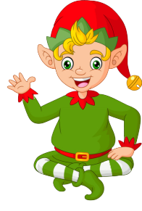
Ask and answer!
Where do you live?
I live in Tran Hung Dao Street.
Check
Back

Slide 13
Ask and answer!
Where do you live?
I live in Quang Trung Road.
Back
Check

Slide 14
Ask and answer!
Where do you live?
I live at 81 Tran Hung Dao Street.
Back
Check

Slide 15
Ask and answer!
Where do you live?
I live at 9 Quang Trung Road.
Back
Check

Slide 16
Ask and answer!
Where do you live?
I live in/at…….
Back
Check

Slide 17
Ask and answer
Where do you live?
I live in/at…….
Back
Check

Slide 18

Ask and answer!
Where do you live?
I live in/at…….
Back
Check

