Slide 1
Hai Thanh Primary school
Welcome to our class !
Teacher: Mai Hong Phuong

Slide 2
Unit 11: My home
Lesson 1 - period 2

Slide 3
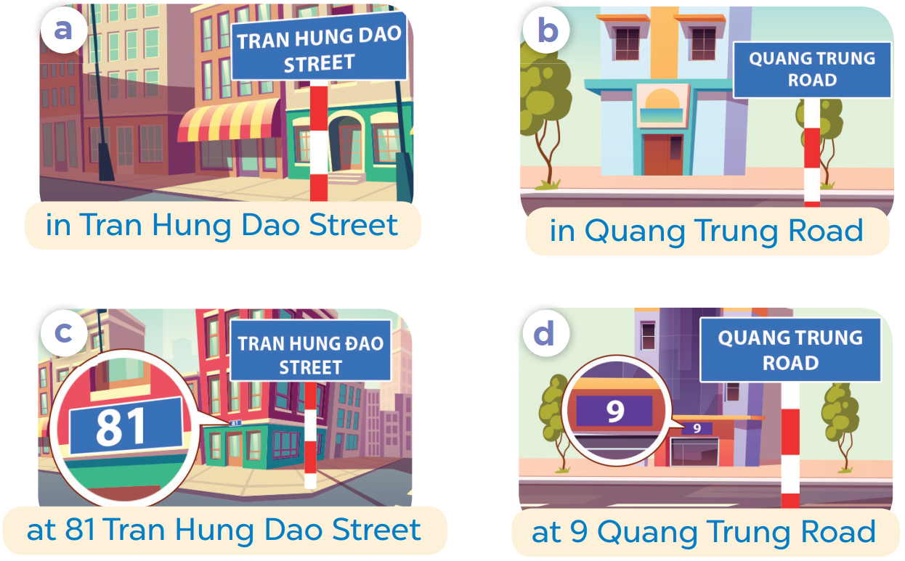
SLAP THE BOARD

Slide 4
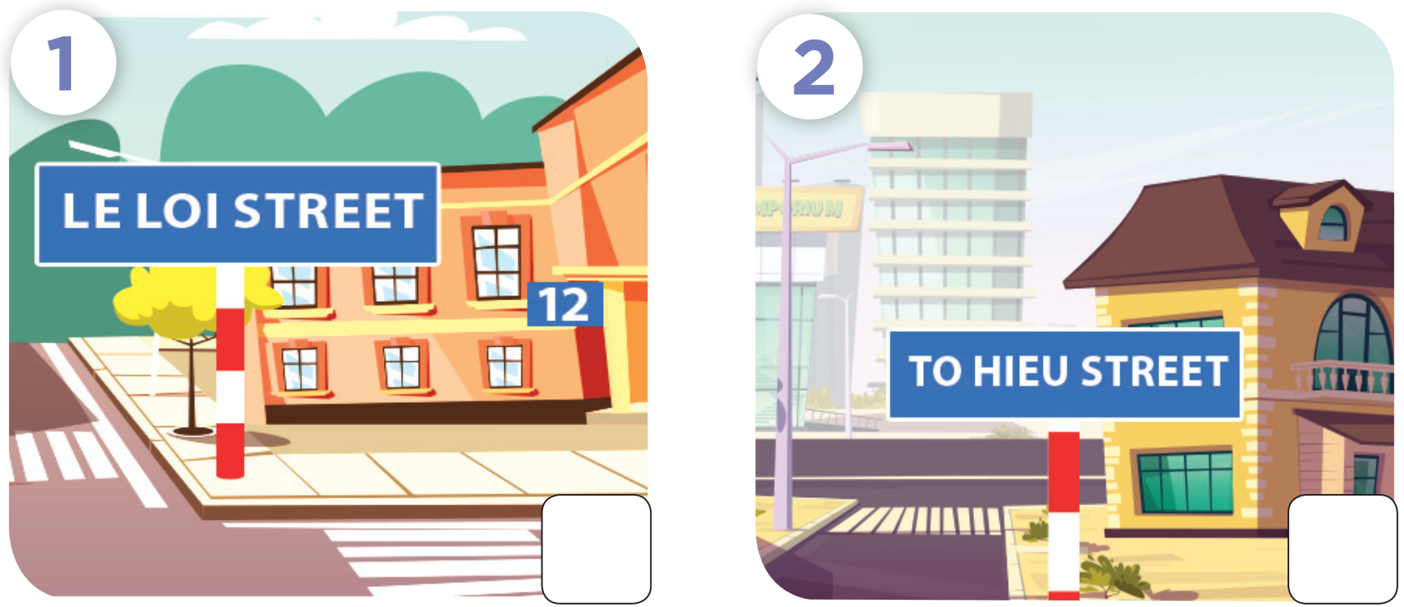

Slide 5
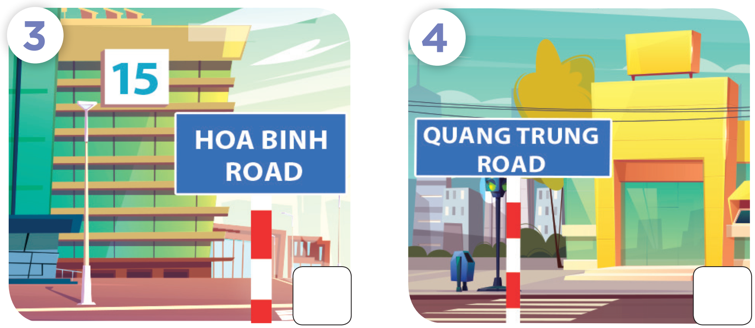

Slide 6
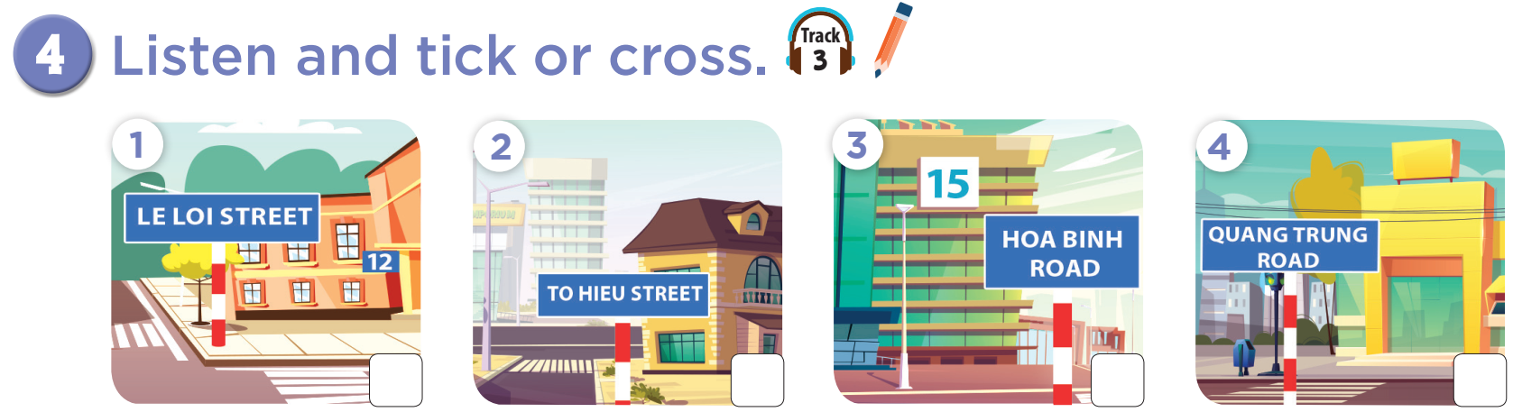

Slide 7



Slide 8

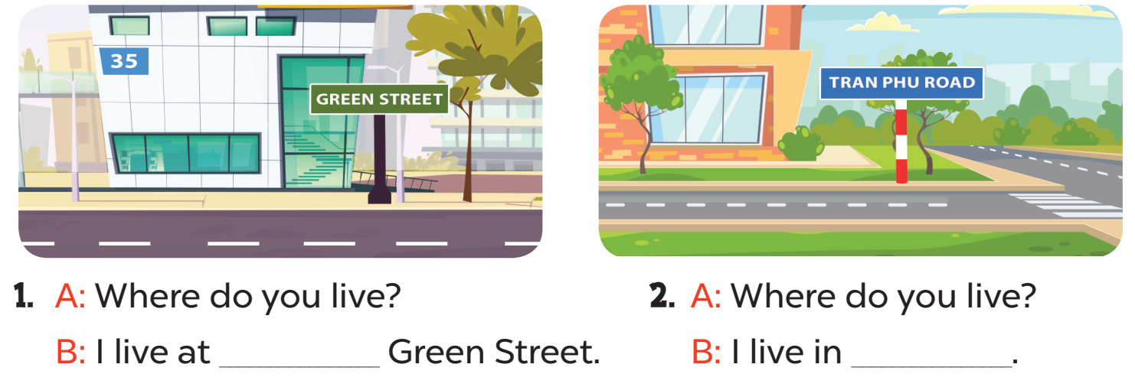
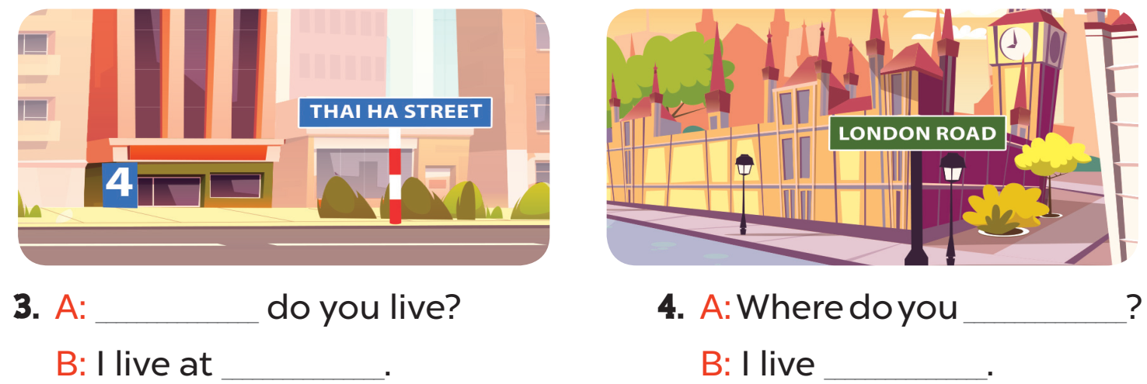

Slide 9
35
Tran Phu Road
Where
live
4 Thai Ha Street
at London Road

Slide 10
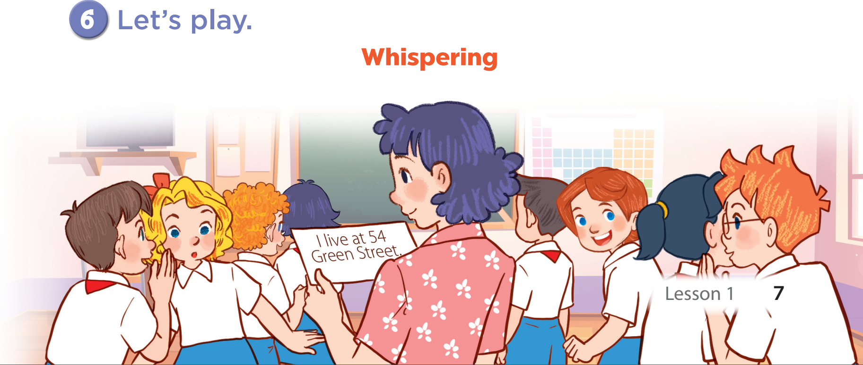

Slide 11
05
Fun corner & wrap-up

Slide 12






BOMBSTAR
PLAY

Slide 13












-1
-1

Slide 14

+1
Back

Slide 15



- ____________________?
- I live in Van Phuc Village.
Where do you live?
Where’s do you live?
Where you live?

Slide 16
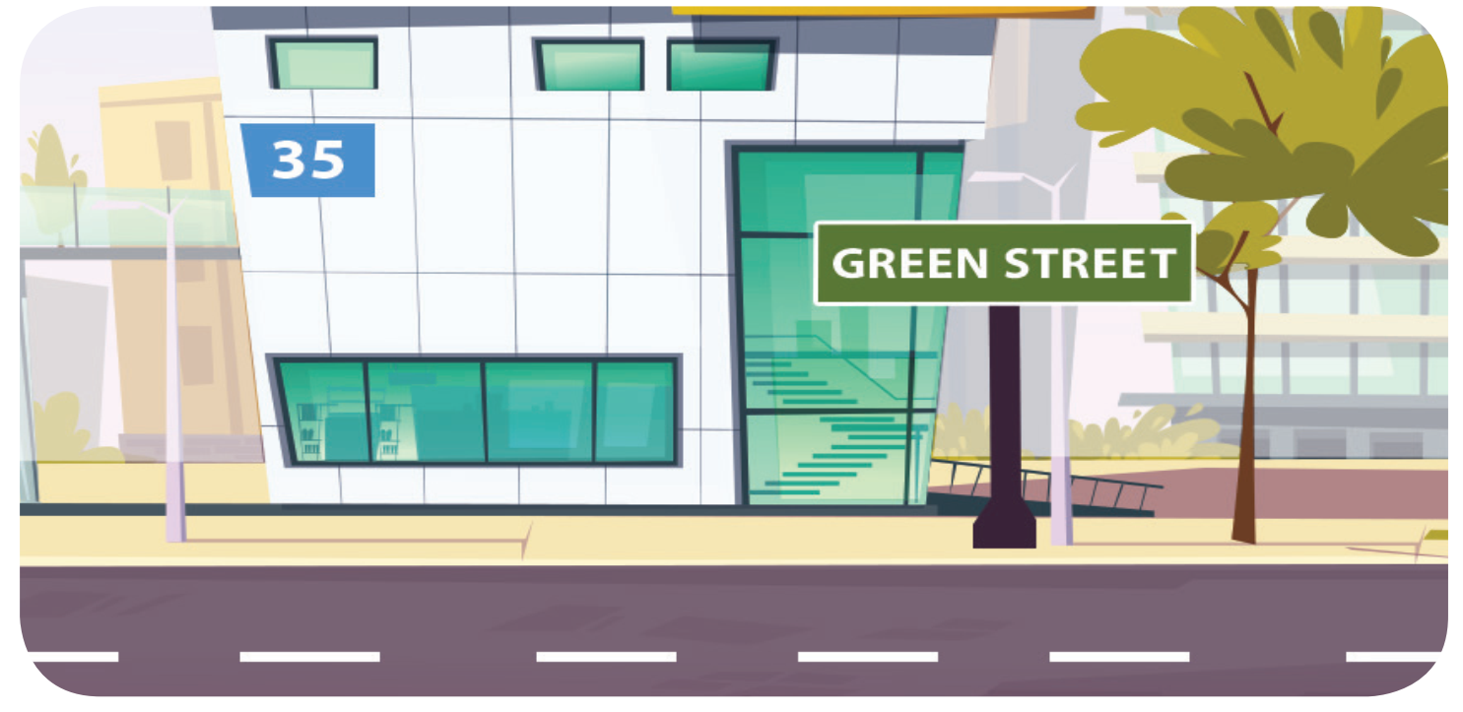
Where do you live?
_____________
I live 35 Green Street.
I live at 35 Green Street.
I live in 35 Green Street.

Slide 17
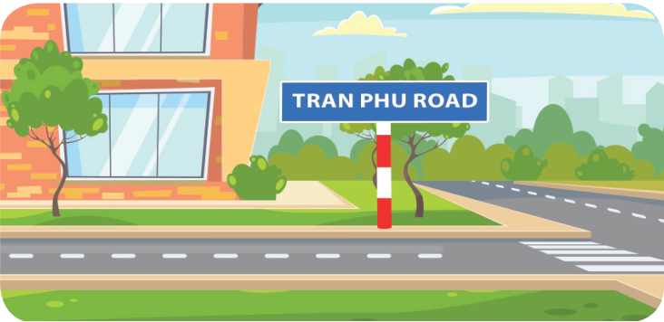
Where do you live?
She lives in Tran Phu Road.
I live in Tran Phu Street.
I live in Tran Phu Road.

Slide 18
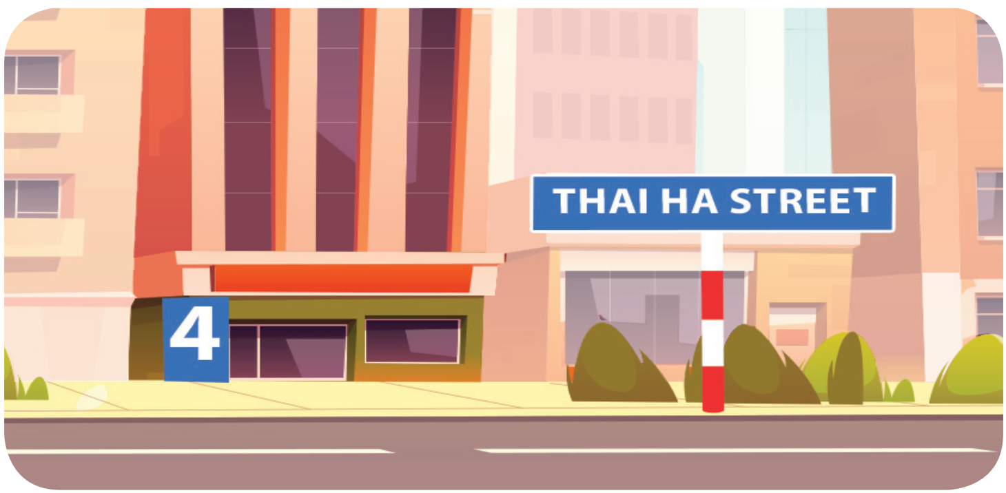
Where do you live?
I live at 4 Thai Ha Street.
I live in Thai Thinh Street.
I live at Thai Ha Street.

Slide 19
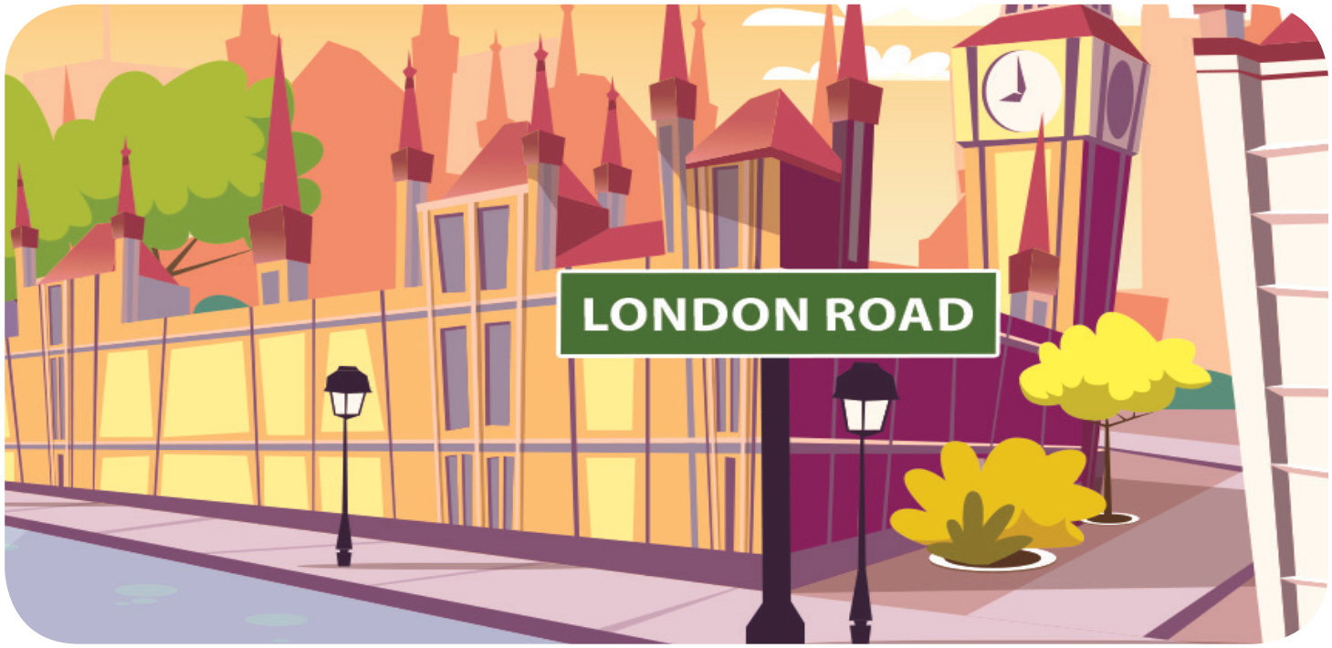
Where do you live?
I live London Road.
I live in London Road.
I live at London Road.

Slide 20
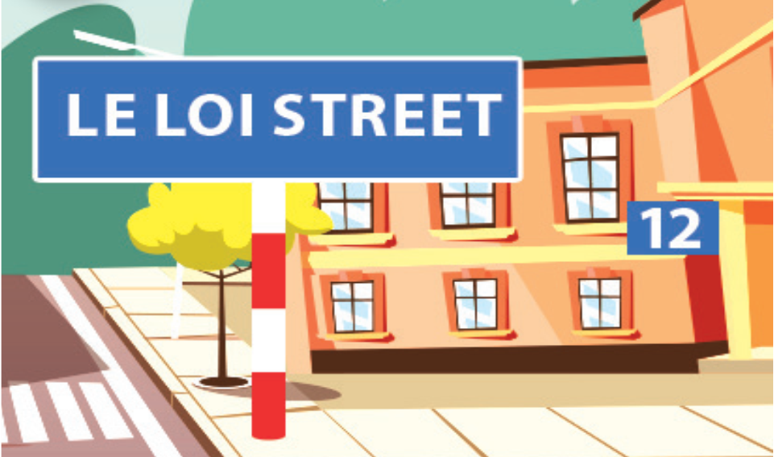
Where does he live?
He lives on Le Loi Street.
He lives in Le Loi Road.
He lives at 12 Le Loi Street.

Slide 21
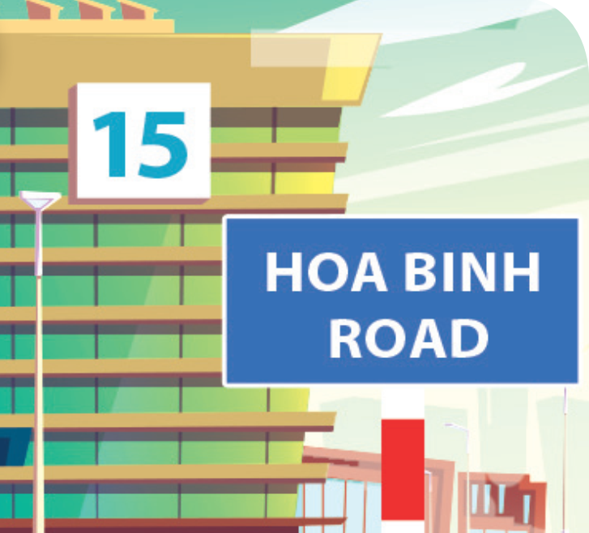
Where does she live?
She lives in 15 Hoa Binh Road.
She lives at 15 Hoa Binh Road.
She lives at 15 Hoa Binh Street.

