Slide 1
Hai Thanh Primary school
Welcome to our class !
Teacher: Mai Hong Phuong

Slide 2
Unit 11: My home
Lesson 2 - period 3

Slide 3
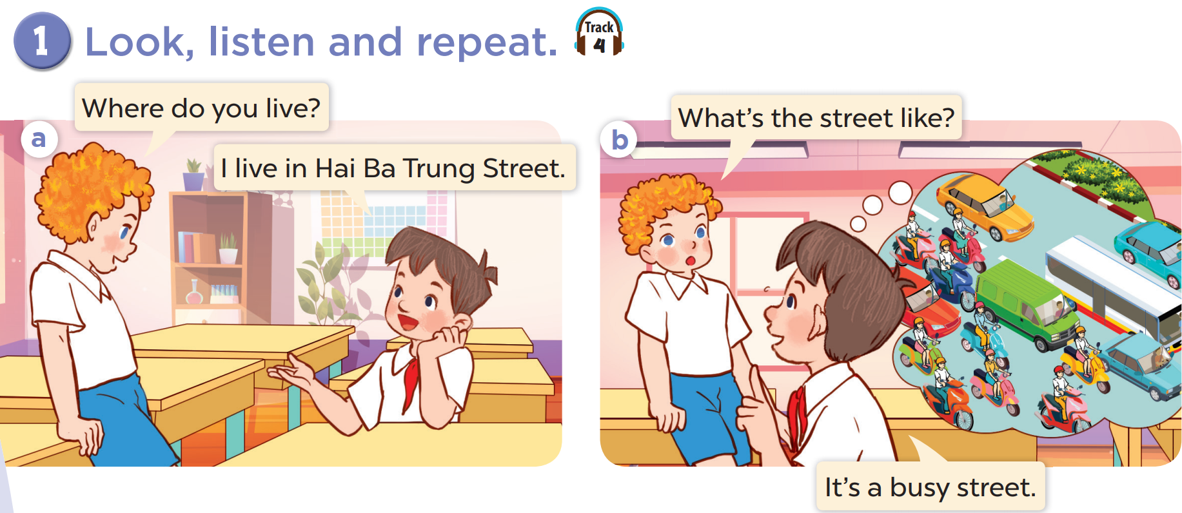

Slide 4
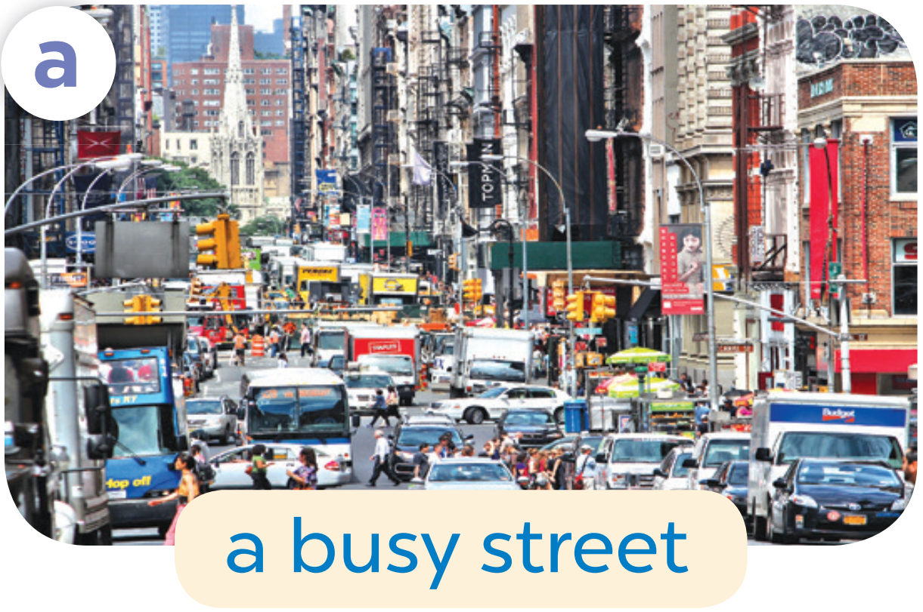

Slide 5
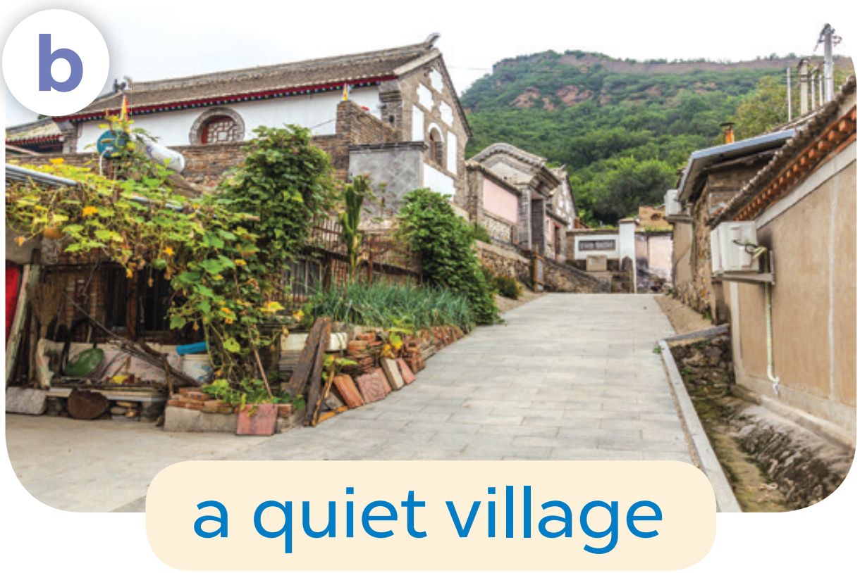

Slide 6
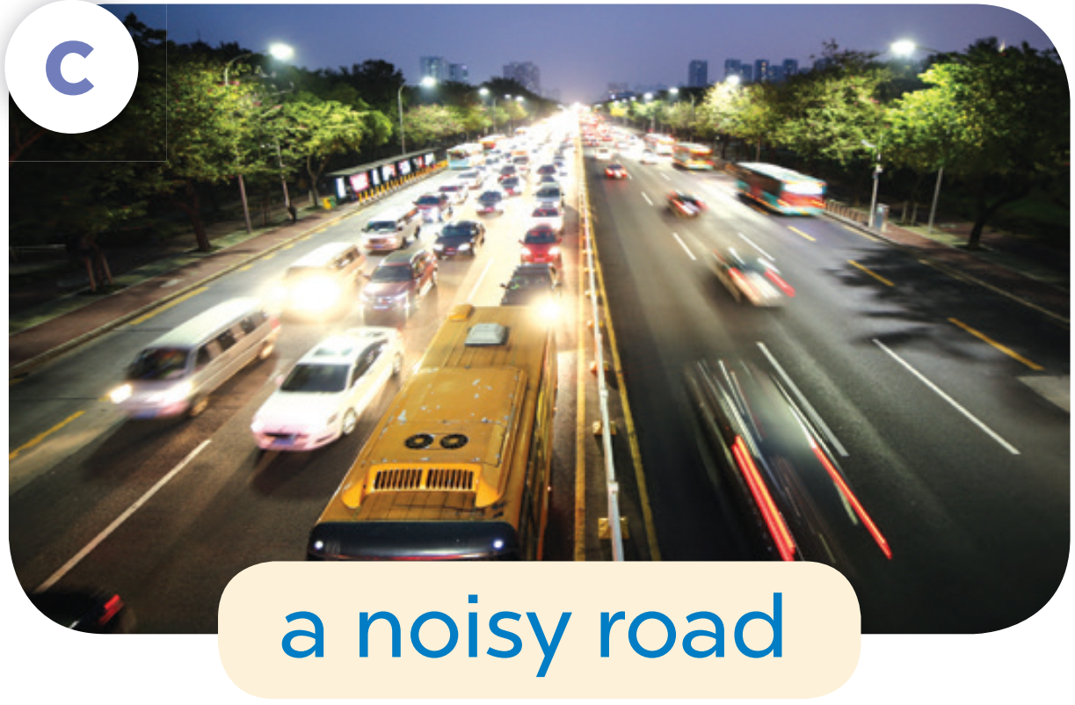

Slide 7


Slide 8
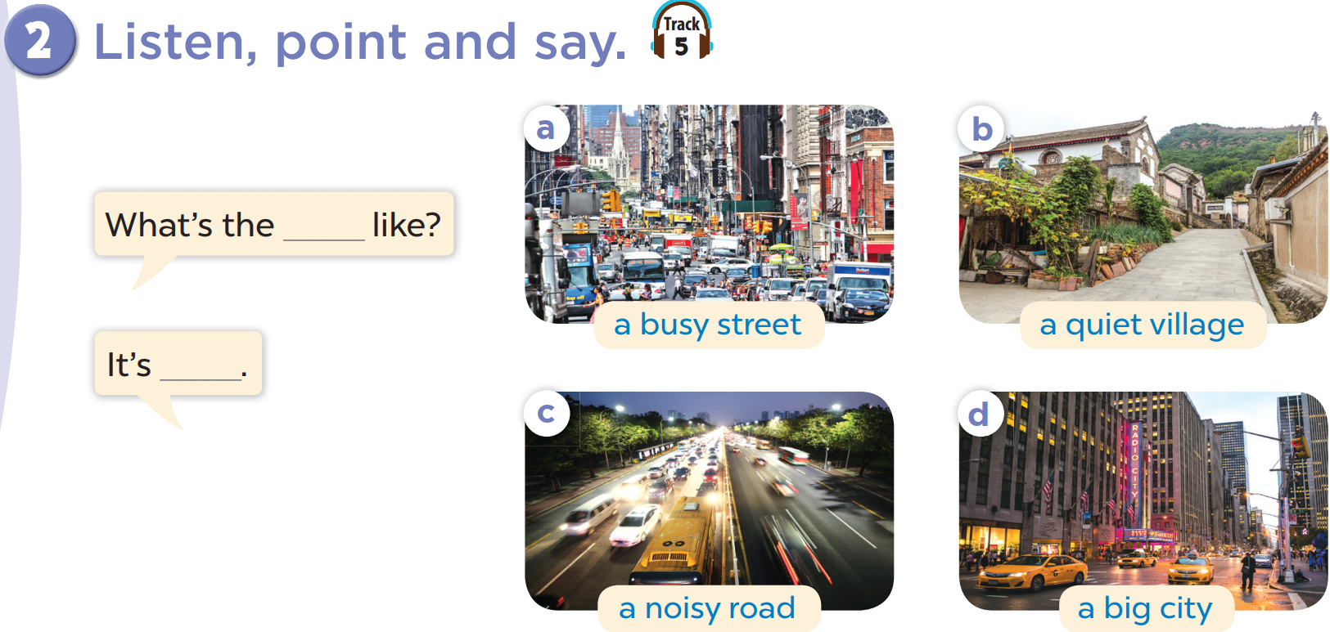

Slide 9
What the street like?
It’s a busy street.

Slide 10
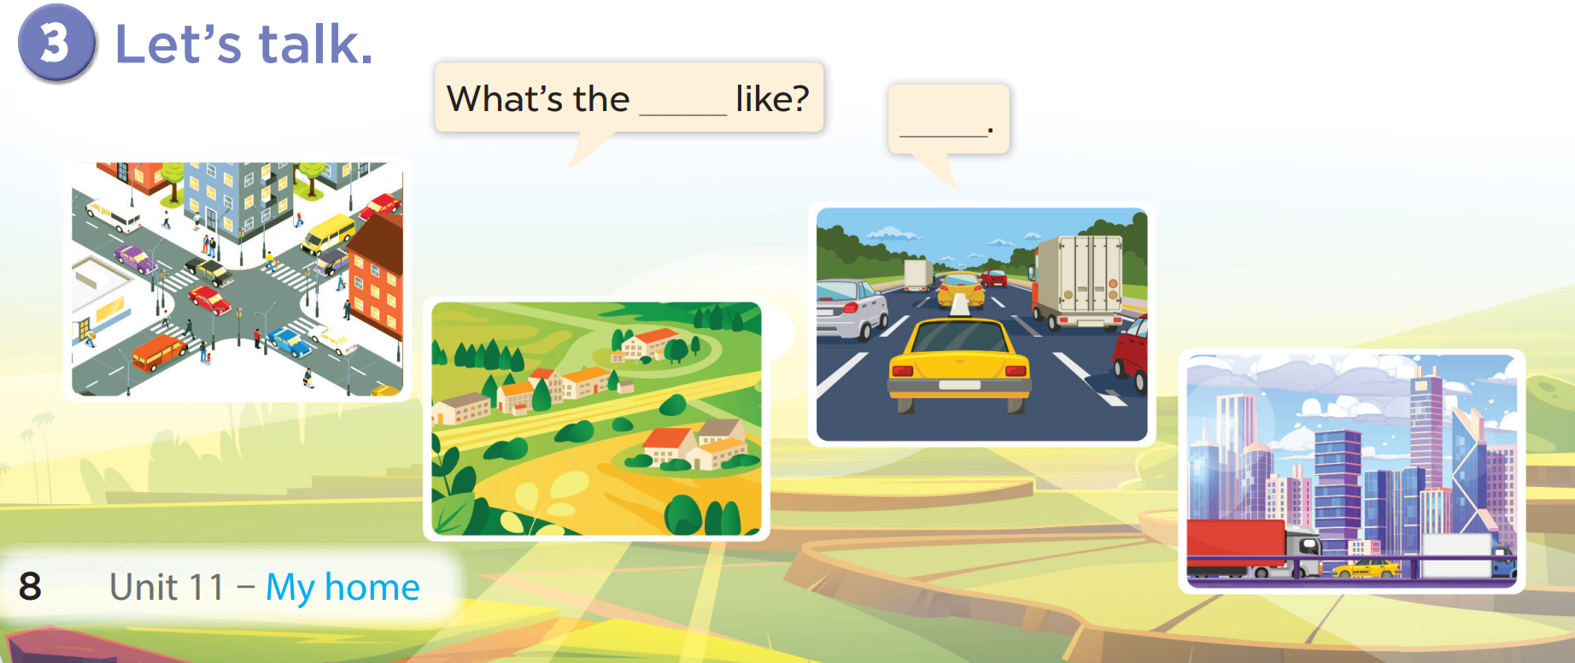

Slide 11
05
fun corner & Wrap-up

Slide 12




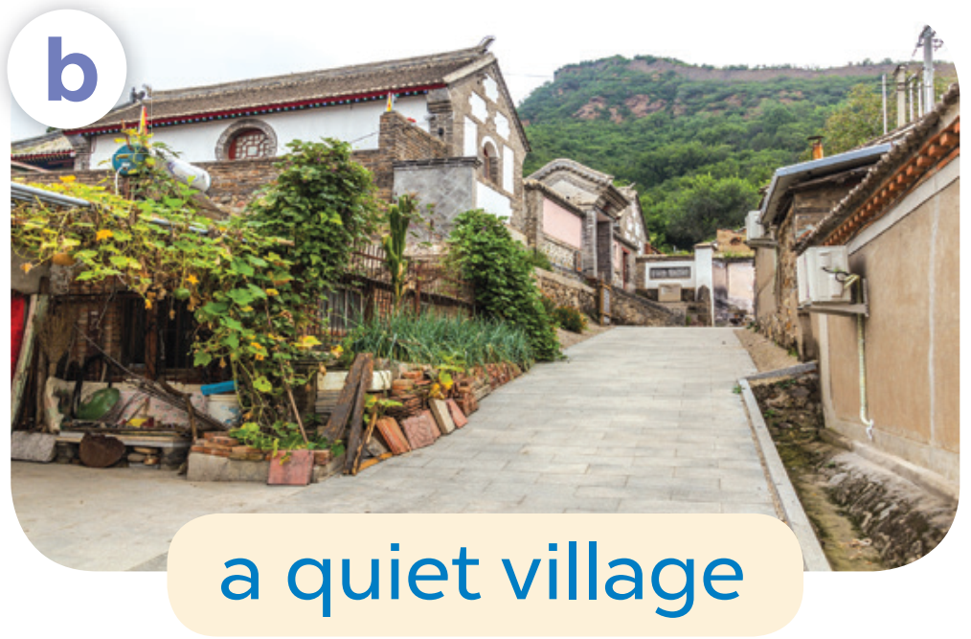
Game
Can you guess what it is?
a quiet village
1
2
3
4
5
6
7
8
9
answer

Slide 13

Game
Can you guess what it is ?
a big city
1
2
3
4
5
6
7
8
9
answer

Slide 14

Game
a busy street
1
2
3
4
5
6
7
8
9
answer

Slide 15
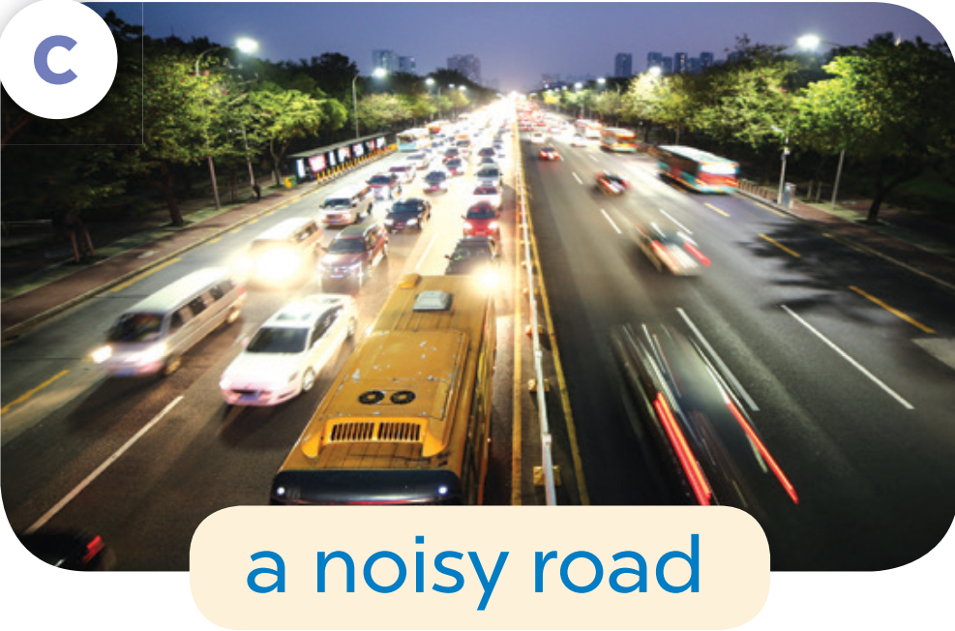
Game
a noisy road
1
2
3
4
5
6
7
8
9
answer

