Slide 1

Hai Thanh Primary school
Welcome to our class !
Teacher: Mai Hong Phuong

Slide 2
Unit 11: My home
Lesson 2 - period 4

Slide 3
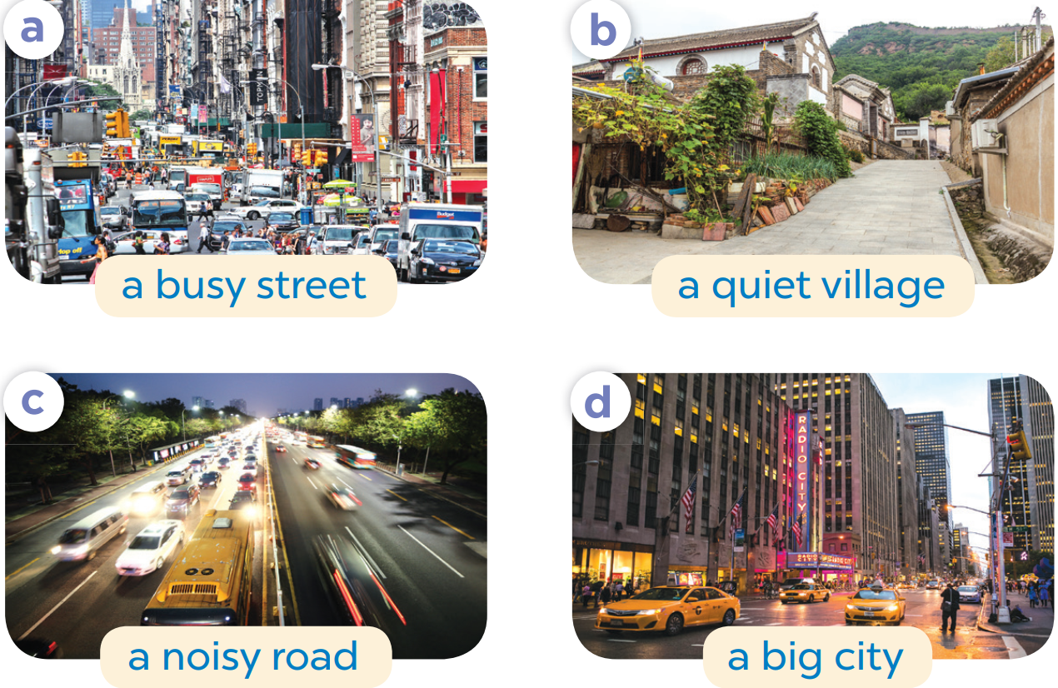
Slap the board

Slide 4

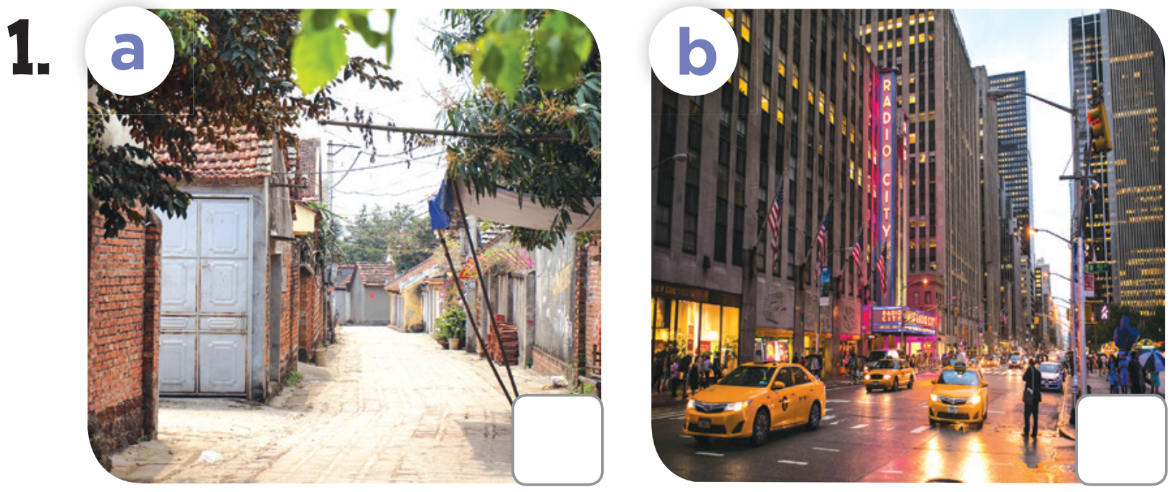
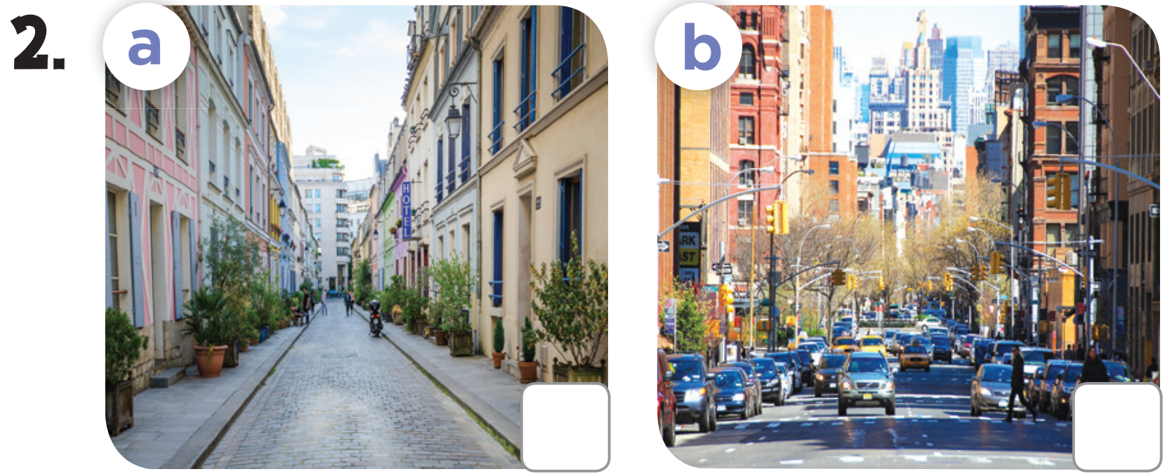

Slide 5


Slide 6
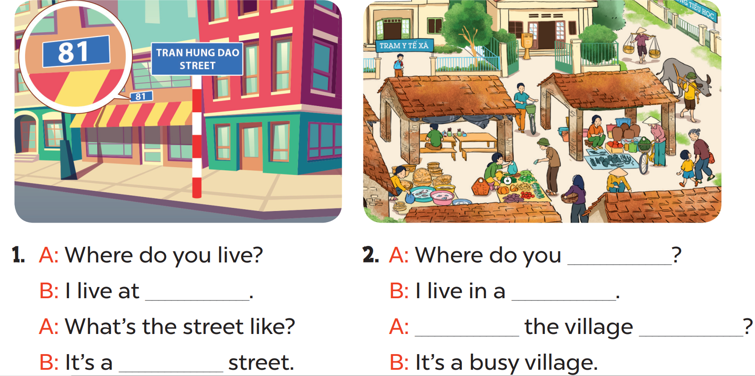

Slide 7
live
81 Tran Hung
Dao Street
village
What’s
like
quiet

Slide 8
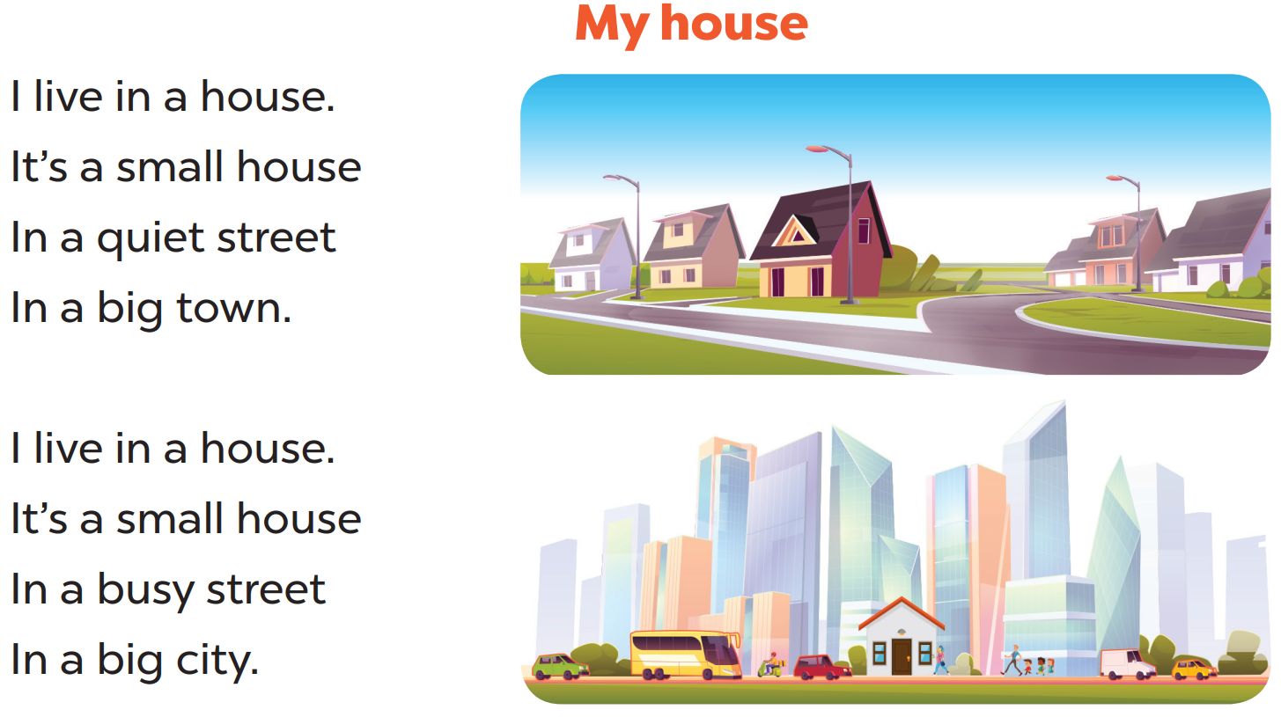

Slide 9

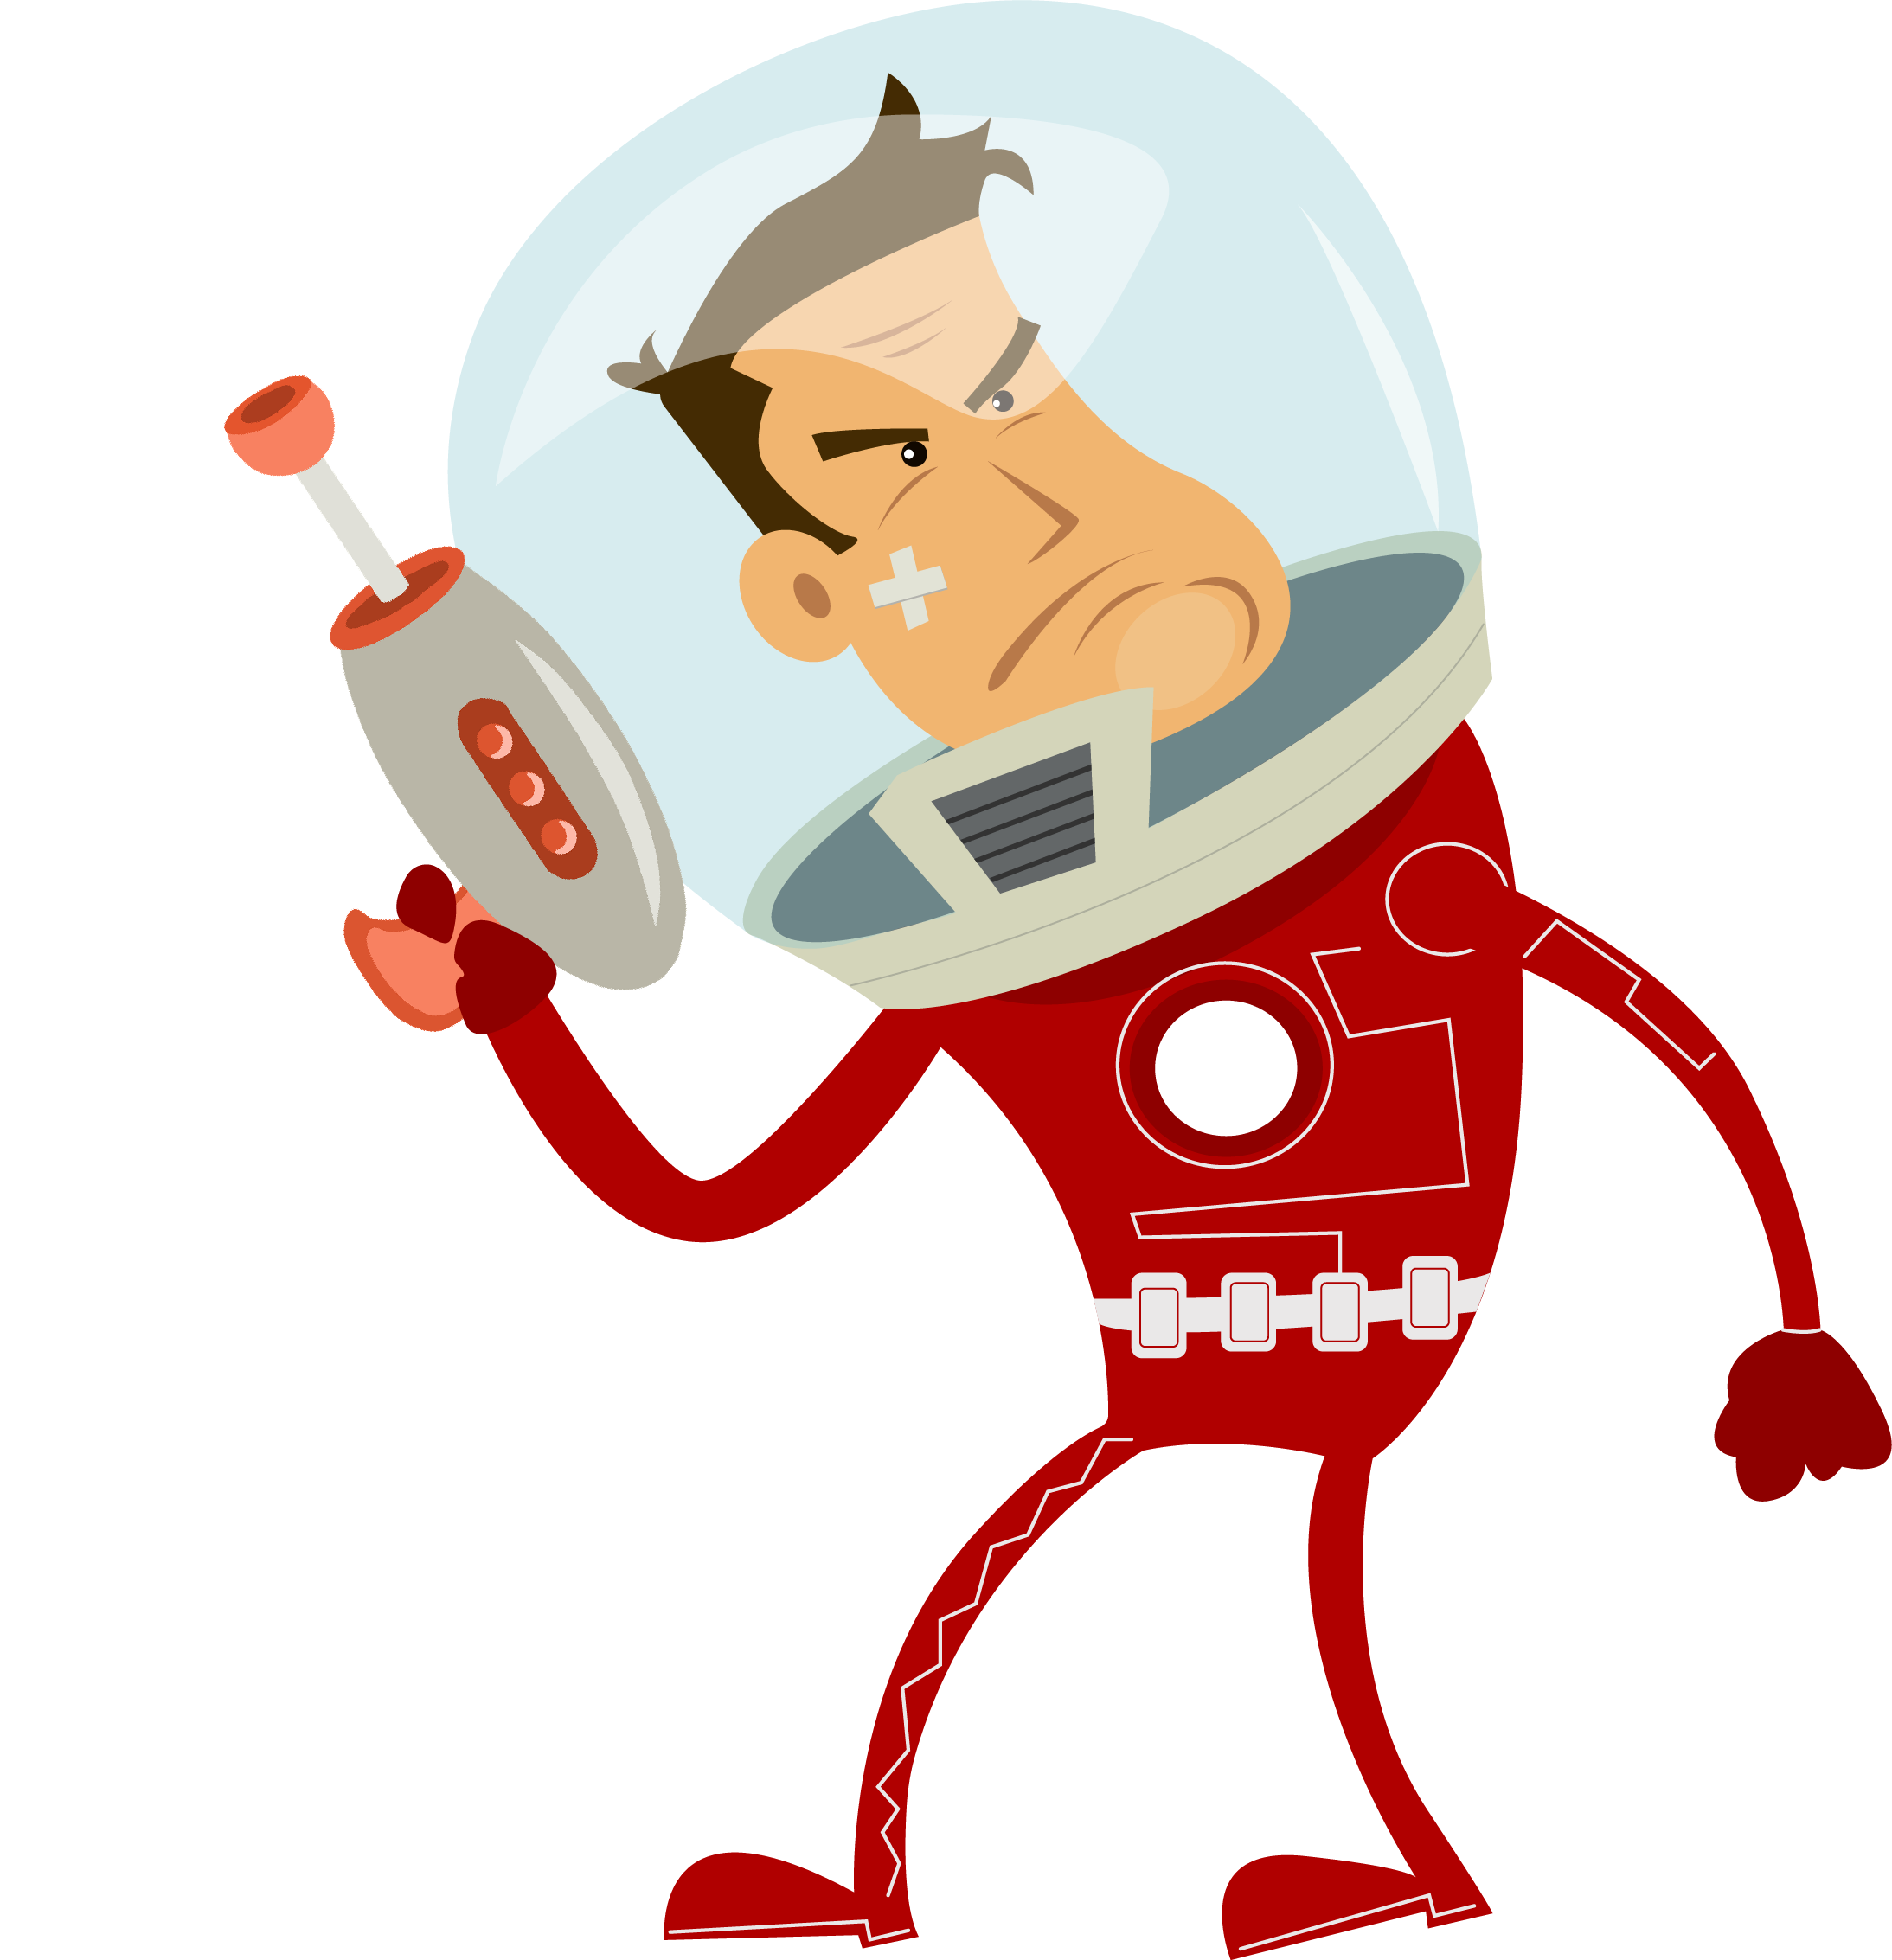
Quiz
START

Slide 10



Where_____you live?
do
Does
do
Is doing
Are doing

Slide 11
I live ____ a city.
in
in
under
at
on

Slide 12
____ the city like?
What’s
What
How
What’s
Why’s

Slide 13
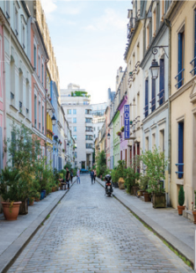
It’s a______street.
quiet
busy
high
quiet
big

Slide 14
_____ do you live?
Where
When
Where’s
When’s
Where

Slide 15
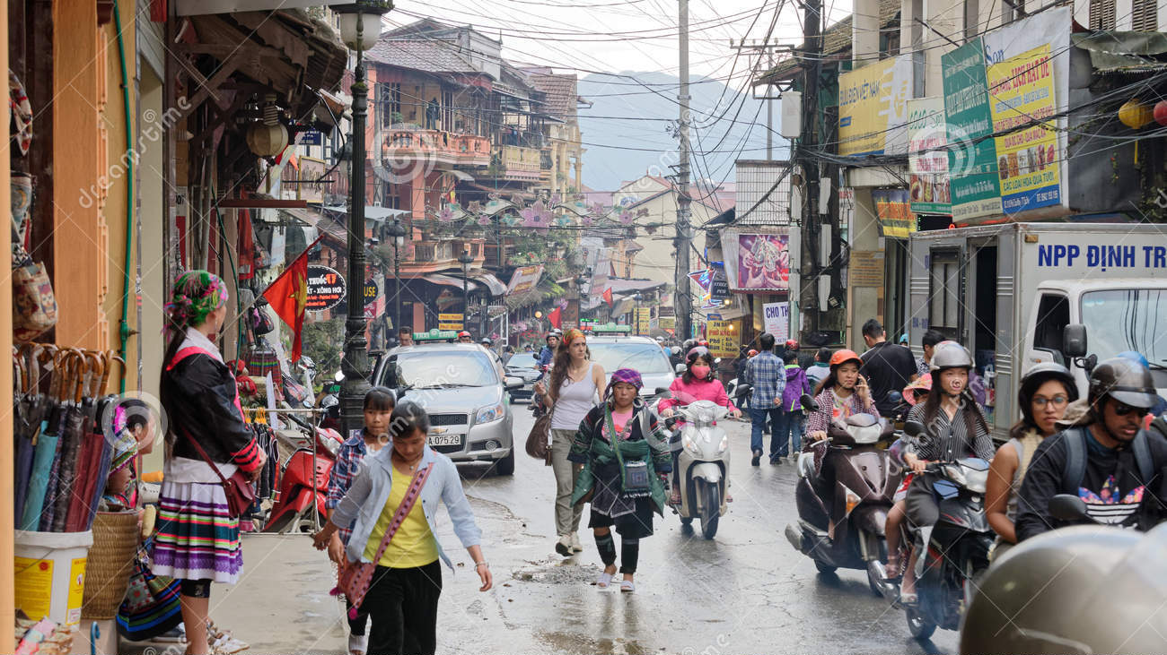
What’s the village like?
It’s______ village.
a busy
a quiet
quiet
busy
a busy

