Slide 1
Hai Thanh Primary school
Welcome to our class !
Teacher: Mai Hong Phuong

Slide 2
Unit 11: My home
Lesson 3 - period 5

Slide 3

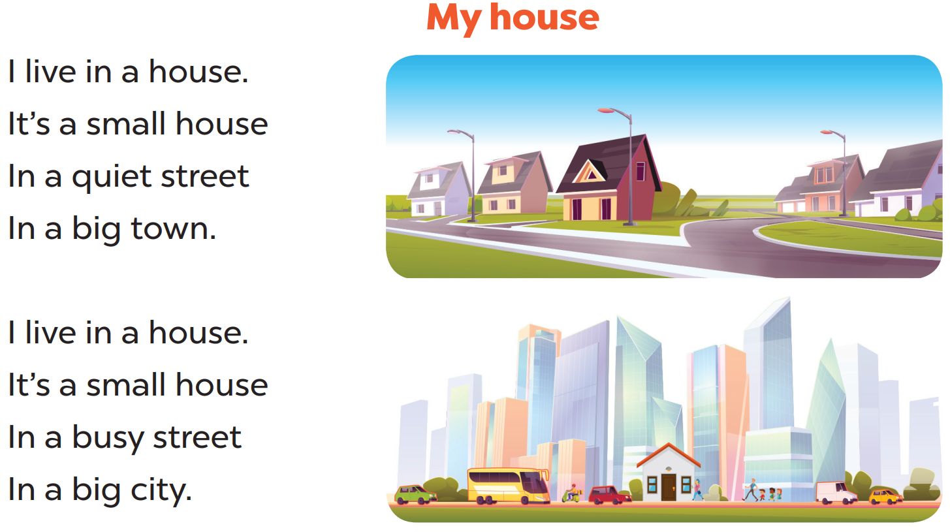

Slide 4


Slide 5
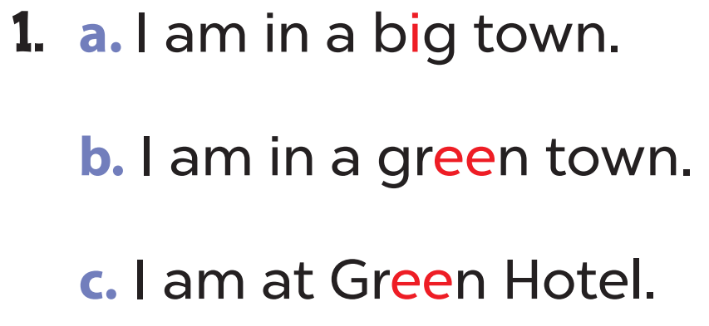
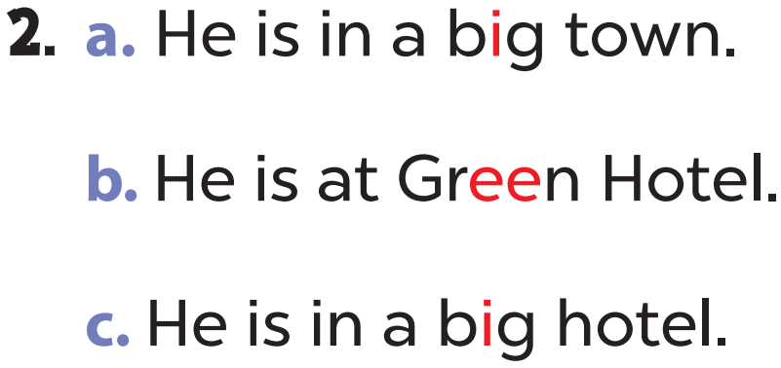

Slide 6


Slide 7
04
Let’s chant.

Slide 8
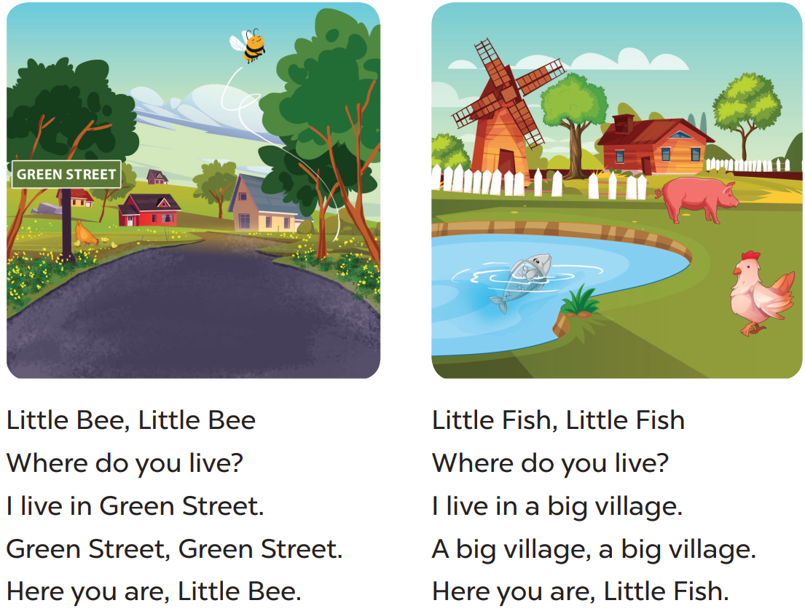

Slide 9
05
fun corner & wrap-up

Slide 10

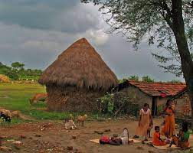
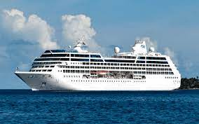
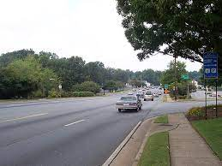
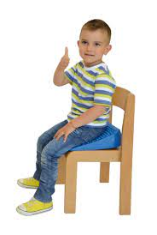

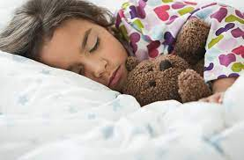
1
2
7
3
6
4
5
Start/Stop
Notes:
1- big
2- village
3- street
4- green
5- sleep
6- sit
7- ship

