Slide 3
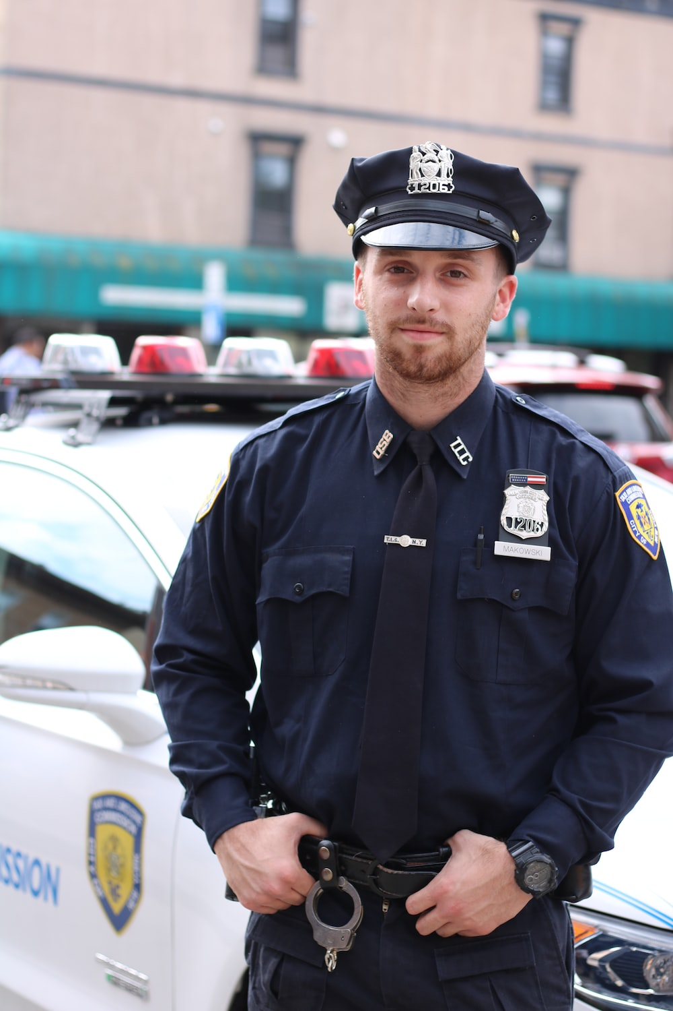
What does he do?
He’s a policeman.

Slide 4
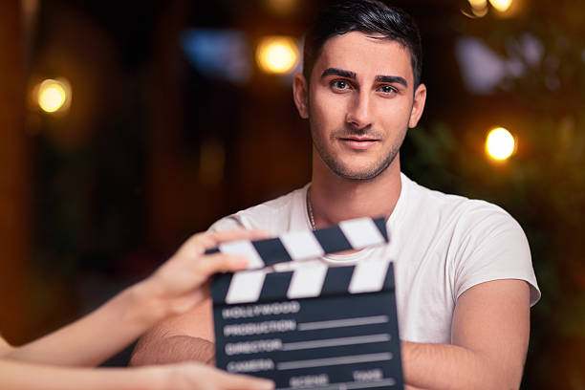
What does he do?
He’s an actor.

Slide 5
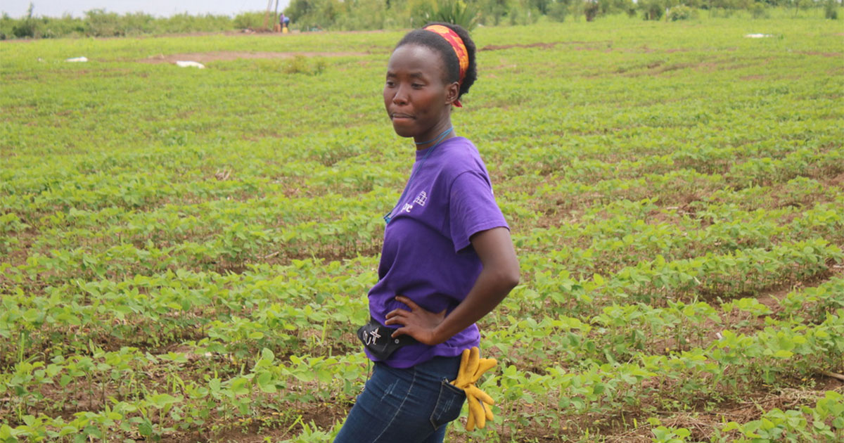
What does she do?
She’s a farmer.

Slide 6

What does she do?
She’s an office worker.

Slide 7

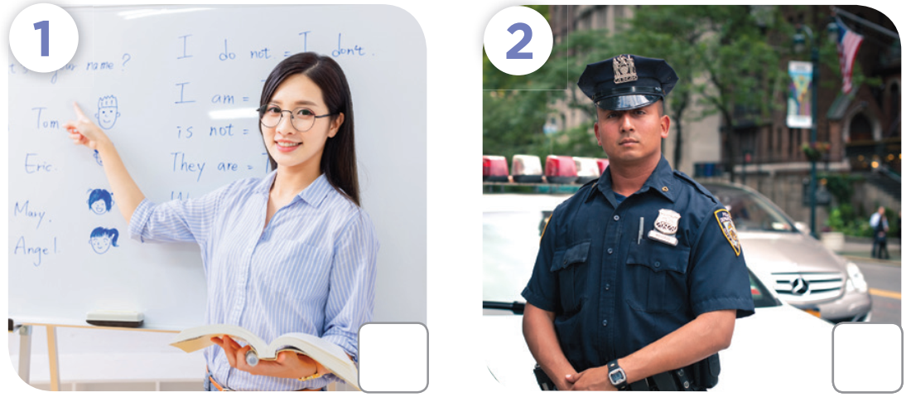
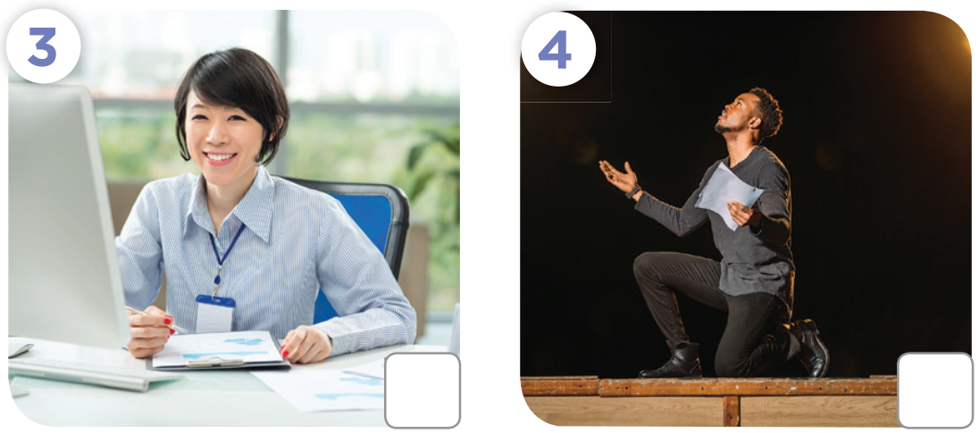

Slide 8
✗
✓
✓
✗

Slide 9
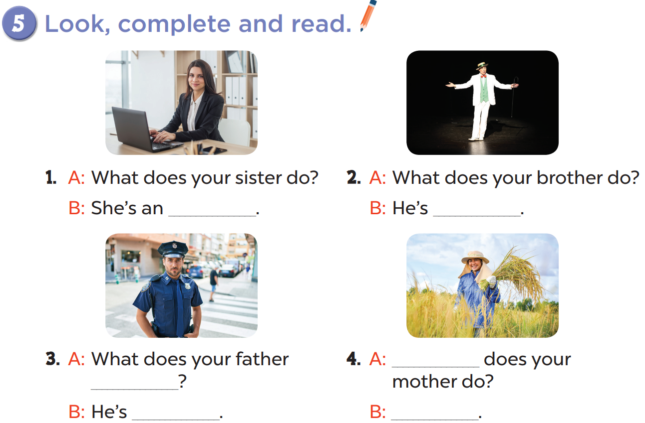

Slide 10
office worker
an actor
What
do
a policeman
She’s a farmer

Slide 11
