Slide 1
Hai Thanh Primary school
Welcome to our class !
Teacher: Mai Hong Phuong

Slide 3
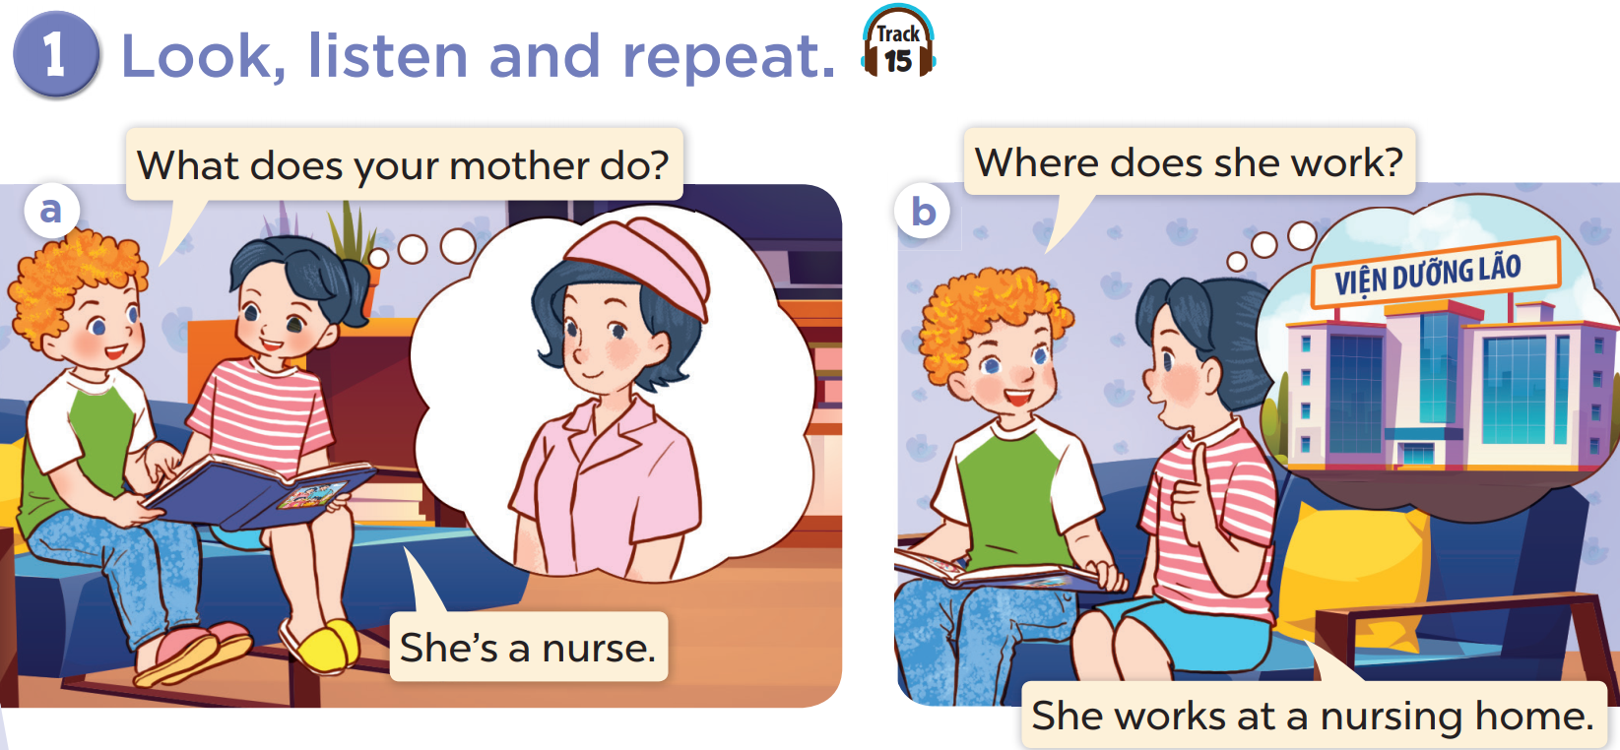

Slide 5
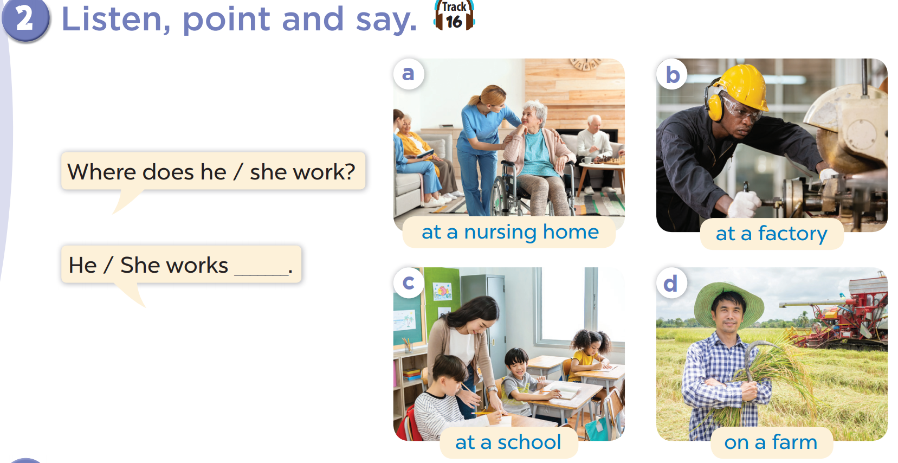

Slide 6
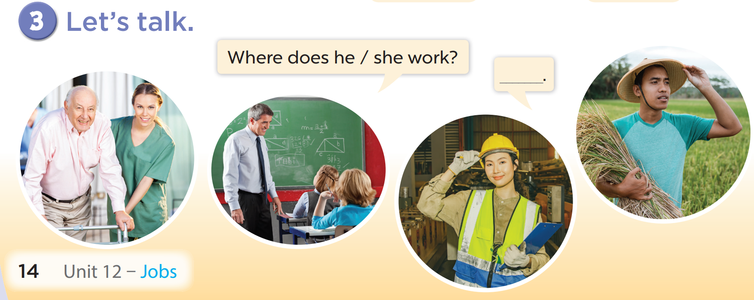

Slide 7
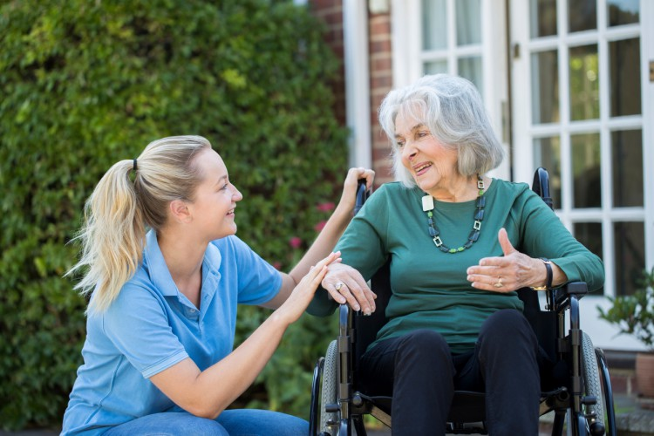
Where does she work?
She works at a nursing home.

Slide 8
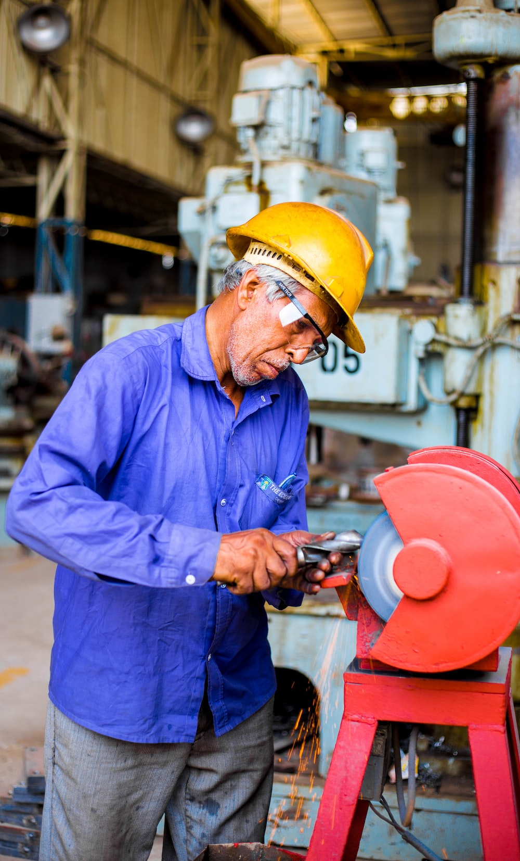
Where does he work?
He works at a factory.

Slide 9

Where does he work?
He works at a school.

Slide 10
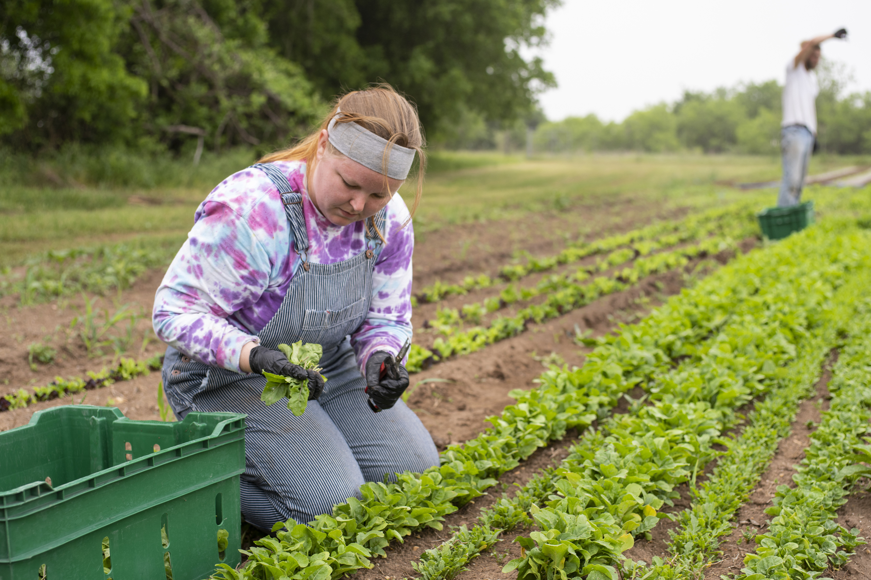
Where does she work?
She works on a farm.

