Slide 1





Hai Thanh Primary school
Welcome to our class !
Teacher: Mai Hong Phuong

Slide 4

https://quizizz.com/admin/quiz/64bf7f6450ea58001d4b4f0a?source=quiz_share
Notes:
https://quizizz.com/admin/quiz/64bf7f6450ea58001d4b4f0a?source=quiz_share

Slide 5
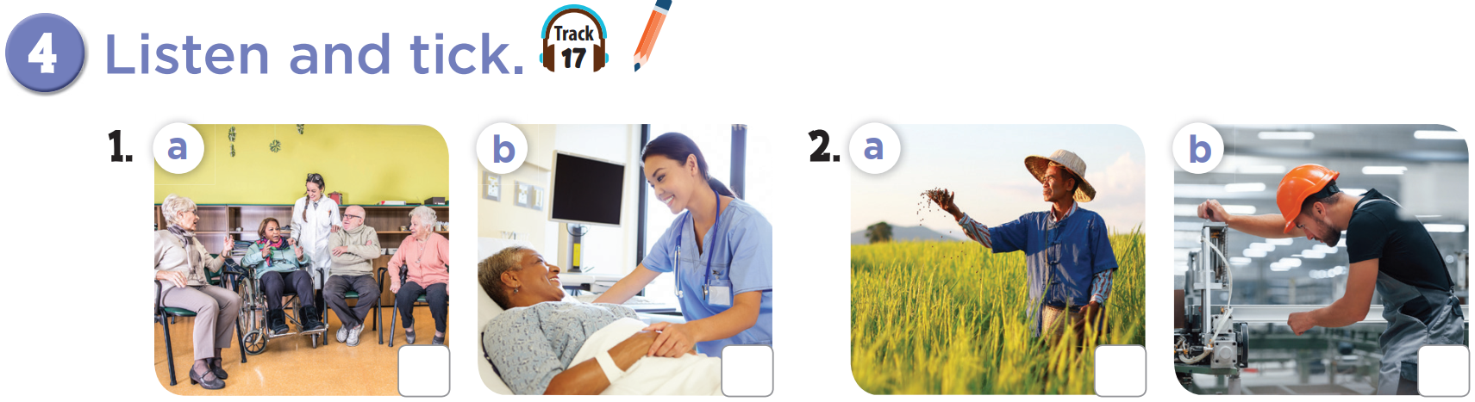


Slide 6
✓
✓

Slide 7
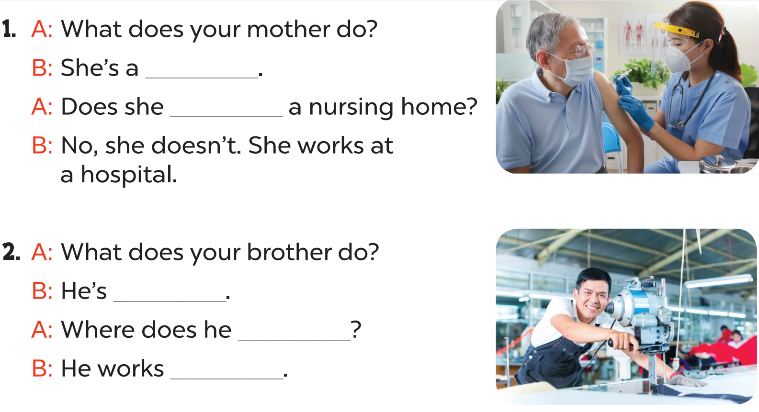

Slide 8
nurse
work at
a worker
work
at a factory

Slide 9
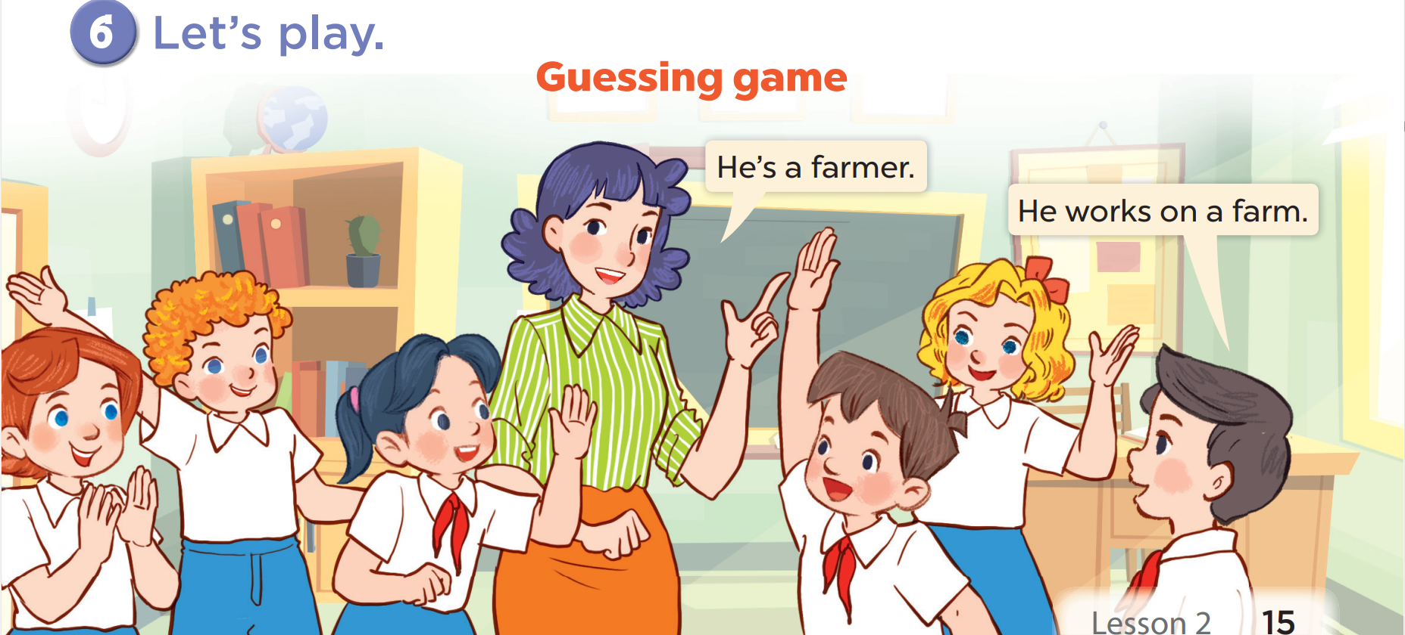

Slide 11

I have to work all day.
People come here when they aren’t fine, they feel tired and sick.
So who am I?
I am not a doctor
I’m a nurse.

Slide 12







THANK YOU
Website: hoclieu.vn
Fanpage: facebook.com/www.tienganhglobalsuccess.vn
Website: sachmem.vn; hoclieu.vn
Fanpage: www.facebook.com/sachmem.vn

