Slide 1

Hai Thanh Primary school
Welcome to our class !
Teacher: Mai Hong Phuong

Slide 3

GUESS THE JOB!
a farmer

Slide 4

GUESS THE JOB!
an office worker

Slide 5
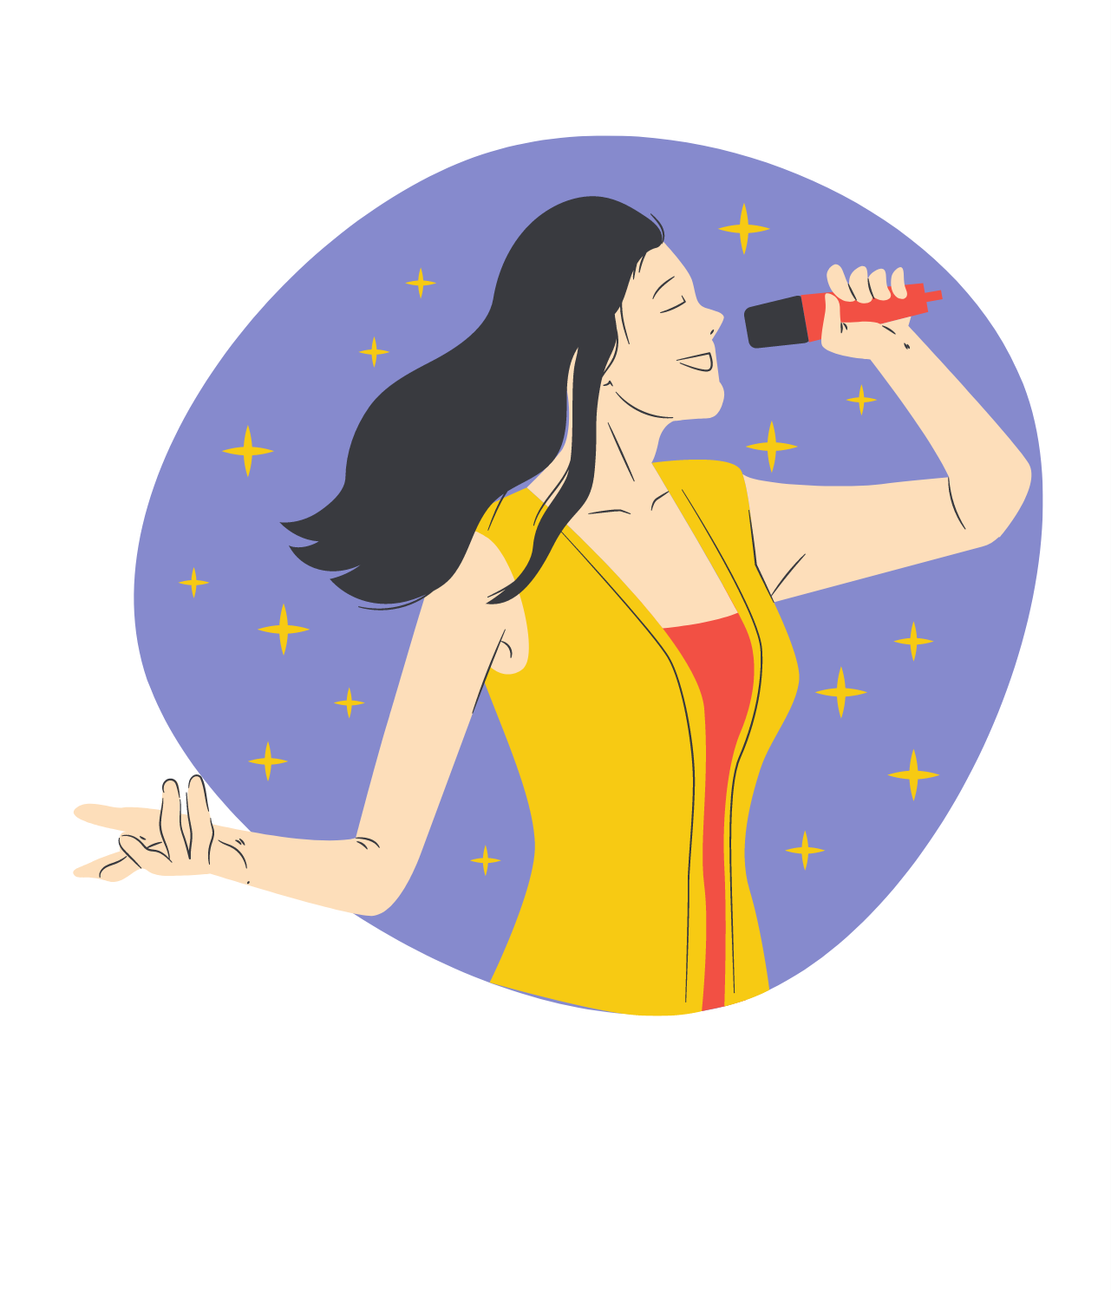
GUESS THE JOB!
a singer

Slide 6

GUESS THE JOB!
a teacher

Slide 7

GUESS THE JOB!
a nurse

Slide 8
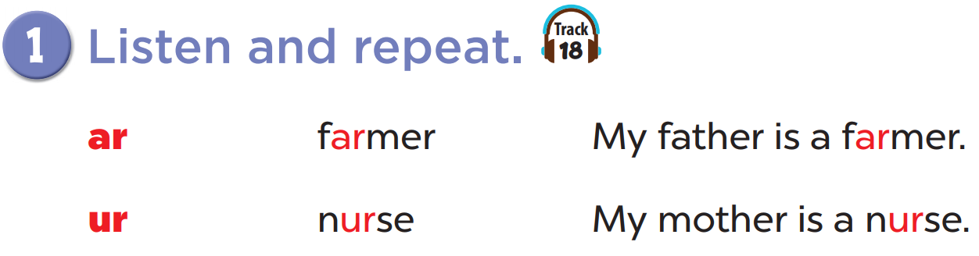


Slide 9
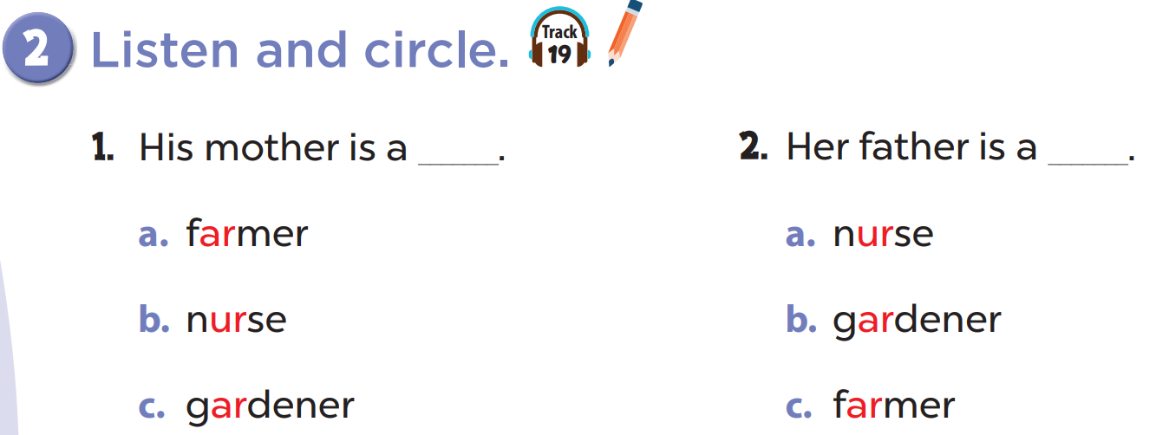

Slide 11
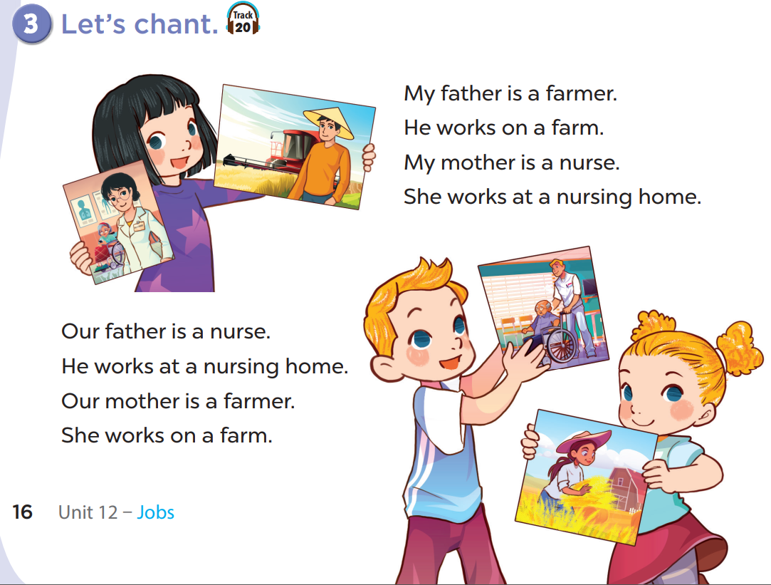

Slide 13
Write your own chant about your family!
My father is...
He works...
My mother is...
She works...

