Slide 1

Hai Thanh Primary school
Welcome to our class !
Teacher: Mai Hong Phuong

Slide 3
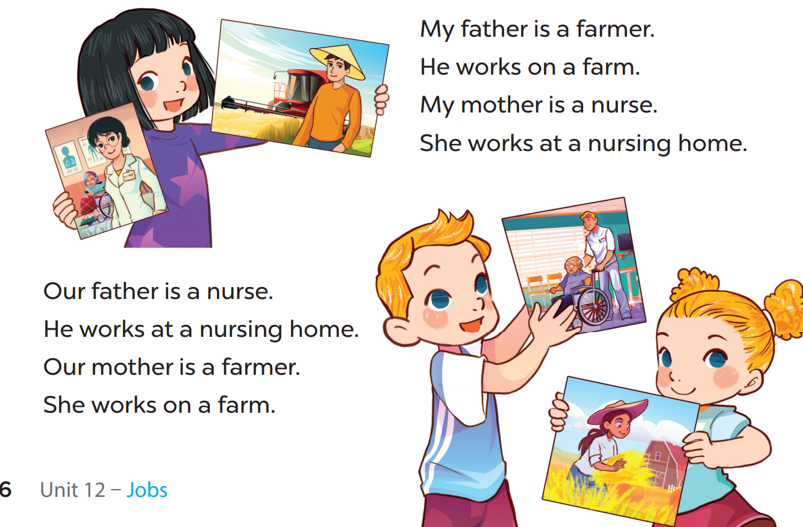

Slide 4
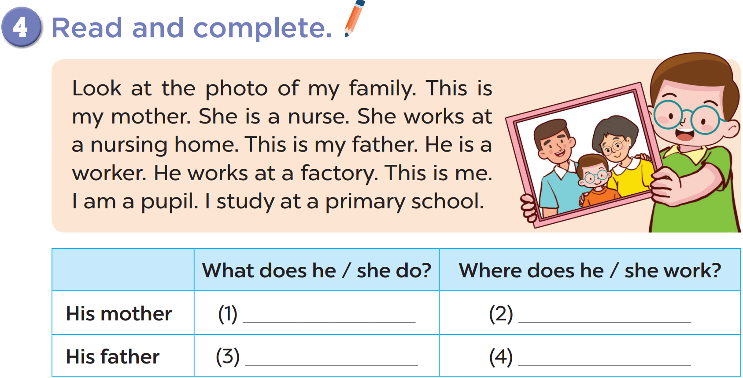
Notes:
chant several times, change the lyrics

Slide 5
a nurse
at a nursing home
a worker
at a factory
Notes:
chant several times, change the lyrics

Slide 6
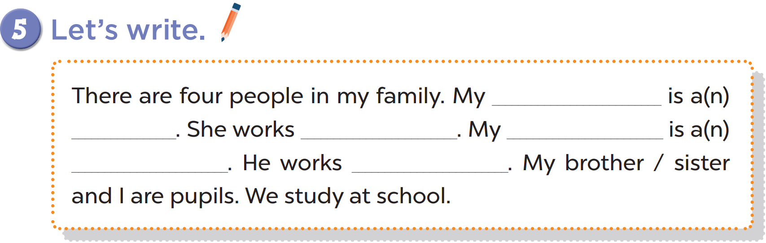

Slide 7
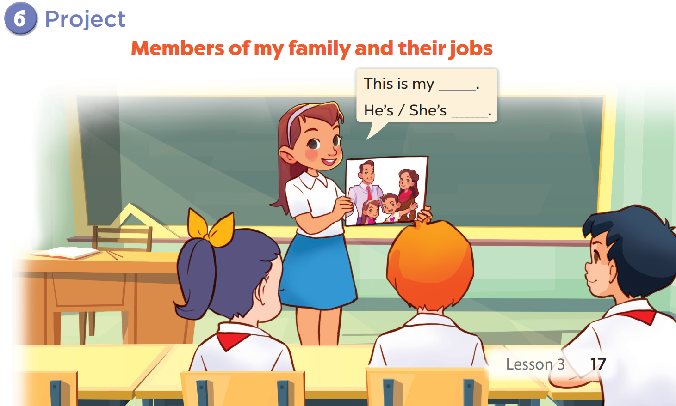

Slide 8





Scrambled Jobs game

Slide 9
eifcof rrkoew
eacoiplmn
office worker
policeman
rrmaef
taorc
farmer
actor

