Slide 1
Hai Thanh Primary School
Teacher: Ho Ngoc Linh

Slide 2

Unit 16 Seasons and the weather
Lesson 2 - Period 3

Slide 3


Table of contents
01
Warm-up and Review
02
Look, listen and repeat.
03
Listen, point and say.
04
Let’s talk.
05
Fun corner and Wrap-up

Slide 4
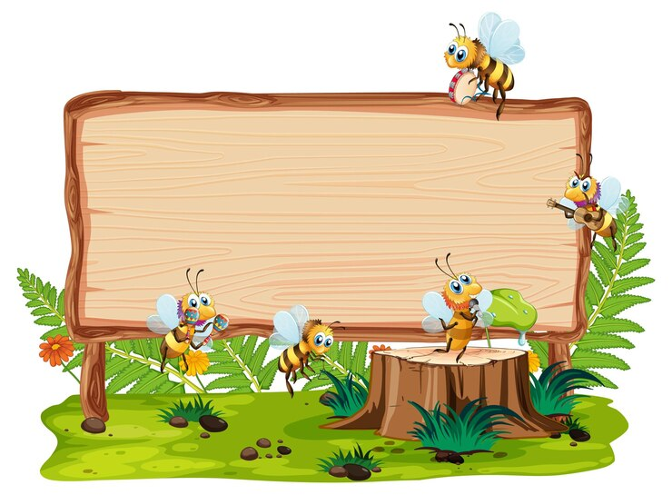

01
Warm-up and Review

Slide 5
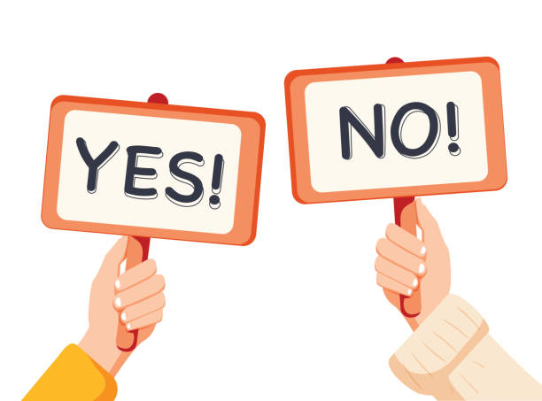
Game

Slide 6
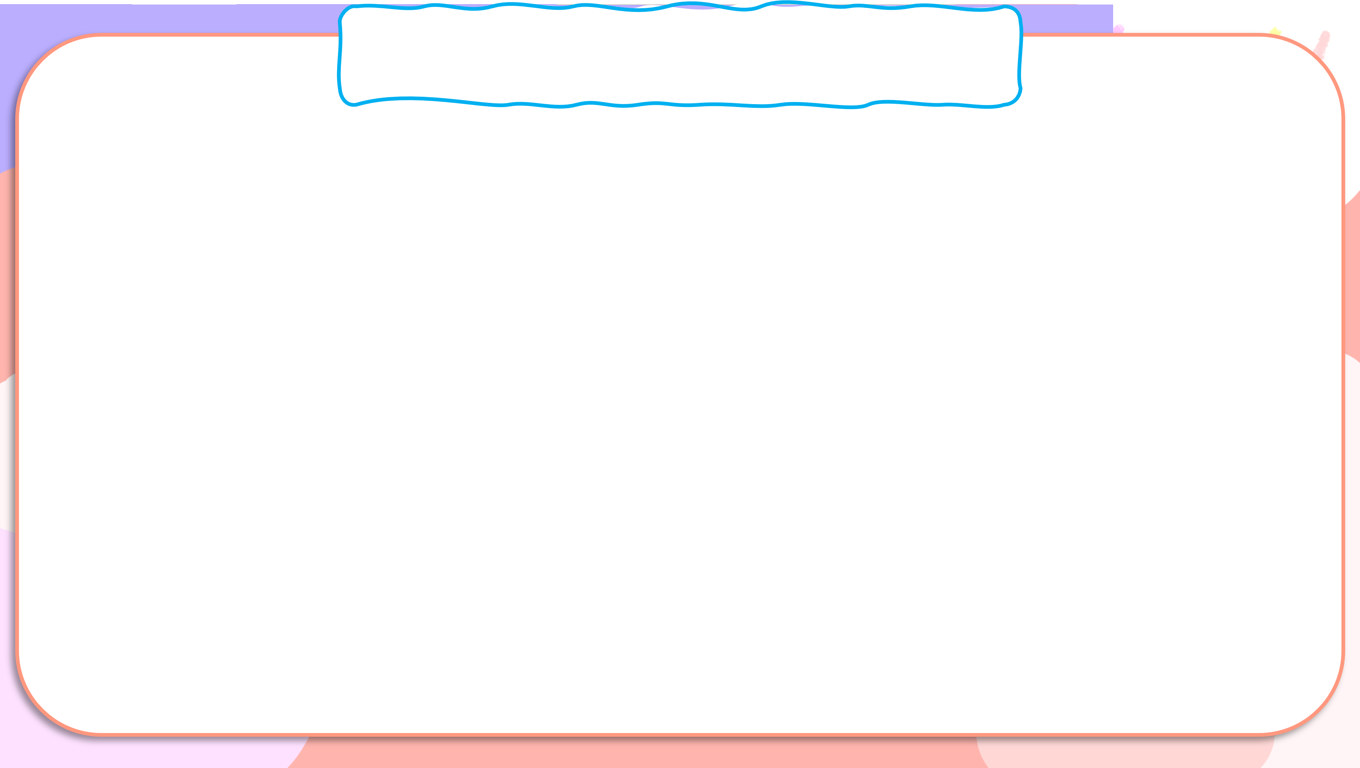
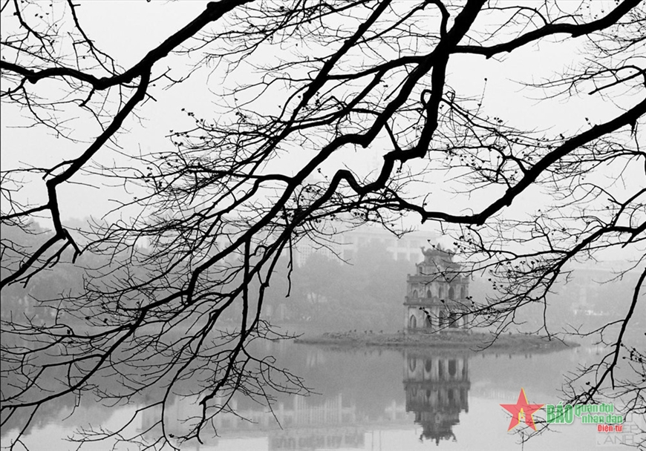

Yes or No?
The weather is hot and sunny in winter.

Slide 7
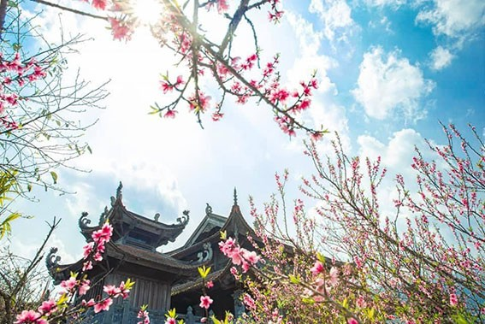
Yes or No?
The weather is warm and sunny in spring.

Slide 8
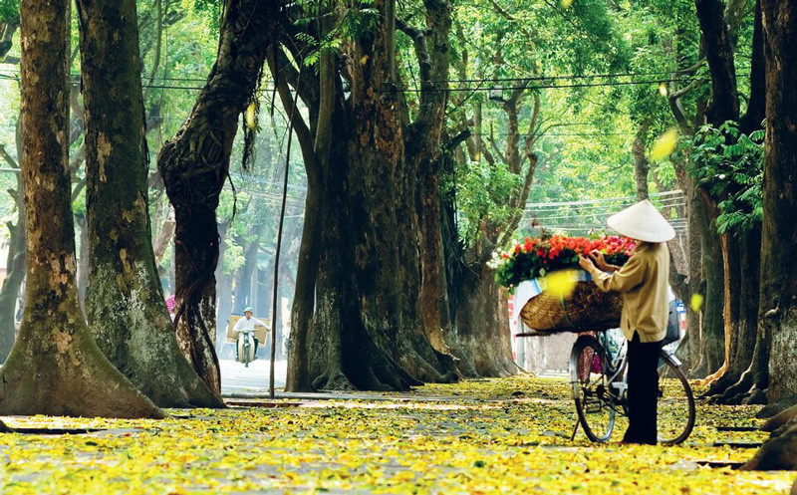
Yes or No?
The weather is cool
and windy in autumn.

Slide 9
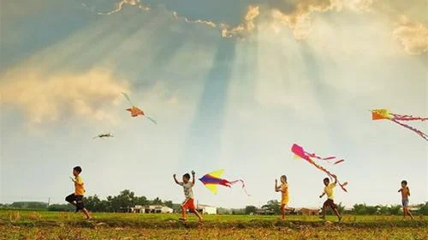
Yes or No?
The weather is cold
and snowy in summer.

Slide 10

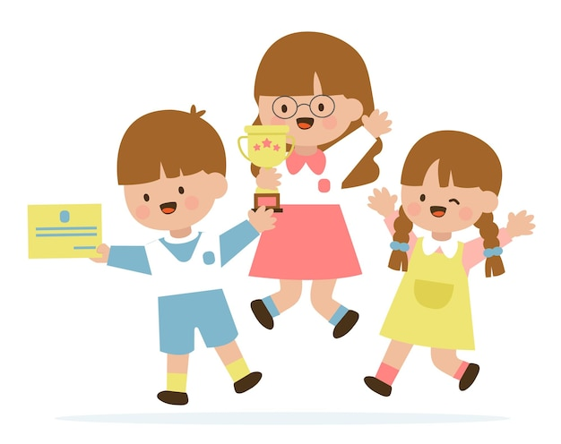

Slide 11
02
Look, listen and repeat.

Slide 12

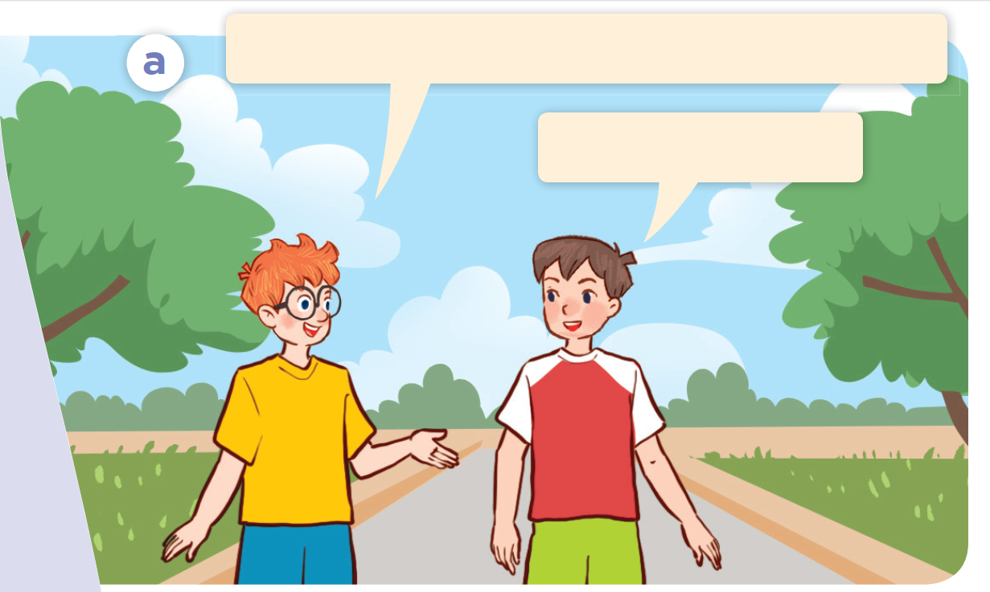
Look.

Slide 13
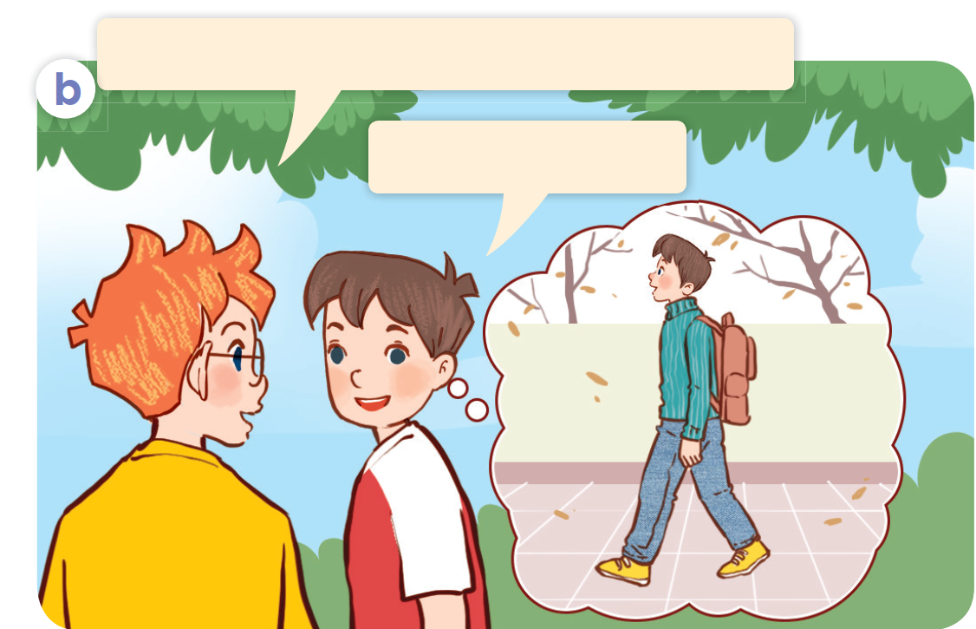
Look.

Slide 14

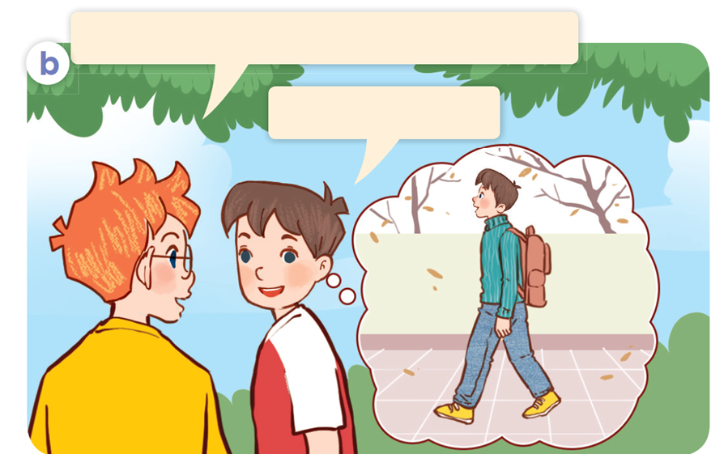
Look, listen and repeat.

Slide 15
Look, listen and repeat.
How’s the weather in Ha Noi in winter?
It’s cold and dry.
Notes:
Click vào từng câu hội thoại để nghe lại.

Slide 16
Look, listen and repeat.
What do you usually wear in winter?
I wear a jumper.
Notes:
Click vào từng câu hội thoại để nghe lại.

Slide 17
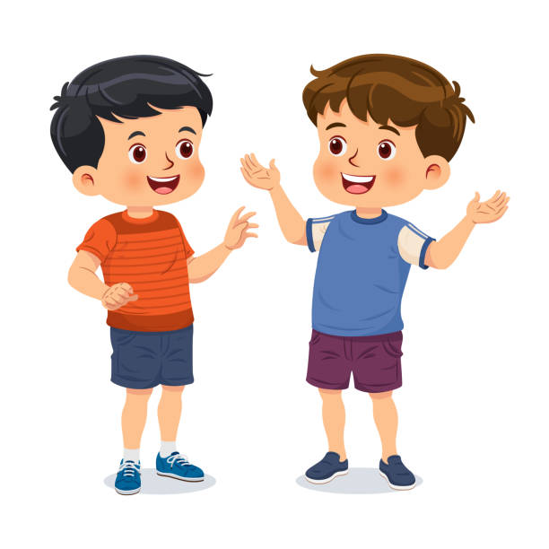
Notes:
Click vào từng câu hội thoại để nghe lại.

Slide 18

Look, listen and repeat.
How’s the weather in Ha Noi in winter?
What do you usually wear in winter?
It’s cold and dry.
I wear a jumper.

Slide 19
03
Listen, point and say.

Slide 20
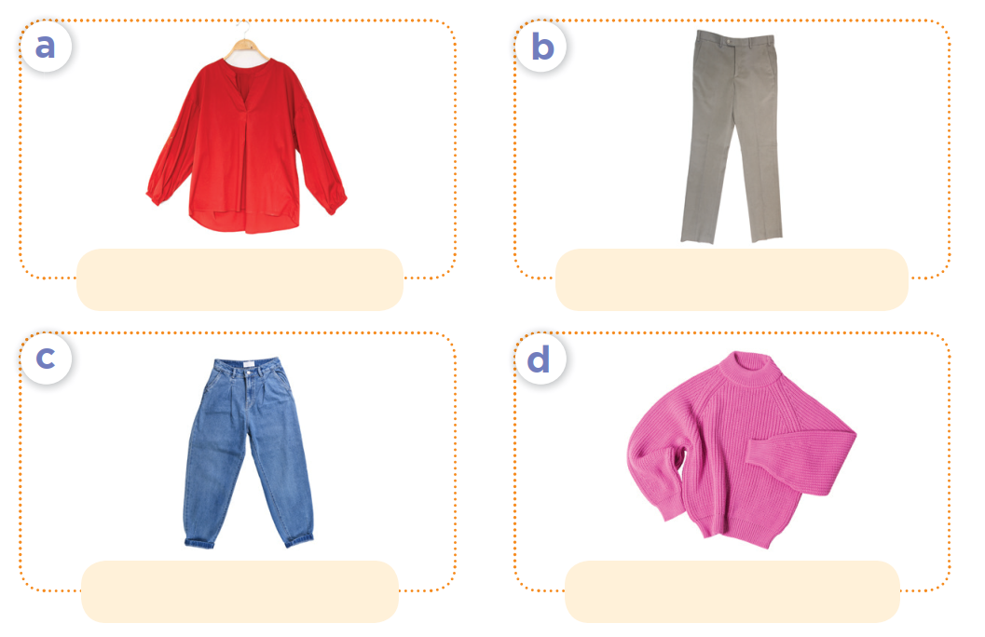
Listen, point and say.

Slide 21
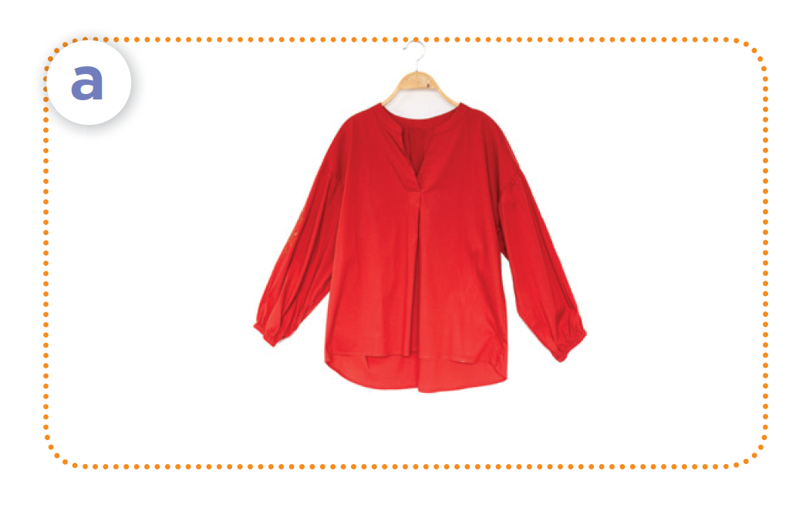
Listen, point and say.
spring / a blouse

Slide 22
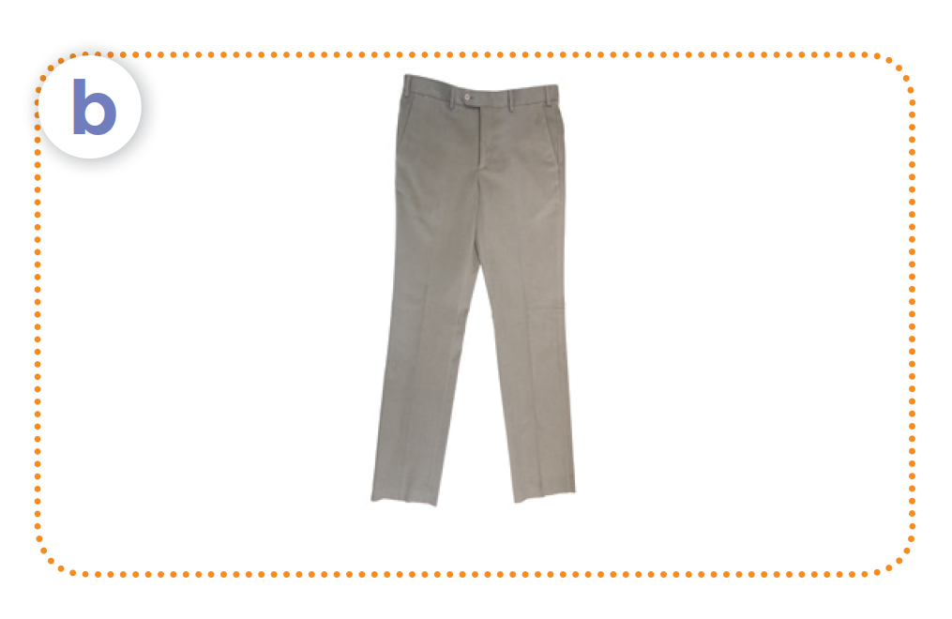
Listen, point and say.
summer / trousers

Slide 23
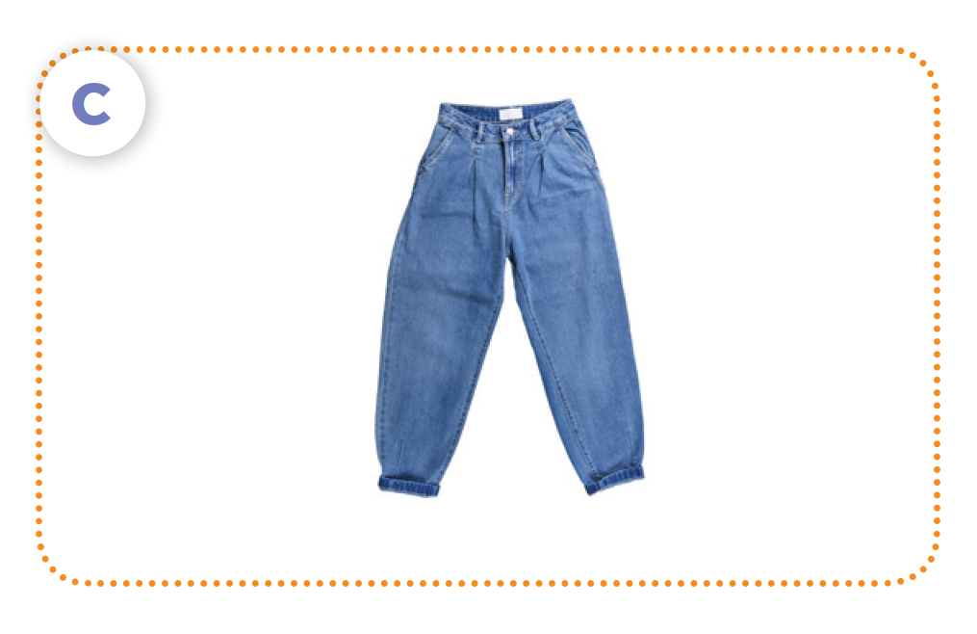
Listen, point and say.
autumn / jeans

Slide 24
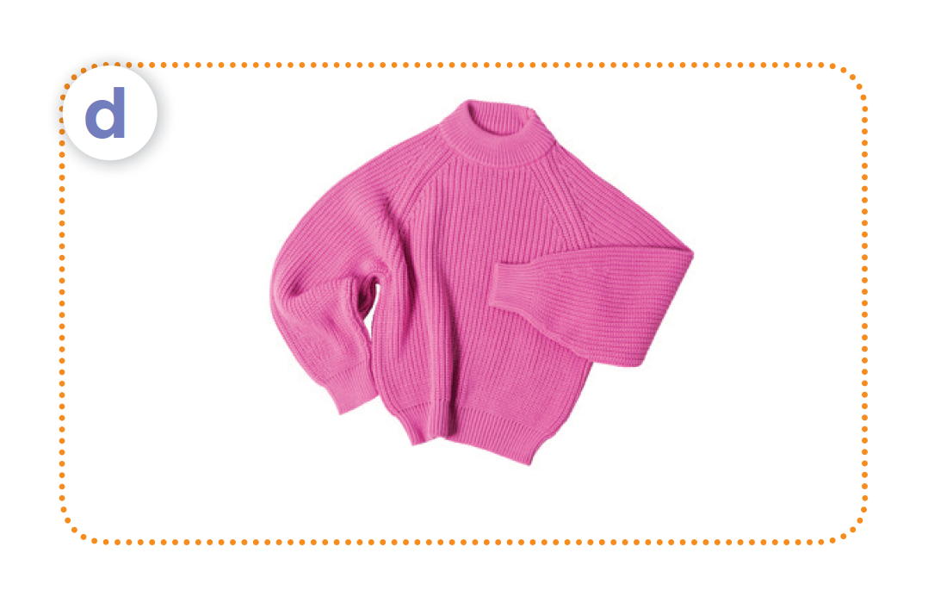
Listen, point and say.
winter / a jumper

Slide 25

What do you usually wear in ___?
I wear ____.

Slide 26
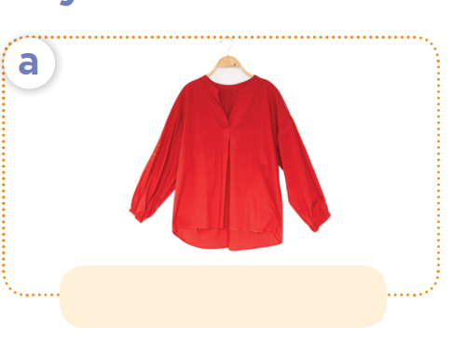
Listen, point and say.
What do you usually wear in spring?
I wear a blouse.
spring / a blouse

Slide 27
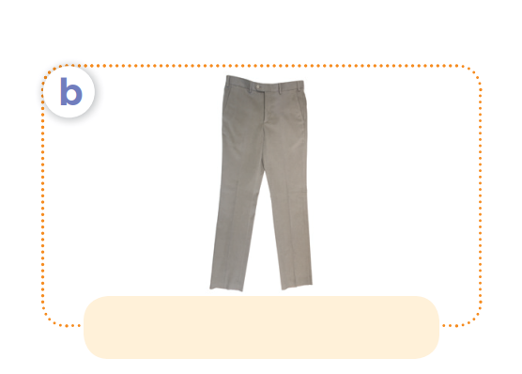
Listen, point and say.
What do you usually wear in summer?
I wear trousers.
summer / trousers

Slide 28
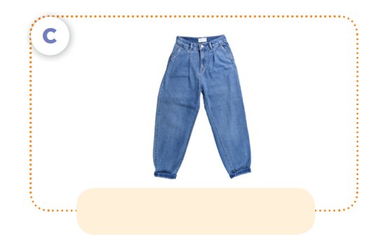
Listen, point and say.
What do you usually wear in autumn?
I wear jeans.
autumn / jeans

Slide 29
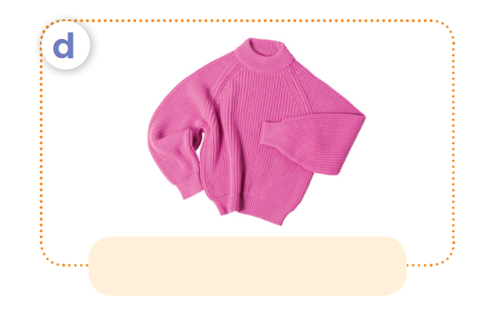
Listen, point and say.
What do you usually wear in winter?
I wear a jumper.
winter / a jumper

Slide 30
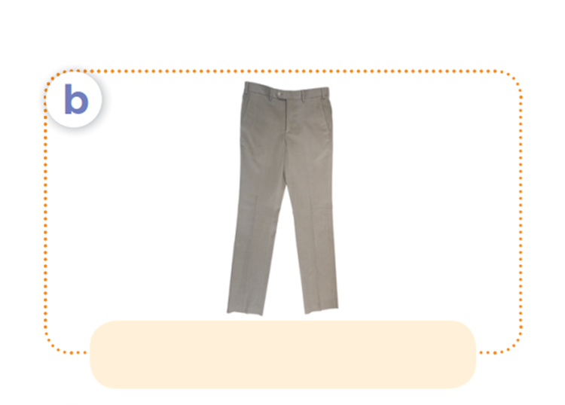
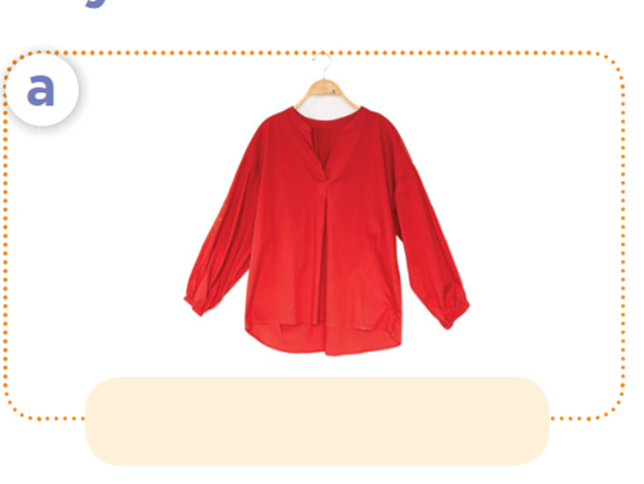

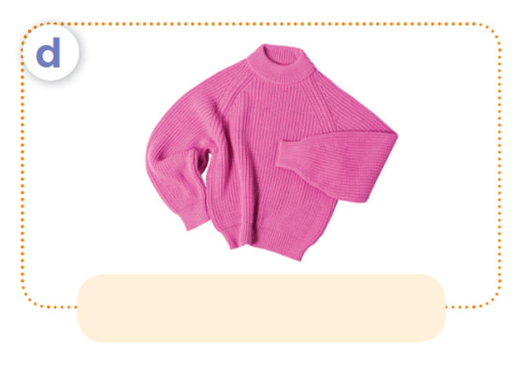
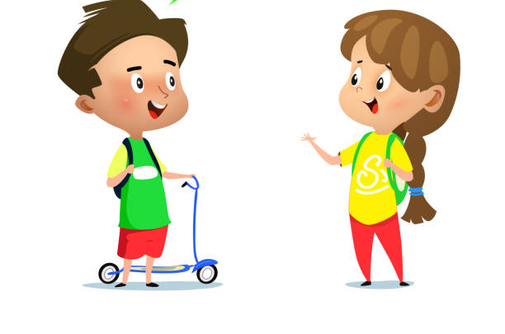
What do you usually wear
in ______?
spring / a blouse
summer / trousers
I wear ____.
autumn / jeans
winter / a jumper

Slide 31
04
Let’s talk.

Slide 32
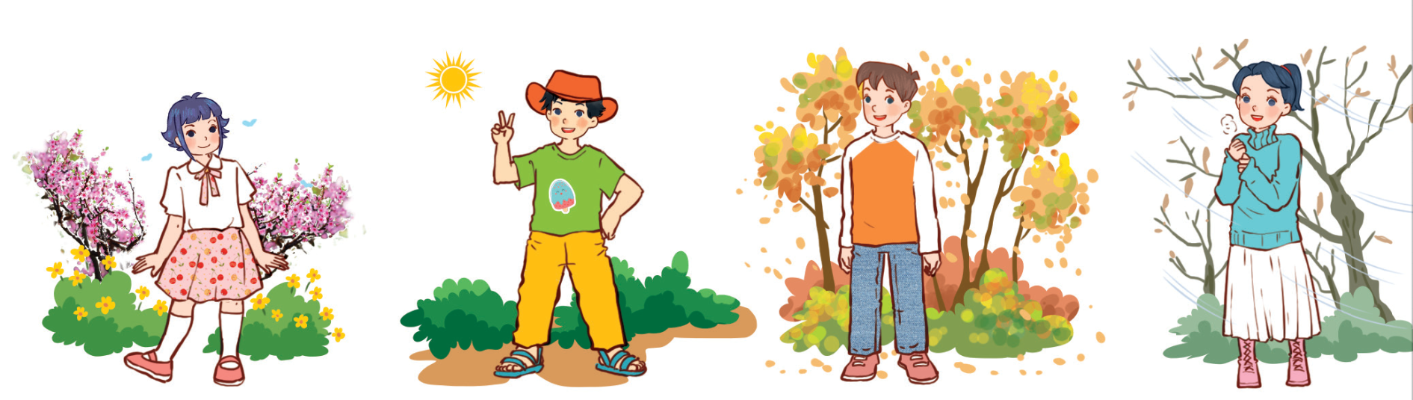
Let’s talk.
What do you usually wear in _____?
_______.

Slide 33
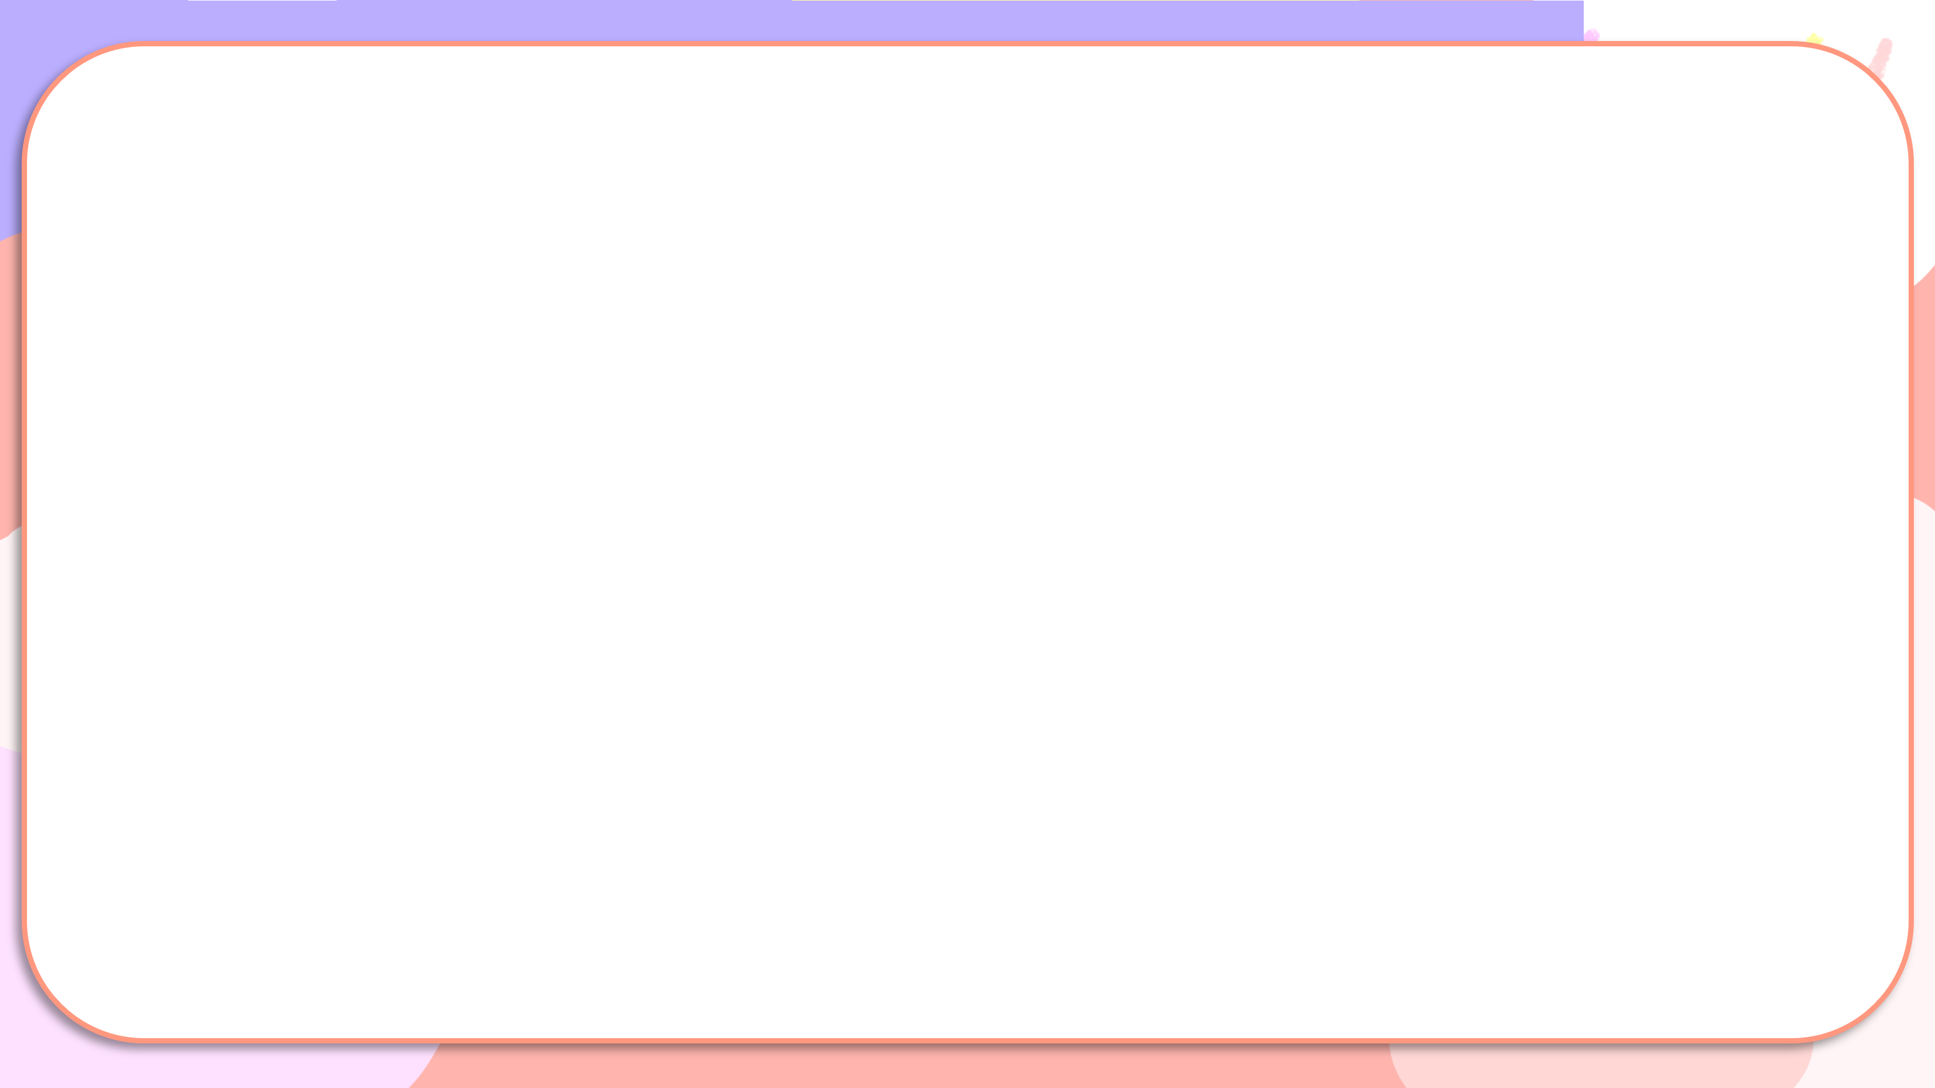


What do you usually wear in _____?
_______.

Slide 34
05
Fun corner and Wrap-up

Slide 35
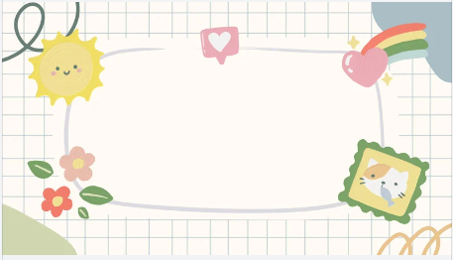


Slide 36

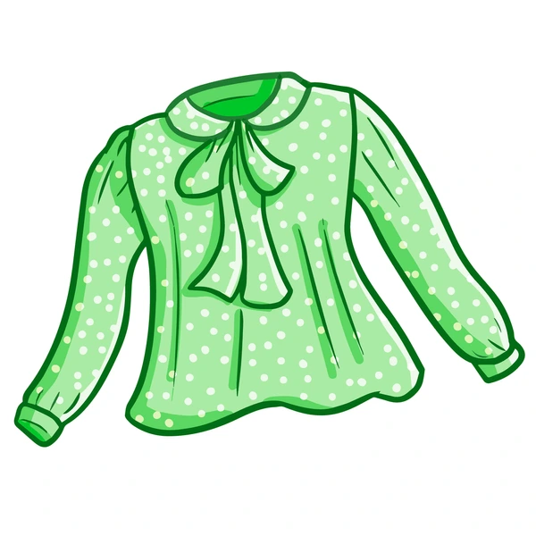
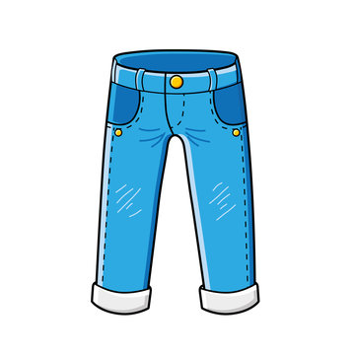

Slide 37
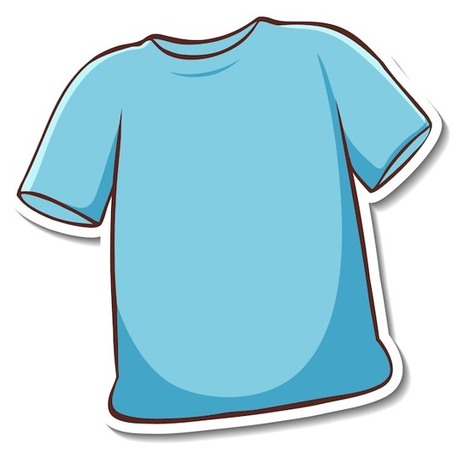
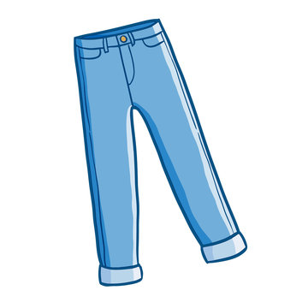

Slide 38
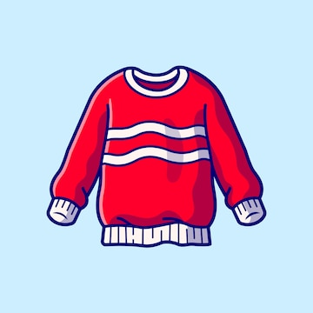
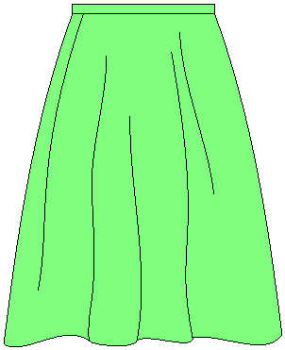

Slide 39
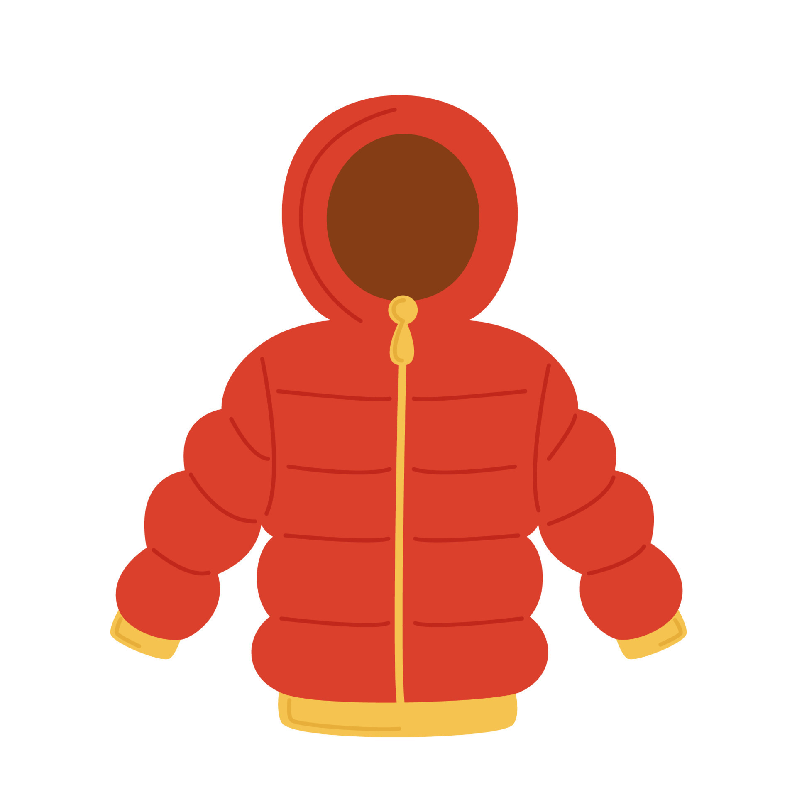
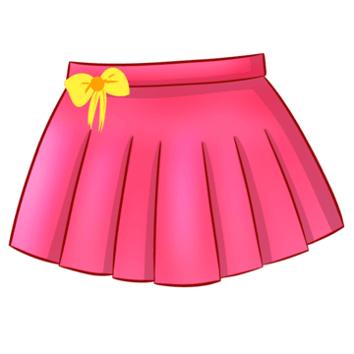

Slide 41


