Slide 1
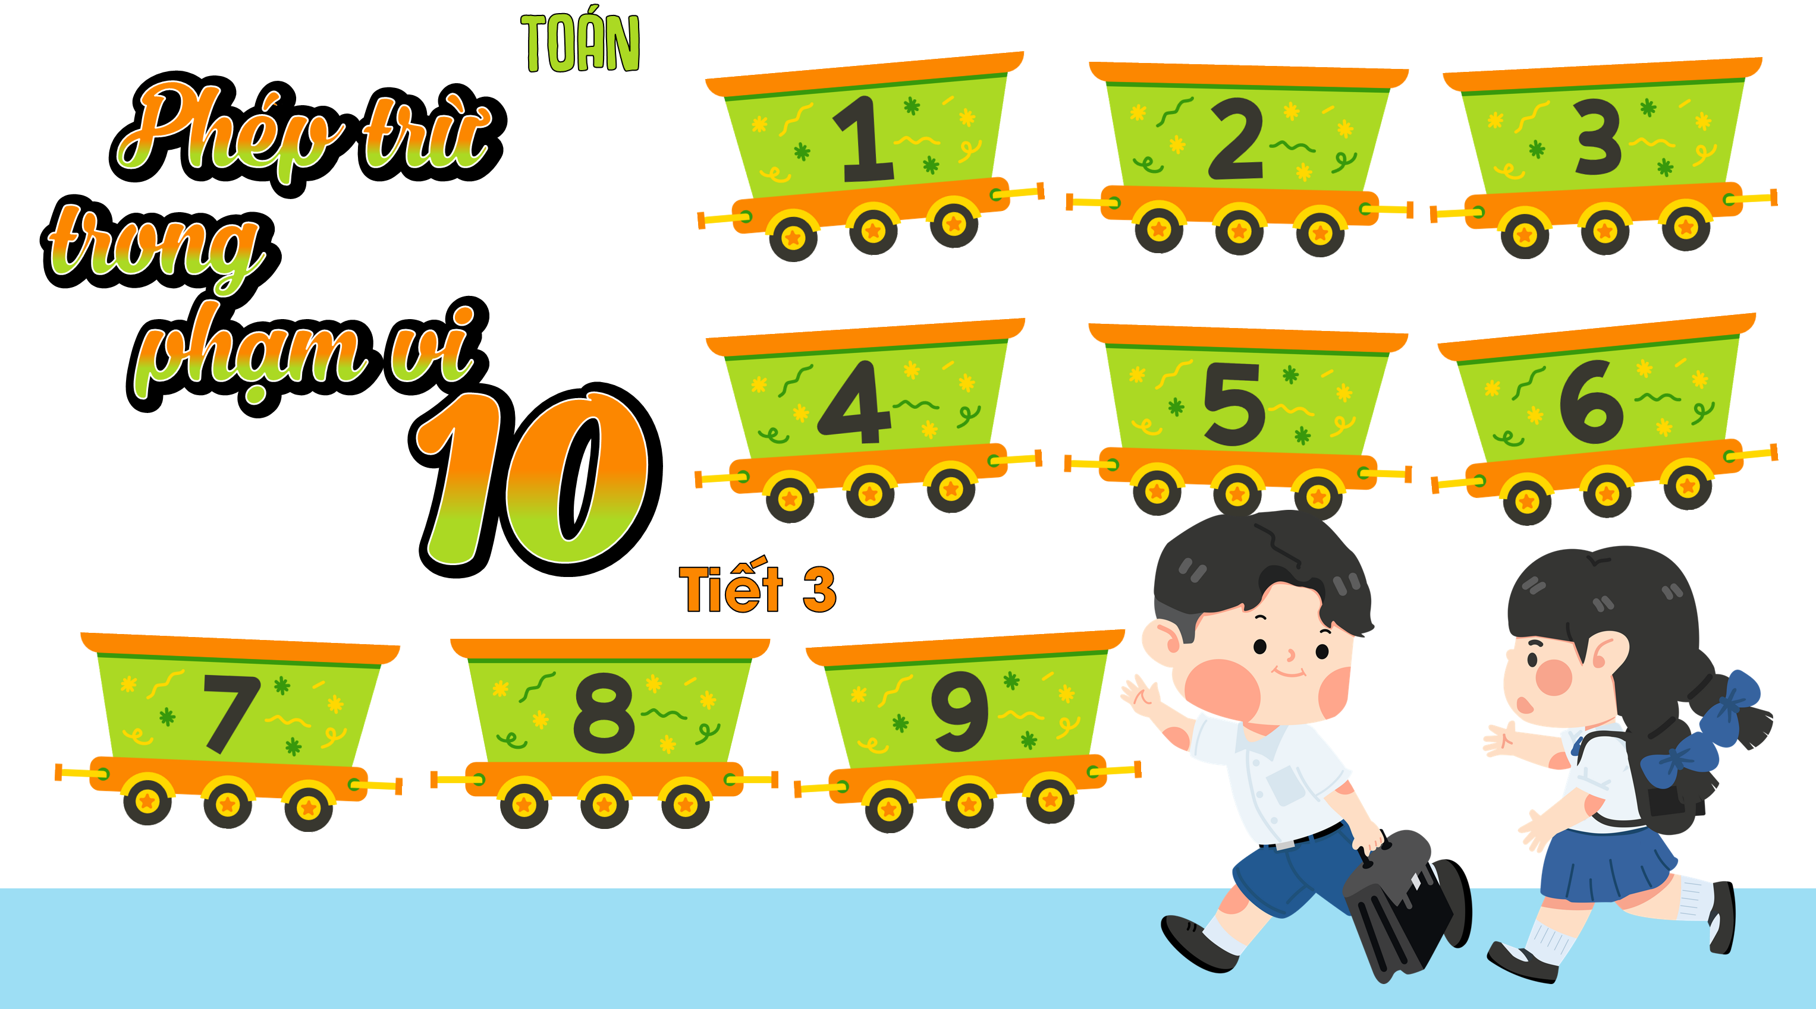

Slide 2

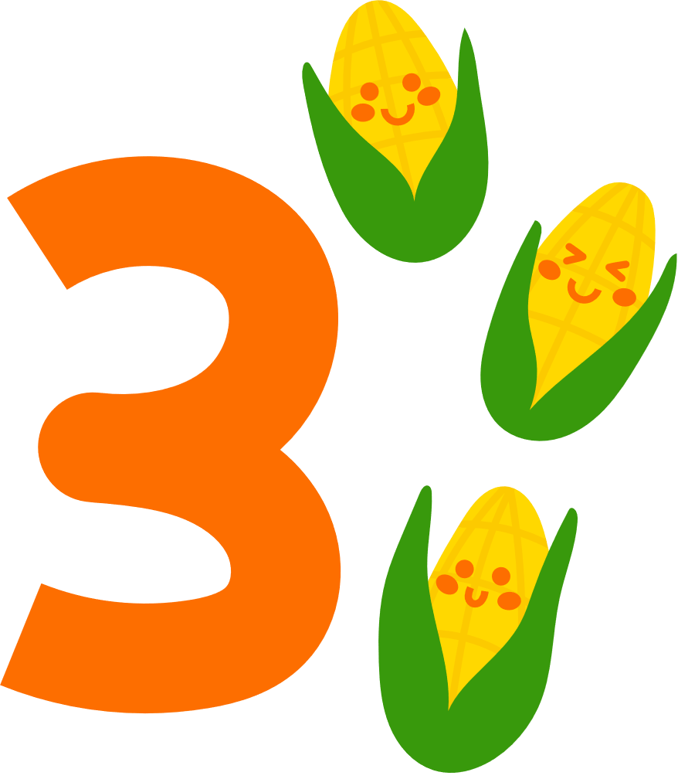
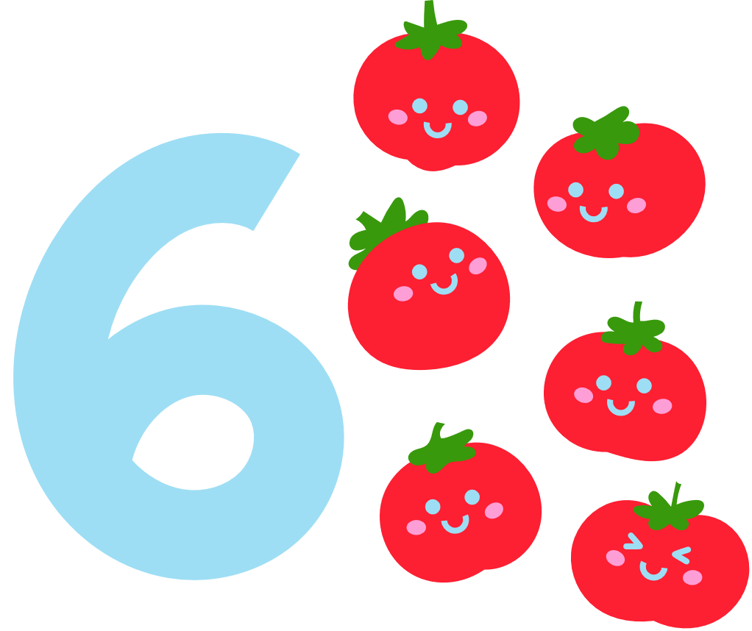
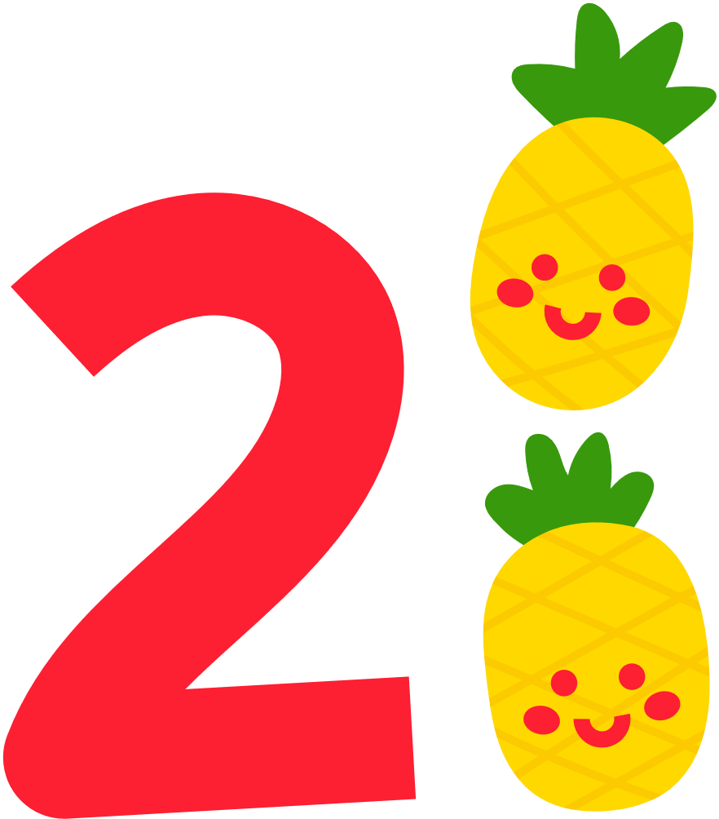
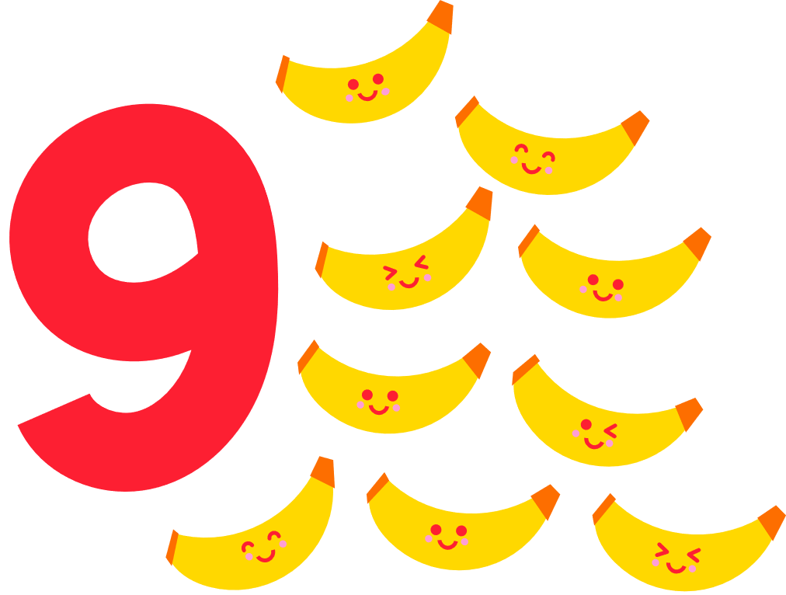

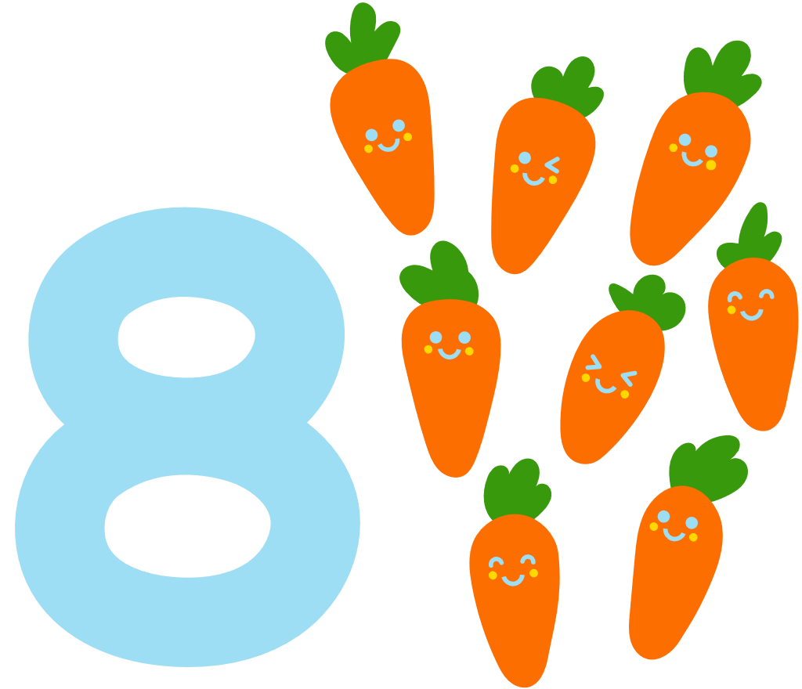
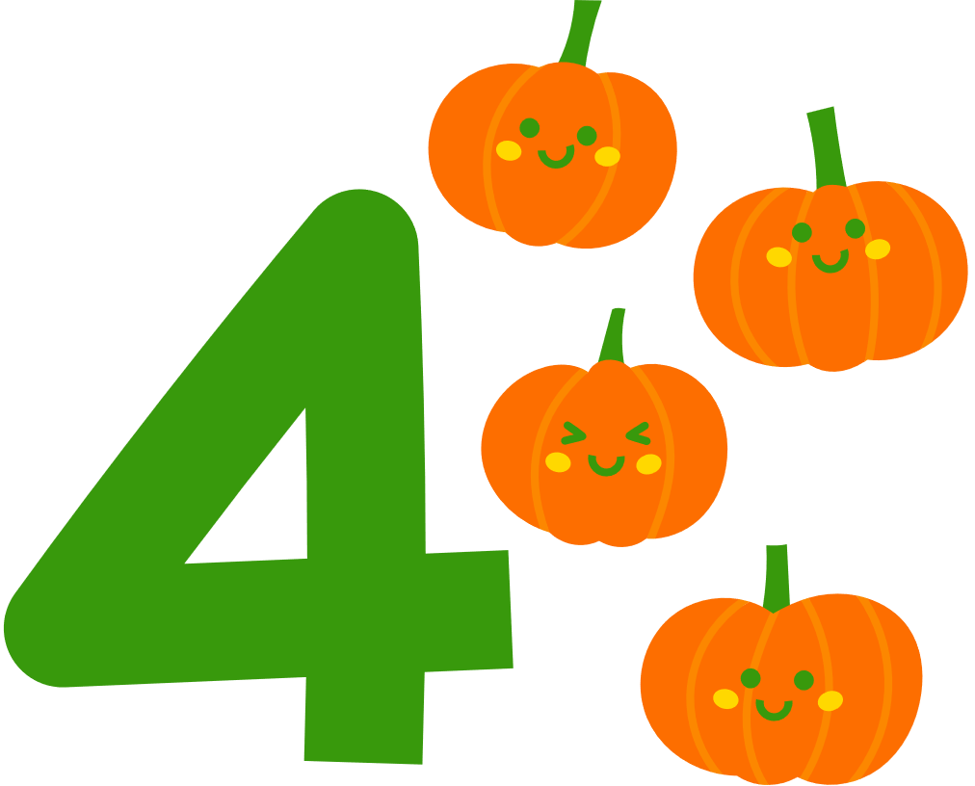
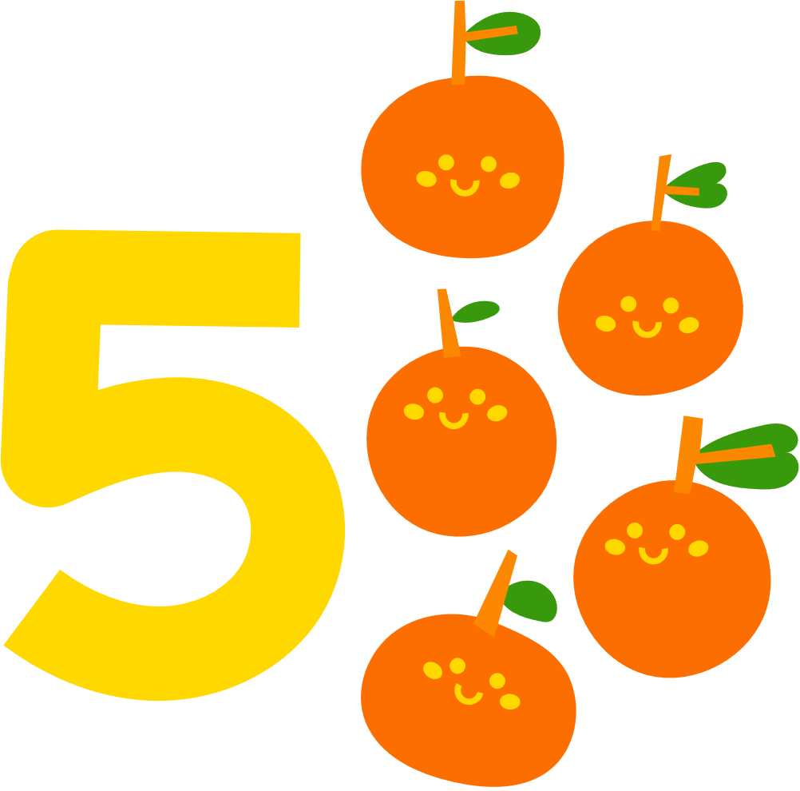
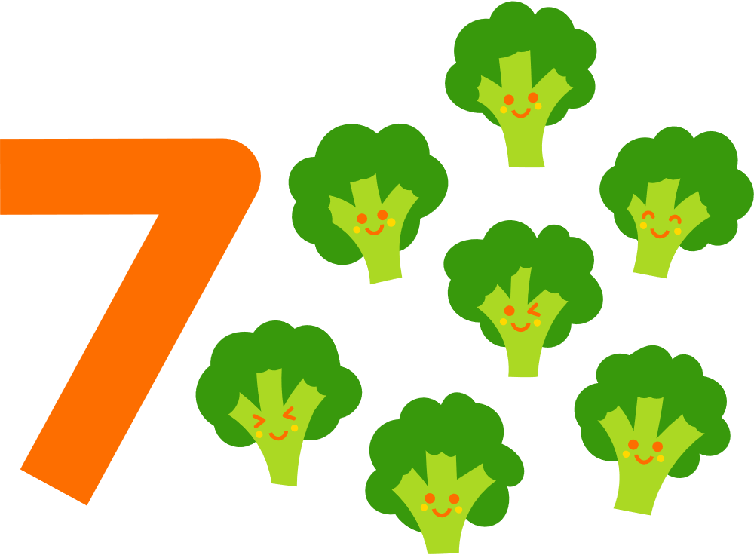



Slide 3




Slide 4
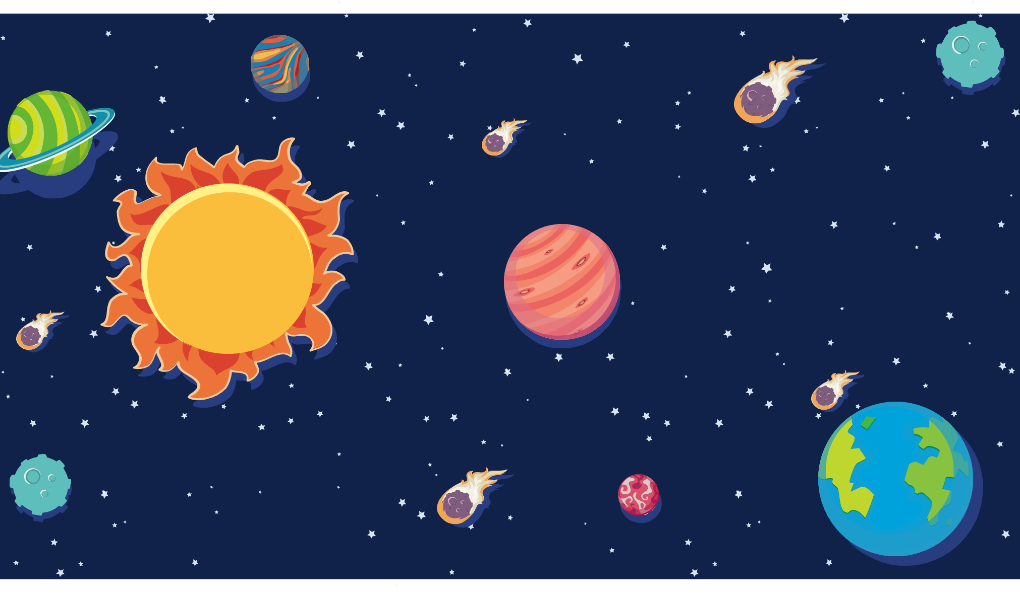



Slide 5

1
3
5
2
4

Slide 6



9 – 5 = ?
5
4
3

Slide 7

1
3
5
2
4

Slide 8
8 – 6 = ?
4
3
2

Slide 9
1
3
5
2
4

Slide 10
7 – 4 = ?
3
1
2

Slide 11
1
3
5
2
4

Slide 12
6 – 3 = ?
4
2
3

Slide 13
1
3
5
2
4

Slide 14
8 – 4 = ?
5
4
3

Slide 15
1
3
5
2
4

Slide 16



