Slide 1
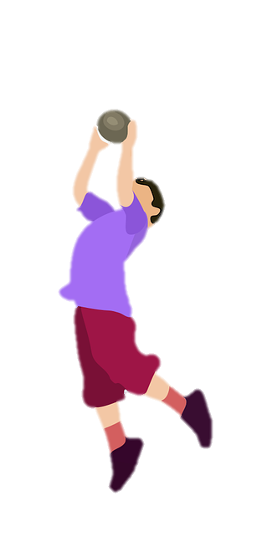
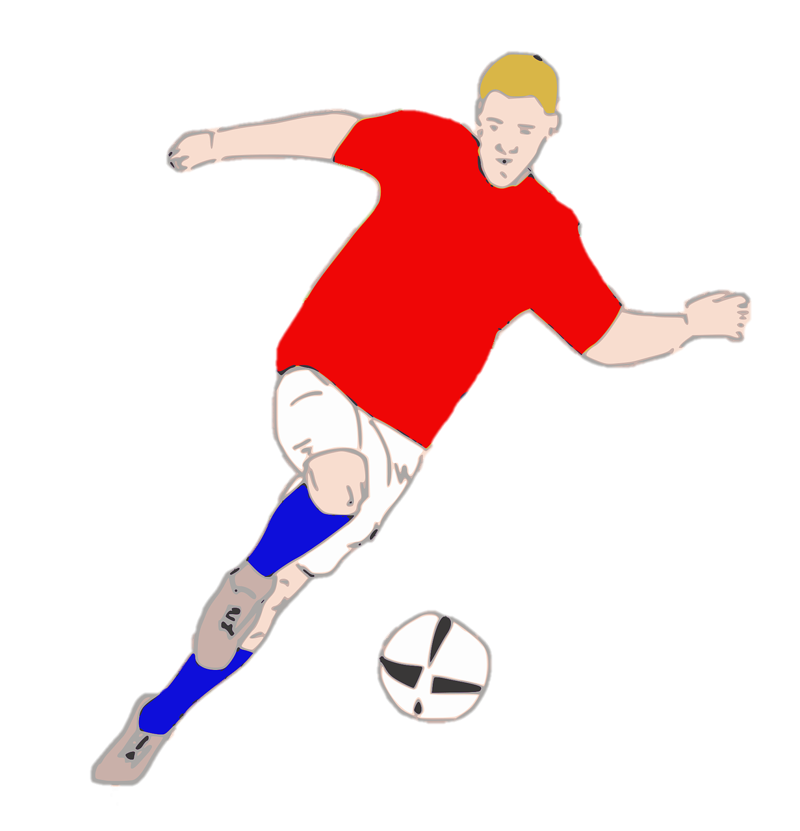
Unit 7:
SPORTS
Lesson 2 – Part 4,5,6

Slide 2
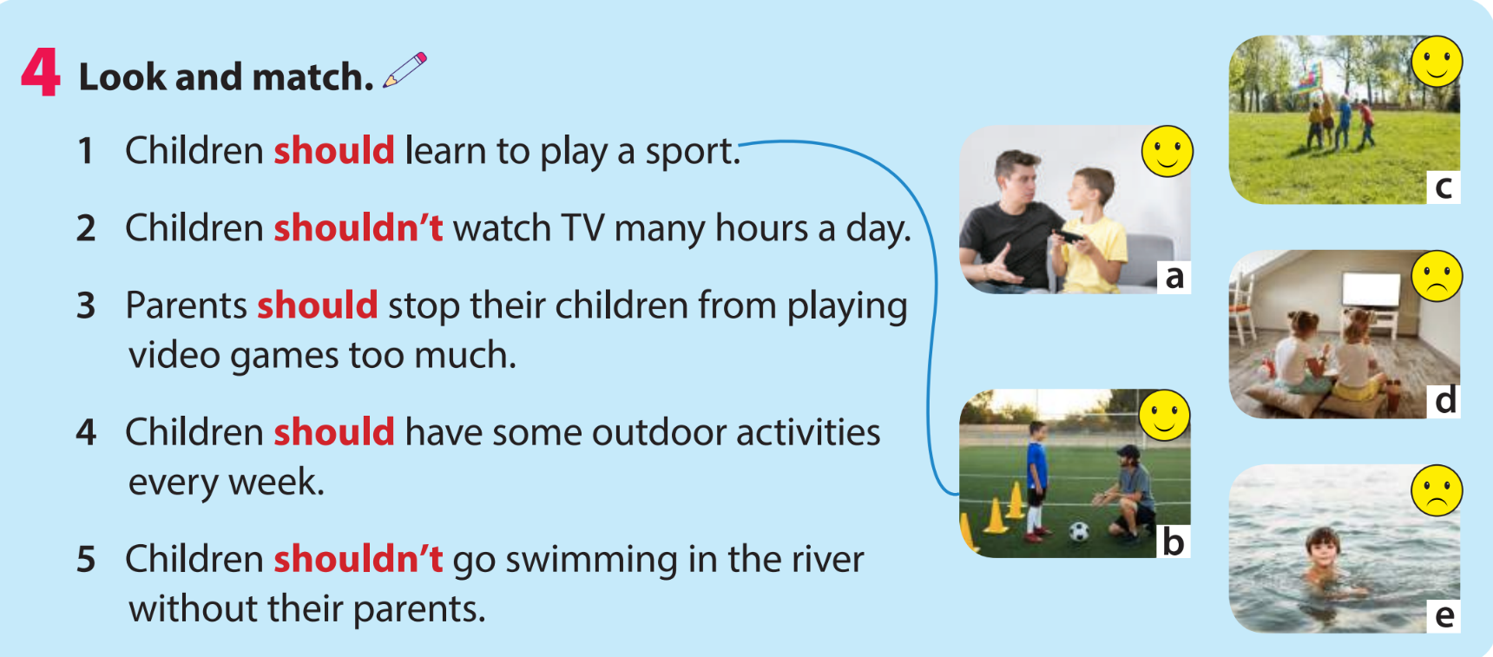

Slide 3

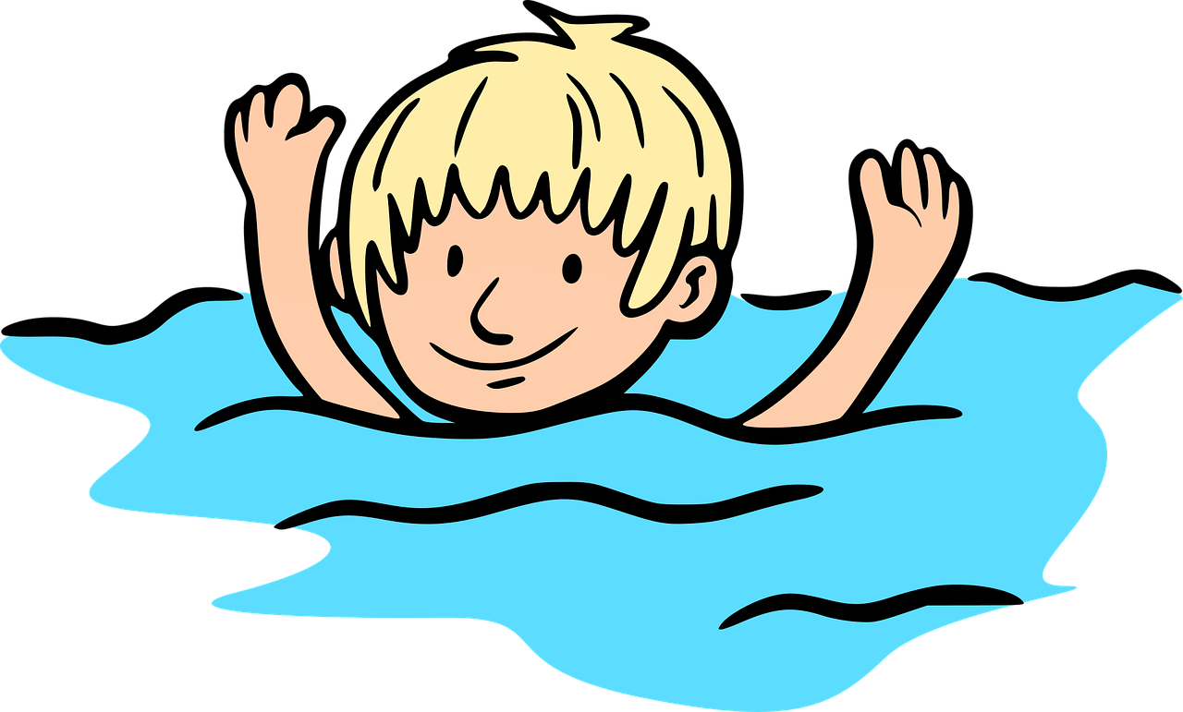

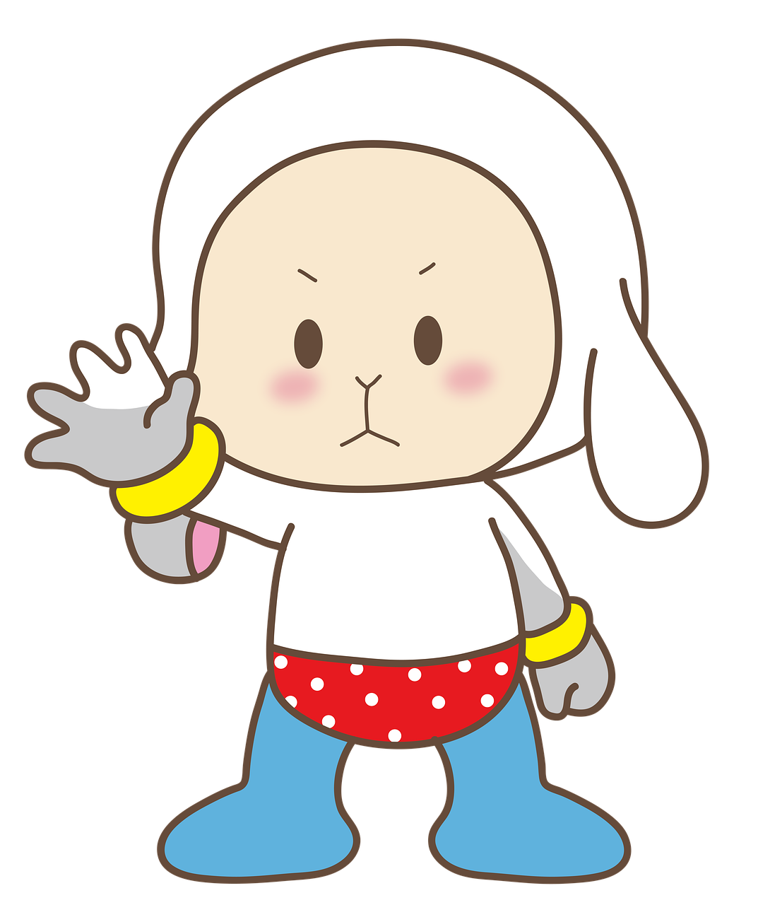
‘should’ or ‘shouldn’t’?
shouldn’t
You _______ swim alone in the river.

Slide 4


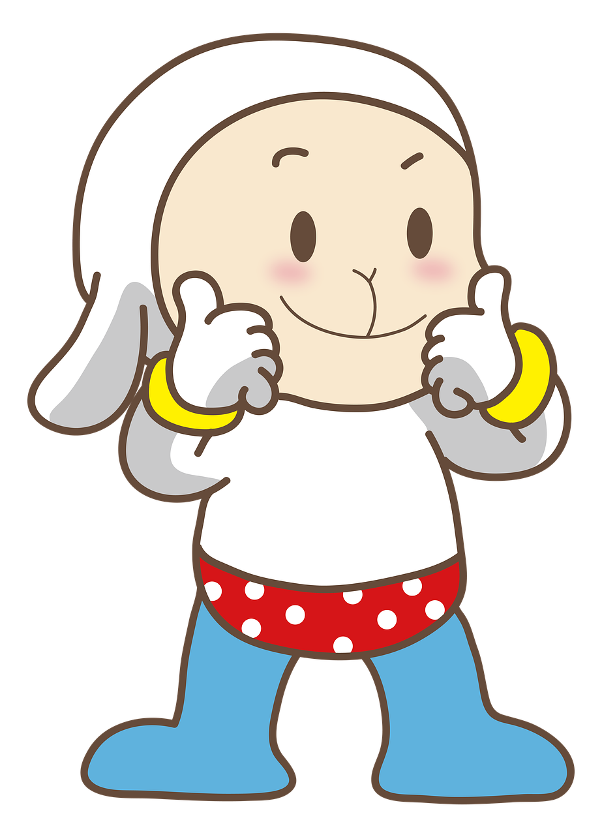
‘should’ or ‘shouldn’t’?
should
You ______ do your homework.

Slide 5
‘should’ or ‘shouldn’t’?
should
You ______ do your homework.

Slide 6
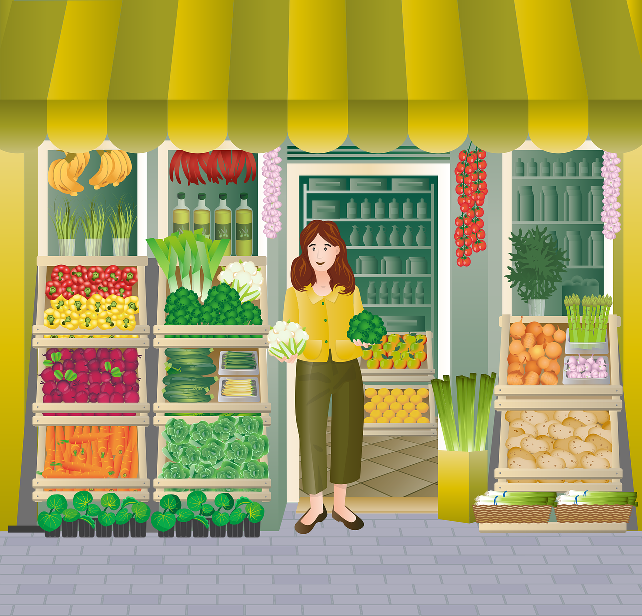
‘should’ or ‘shouldn’t’?
We _____ eat a lot of vegetables.
should

Slide 7
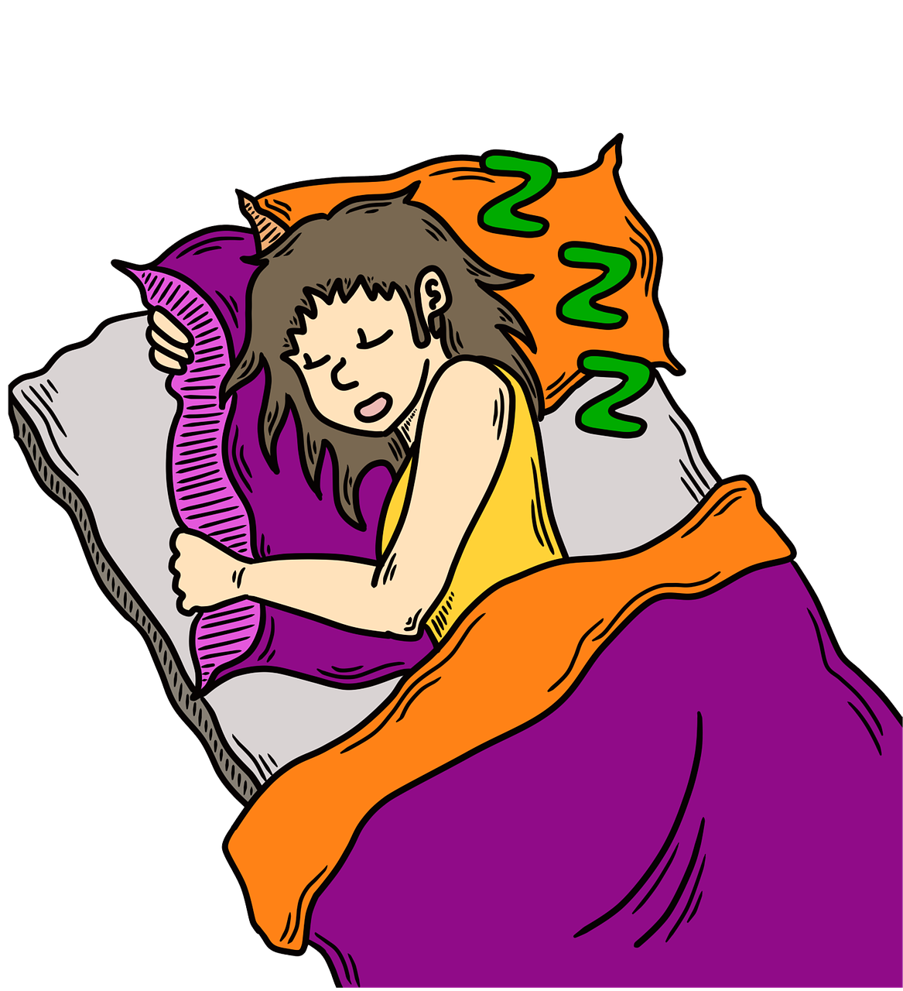
‘should’ or ‘shouldn’t’?
You ________ go to bed late.
shouldn’t

Slide 8
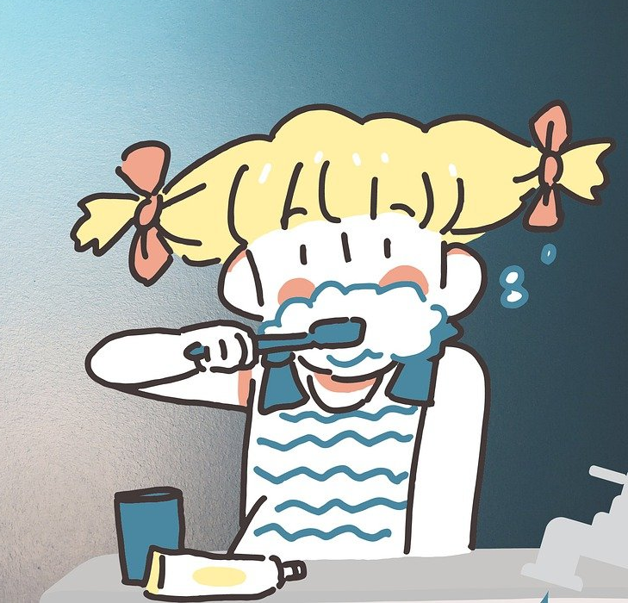
‘should’ or ‘shouldn’t’?
We _____ brush our teeth twice a day.
should

Slide 9

‘should’ or ‘shouldn’t’?
We _______ run in the library.
shouldn’t

Slide 10
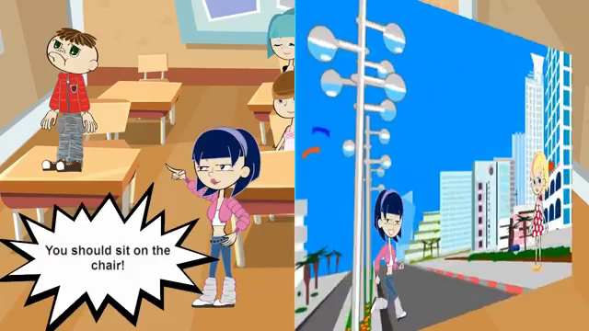

Slide 12

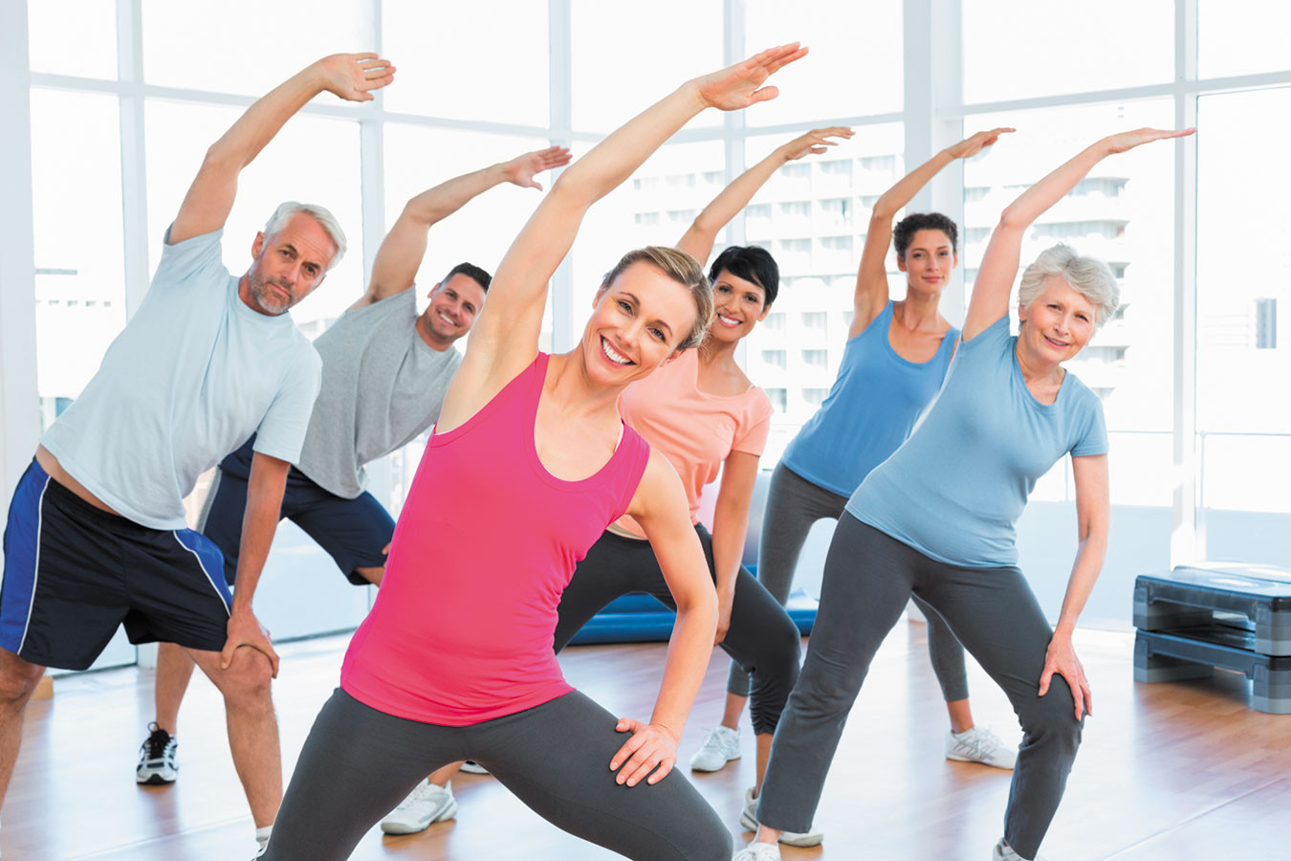
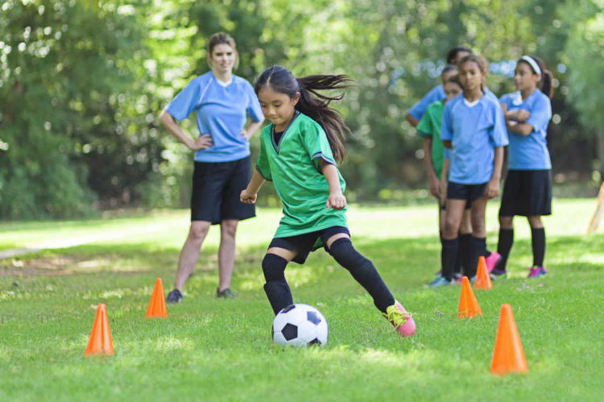
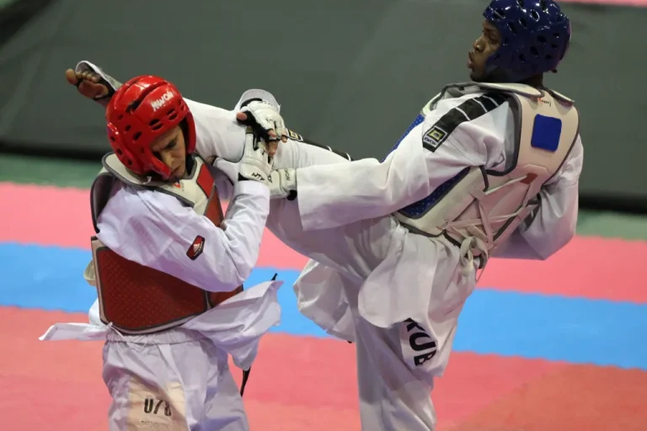
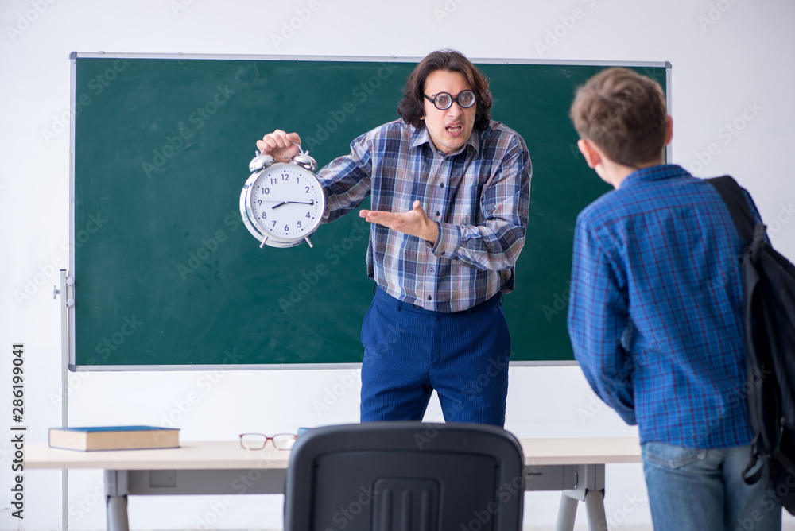
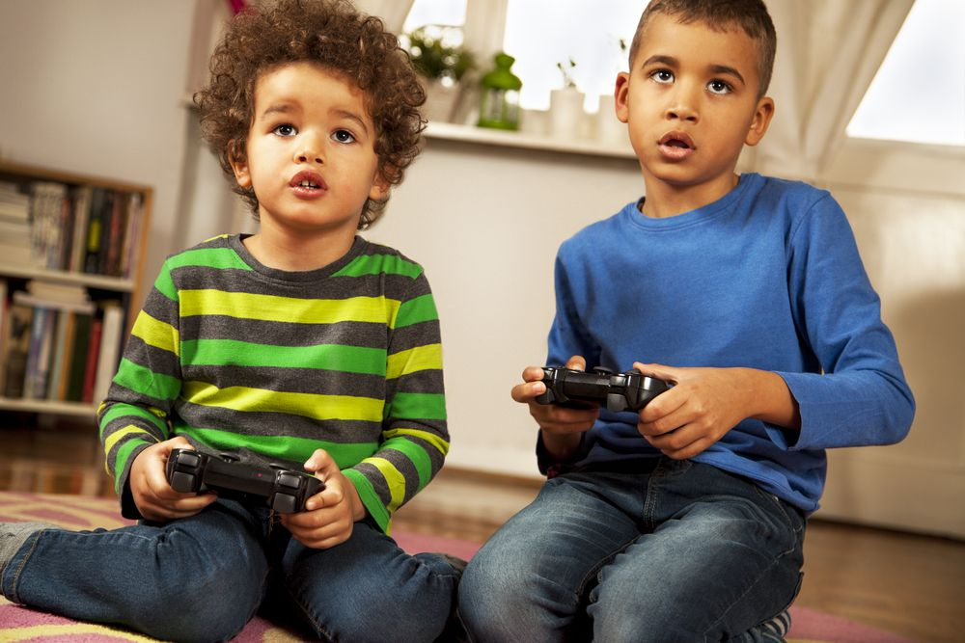
5 Make sentences using should or shouldn’t.
People should do exercise every day.
People / do exercise / every day.
______________________________________________
Children / learn / sports.
______________________________________________
In taekwondo / people / control / movements.
______________________________________________
Students / not / be late / school.
______________________________________________
Young people / not / play / video games / too much.
______________________________________________
Children should learn sports.
In taekwondo, people should control (their) movements.
Students should not be late for school.
Young people should not play video games too much.

Slide 13

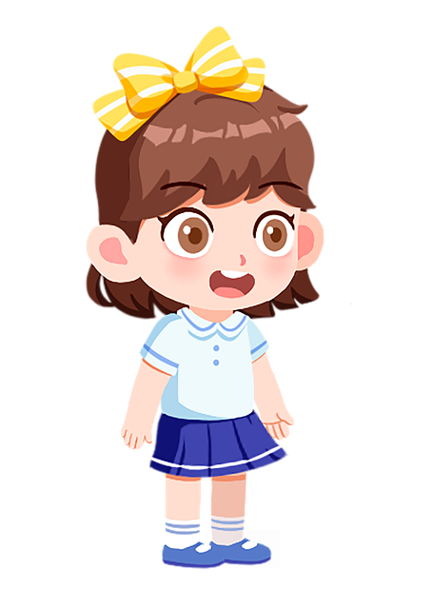

6 Let’s talk.
What should we do to stay healthy?
We should do exercise every day.
I should do exercise every day.
I should learn sports.
I shouldn’t be late for school.
I shouldn’t play video games too much.

