Slide 1



5
My future job
Lesson 1 - Period 2
School: Hoa Nghia Primary School Teacher: Tran Thi Quynh

Slide 2
TABLE OF CONTENTs
01. Warm-up
02. Listen and number.
03. Read and complete.
04. Listen, complete and sing.
05. Fun corner and wrap-up

Slide 3
01.
Warm-up

Slide 4
I would like to be a ______.
firefighter

Slide 5
I would like to be a ______.
writer

Slide 6
I would like to be a ______.
gardener

Slide 7
I would like to be a ______.
teacher

Slide 8
I would like to be a ______.
reporter

Slide 9
I would like to be a ______.
driver

Slide 10
02.
Listen and number.

Slide 11
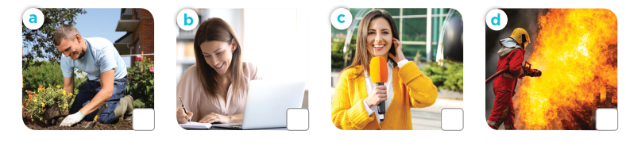
Listen and number.
2
3
1
4
gardener
writer
reporter
firefighter

Slide 12
03.
Read and complete.

Slide 13
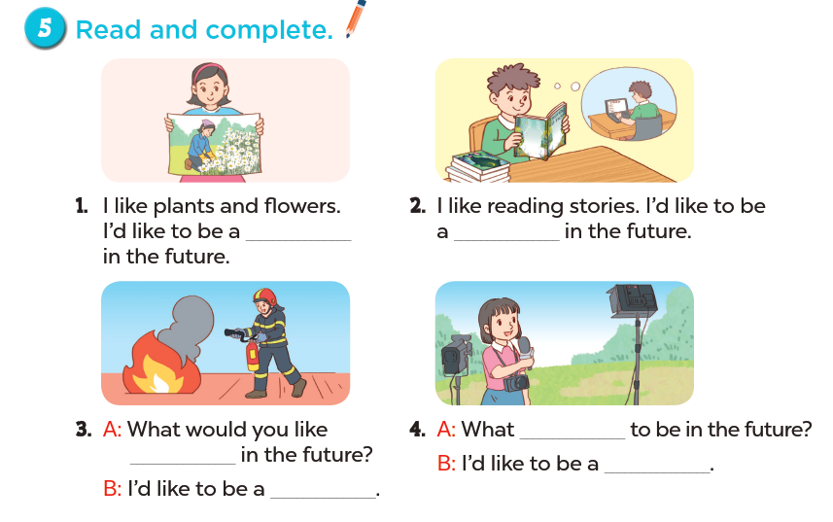
Read and complete.

Slide 14
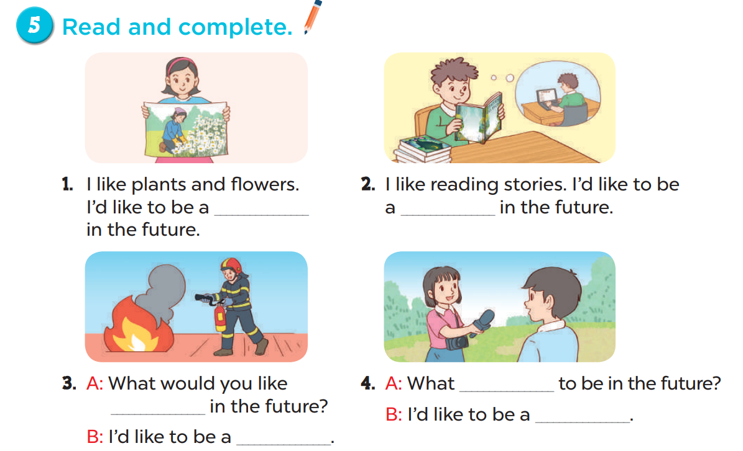
Look and say.
Read and complete.
gardener
writer
would
to be
reporter
firefighter

Slide 15
04.
Listen, complete and sing.

Slide 16
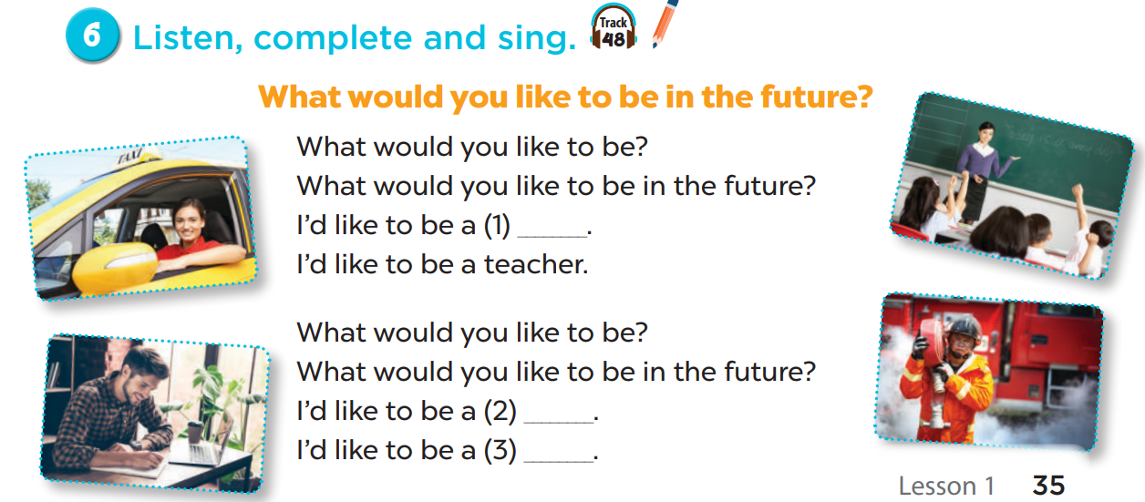
Listen, complete and sing.
firefighter
writer
driver

Slide 17
05.
Fun corner and wrap-up

