Slide 1

Our school rooms
Lesson 3 - Period 5
School: Hoa Nghia Primary School
Teacher: Tran Thi Quynh

Slide 2
Table of contents
01
02
03
04
Let's chant.
Warm up & Review
05
Listen and repeat.
Fun corner
& Wrap up
Circle, listen and check.

Slide 3
01
Warm up & Review

Slide 4
Listen, and clap. How many syllables?
upstairs
along
library
corridor
downstairs
second
sunny
computer
ahead
2 syllables | More than 2 syllables

Slide 5
We say the red part more loudly.
The stress is on the second syllable.
down’stairs
up’stairs
downstairs
upstairs
a’long
a’head
along
ahead
inside
in’side
in’door
indoor

Slide 6
02
Listen and repeat.

Slide 7
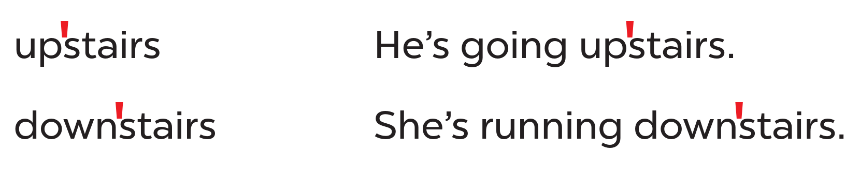
Look at the words and the sentences.
Work in pairs and say.
Listen and repeat.
stress mark

Slide 8
03
Circle, listen and check.

Slide 9
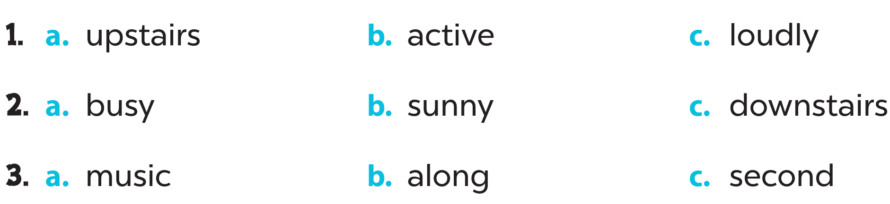
Look and circle.
Listen and check.

Slide 10
04
Let’s chant.

Slide 11
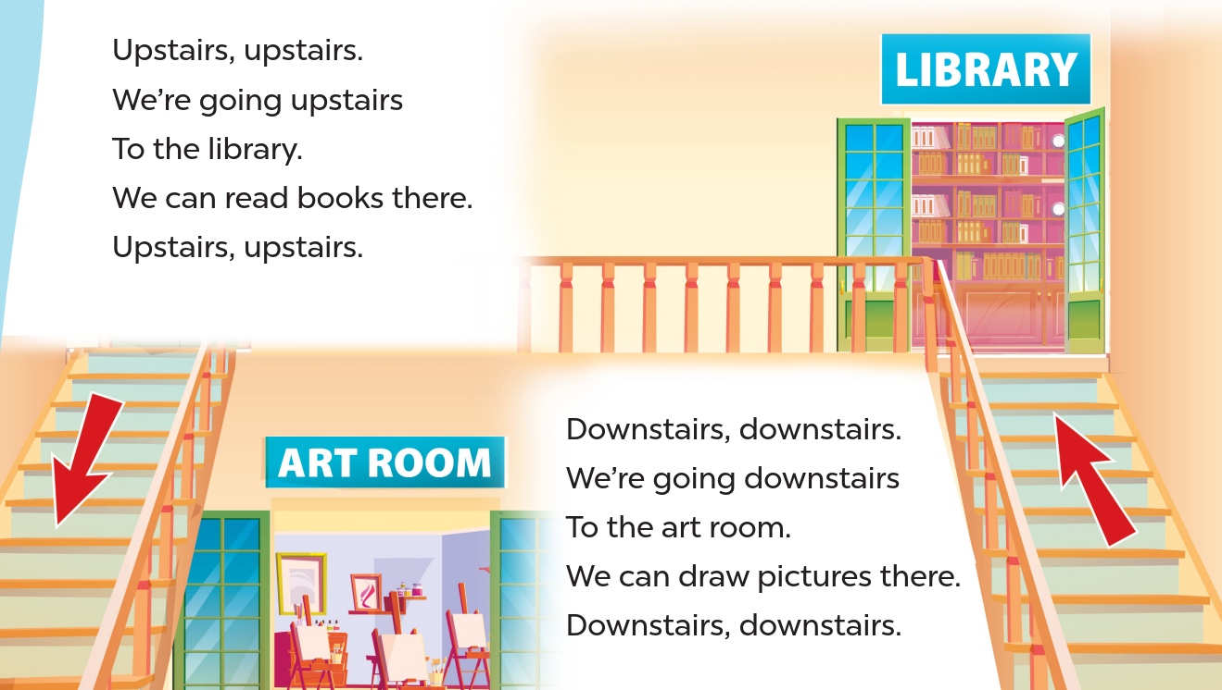
Listen and repeat.
Clap and chant.
Look and read.

Slide 12
05
Fun corner & Wrap up

