Slide 1
Unit 15
OUR
HEALTH
Lesson 3 – Period 5
Hoa Nghia Primary School
Class 5B
Teacher: Pham Thi Thu Trang

Slide 2
01
Warm-up and Review

Slide 3
ZOOM IT IN!
(HEALTH EDITION)

Slide 4
WELCOME!

Slide 5
GUESS
THE ZOOMED PICTURE

Slide 6
ARE YOU READY?

Slide 7
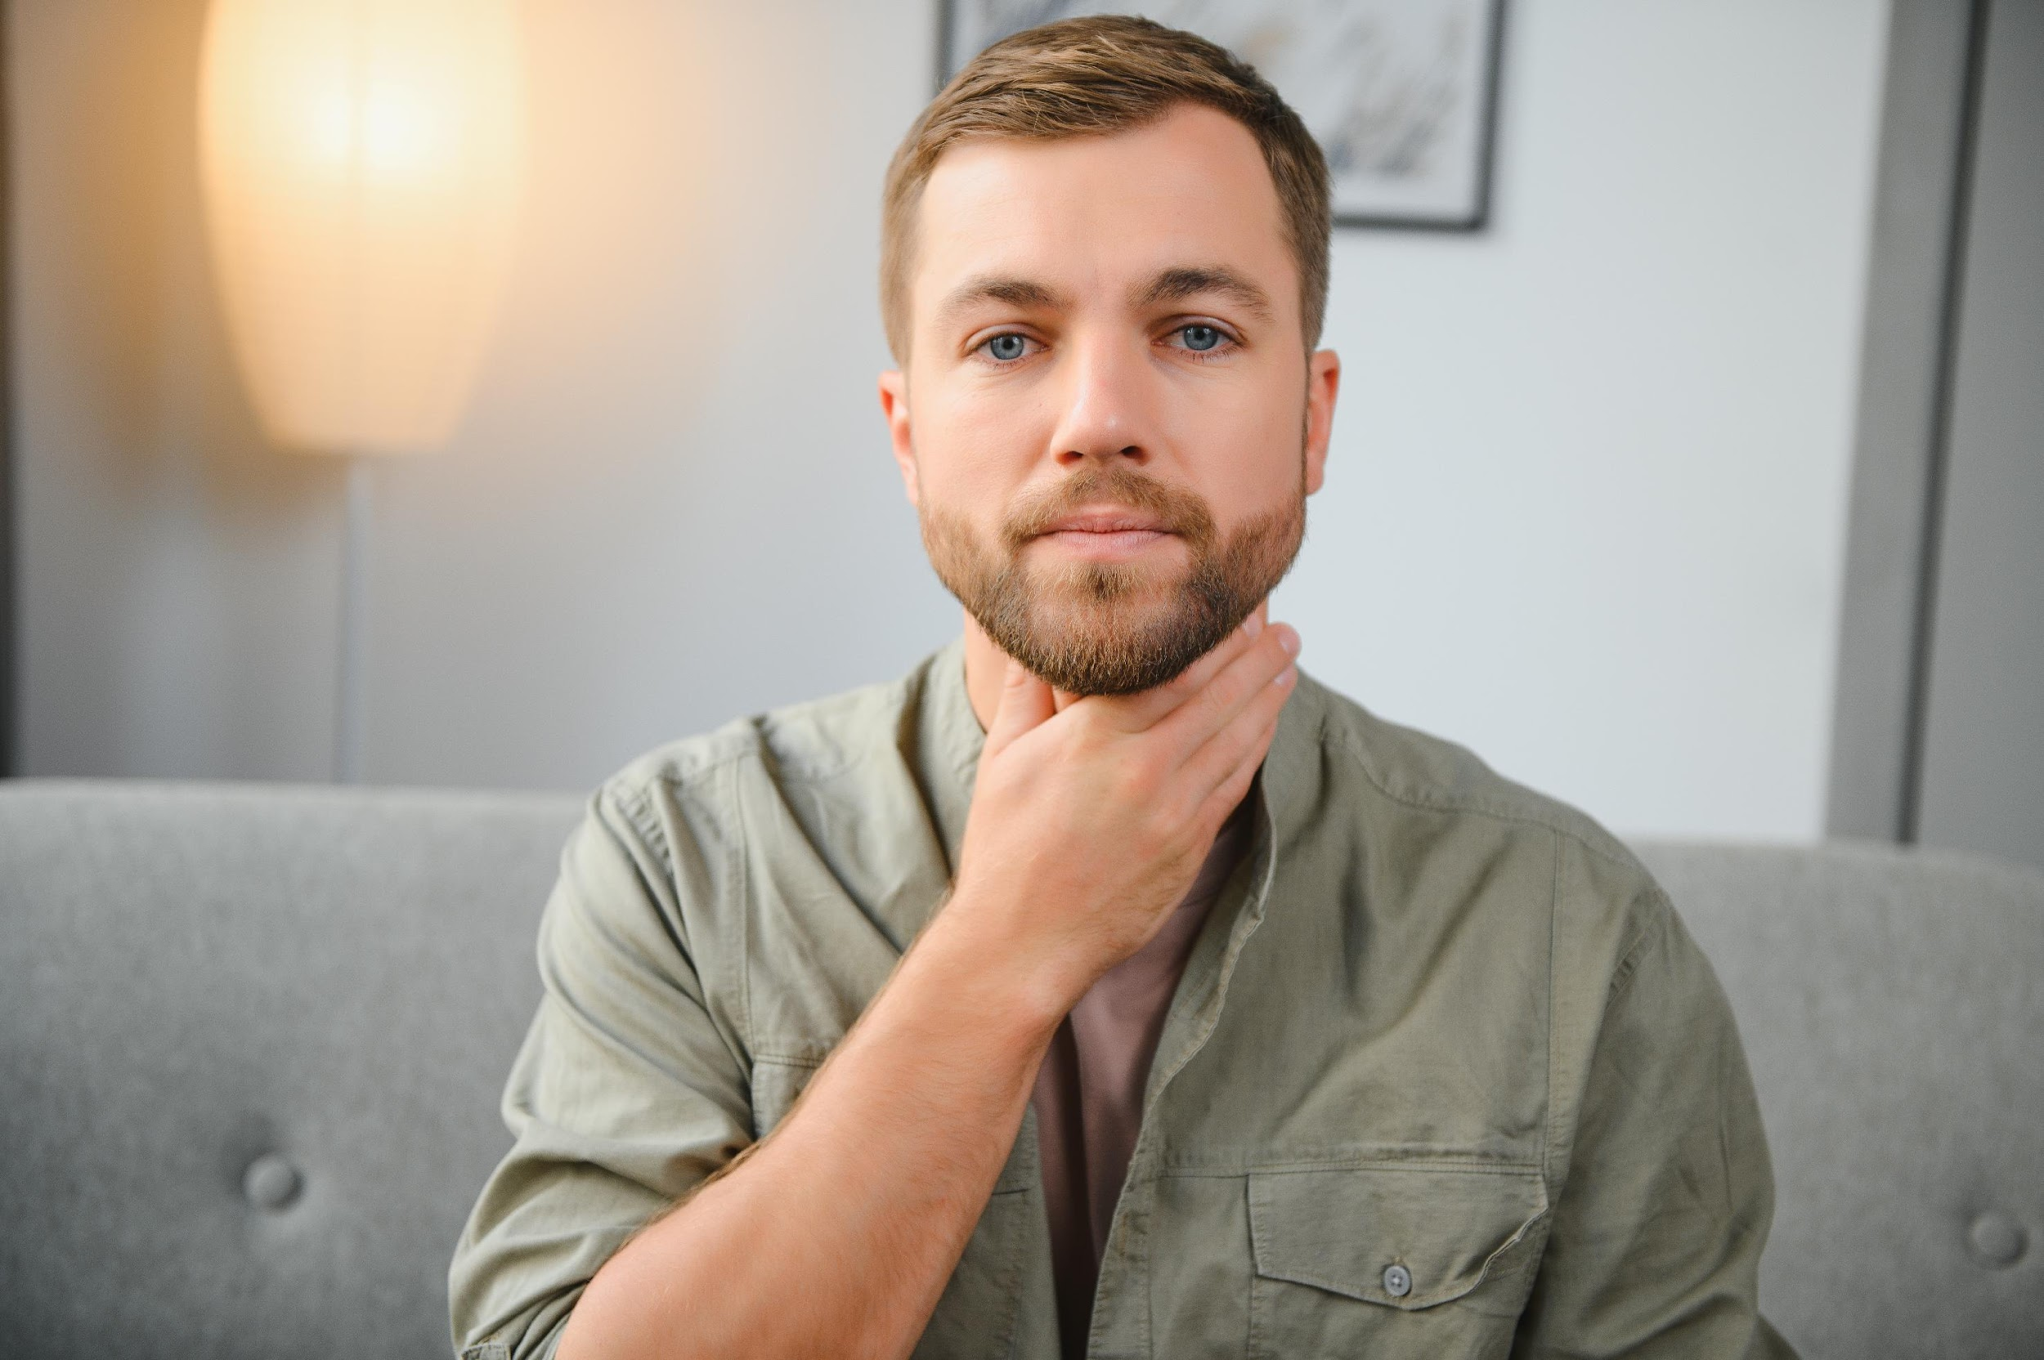

Slide 8

sore throat

Slide 9


Slide 10
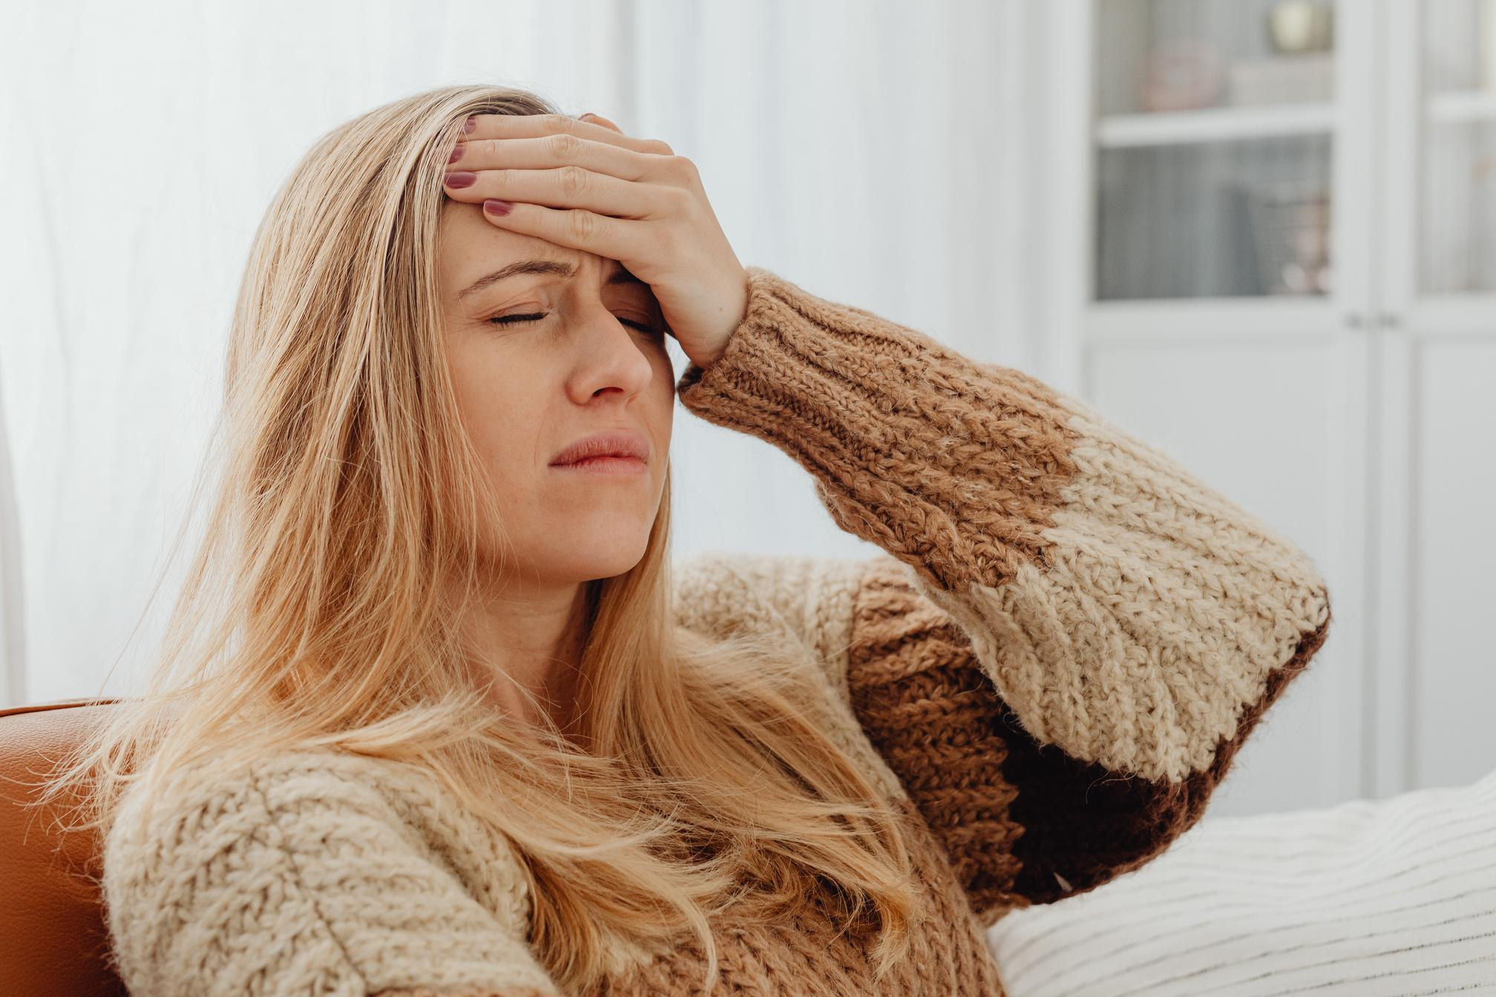
headache

Slide 11


Slide 12

stomachache

Slide 13
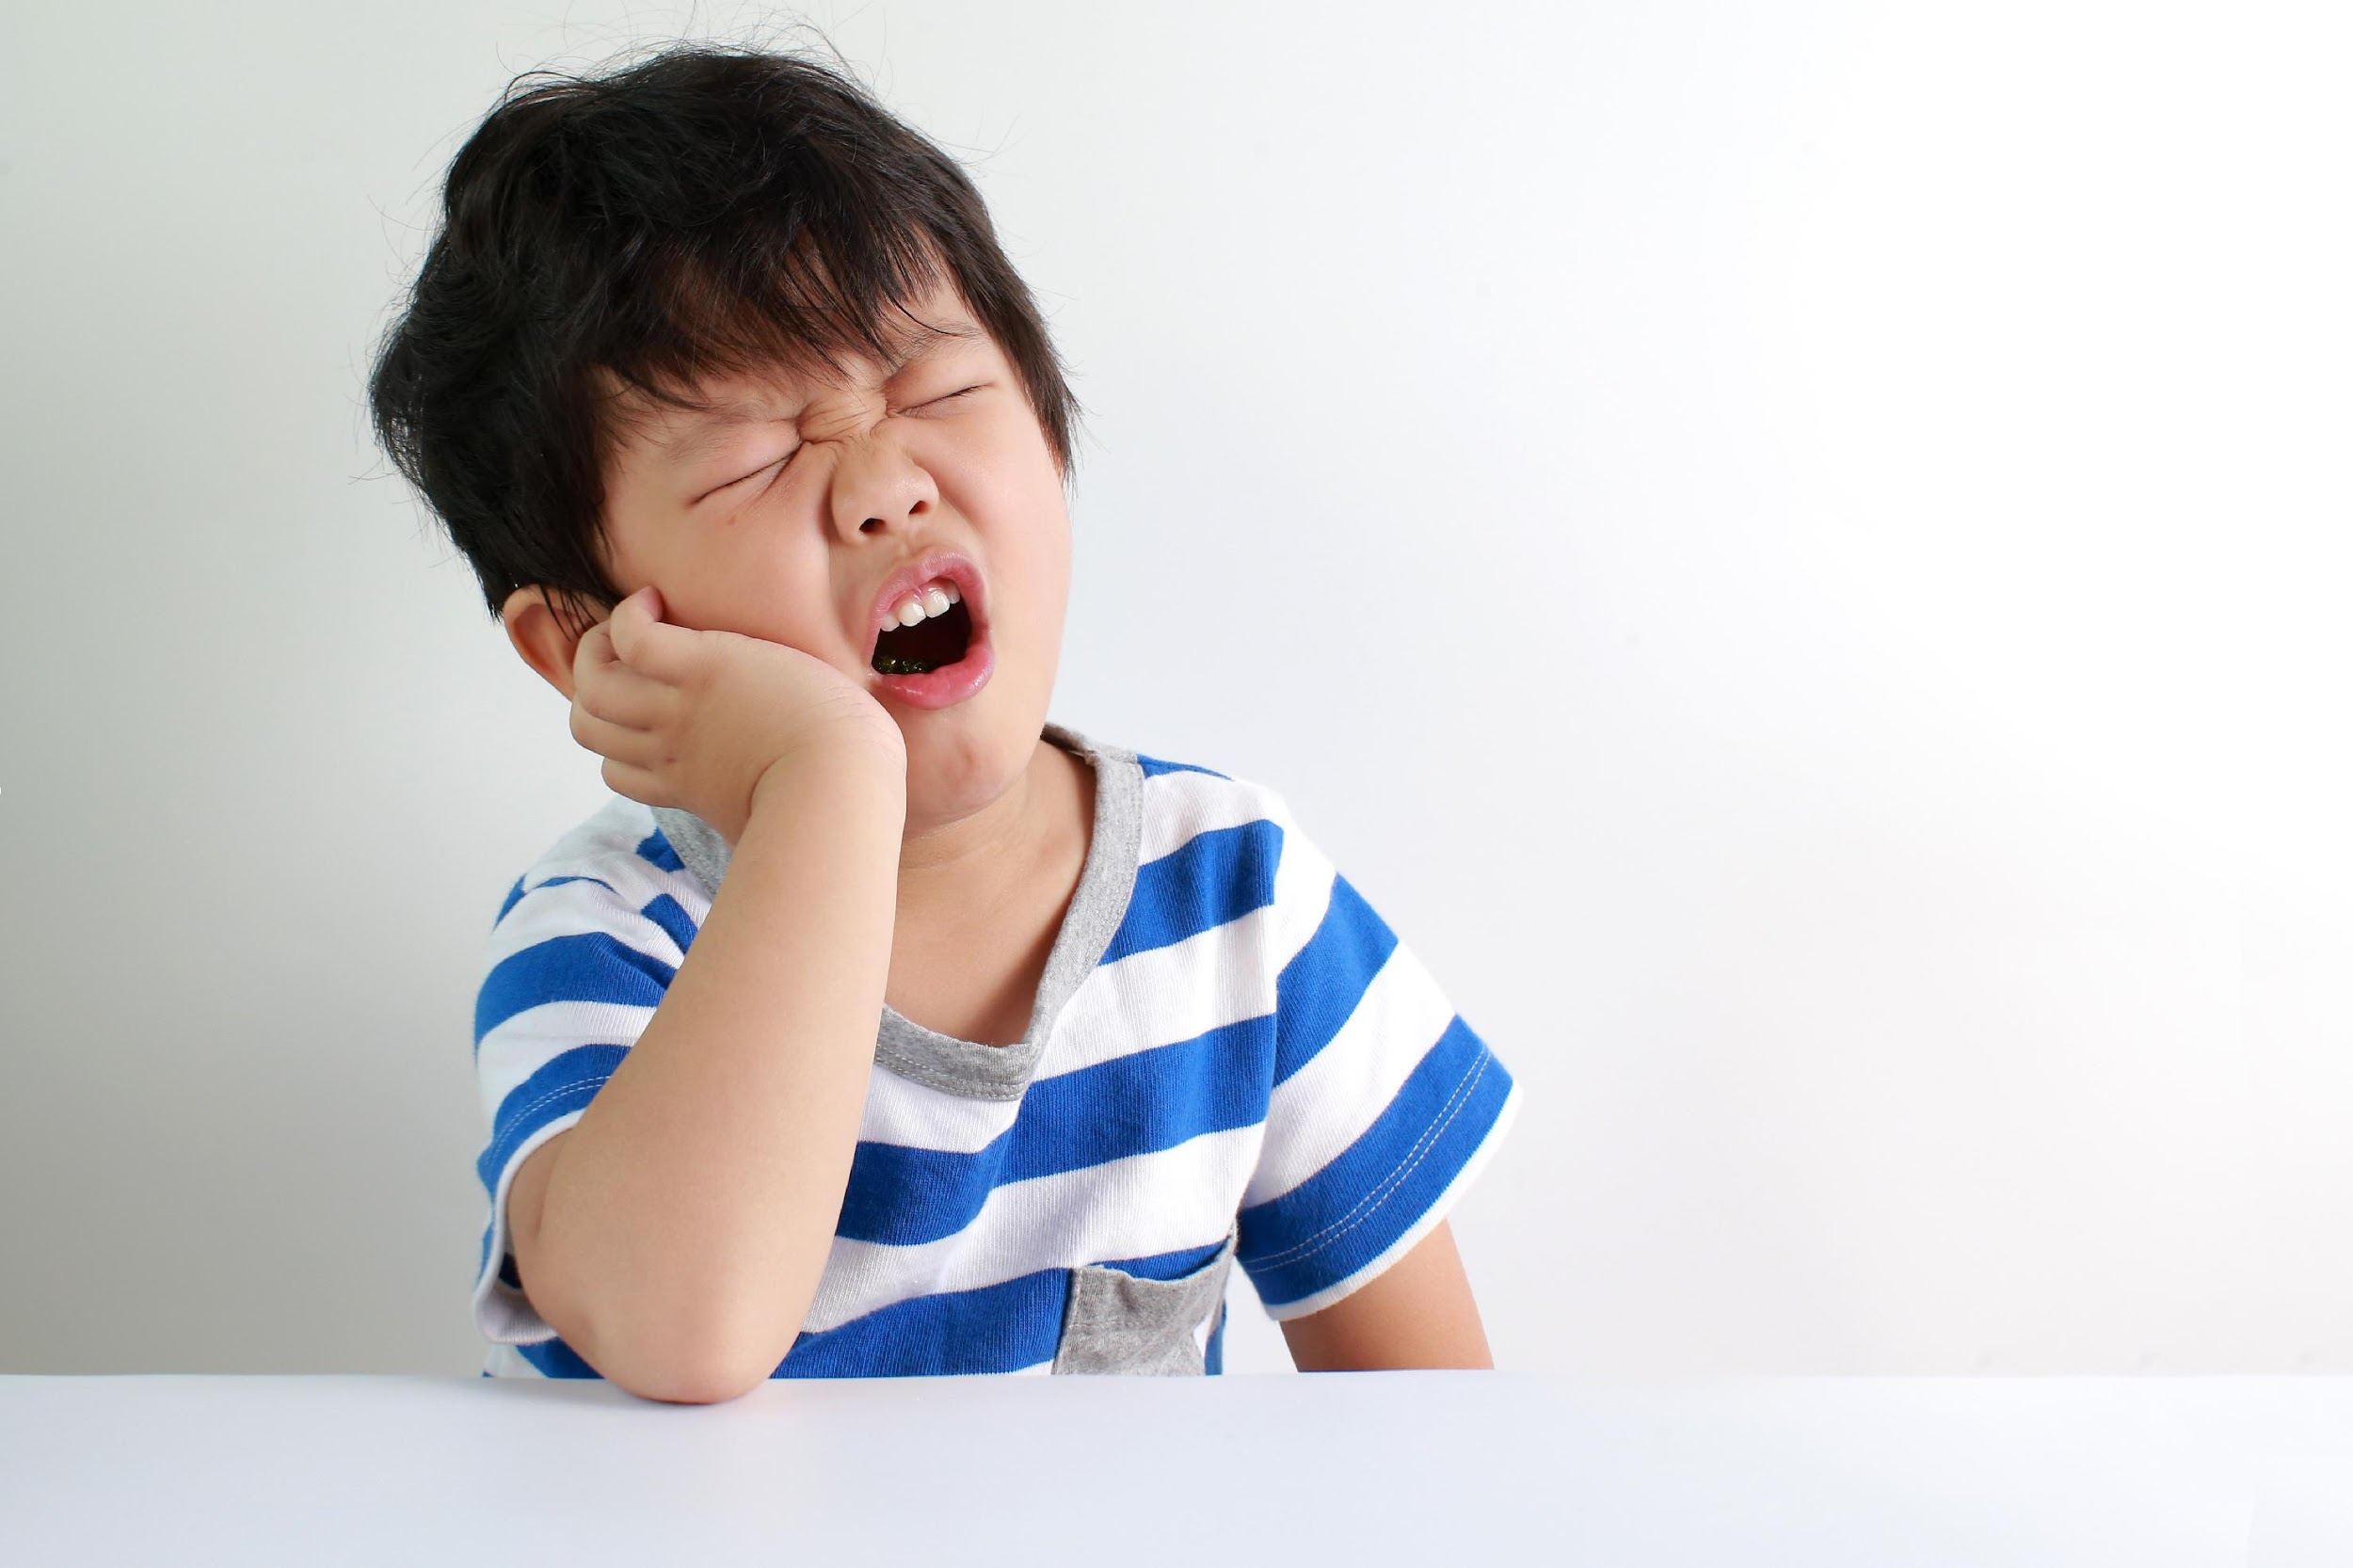

Slide 14
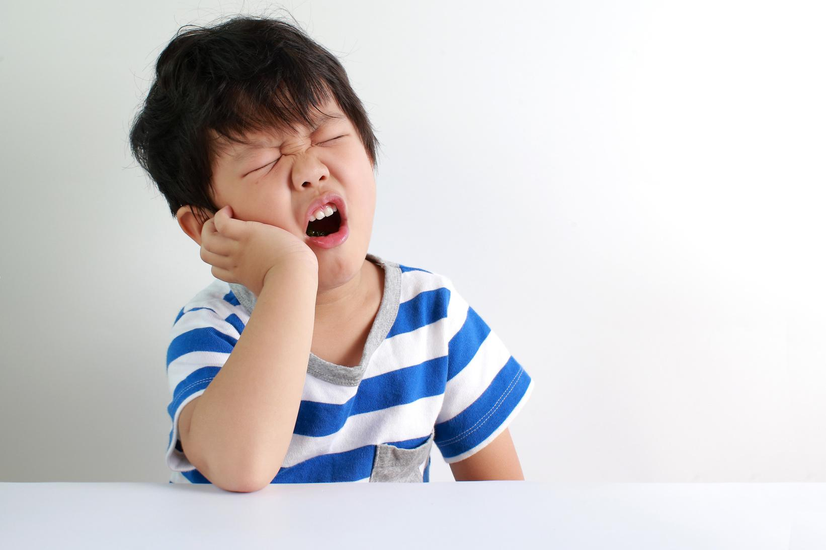
toothache

Slide 15
THANK YOU!
SEE YOU NEXT TIME.

