Slide 1
Unit 16
Seasons and the weather
Lesson 2 - Period 3
Hoa Nghia Primary School
Class 5B
Teacher: Pham Thi Thu Trang

Slide 2

01
Warm-up and Review

Slide 3

Game

Slide 4


Yes or No?
The weather is hot and sunny in winter.

Slide 5

Yes or No?
The weather is warm and sunny in spring.

Slide 6

Yes or No?
The weather is cool
and windy in autumn.

Slide 7

Yes or No?
The weather is cold
and snowy in summer.

Slide 8



Slide 9
05
Fun corner and Wrap-up

Slide 10


Slide 11




Slide 12

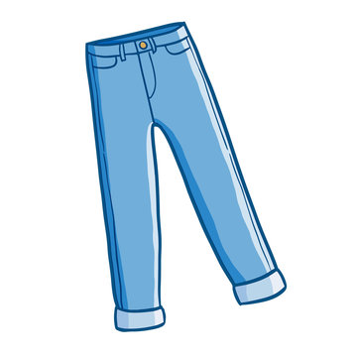

Slide 13



Slide 14



