Slide 1
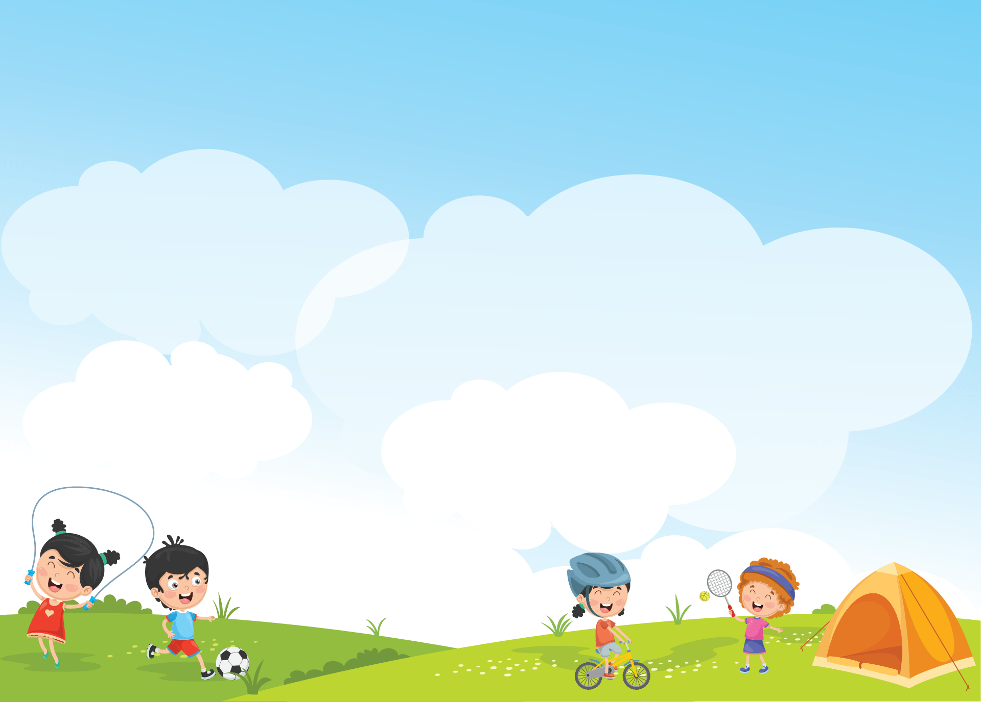


Giáo viên: Đồng Thị Như Quỳnh
Lớp dạy: 5A5, 5A6, 5A7
Đơn vị công tác: TRƯỜNG TIỂU HỌC HƯNG ĐẠO

Slide 2







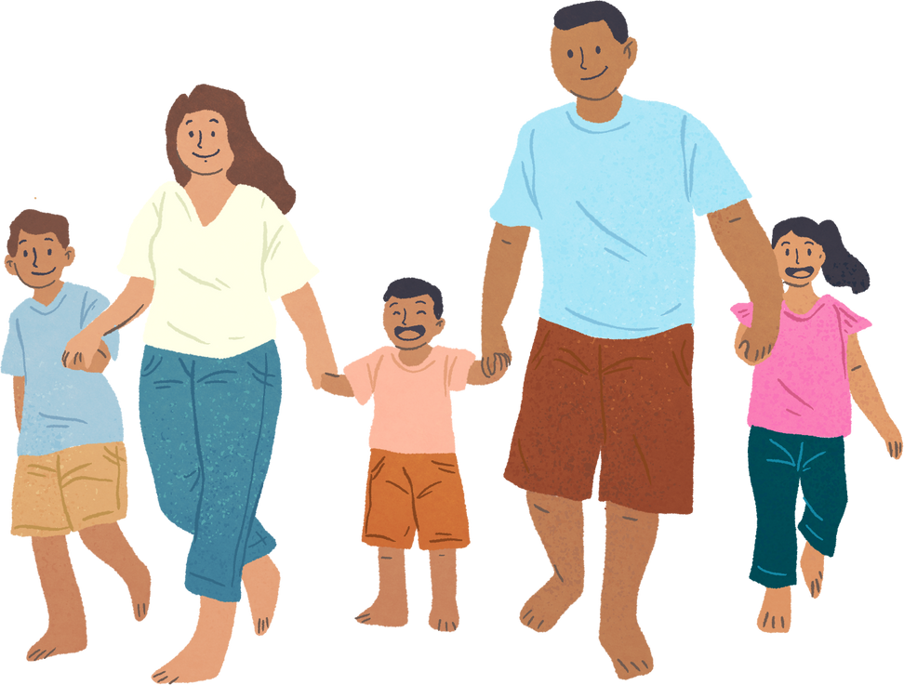

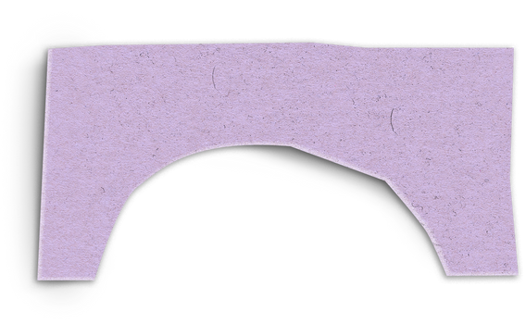
Unit 11: FAMILY TIME
Lesson 1 - Period 1

Slide 3





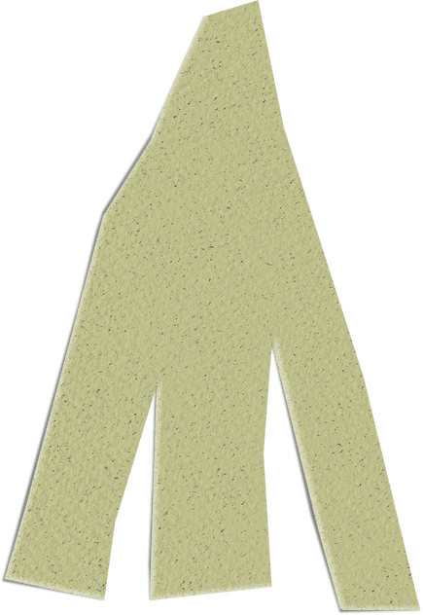


01
Warm-up and Review.

Slide 4





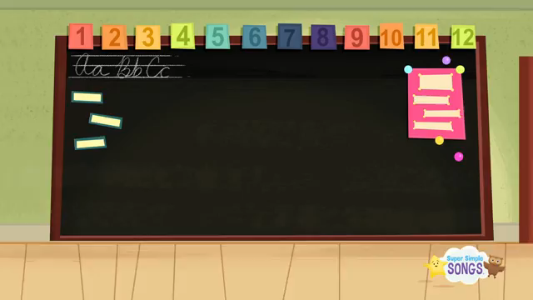






Sing and do actions
https://www.youtube.com/watch?v=tVlcKp3bWH8
Notes:
https://www.youtube.com/watch?v=tVlcKp3bWH8

Slide 5
02
Activity 1
Look, listen and repeat.

Slide 6



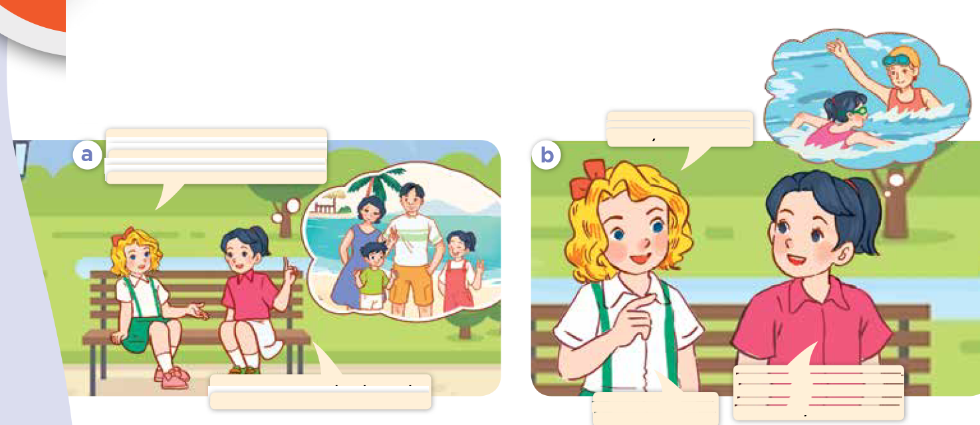
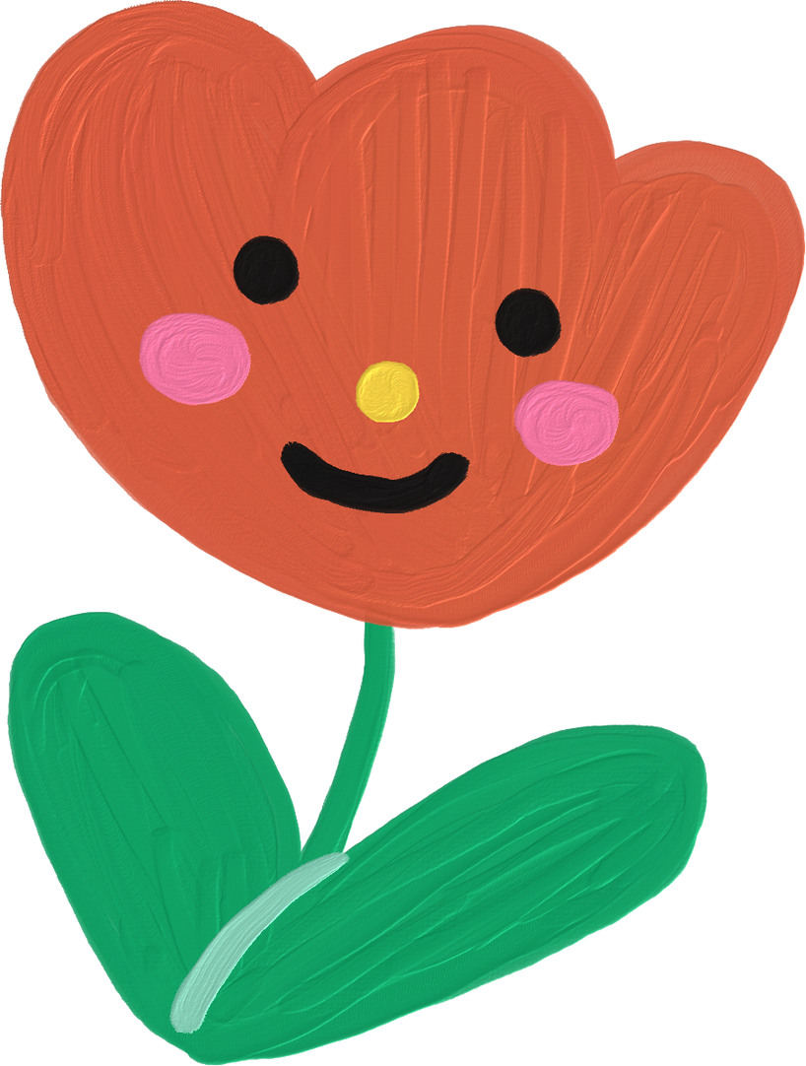
Look and say.
Notes:
Step 1: Have pupils look at Pictures a and b, identify the characters and their activities.

Slide 7
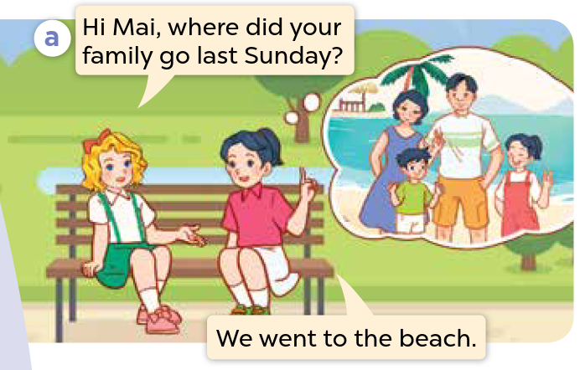

Look, listen and repeat.
Notes:
Step 2: Ask pupils to look at the pictures. Play the recording for them to listen. Play the recording again, sentence by sentence, for pupils to listen and repeat. Correct their pronunciation where necessary.

Slide 8
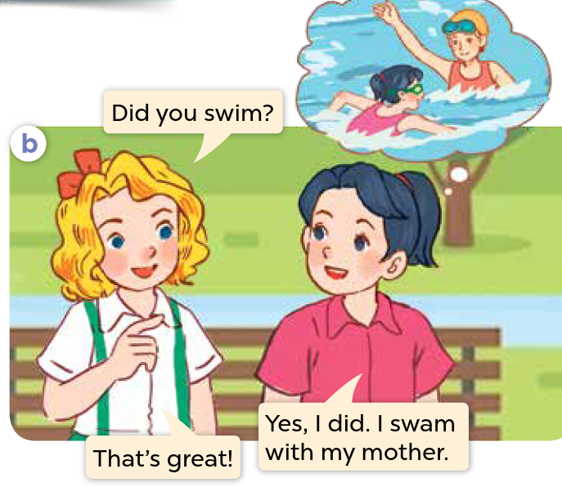
Look, listen and repeat.
Notes:
Step 2: Ask pupils to look at the pictures. Play the recording for them to listen. Play the recording again, sentence by sentence, for pupils to listen and repeat. Correct their pronunciation where necessary.

Slide 9
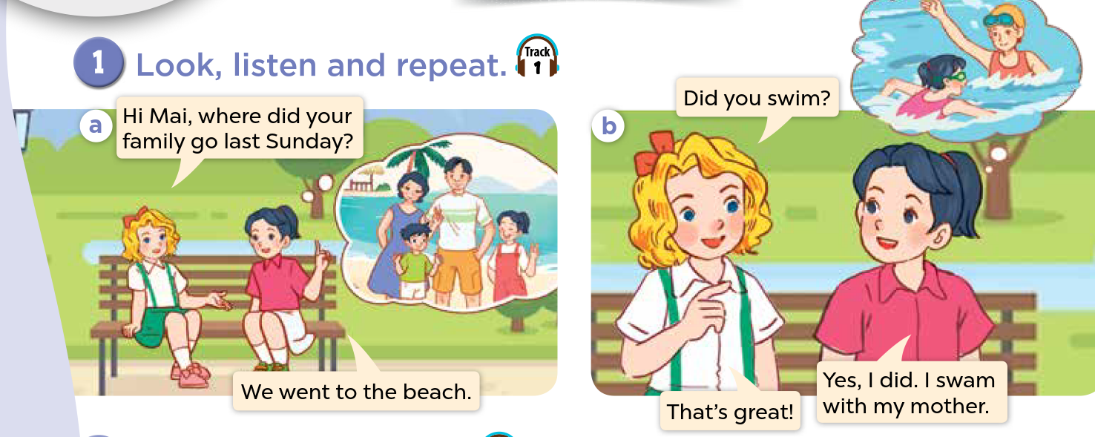
Look, listen and repeat.
Notes:
Step 3: Play the recording again for pupils to listen and repeat in chorus, sentence by sentence.
Step 4: Invite a few pairs to the front of the classroom to listen and repeat the sentences in the recording.
Step 5: Draw their attention to the question Did you swim? and the answer Yes, I did. I swam with my mother. Tell pupils that they are the question and the answer about whether someone did something in the past.

Slide 10
03
Activity 2
Listen, point and say.

Slide 11


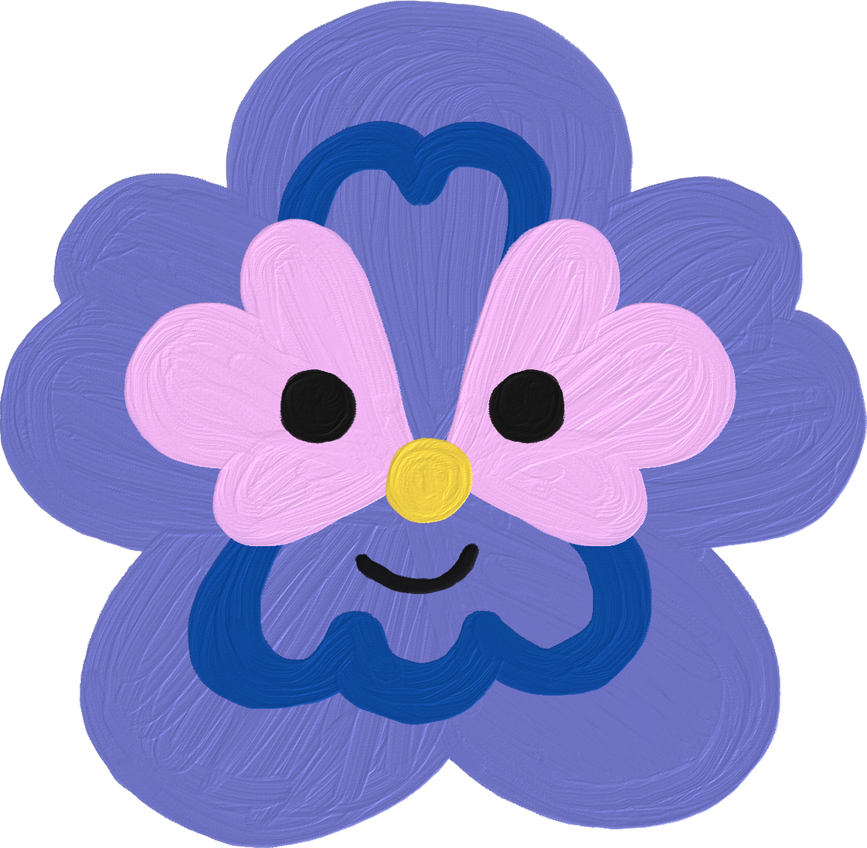
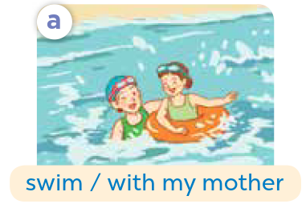
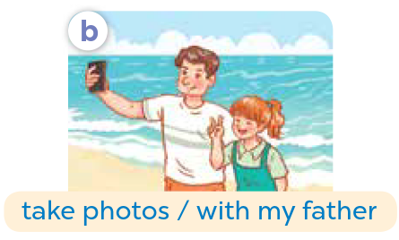
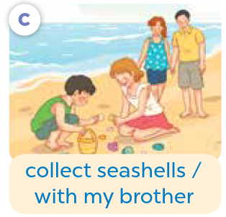
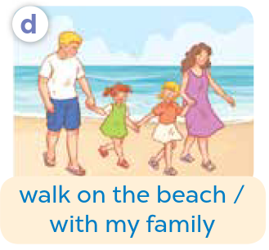

Listen, point and say.
Notes:
Step 1: Have pupils look at pictures a, b, c and d and identify the characters and their activities in the past.

Slide 12
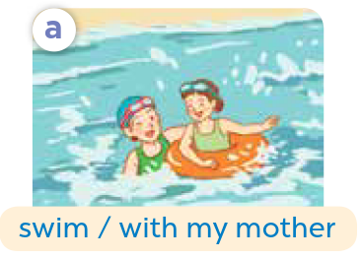
Listen, point and say.
Notes:
Step 2: Have pupils point at picture a, listen to the recording and repeat the words (swim / with my mother). Point at the bubbles and picture a again and have pupils listen and repeat after the recording (Did you swim? - Yes, I did. I swam with my mother.).
Step 3: Follow the same procedure with the other three pictures (b, c, d). Have the class repeat the questions and answers a few times.

Slide 13
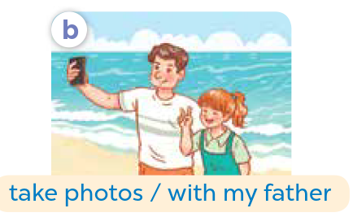
Listen, point and say.
Notes:
Step 2: Have pupils point at Picture a, listen to the recording and repeat the words (swim / with my mother). Point at the bubbles and Picture a again and have pupils listen and repeat after the recording (Did you swim? - Yes, I did. I swam with my mother.).
Step 3: Follow the same procedure with the other three pictures (b, c, d). Have the class repeat the questions and answers a few times.

Slide 14
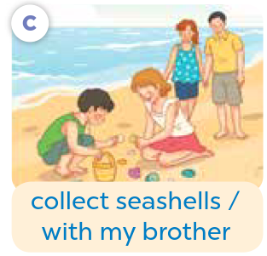
Listen, point and say.
Notes:
Step 2: Have pupils point at Picture a, listen to the recording and repeat the words (swim / with my mother). Point at the bubbles and Picture a again and have pupils listen and repeat after the recording (Did you swim? - Yes, I did. I swam with my mother.).
Step 3: Follow the same procedure with the other three pictures (b, c, d). Have the class repeat the questions and answers a few times.

Slide 15
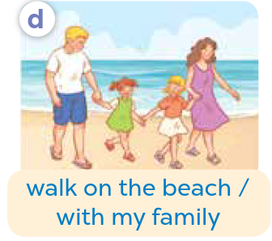
Listen, point and say.
Notes:
Step 2: Have pupils point at Picture a, listen to the recording and repeat the words (swim / with my mother). Point at the bubbles and Picture a again and have pupils listen and repeat after the recording (Did you swim? - Yes, I did. I swam with my mother.).
Step 3: Follow the same procedure with the other three pictures (b, c, d). Have the class repeat the questions and answers a few times.

Slide 16
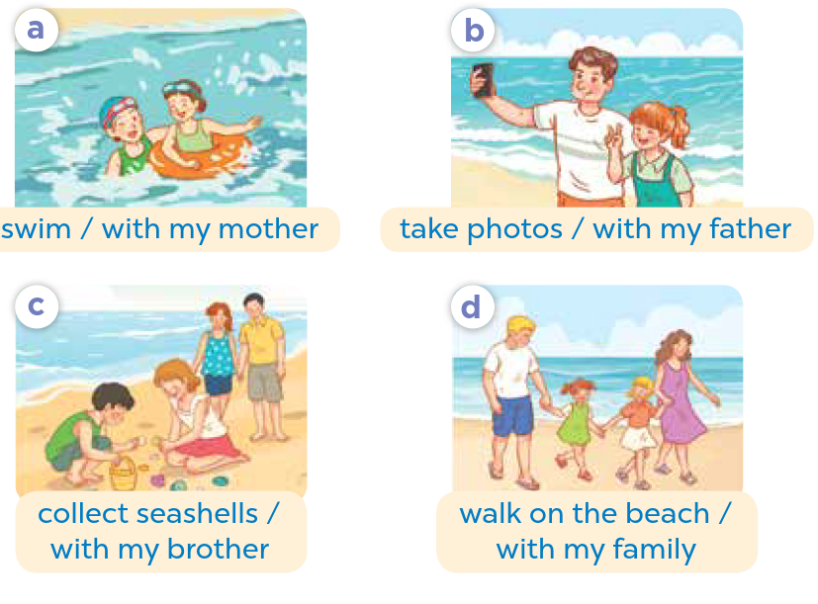
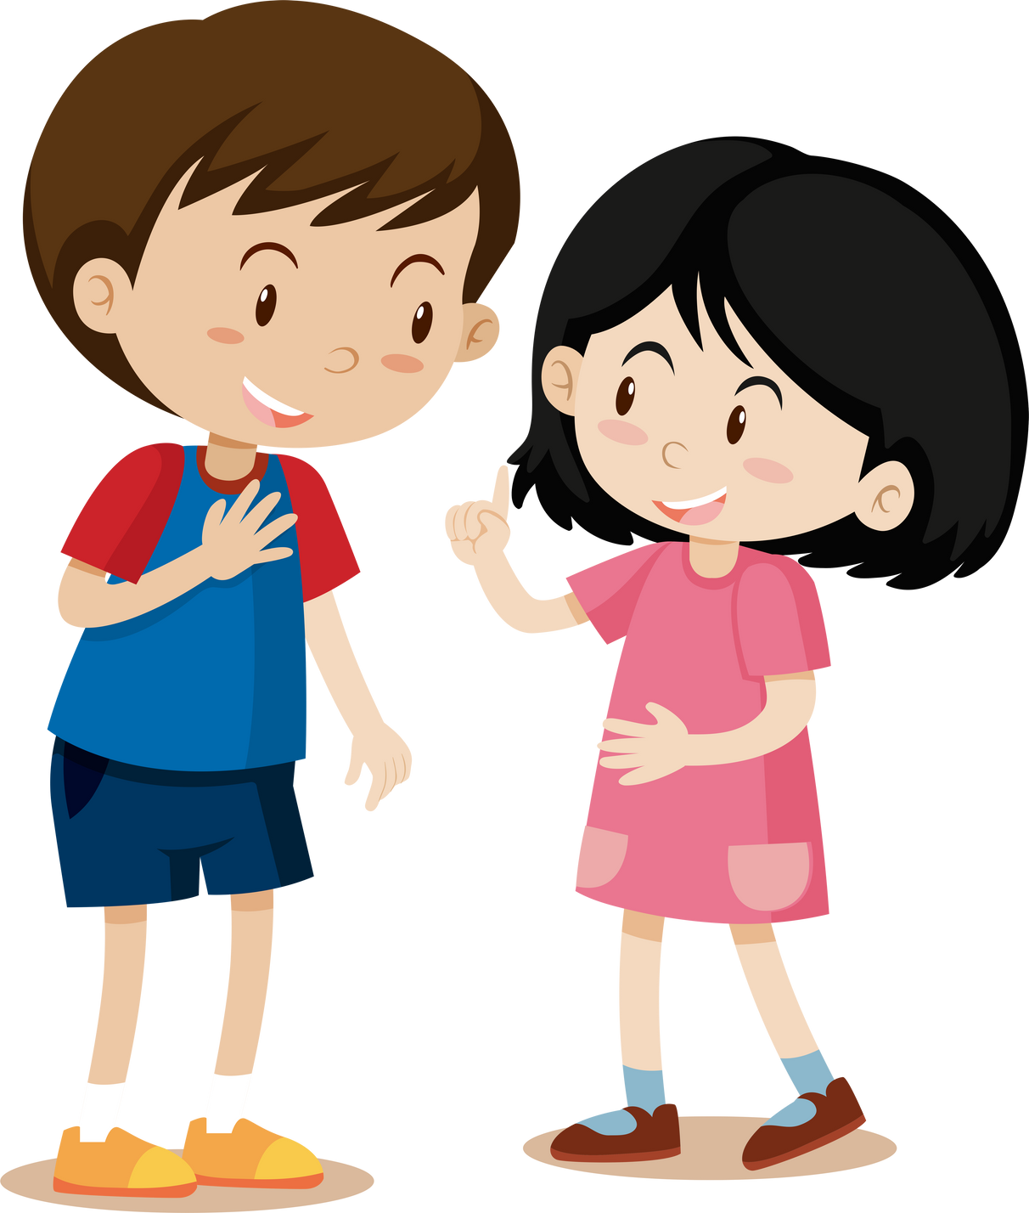
Work in pairs.
Did you _____?
Yes, I ___. I ___.
Notes:
Step 4: Have pairs practise asking and answering the question Did you _____? – yes, I did. I ___.using the picture cues and the word phrases of time.

Slide 17






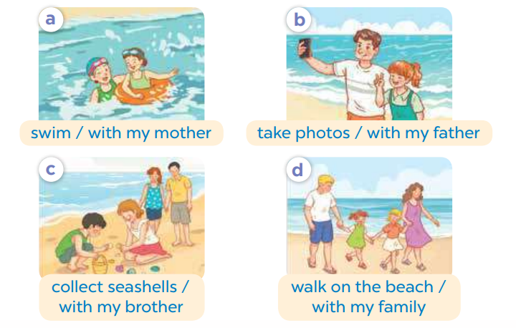

Work in pairs.
Did you swim?
Yes, I did. I swam
with my mother.
swim / with my mother
Notes:
Step 5: Invite a few pairs to point at the pictures and say the questions and answers in front of the class. Extension (For consolidation): Invite a few pairs of pupils to act out the conversations in front of the class.

Slide 18
Work in pairs.
Did you take photo?
Yes, I did. I took photo with my father.
take photo / with my father
Notes:
Step 5: Invite a few pairs to point at the pictures and say the questions and answers in front of the class. Extension (For consolidation): Invite a few pairs of pupils to act out the conversations in front of the class.

Slide 19
Work in pairs.
Did you collect seashells?
Yes, I did. I collected seashells with my brother.
collect seashells / with my brother
Notes:
Step 5: Invite a few pairs to point at the pictures and say the questions and answers in front of the class. Extension (For consolidation): Invite a few pairs of pupils to act out the conversations in front of the class.

Slide 20
Work in pairs.
Did you walk on the beach?
Yes, I did. I walked on the beach with my family.
walk on the beach / with my family
Notes:
Step 5: Invite a few pairs to point at the pictures and say the questions and answers in front of the class. Extension (For consolidation): Invite a few pairs of pupils to act out the conversations in front of the class.

Slide 21



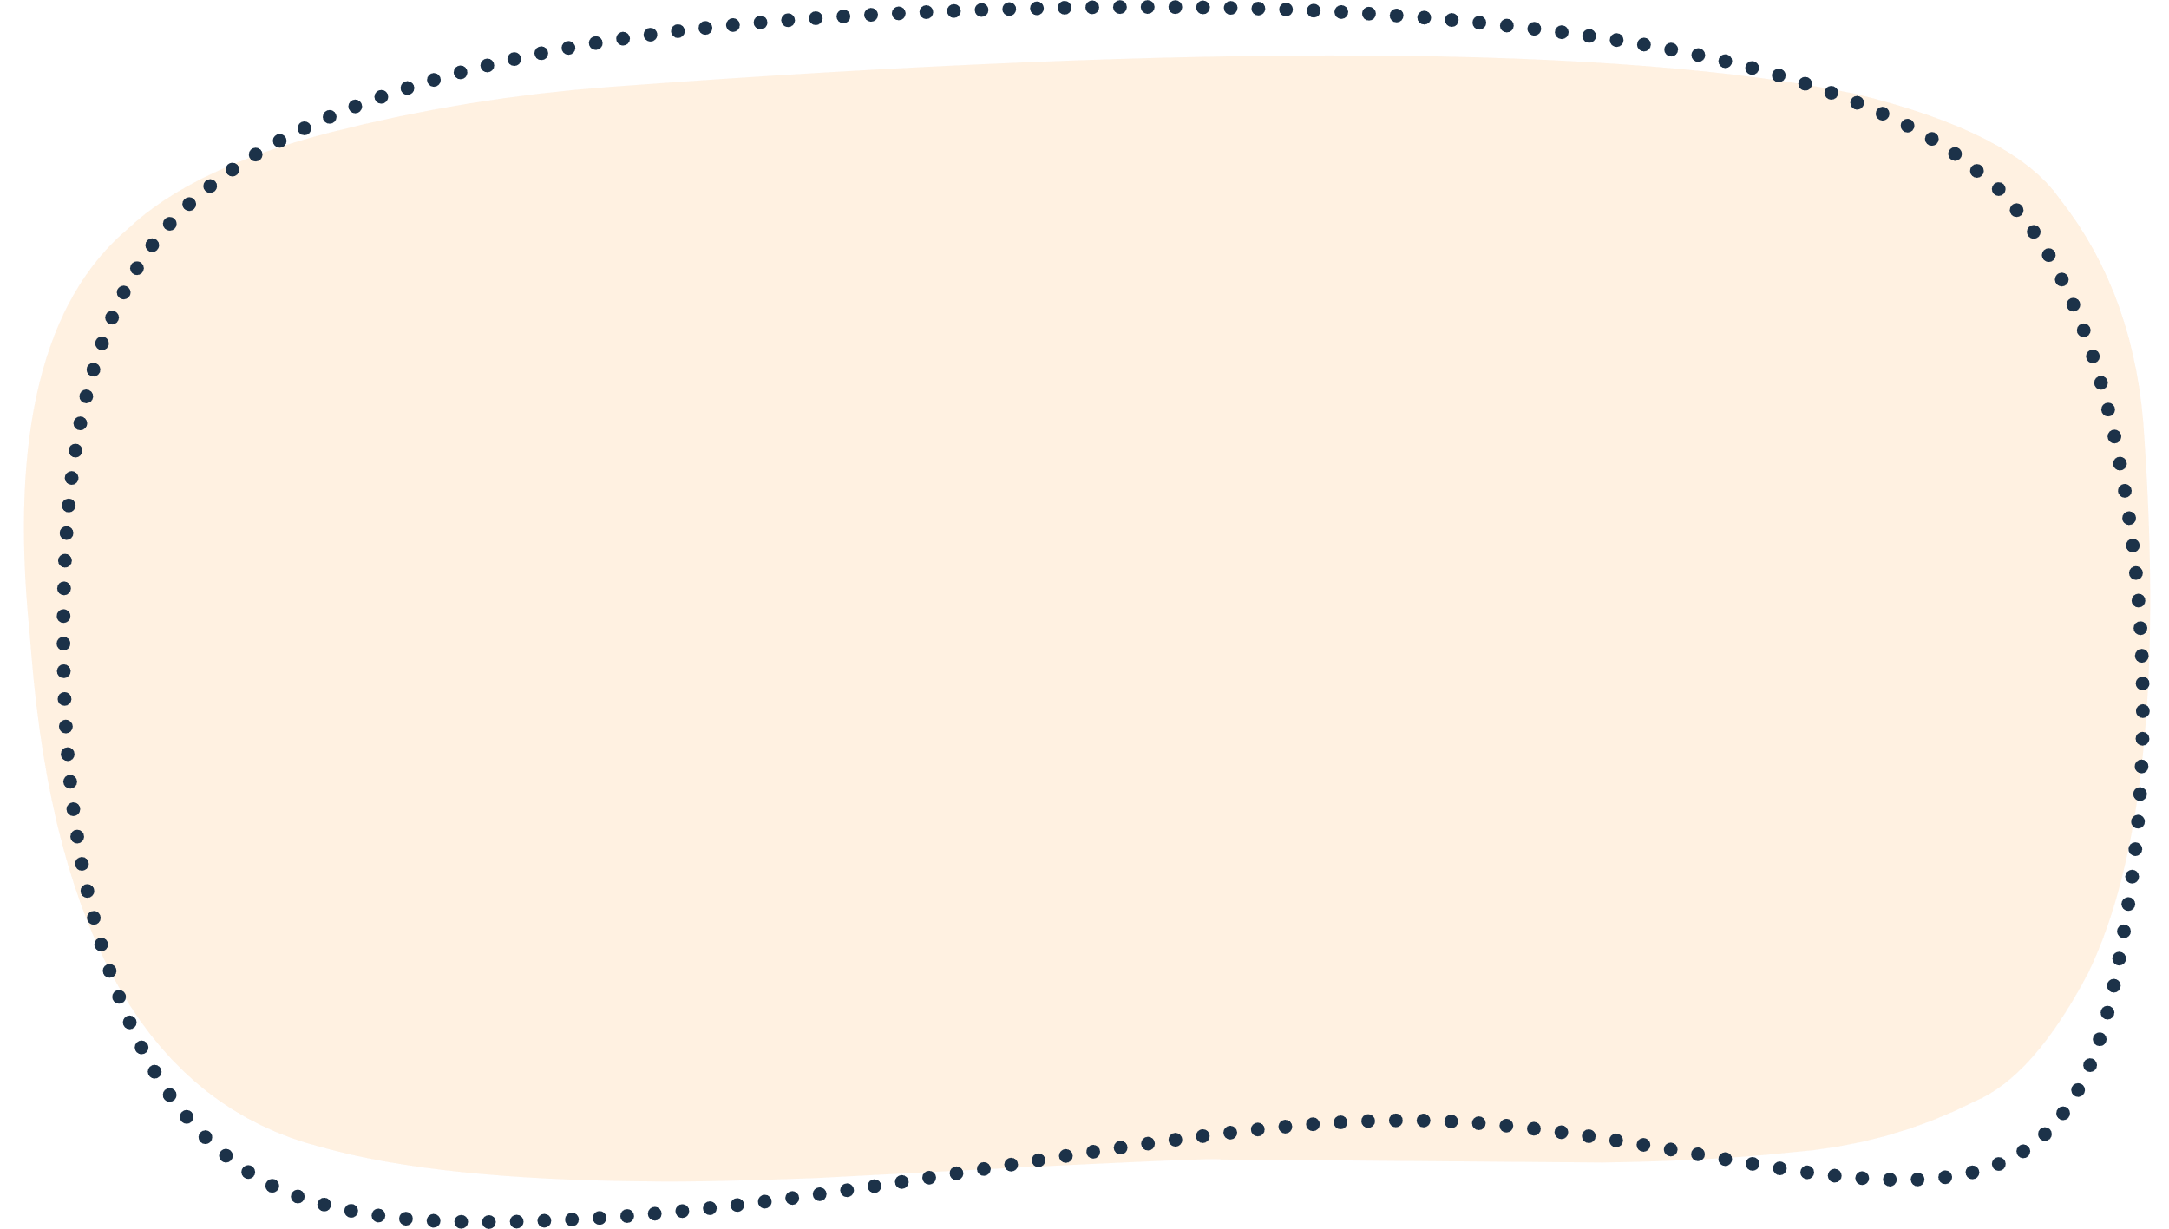

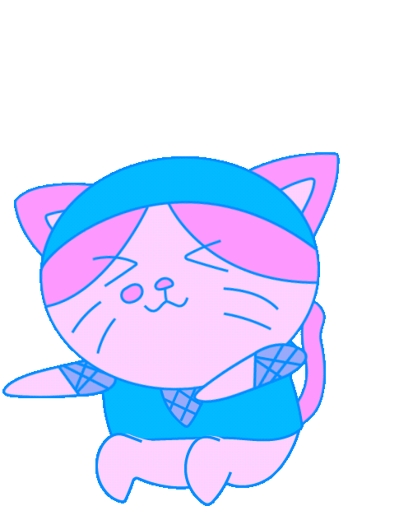





Slide 22
04
Activity 3
Let’s talk.

Slide 23


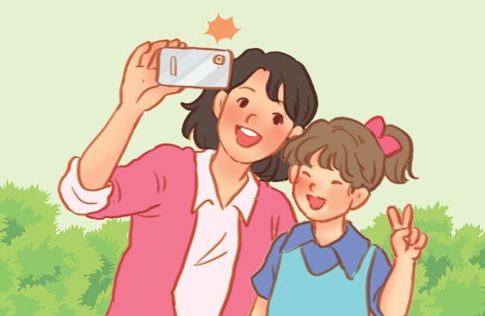
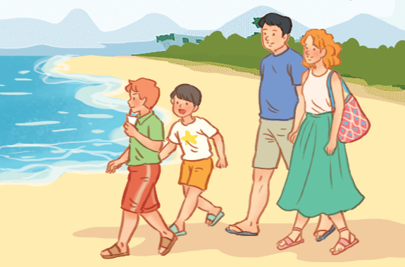

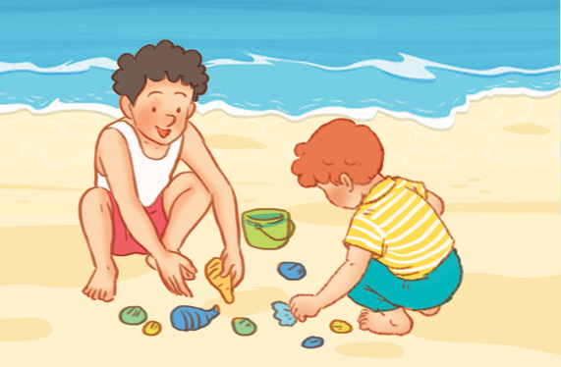
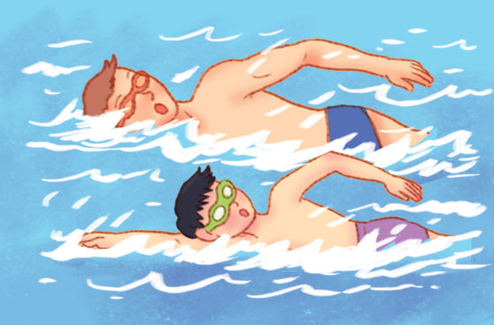

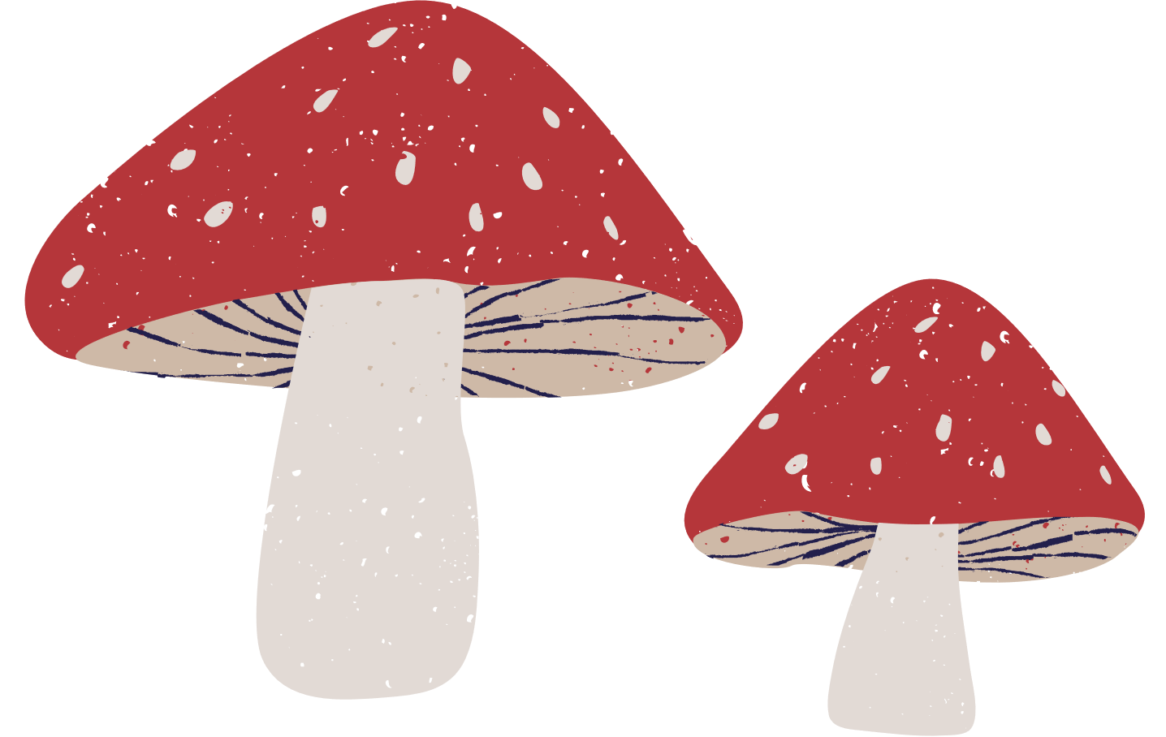

Let’s talk.
Did you _____?
_____.
Notes:
Step 1: Draw pupils’ attention to the pictures. Ask questions to help them identify the context (see Input).

Slide 24
Work in pairs.
Did you _____?
_____.
Notes:
Step 2: Put pupils into pairs and practise asking and answering questions about whether someone did something in the past. Go around the classroom to offer support where necessary.

Slide 25
Let’s talk.
Did you take photo?
Yes, I did. I took photo
with my mother.
Notes:
Step 3: Invite a few pairs to the front of the class to ask and answer questions about whether someone did something in the past using the picture cues. Praise pupils if they perform well.

Slide 26
Let’s talk.
Did you collect seashells?
Yes, I did. I collected
seashells with my brother.
Notes:
Step 3: Invite a few pairs to the front of the class to ask and answer questions about whether someone did something in the past using the picture cues. Praise pupils if they perform well.

Slide 27
Let’s talk.
Did you walk on the beach?
Yes, I did. I walked
on the beach with my family.
Notes:
Step 3: Invite a few pairs to the front of the class to ask and answer questions about whether someone did something in the past using the picture cues. Praise pupils if they perform well.

Slide 28
Let’s talk.
Did you swim?
Yes, I did. I swam
with my father.
Notes:
Step 3: Invite a few pairs to the front of the class to ask and answer questions about whether someone did something in the past using the picture cues. Praise pupils if they perform well.

Slide 29
05
Fun corner and wrap-up.

Slide 30


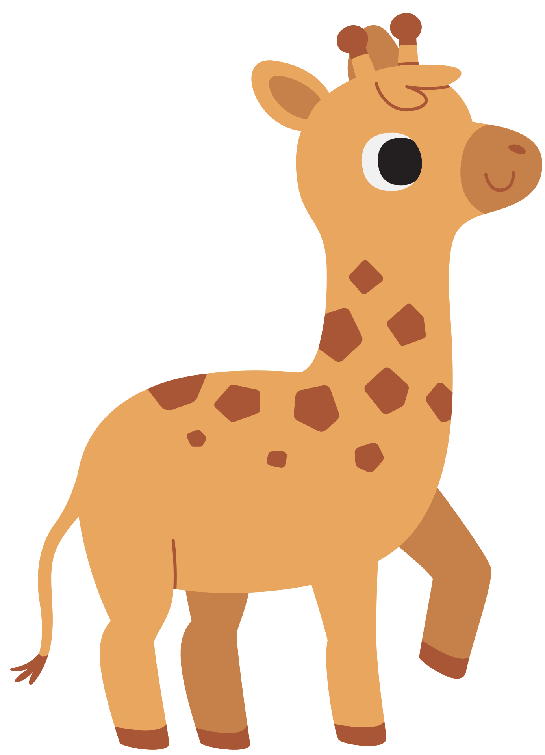


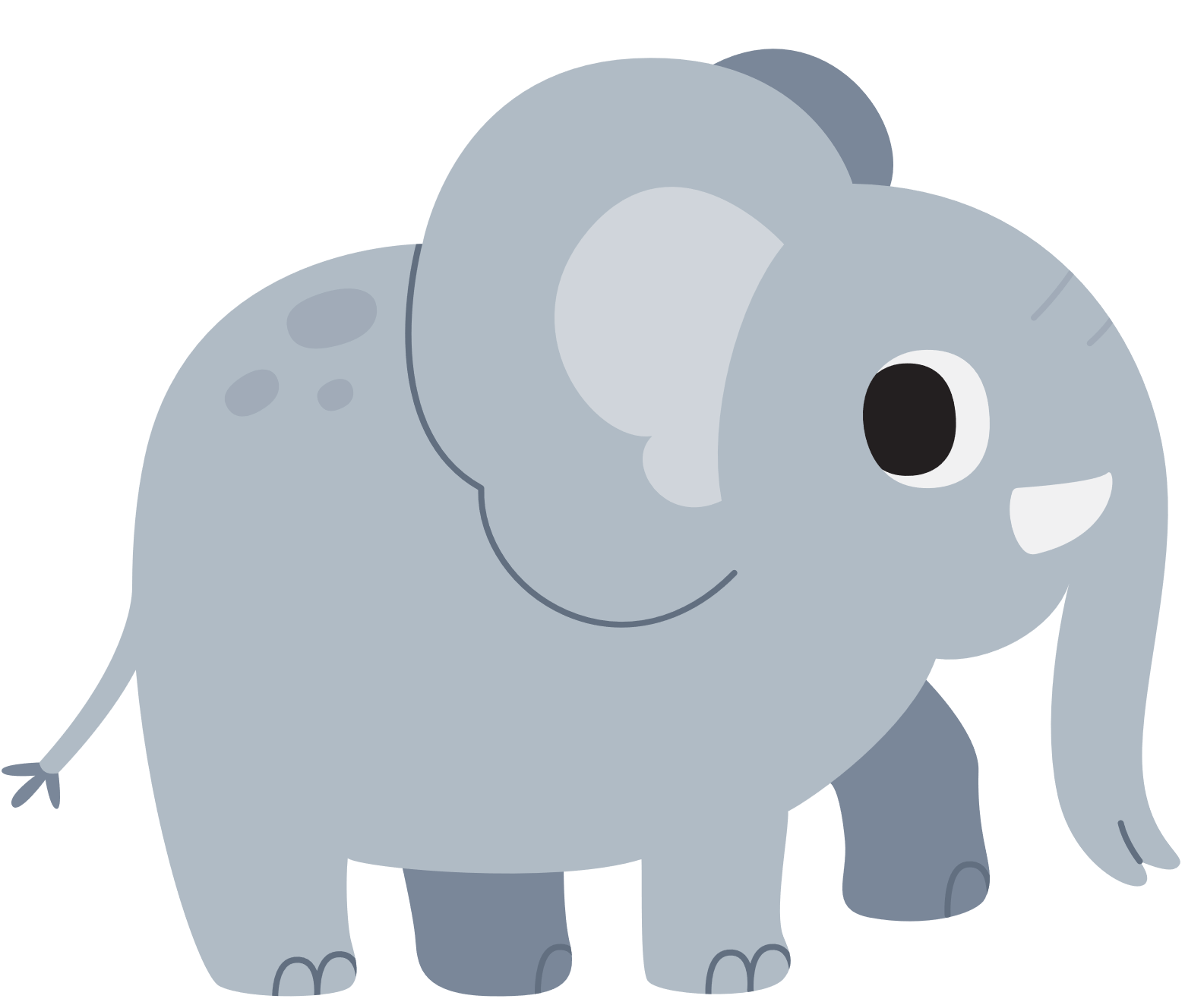
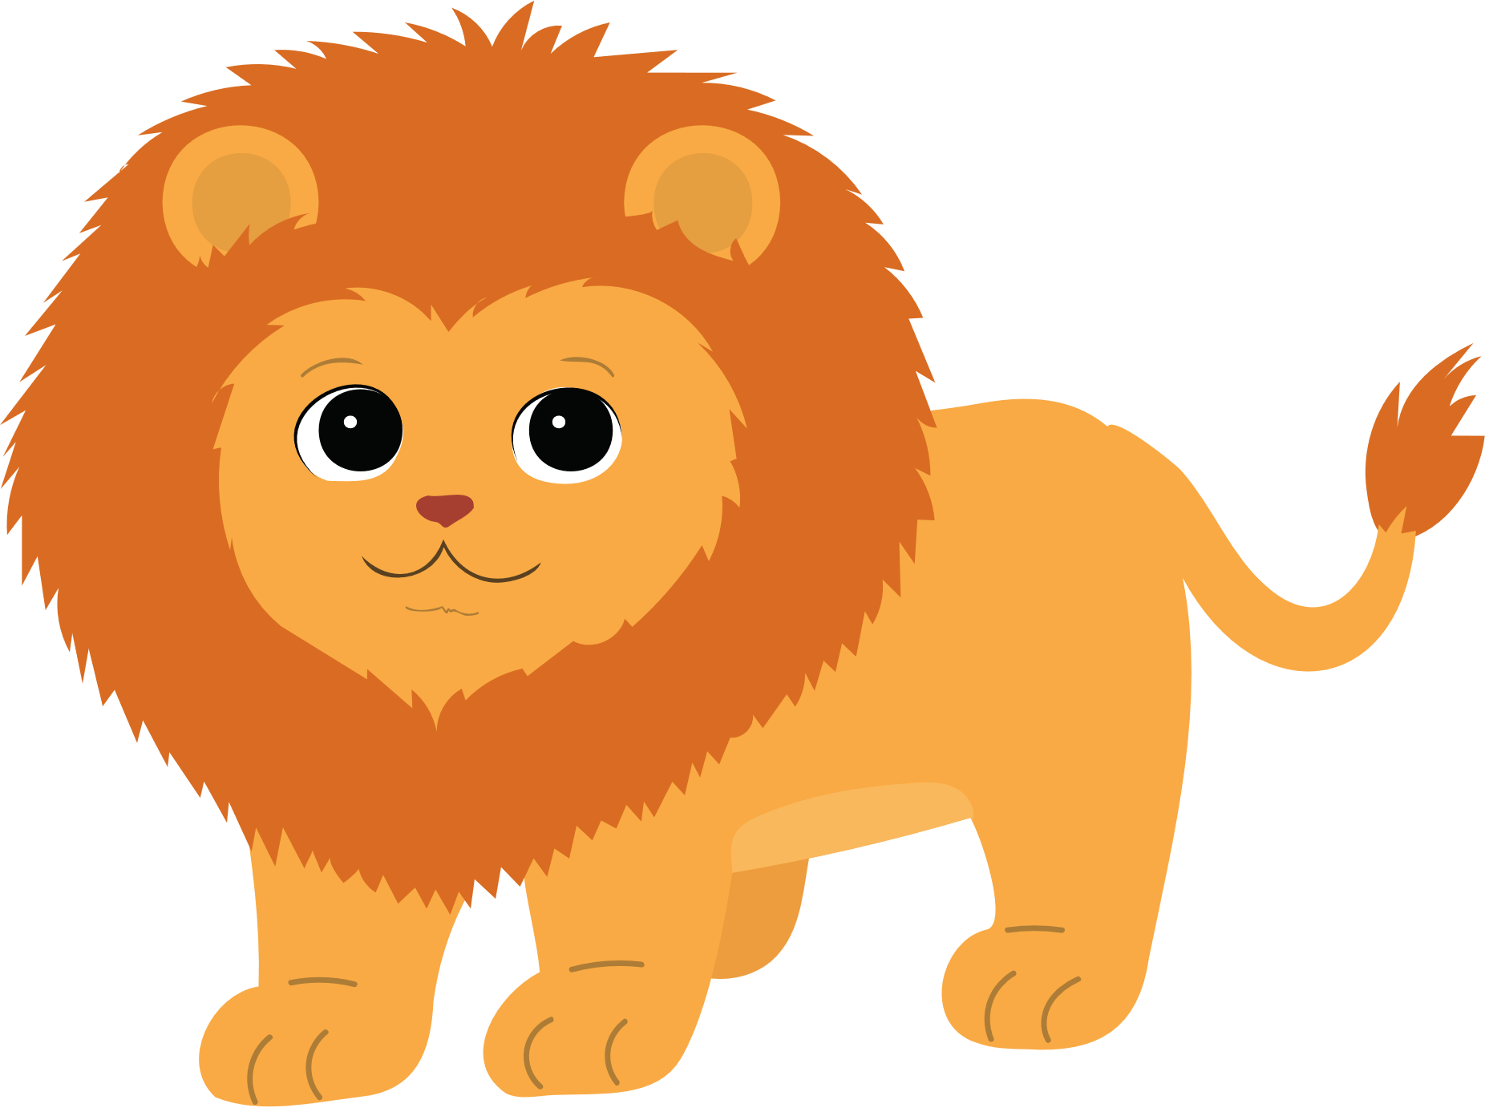
LUCKY ANIMALS
Notes:
- Click the animals.
- After the game, click NEXT to move on the next slide.

Slide 31

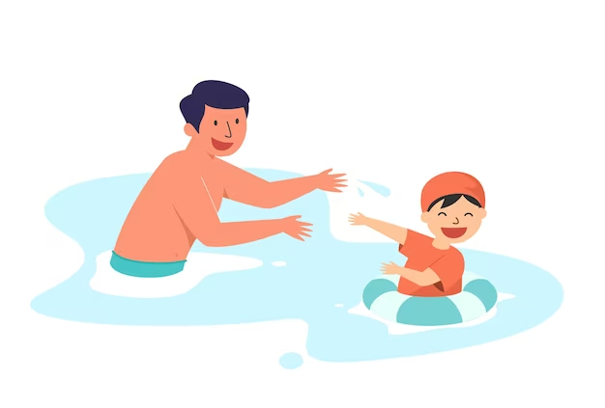




Yes, I did. I swam
with my father.
Did you swim?
+ 1
Notes:
- Click the animal to get points
- Click BACK to continue the game with the other animals.

Slide 32

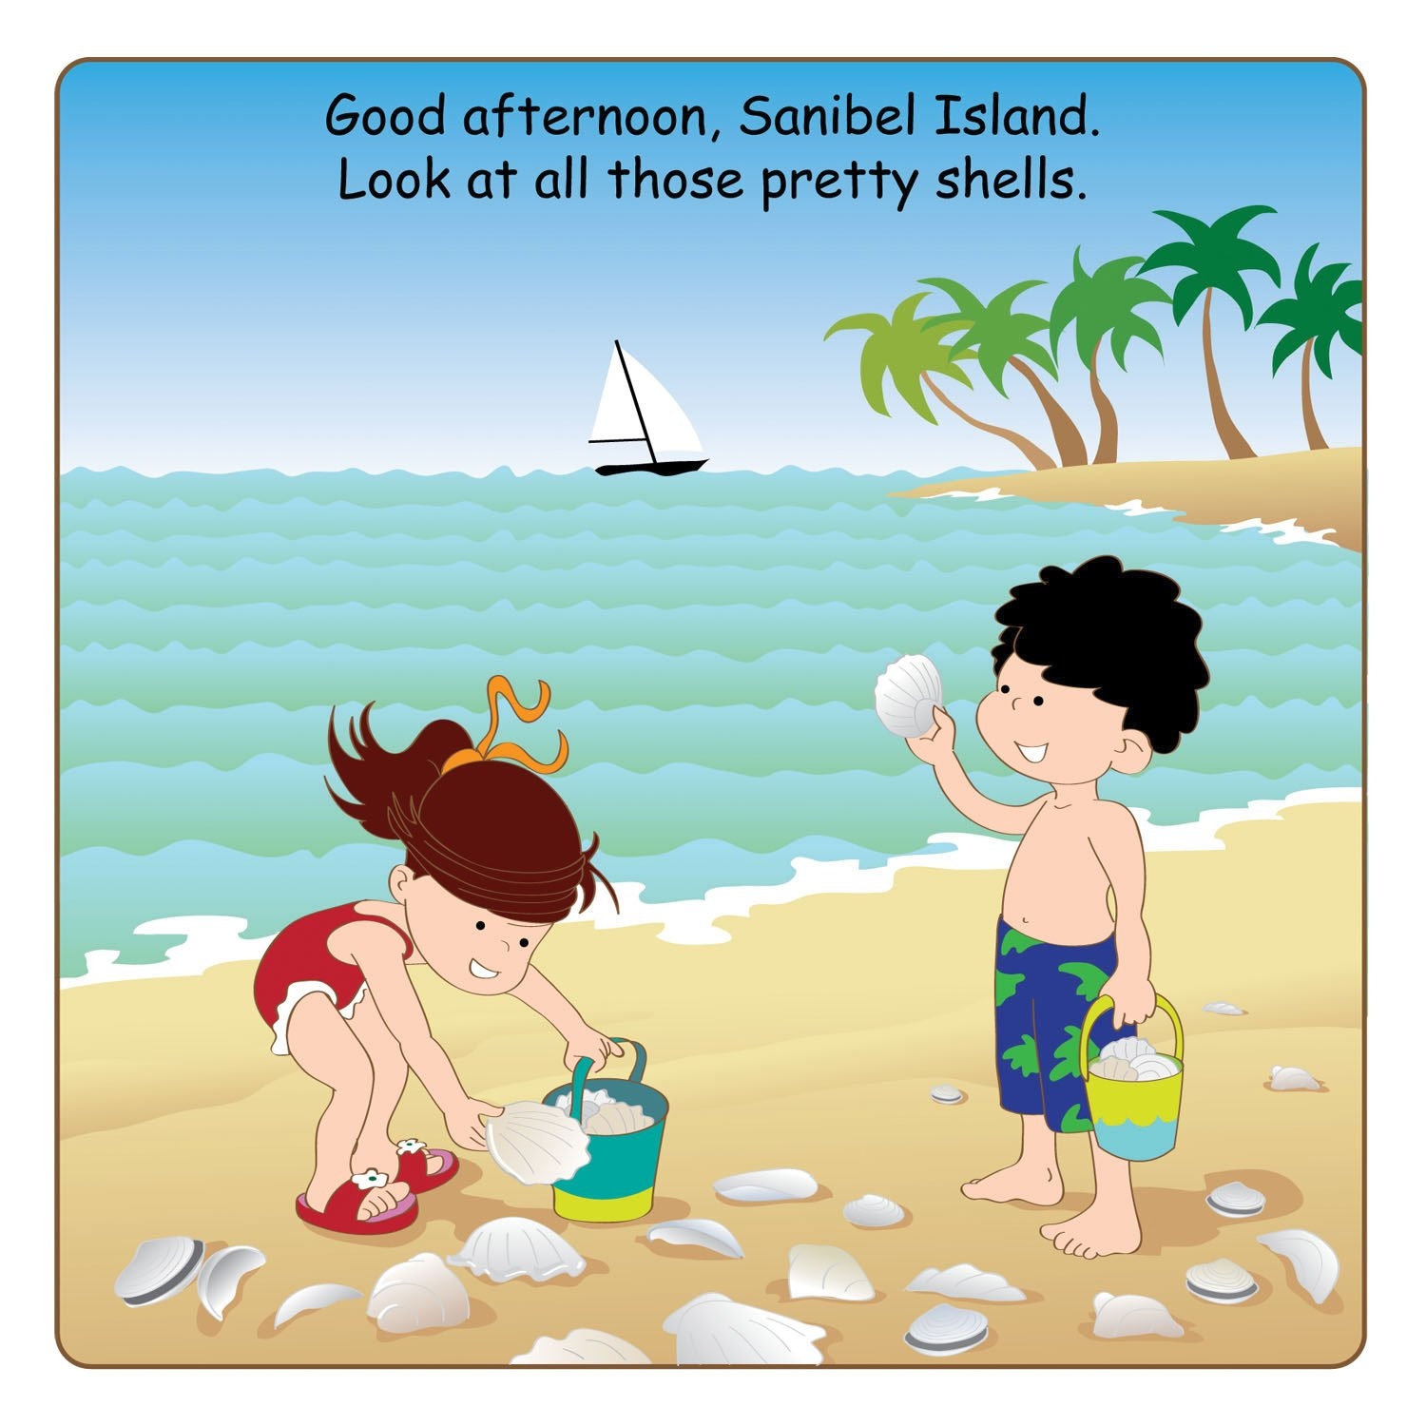


Yes, I did. I collected
seashells with my brother.
Did you
collect seashells?
+ 3
Notes:
- Click the animal to get points
- Click BACK to continue the game with the other animals.

Slide 33

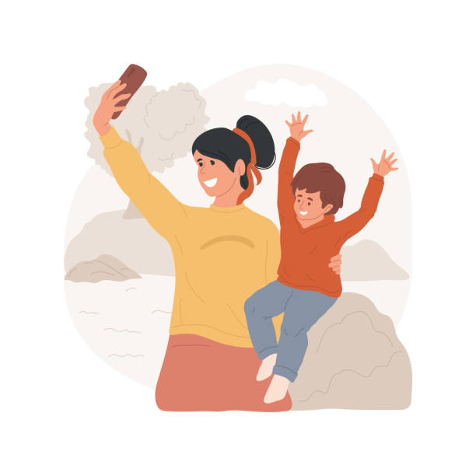
Yes, I did. I took
photos with my mother.
Did you take photos?
+ 2
Notes:
- Click the animal to get points
- Click BACK to continue the game with the other animals.

Slide 34
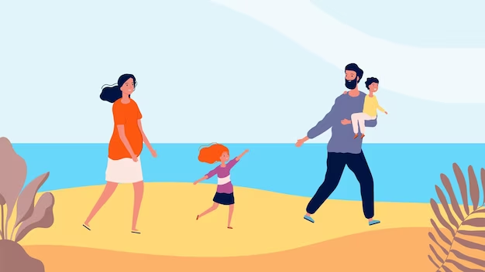

Yes, I did. I walked
on the beach
with my family.
Did you
walk on the beach?
+ 3
Notes:
- Click the animal to get points
- Click BACK to continue the game with the other animals.

Slide 35

+ 3
Notes:
- Click the animal to get points
- Click BACK to continue the game with the other animals.

Slide 36


Scoreboard
TEAM A
TEAM B

Slide 37



Slide 38
Website: hoclieu.vn
Fanpage: https://www.facebook.com/tienganhglobalsuccess.vn/

