Slide 1
Tiếng Anh 1
Giáo viên: Hoàng Thị Hồng
Lớp dạy: 1A4, 1A5, 1A6
Đơn vị công tác: Trường TH Hưng Đạo

Slide 2
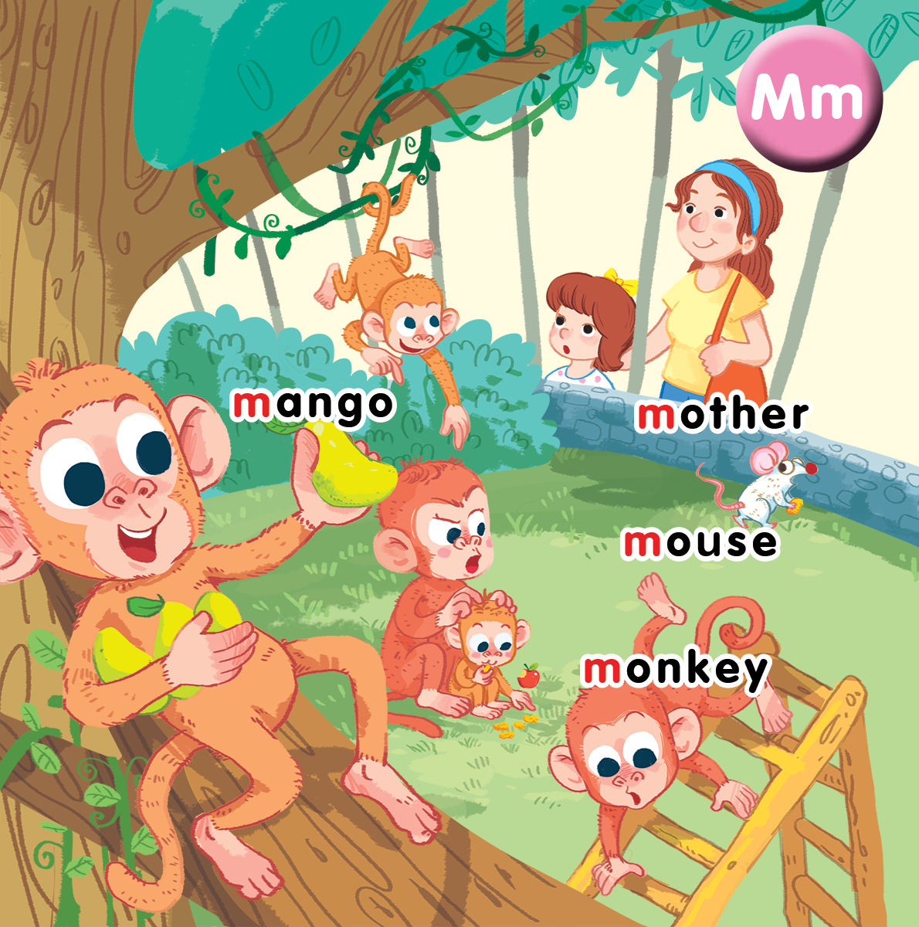
Unit 10
At the zoo
Lesson 1
Notes:
By the end of the unit, pupils will be able to:
- pronounce the sound of the letter M/m in isolation and in the words.
mango, monkey, mother and mouse correctly.
- say the sound of the letter M/m and the words mango, monkey, mother and mouse in a chant.
- recognize the words in different situations when listening.
- use ”That’s a _____.” to identify someone or something.
- trace the letter M/m and complete the words __ango, __other, ___onkey, ___ouse.
- sing a song with the structure ”That’s a/my _____.”
Lesson 1
By the end of the lesson, pupils will be able to:
pronounce the sound of the letter m in isolation and in the words mother, mouse, mango, monkey.
listen and recognize the words mother, mouse, mango, monkey.
recognize and say the words.

Slide 3

Warm-up
Notes:
Goal: Warm up the class and introduce the sound m.
Time: 5 minutes
Have pupils look at the picture parts and guess the letter.
Ask What is it? Students answer the letter.

Slide 4
1
2
3
                M
4
5
6

Slide 5
                M

Slide 6



Notes:
Listen and repeat is divided into 4 steps.

Slide 7

m
Notes:
Step 1
Goal: Listen and repeat the sound u and introduce the context.
Time: 3 minutes
Say Open your book! with a TPR action. Have pupils open the book, Unit 10 At the zoo. Teacher opens the digital book.
Stick the card with letter m and say the sound.
Play the recording or say and have pupils listen and repeat.
Say Today we will learn four words having the sound m.
Introduce the context of the picture by eliciting from pupils.

Slide 8

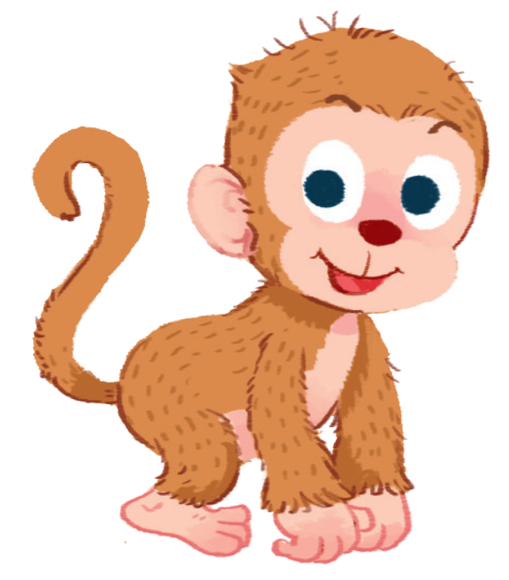
mother
monkey
Notes:
Step 2
Goals: Pupils will be able to listen and repeat the unit key words mother and monkey.
Recognize and say the words with flashcards.
Time: 3 minutes
Introduce the unit keywords mother and monkey with flashcards.
On the board, there are two flashcards for mother and monkey. The flashcard for mother is above the flashcard for monkey.
Teacher points to the mother, says the word and has pupils repeat the word.
Do the same with monkey.
Have pupils guess the word and repeat by pointing to mother and monkey. Hold your hand up or down to the position of the flashcard.
Turn over the cards, have pupils guess the card and shout out the word.
Swap the cards and have pupils guess.

Slide 9


mango
mouse
Notes:
Step 3
Goals: Pupils will be able to listen and repeat the Unit keywords mango and mouse.
Recognize and say the words with flashcards.
Time 3 minutes.
Do the same with step 2.

Slide 10
mango
mother
monkey
mouse
Notes:
Step 4
Goals: Pupils will practice more the new words.
Time 3 minutes.
Memory game
Show the slide for the first time.
Then show the next slides that the order of the 2 words has been changed.
Have pupils find out what words have been changed and say.

Slide 14



Notes:
Point and say is divided into 3 main steps.
Step 1
Goal: Pupils will be able to listen and repeat the words.
Time: 3 minutes
Have pupils listen and repeat the words once again but vary the speed to have fun.
Step 2.
Goal: Pupils will be able to listen and point to the pictures.
Time: 3 minutes
Have pupils listen and point to the pictures in the book.
Teacher can ask some pupils to read then others point.
Step 3
Goal: Pupils will be able to point and say to the pictures.
Time: 5 minutes
Point to the word mother and say mother.
Point to other words and have pupils say.
Have pupils work in pair, 1 points and the other says.

Slide 16
Game
Notes:
Chair game
Goal: Pupils will be able to recognize the unit words through pictures, sounds, and meanings.
Time: 5 minutes
Put 4 flashcards into 4 different chairs.
Two persons play each round.
Teacher speaks a word in English.
Have pupils quickly sit on the chair with the word on.
Who is faster is the winner.
After the game, have the whole class repeat the word in chorus.

Slide 17

Chair game

Slide 18

It’s time to say goodbye
Notes:
Goodbye
Time: 2 minutes
Repeat the words with rhythm and say goodbye.

Slide 19
Goodbye

Slide 20
Goodbye

Slide 21
Goodbye

Slide 22
Goodbye

Slide 23
Website: hoclieu.vn
Fanpage: facebook.com/www.tienganhglobalsuccess.vn

