Slide 1
Tiếng Anh 2
Giáo viên: Lê Thị Minh Hiếu
Lớp dạy: 2A1, 2A4, 2A5
Đơn vị công tác: Trường TH Hưng Đạo

Slide 3
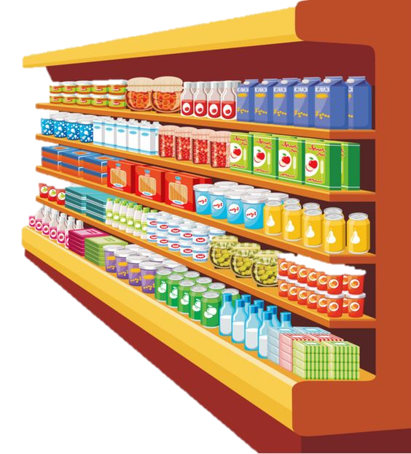
Unit 6 In the grocery store
Lesson 3 - Period 3

Slide 4










Classroom Rules

Slide 5



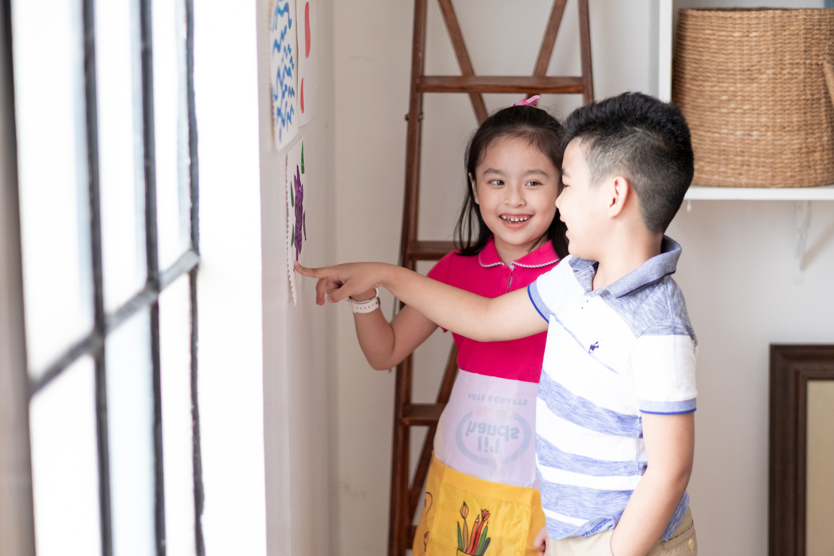



Rule 1
Listen to
your friend
talking in front.

Slide 6








Rule 2
Raise your hand
if you have a question.

Slide 7




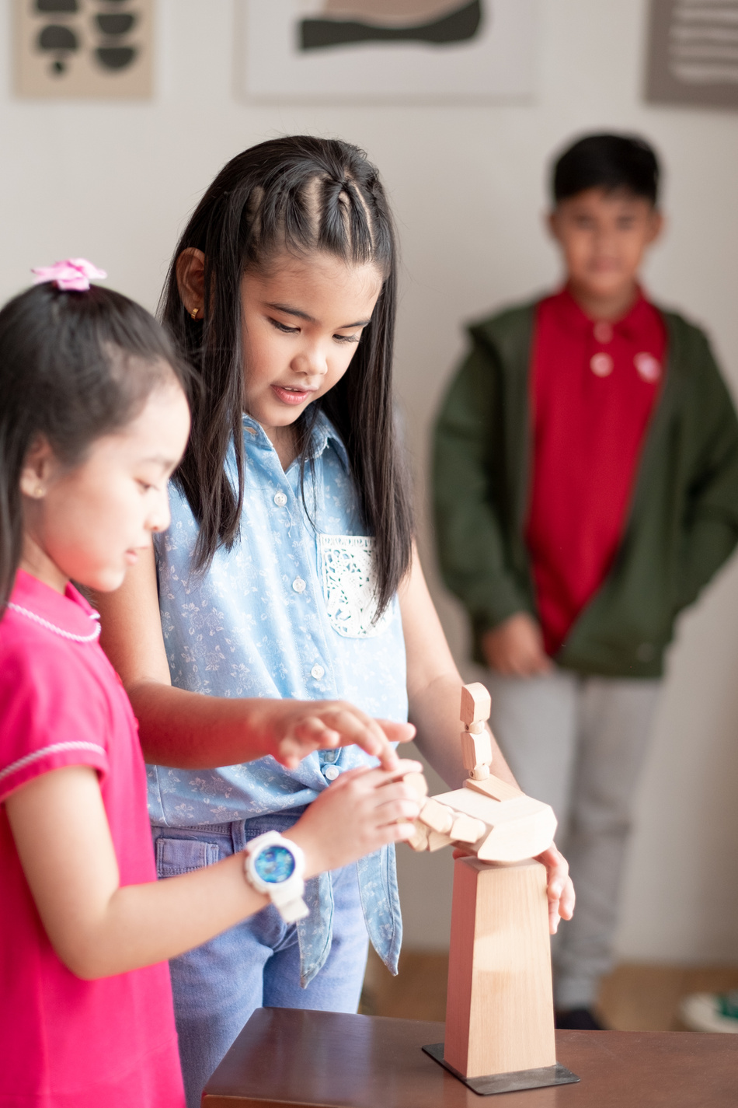


Rule 3
Wait for
your turn.

Slide 8








TABLE OF CONTENTS
1
Warm-up and review.
2
Activity 6: Listen and repeat.
3
Activity 7: Let’s talk.
4
Activity 8: Let’s sing.
5
Fun corner and wrap-up.

Slide 9

01
Warm-up and Review.

Slide 10












20
19
18
17
16
15
14
13
12
11
10
9
8
7
6
5
4
3
2
1
0
20
19
18
17
16
15
14
13
12
11
10
9
8
7
6
5
4
3
2
1
0
KIM’S GAME
START
Round 1
Round 2
Round 3
Round 4
Notes:
Lượt 1 : GV cho HS xem 1 set gồm 3 tranh sau đó HS kể ại những gì đã xem được.
Lượt 2: chơi tương tự nhưng số lượng tranh tăng thêm 1 hình.
- Lượt 3&4: tương tự nhưng số lượng tranh tăng lên 1- 2 hình và tùy theo khả năng của HS thì GV có thể cho dừng lại hoặc chơi tiếp.

Slide 11




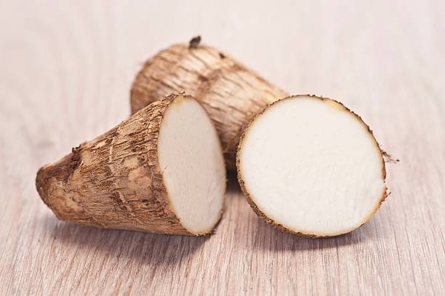







KIM’S GAME
START
FINISH

Slide 12

KIM’S GAME
FINISH
START

Slide 13
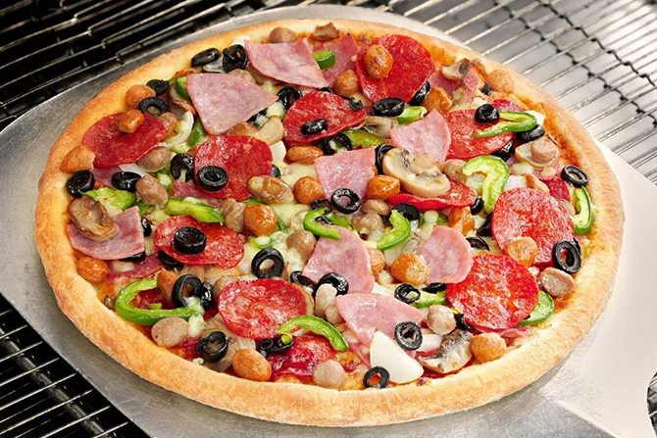
KIM’S GAME
FINISH
START

Slide 14

KIM’S GAME
FINISH
START

Slide 15












Slide 16


06 Activity 6 Listen and repeat.

Slide 17




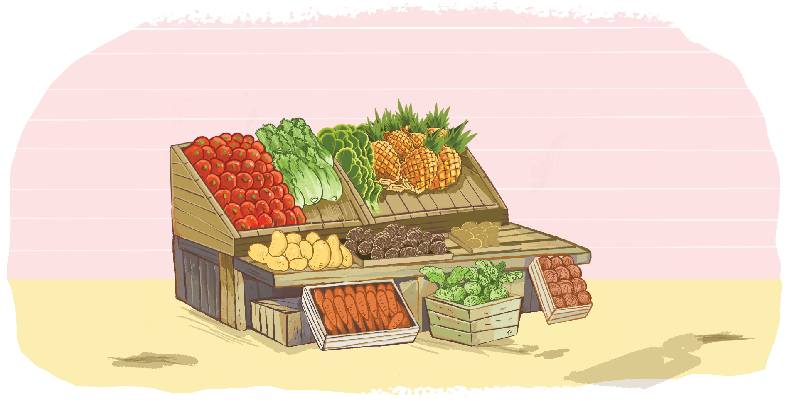
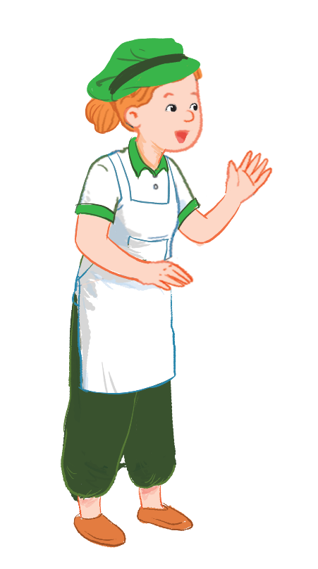
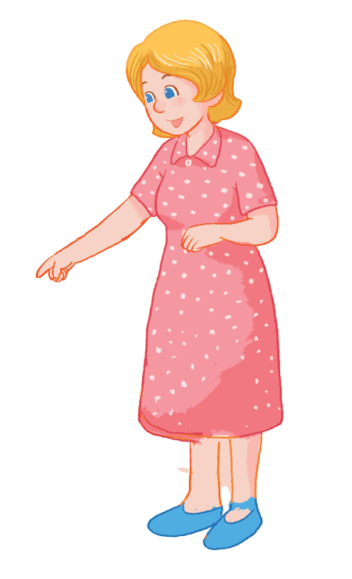
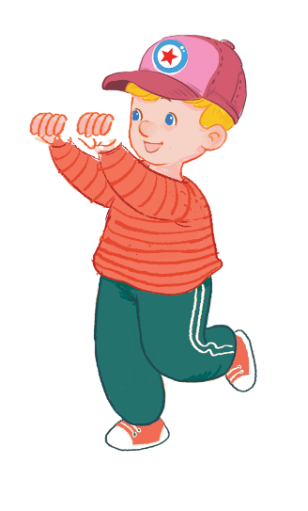

Listen and repeat.
I want some yams.
I want some yams.
I want some yams.
I want some yams.
What do you want?
What do you want?
What do you want?
What do you want?

Slide 18

07 Activity 7 Let’s talk.

Slide 19


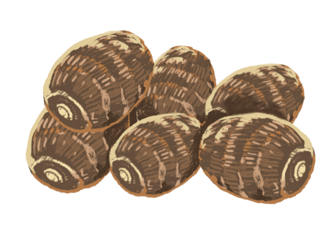

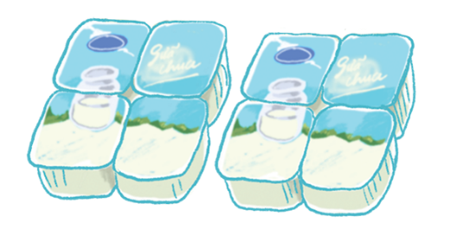
Let’s talk.
What do you want?
I _____ .
a
b
c

Slide 20

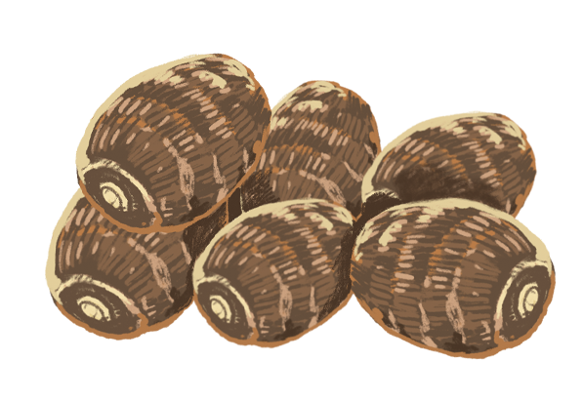
What do you want?
I ______ .
a

Slide 21
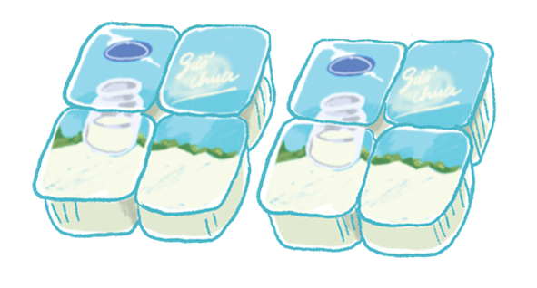
What do you want?
I ______.
b

Slide 22
What do you want?
I ______ .
c

Slide 23

08 Activity 8 Let’s sing.

Slide 24






Let’s sing!
Yo-yos and yogurt.
Yo-yos and yogurt.
Yo-yos and yogurt.
Yo-yos and yogurt.
I want some yo-yos.
I want some yo-yos.
I want some yo-yos.
I want some yo-yos.
I want some yogurt.
I want some yogurt.
I want some yogurt.
I want some yogurt.
Yams and apples.
Yams and apples.
Yams and apples.
Yams and apples.
Mum wants some yams.
Mum wants some yams.
Mum wants some yams.
Mum wants some yams.
Mum wants some apples.
Mum wants some apples.
Mum wants some apples.
Mum wants some apples.

Slide 25
05 Fun corner and Wrap-up.

Slide 26


Option 1
Option 2

Slide 27

TIC-TAC-TOE
GAME

Slide 28


Slide 29

TIC-TAC-TOE GAME
1
2
3
X
O
O
X
X
O
4
5
6
O
O
X
Team X
X
X
O
Team O
X1
X2
X3
O1
O2
O3
X4
X5
X6
O4
O5
O6
7
8
9
O
O
X
X
X
O
X7
X8
X9
O7
O8
O9

Slide 30








What do you want?
I want some yogurt.
KEY
Notes:
HS trả lời sai GV click vào hình ngôi sao
HS trả lời đúng GV click vào KEY.

Slide 31
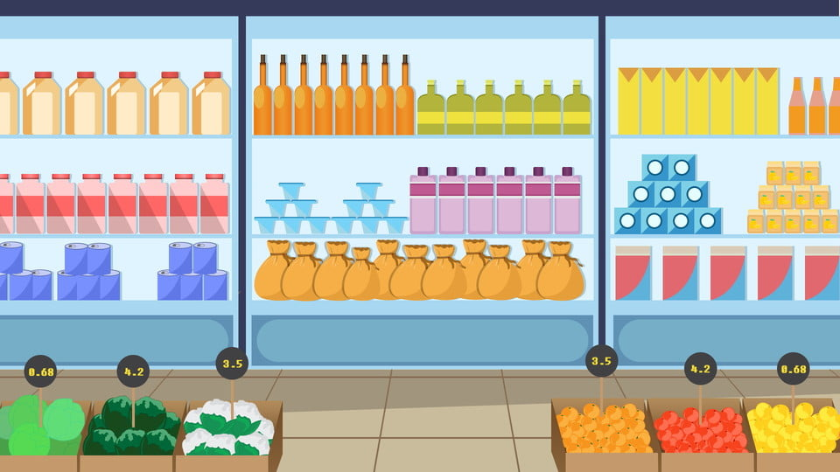
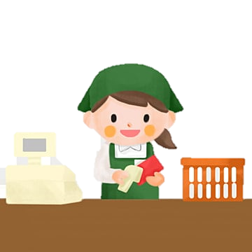


What do you want?
I want some yams.
KEY

Slide 32
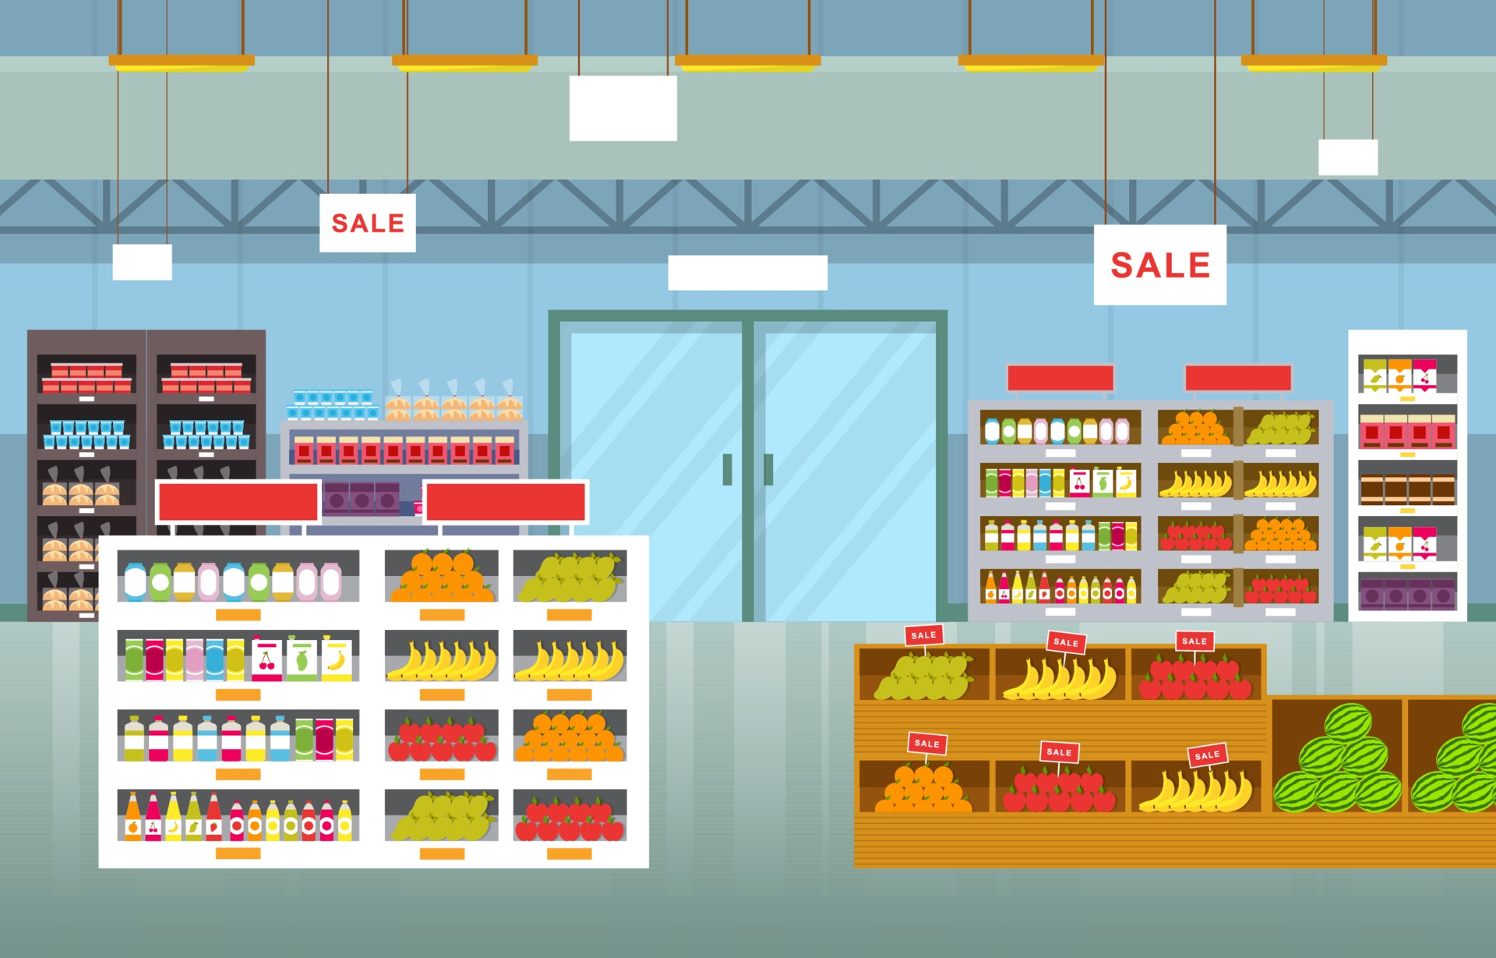




What do you want?
I want some jelly.
KEY

Slide 33
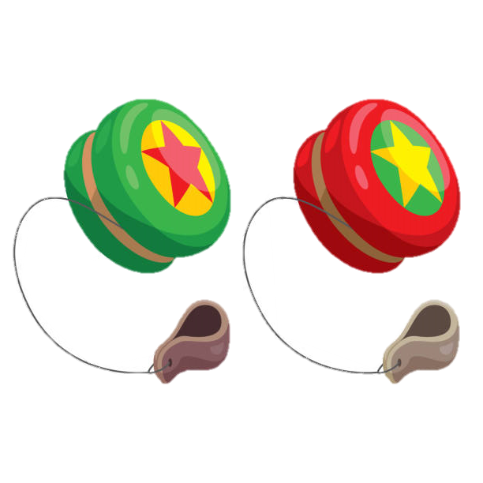
What do you want?
I want some yo-yos.
KEY

Slide 34

What do you want?
I want some apples.
KEY

Slide 35




Which word is correct?
a. yams
b. yo-yos
c. yellow
KEY

Slide 36




Is there a fox?
Yes, there is.
KEY

Slide 37


Which word is correct?
a. yo-yos
b. yams
c. yogurt
KEY

Slide 38


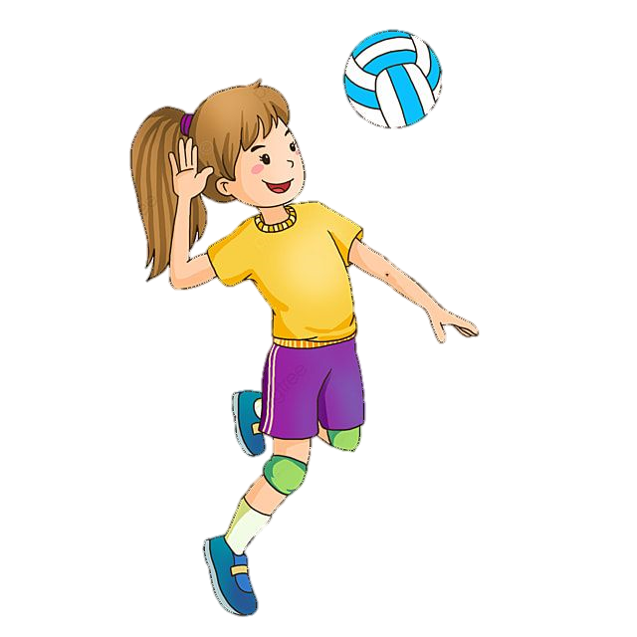


Which picture is correct?
volleyball
volleyball
volleyball
A
B
C
KEY

Slide 39


Team X
Team X
Team X
CongratulationS !!!

Slide 40
Team O
Team O
Team O
CongratulationS !!!

Slide 41
You both WON the game!
Team X
AND
Team O
CongratulationS !!!

Slide 42
GAME Quick reveal
TEAM 1
TEAM 2
20
19
18
17
16
15
14
13
12
11
10
9
8
7
6
5
4
3
2
1
0
20
19
18
17
16
15
14
13
12
11
10
9
8
7
6
5
4
3
2
1
0
Notes:
Chia 2 đội chơi.
GV click vào màn hình để hiện tranh. HS chỉ được nhìn qua chớp nhoáng và đọc được tên bức tranh đó thì ghi điểm.

Slide 45

Time to say goodbye!
y

Slide 46
Website: hoclieu.vn
Fanpage: https://www.facebook.com/tienganhglobalsuccess.vn/

