Slide 1
Tiếng Anh 2
Giáo viên: Lê Thị Minh Hiếu
Lớp dạy: 2A1, 2A4, 2A5
Đơn vị công tác: Trường TH Hưng Đạo

Slide 3

Unit 10
Lesson 2 - Period 2

Slide 4










Classroom Rules

Slide 5



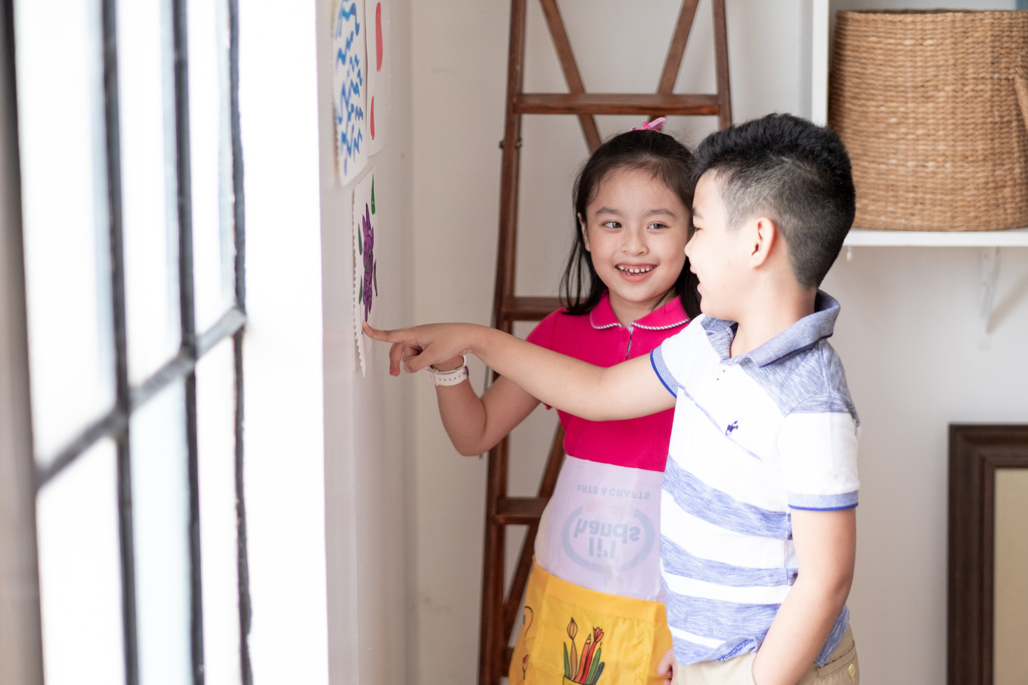



Rule 1
Listen to
your friend
talking in front.

Slide 6








Rule 2
Raise your hand
if you have a question.

Slide 7




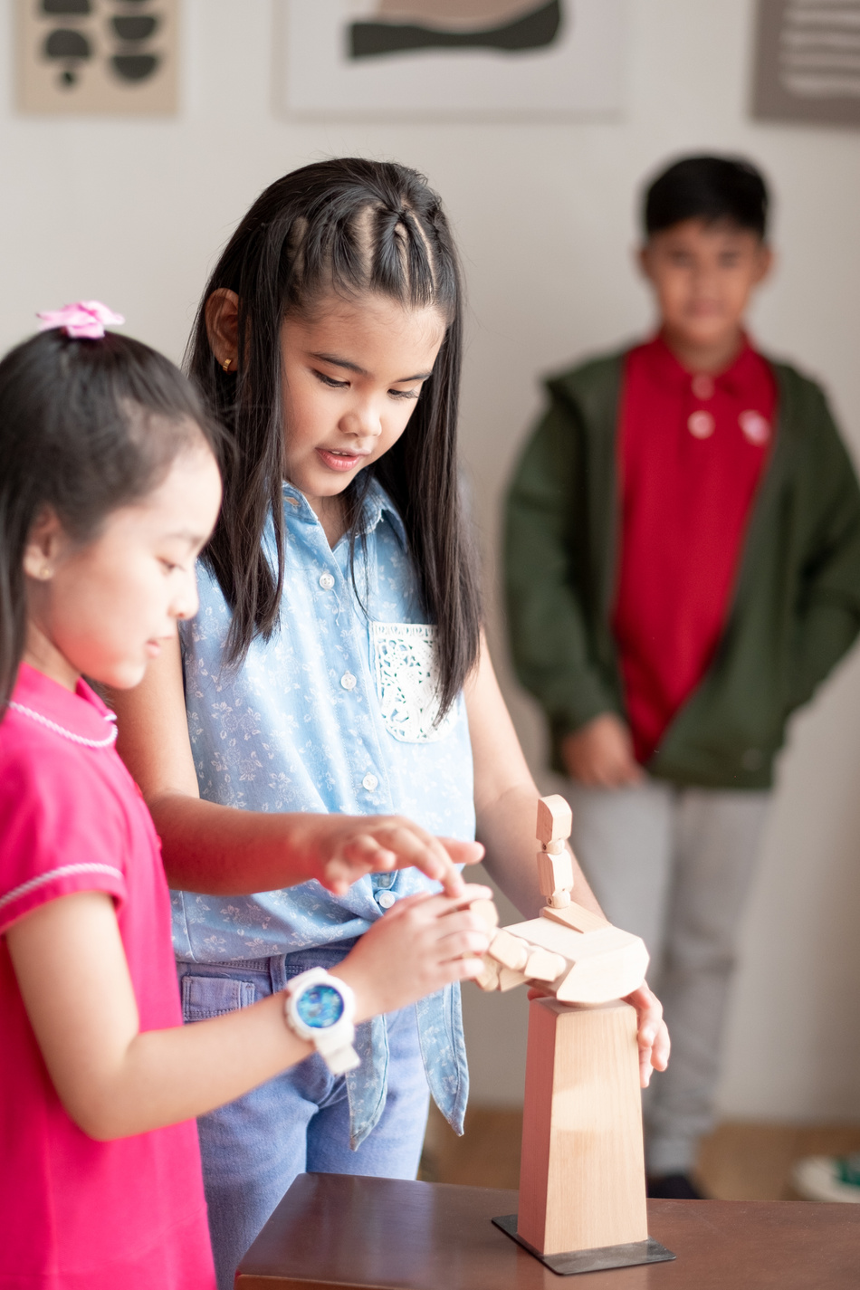


Rule 3
Wait for
your turn.

Slide 8


Table of contents
1.
2.
3.
4.
Warm-up and review.
Activity 3: Listen and chant.
Activity 4: Listen and circle.
Activity 5: Look and write.
5.
Fun corner and wrap-up.

Slide 9
01
Warm up and Review.

Slide 10
Vanishing Flashcards
Notes:
Tell the class they are remembering the pictures and say the pictures’ names.
- Divide the class into four teams.
- Place pictures on the board.
- Give them a moment to memorize the pictures and then tell them to close their eyes.
- Take away one of the pictures and then tell the pupils to open their eyes again. The first pupil who guesses and says the missing picture correctly get one point for his/her team.
The team with the most points to win.

Slide 11




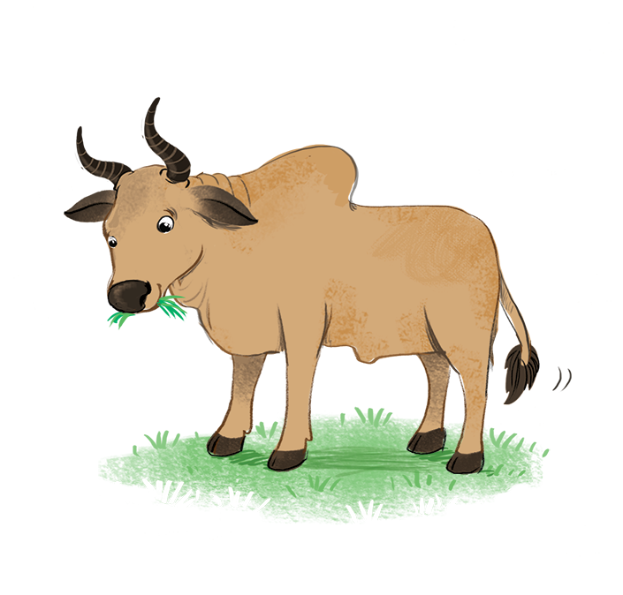











Slide 12


Slide 13


Slide 14


Slide 15
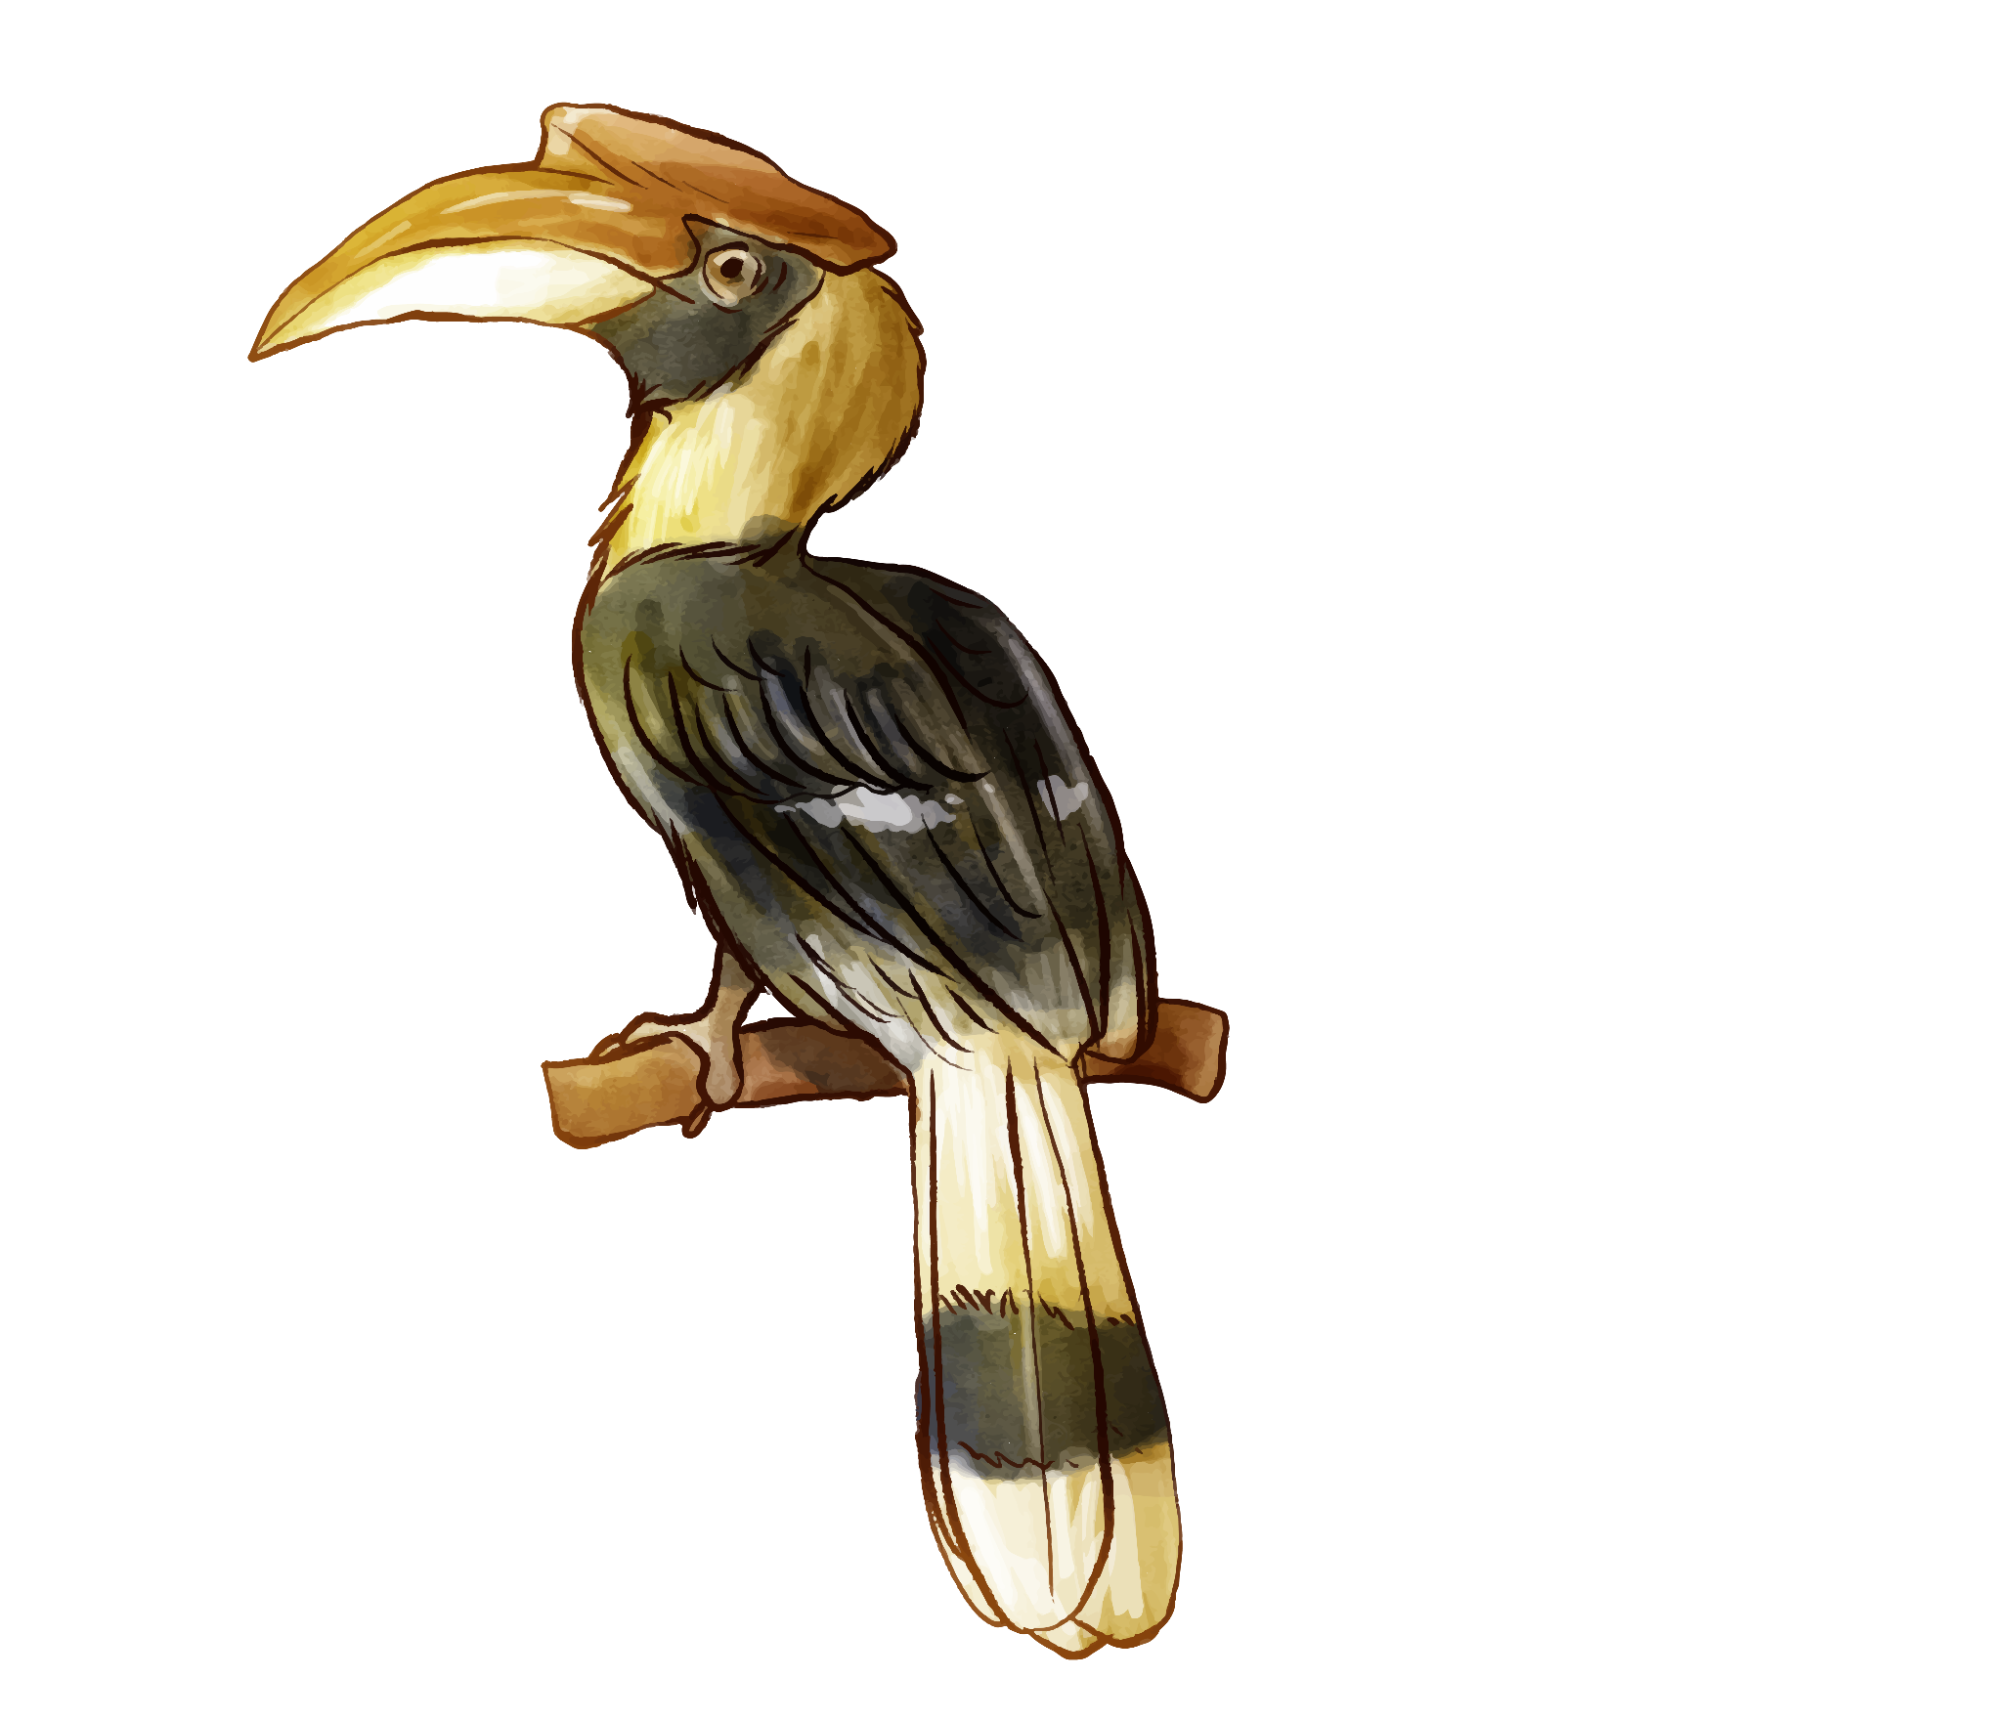
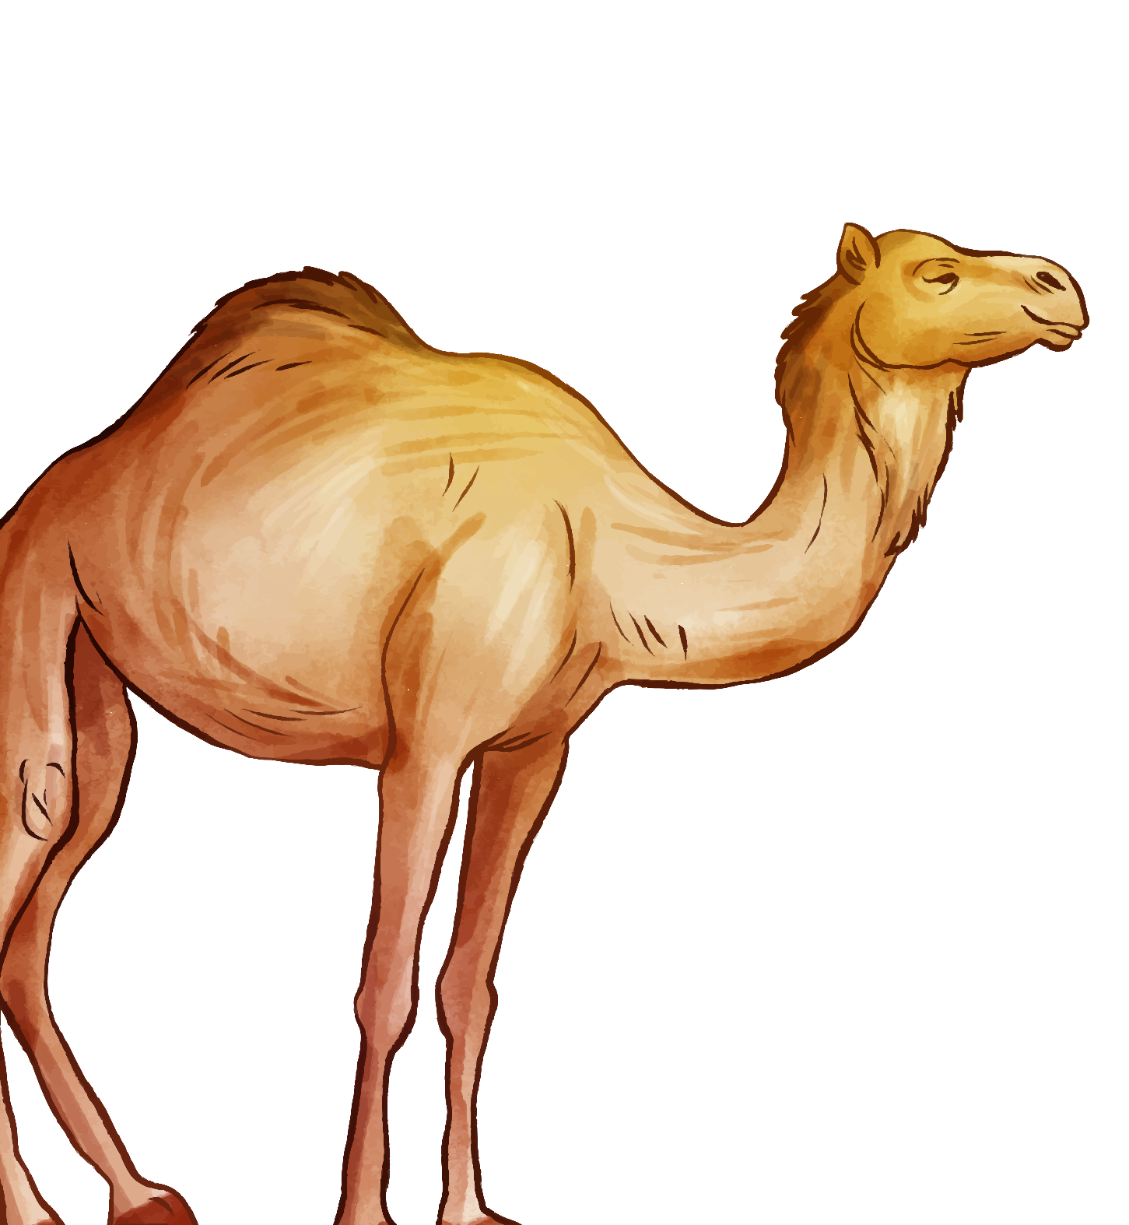
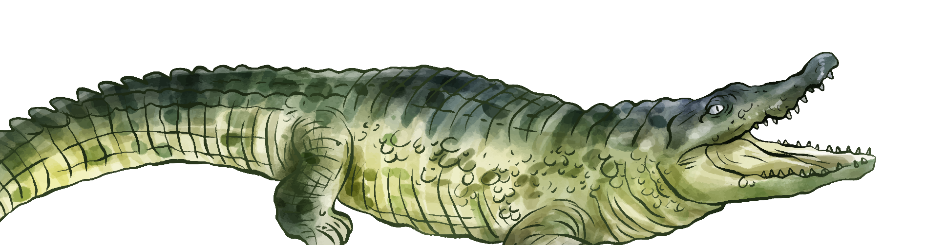
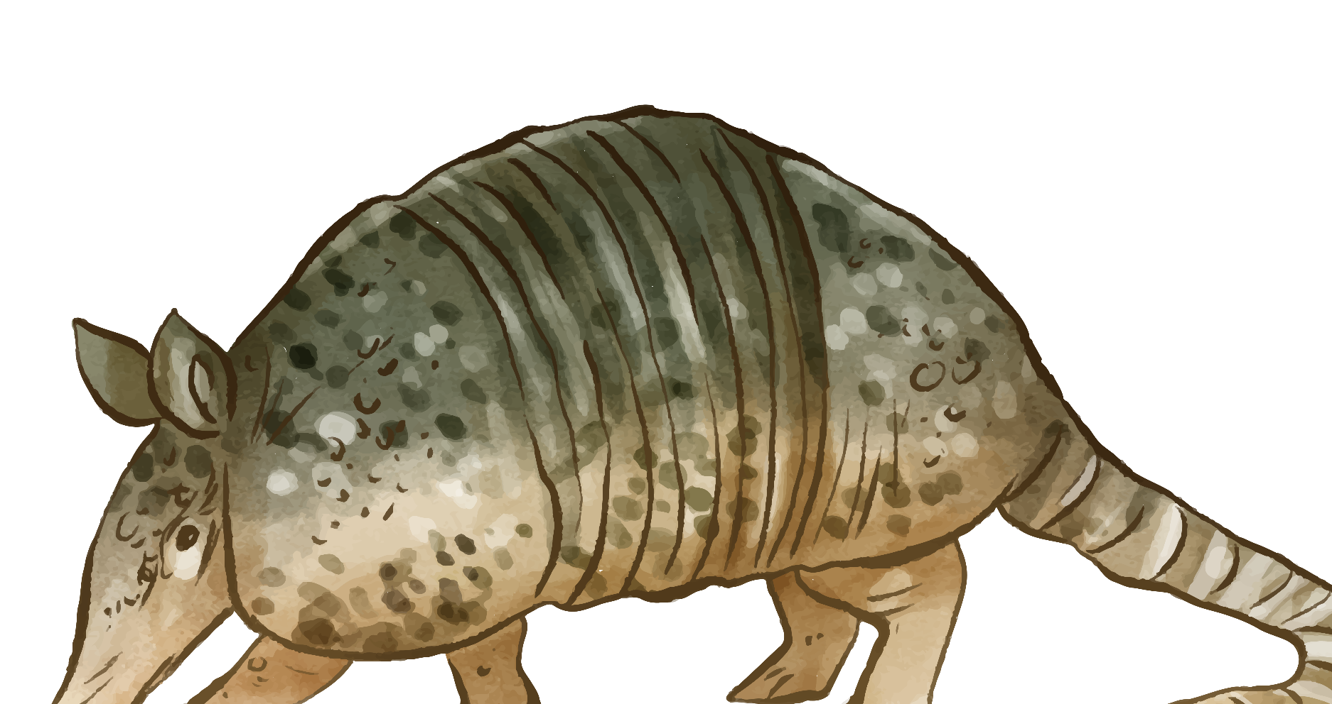
02
Listen and chant.
Activity 3

Slide 16

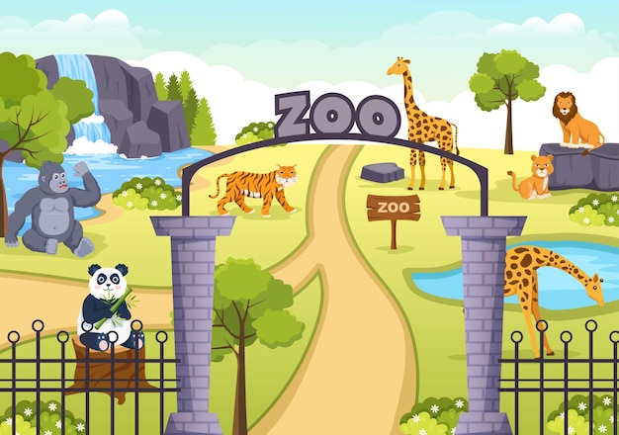
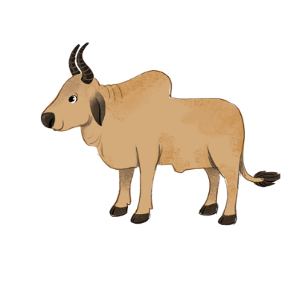



Listen and chant.
Z, z, zoo.
Z, z, zoo.
Z, z, zoo.
Z, z, zoo.
We’re at the zoo.
We’re at the zoo.
We’re at the zoo.
We’re at the zoo.
Z, z, zebra.
Z, z, zebra.
Z, z, zebra.
Z, z, zebra.
That’s a zebra.
That’s a zebra.
That’s a zebra.
That’s a zebra.
Z, z, zebu.
Z, z, zebu.
Z, z, zebu.
Z, z, zebu.
That’s a zebu.
That’s a zebu.
That’s a zebu.
That’s a zebu.

Slide 17


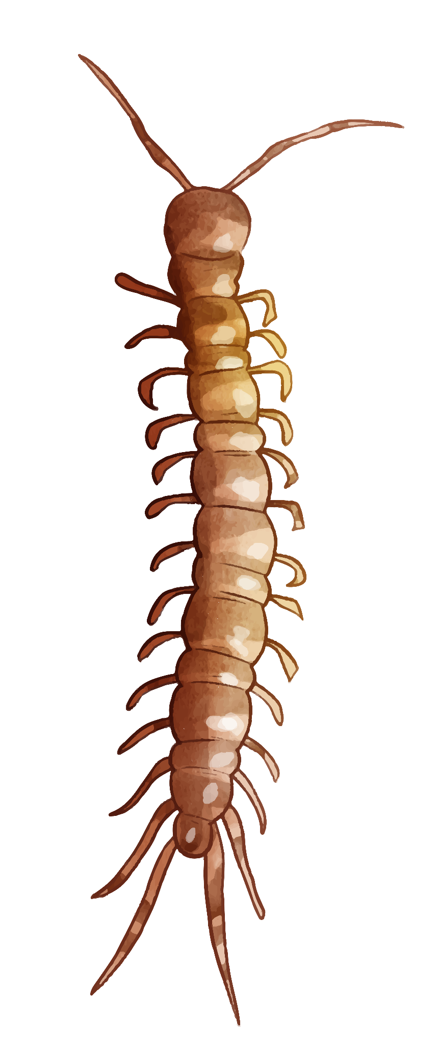

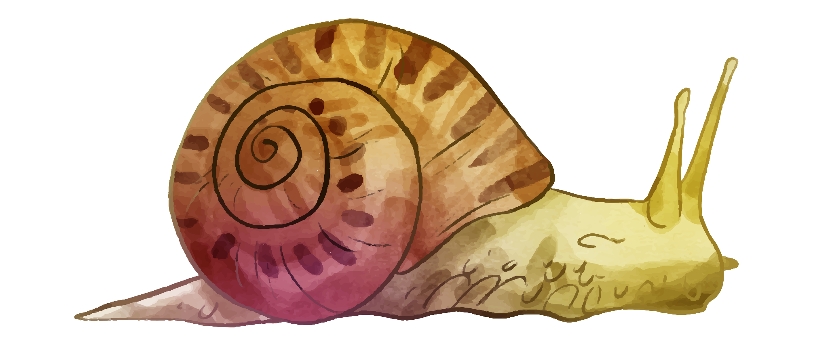
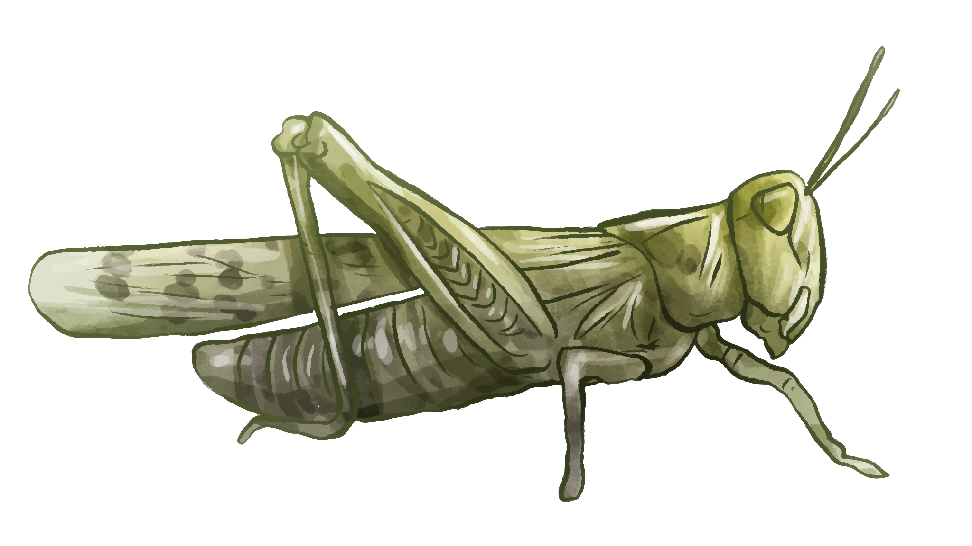
03
Listen and circle.
Activity 4

Slide 18



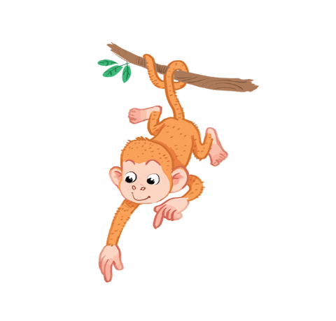




Listen and circle.
1
2

Slide 19


1

Slide 20
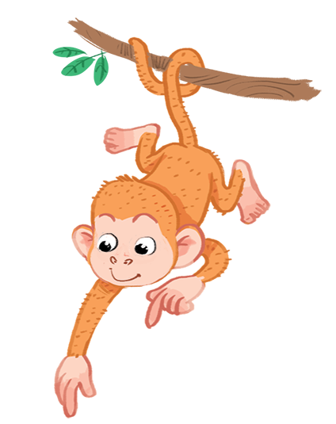
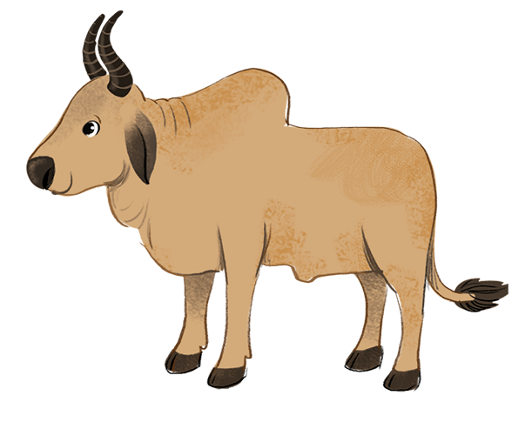
2

Slide 21


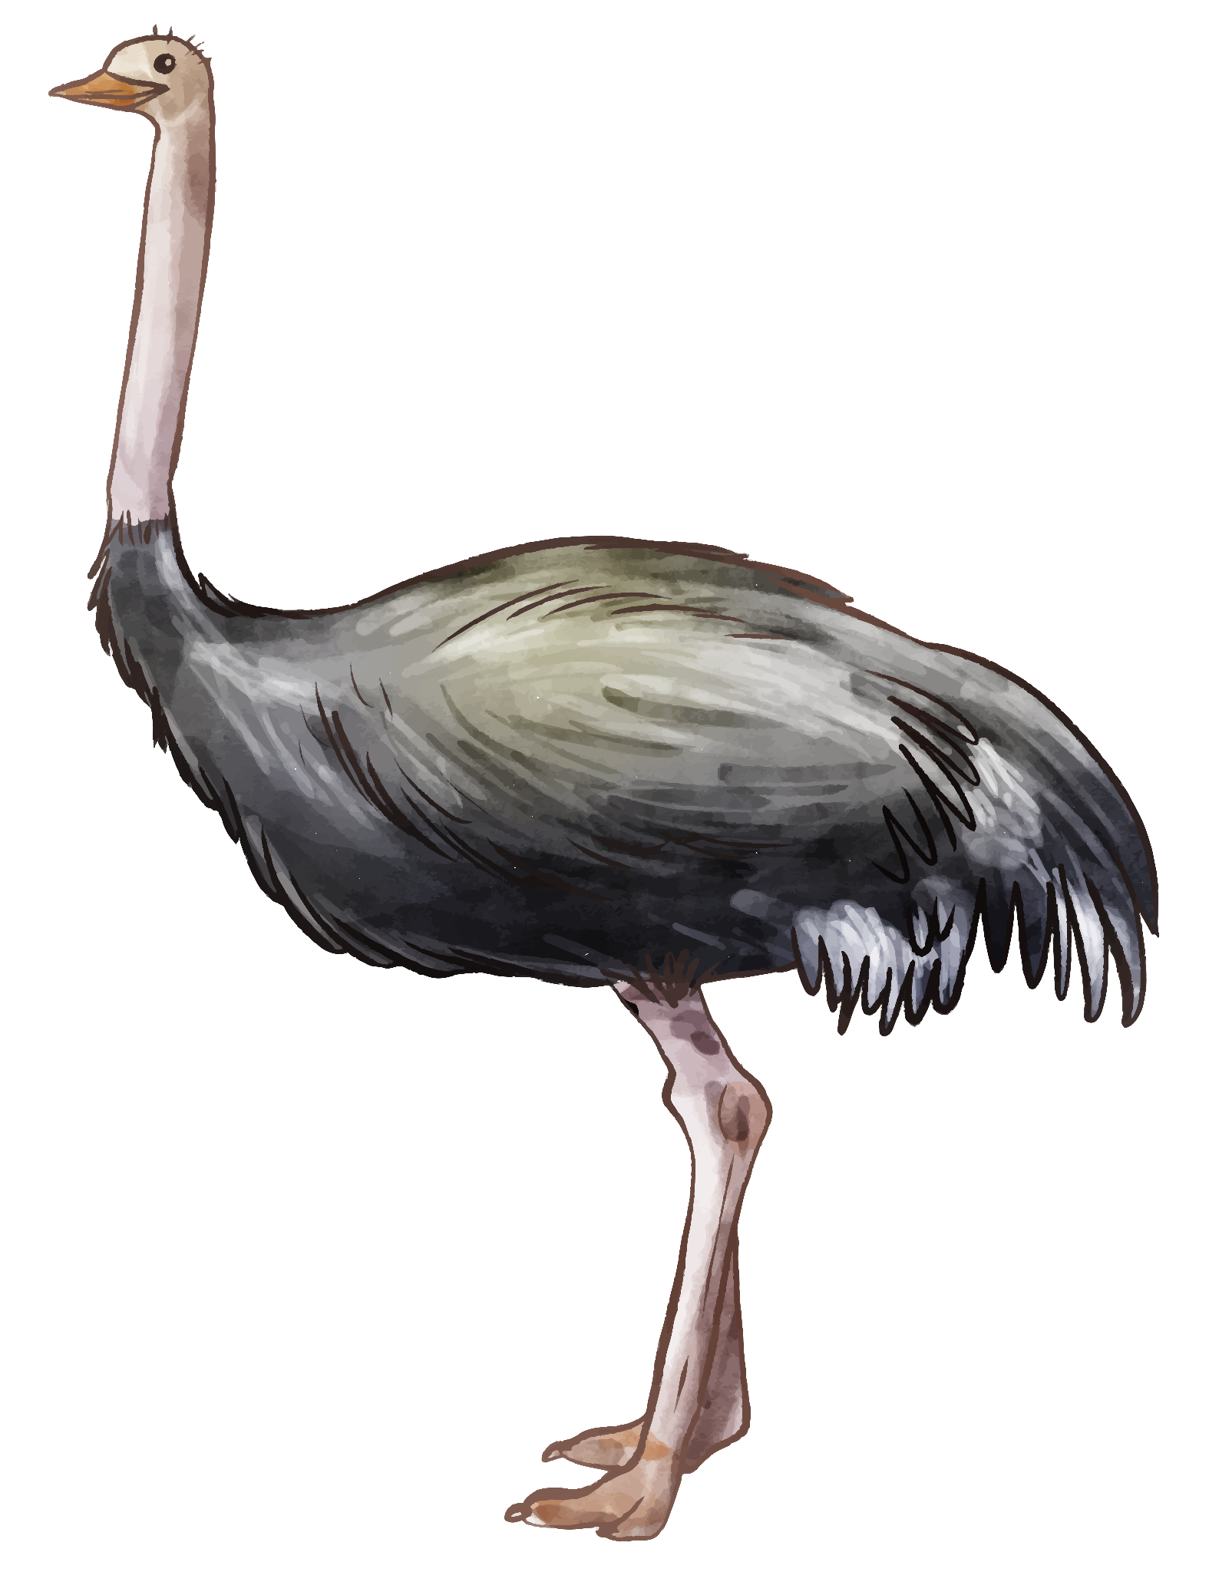


04
Look and write.
Activity 5

Slide 22
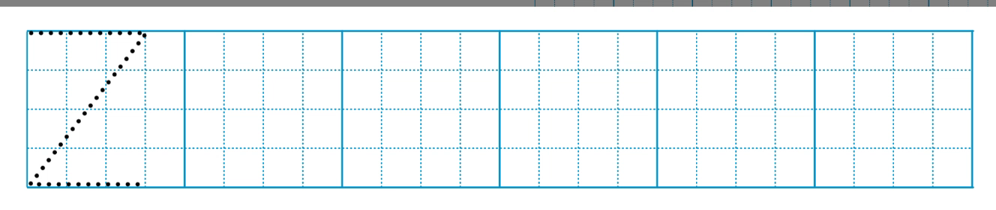
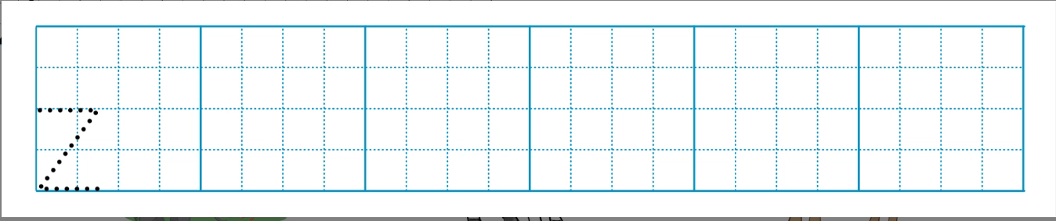

Slide 23
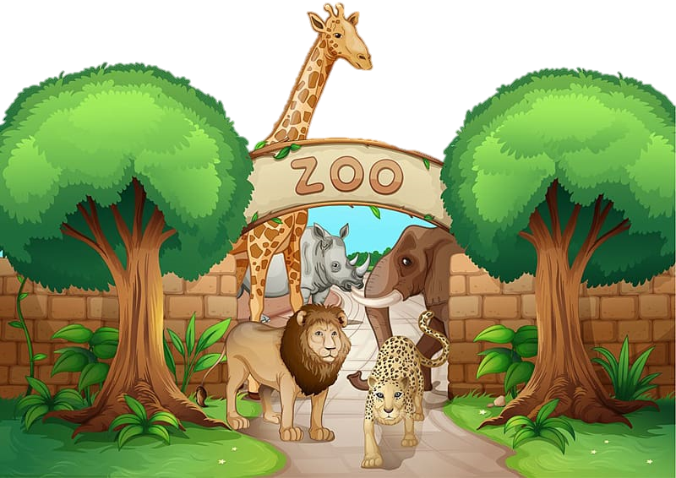




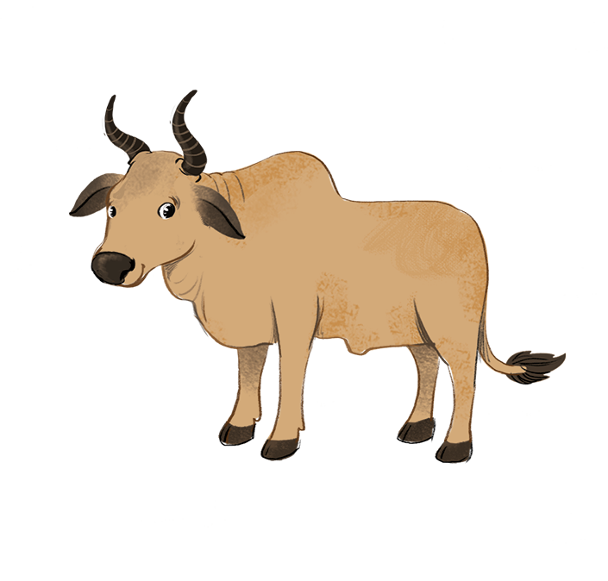


Look and write.
z
oo
z
ebra
z
ebu

Slide 24
05
Fun corner and Wrap-up.

Slide 25


Option 1
Option 2

Slide 26
Monkey climbing

Slide 27










Slide 28







Well done
Well done

Slide 29



z
o
o
____

Slide 30
z
a
____
e
b
r

Slide 31
____
e
b
u
z

Slide 32
o
x
f
____

Slide 33
o
____
x

Slide 34


Slide 35
Slow reveal

Slide 36

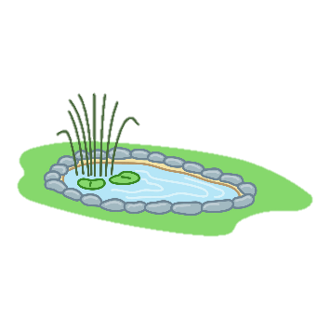












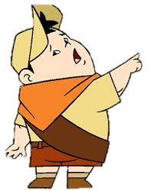


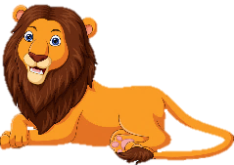




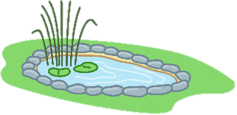
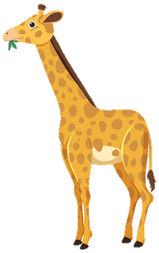




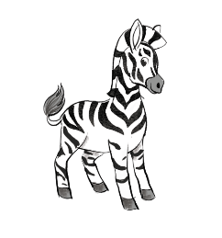



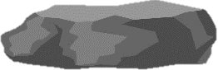


Notes:
Game mô phỏng cậu bé đi tham quan sở thú.
- GV click vào hình cậu bé để di chuyển đến các chuồng thú sau đó click vào hình định vị để đi đến câu hỏi.
- HS trả lời xong GV click vào hình cánh cửa chuồng thú để hiện ra các con vật bên trong.

Slide 37

zebu

Slide 38
giraffe

Slide 39
zebra

Slide 40

lion

Slide 41

elephant

Slide 43

Time to say goodbye!
z

Slide 44
Website: hoclieu.vn
Fanpage: https://www.facebook.com/tienganhglobalsuccess.vn/

