Slide 1
Tiếng Anh 1
Giáo viên: Tô Thị Hà
Lớp dạy: 1A1, 1A2, 1A3
Đơn vị công tác: Trường TH Hưng Đạo

Slide 2
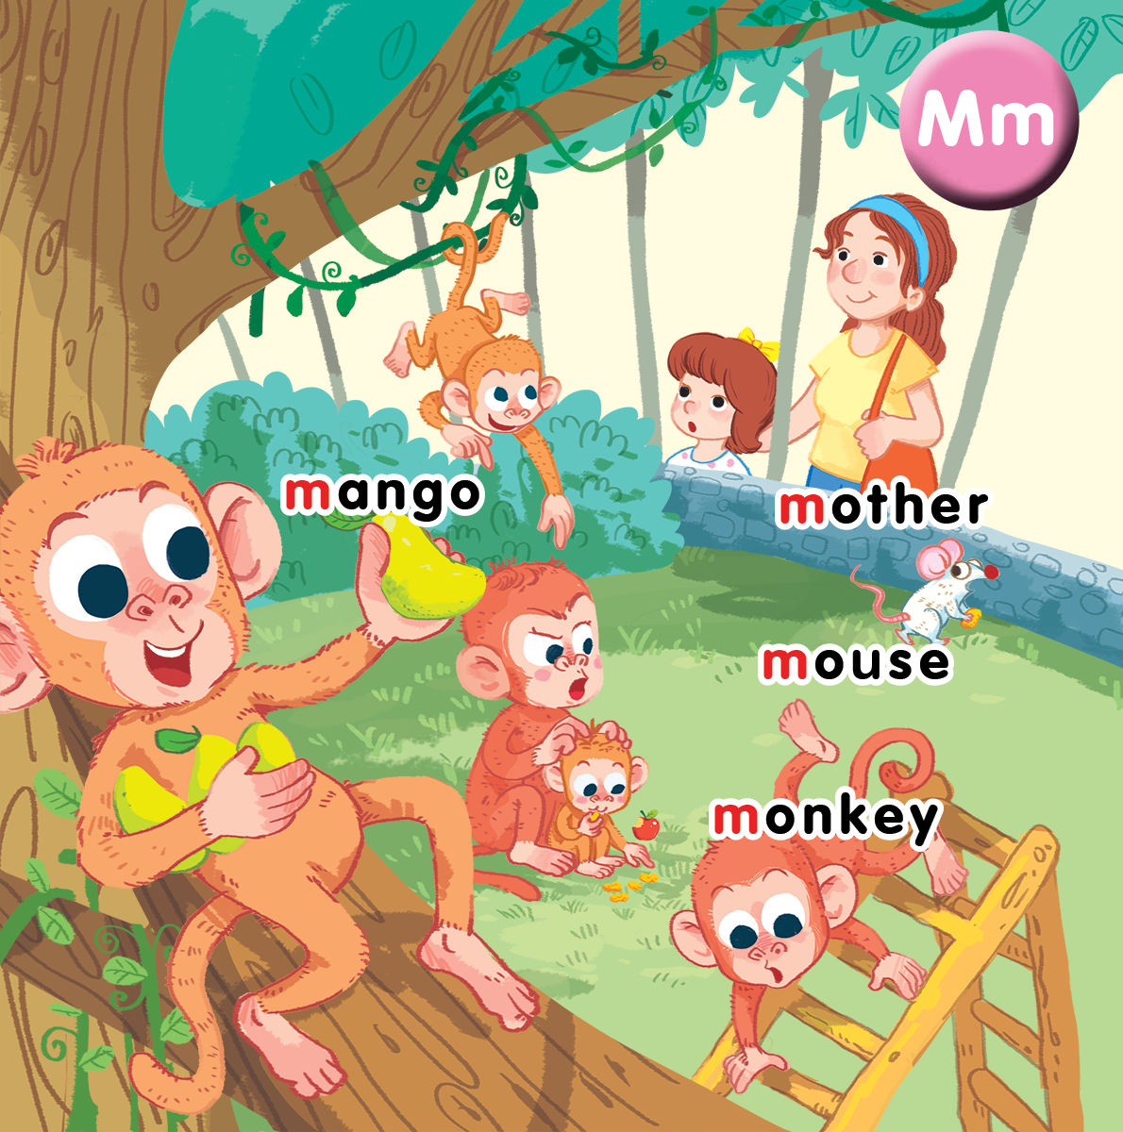
Unit 10 At the zoo Lesson 2
Notes:
By the end of the unit, pupils will be able to:
- say the sound of the letter M/m, the words mother, mouse, monkey, mango in a chant.
- listen, recognize the words and tick the correct boxes.
- trace the letter M/ m and complete the words _other, _onkey, _ouse, _ango.

Slide 3

Warm-up
Notes:
Slap the slide
Goal: Warm up and revise the unit keywords.
Time: 5 minutes
Show the slide
Have pupils slap the picture on the slide when the teacher says the word.

Slide 4

Slap the slide

Slide 5

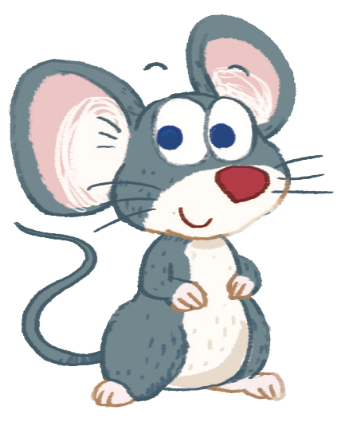
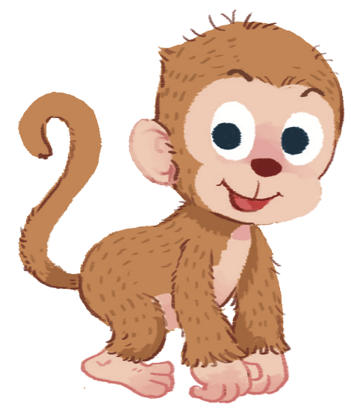
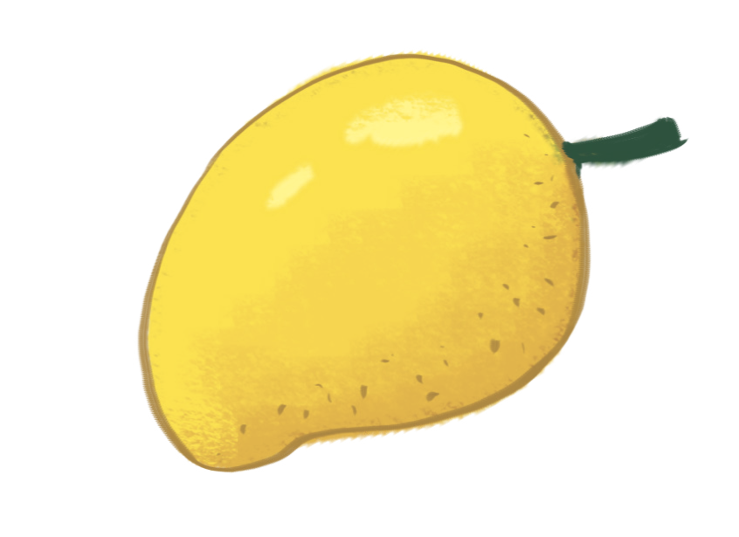

Slide 6


Listen and chant
Notes:
Listen and chant is divided into 3 steps.
Step 1
Goal: Pupils will be able to read the chant lyrics.
Time: 3 minutes.
Have pupils read the chant lyrics in chorus, then in groups.
Step 2
Goal: Pupils will be able to listen, chant and clap along.
Time: 3 minutes
Play the recording, have pupils listen and clap along.
Play the recording, have pupils listen, clap and chant along.
+ Round 1. Have pupils listen and clap along.
+ Round 2. Have pupils listen and do the TPR actions with teacher.
+ Round 3. Have pupils listen and do the actions and chant along.
+ Repeat round 3 several times.
Step 3
Goal: Pupils will be able to chant and clap along in pairs.
Time: 3 minutes
Have pupils chant along in pairs.

Slide 7

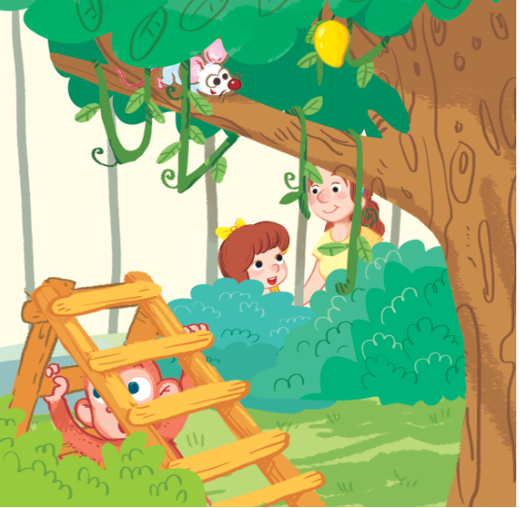
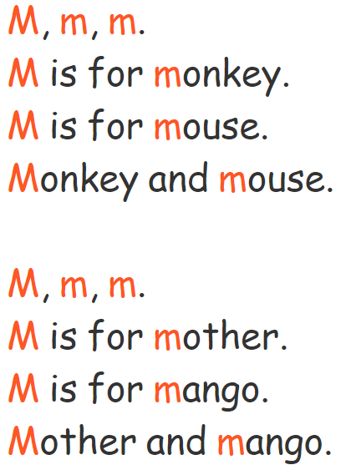
Listen and chant

Slide 8

Listen and tick
Notes:
Listen and tick is divided into 2 steps.
Step 1
Goal: Pupils will be able to listen and choose the correct pictures.
Time: 5 minutes
Say Listen and tick with the TPR actions.
Play the recording and demonstrate the example.
Play the recording and have pupils do the task.
Step 2
Goal: Check
Time: 5 minutes
Play the recording and have pupils say the answer.
Play the recording again and have pupils repeat then give correct answer.

Slide 9
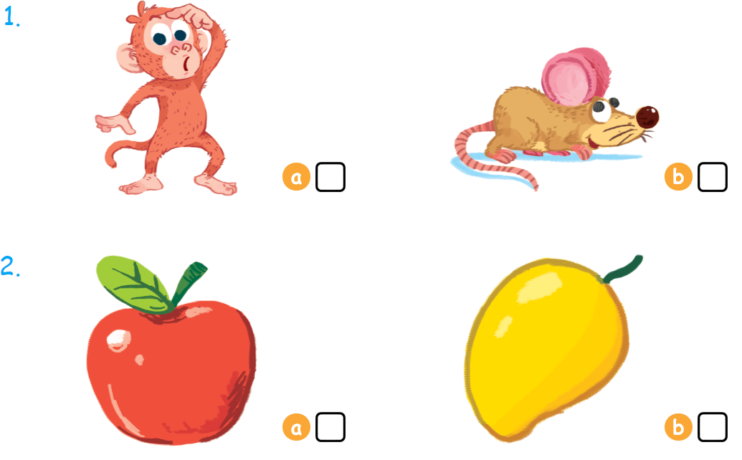

Listen and tick

Slide 10



Look, trace and write
Notes:
Goal: Pupils will be able to trace the letter.
Time: 5 minutes
Have pupils write the word by air tracing and say the word.
Demonstrate how to trace the word and have pupils do the task.

Slide 11
Game
Notes:
Mime game
Goal: Revise the words
Time: 5 minutes
Use the flashcards to play the game.
Have one pupil mime the word for others to guess and say.

Slide 12

Goodbye
Notes:
Goodbye
Time: 1 minute
Repeat the words with rhythm and say goodbye.

Slide 13
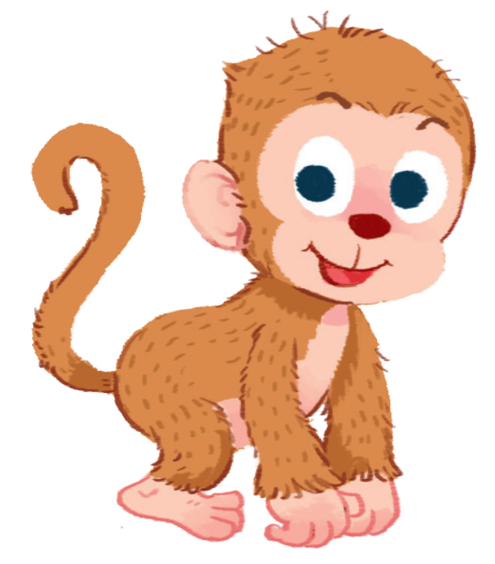
Goodbye

Slide 14

Goodbye

Slide 15
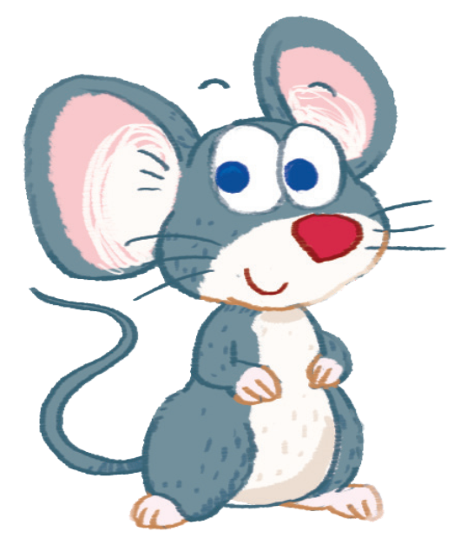
Goodbye

Slide 16
Website: hoclieu.vn
Fanpage: facebook.com/www.tienganhglobalsuccess.vn

