Slide 1
Tiếng Anh 3
Giáo viên: Tô Thị Hà
Lớp dạy: 3A1
Đơn vị công tác: Trường TH Hưng Đạo

Slide 2



Slide 3
REVIEW 2.2

Slide 4
Table of Contents
1
2
3
4
Warm-up and review
Read and match.
Look, complete and read.
Ask and anwer.
5
Fun corner and wrap-up

Slide 5
1
Warm-up and review

Slide 6
Look and guess!

Slide 7


Slide 8


Slide 9


Slide 10
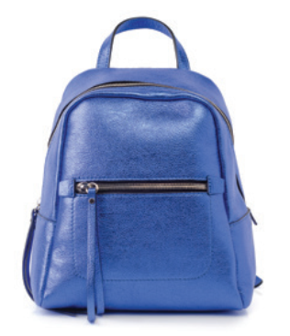

Slide 11


Slide 12


Slide 13
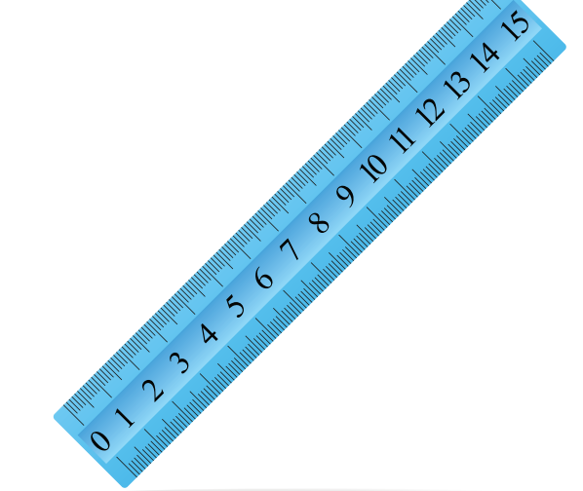

Slide 14
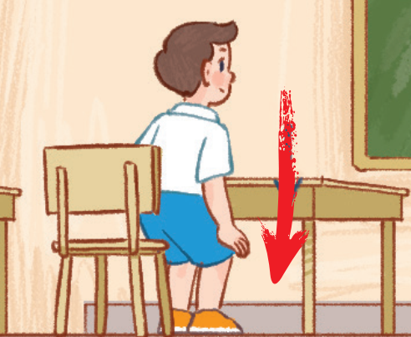

Slide 15
2
Read and match.

Slide 16
WHO IS FASTER?
Work in groups of 4-5 pupils.
Each group receives 1 set of sentences from the teacher.
Work together, match the questions with the answers.
The fastest one will be the winner.
Notes:
Giáo viên in các câu hỏi và trả lời của bài 3 trang 75 và cắt rời câu hỏi/trả lời thành các set để đưa cho hs.

Slide 17
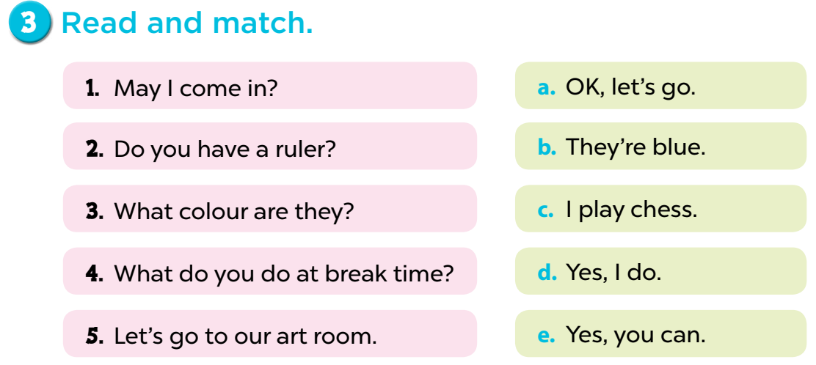

Slide 18
3
Look, complete and read.

Slide 19
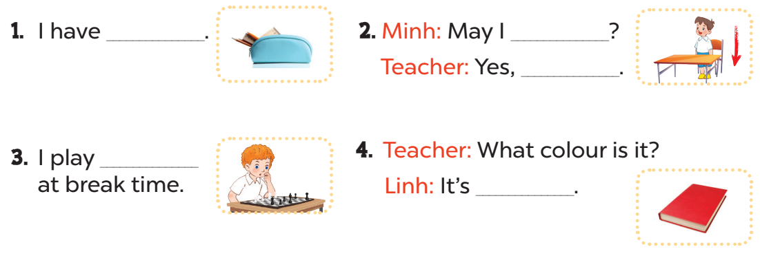
a pencil case
sit down
you can
chess
red

Slide 20
4
Ask and anwer.

Slide 21
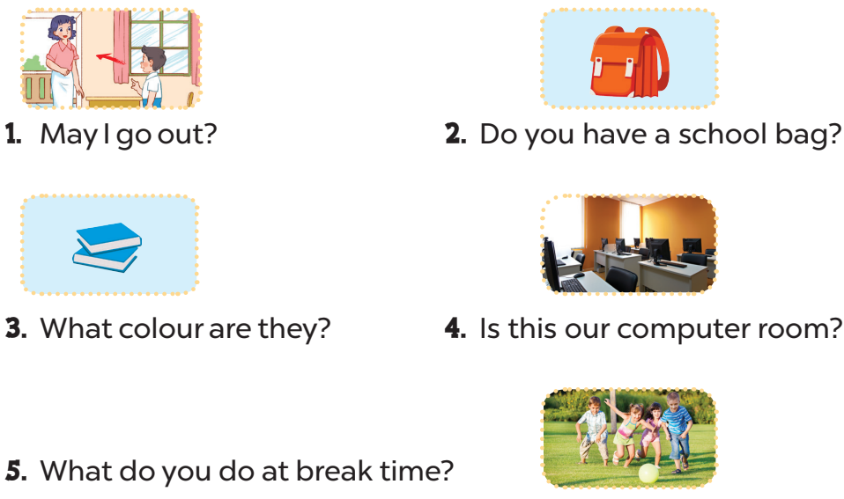
Yes, you can/No, you can’t.
Yes, I do.
They’re blue.
Yes, it is.
I play football.

Slide 22
5
Fun corner and wrap-up

Slide 23


Slide 24

1
2
3
4
TEAM 1
5
6
7
8
TEAM 2
9
10
11
12
TEAM 3
Notes:
Lucky number

Slide 25


What colour is it?
+ 2 points
It’s blue.

Slide 26
What colour is it?
+ 5 points
It’s yellow.

Slide 27


What colour are they?
+ 3 points
They’re green.

Slide 28

What colour are they?
- 3 points
They’re black.

Slide 29
Do you have ......................?
+ 4 points
Yes, I do.

Slide 30

What colour is it?
- 5 points
It’s pink.

Slide 31
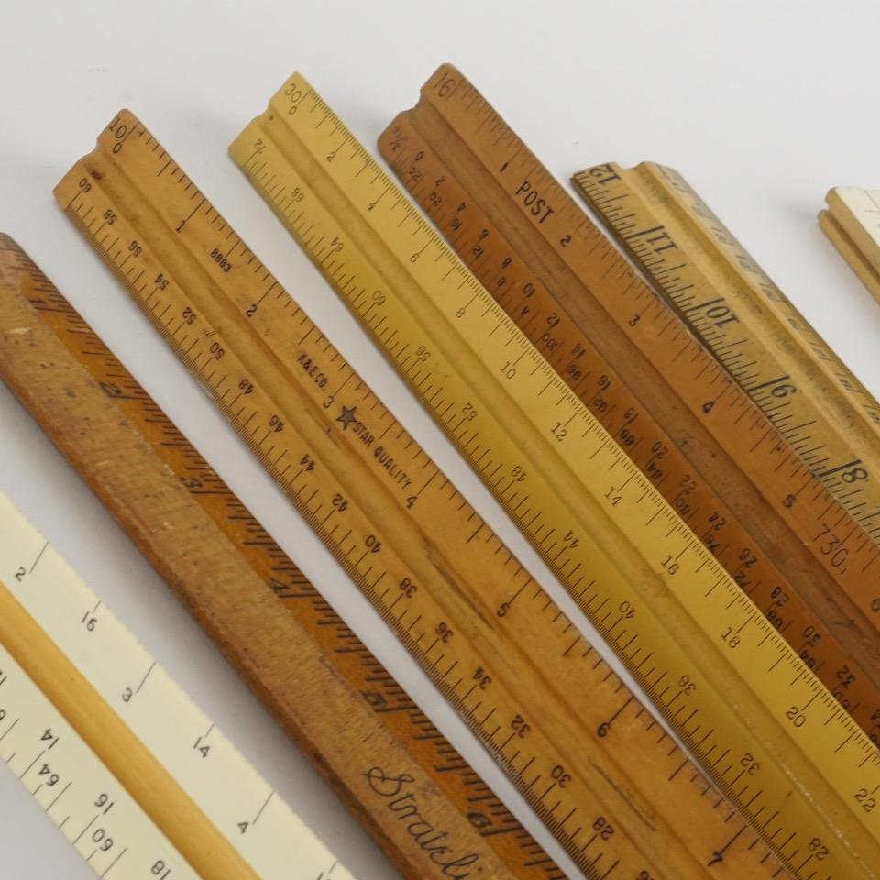
Do you have erasers?
+ 3 points
No, I don’t. I have rulers.

Slide 32
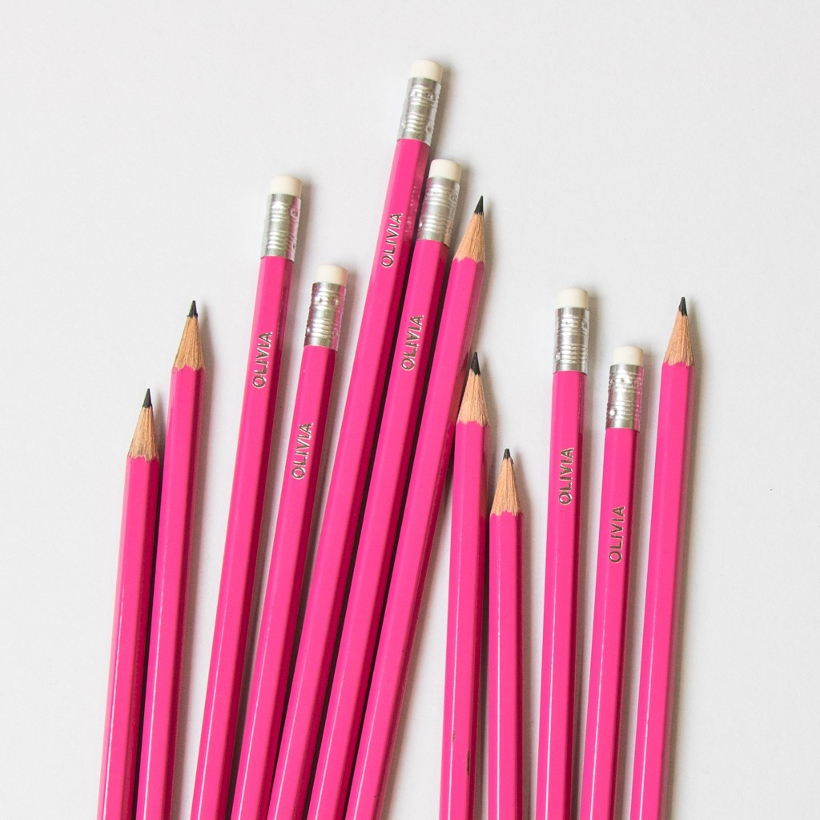
Do you have bags?
+ 1 points
No, I don’t. I have pencils.

Slide 33
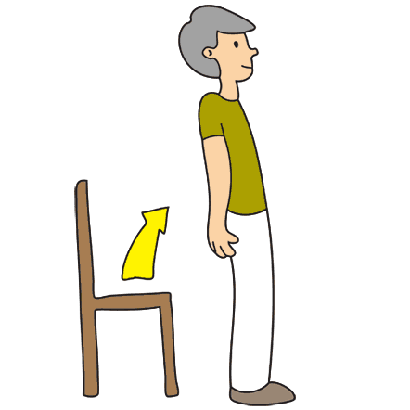
+ 5 points
Stand up, please!

Slide 34
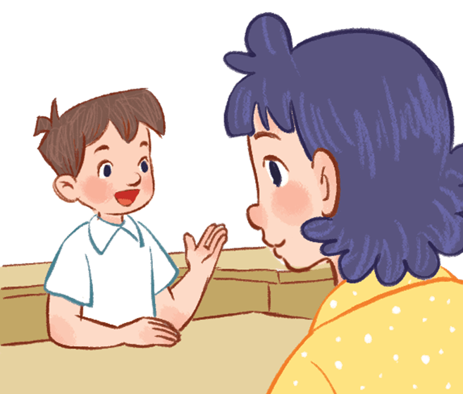
Vietnamese?
+ 10 points
May I speak Vietnamese?

Slide 35
What do you do at break time?
- 5 points
I play football.

Slide 36

What do you do at break time?
+ 8 points
I chat with my friends.

Slide 37

Website: sachmem.vn
Fanpage: www.facebook.com/sachmem.vn

