Slide 1



Giáo viên: Đồng Thị Như Quỳnh
Lớp dạy: 5A5, 5A6, 5A7
Đơn vị công tác: TRƯỜNG TIỂU HỌC HƯNG ĐẠO

Slide 2

OUR SPECIAL DAYS
Lesson 1 ( 4, 5, 6 )

Slide 3
01
Warm-up

Slide 4
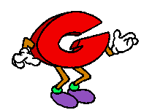
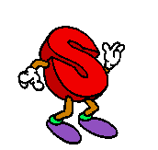
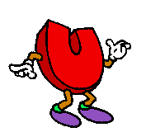

Can you?

Slide 5
Look and guess the occasions
1 picture open: 3 points
2 pictures open: 2 points
All pictures open: 1 point

Slide 6

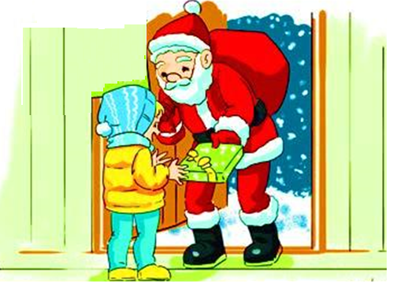


Christmas Day

Slide 7
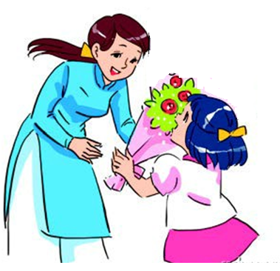


Teachers’ Day

Slide 8
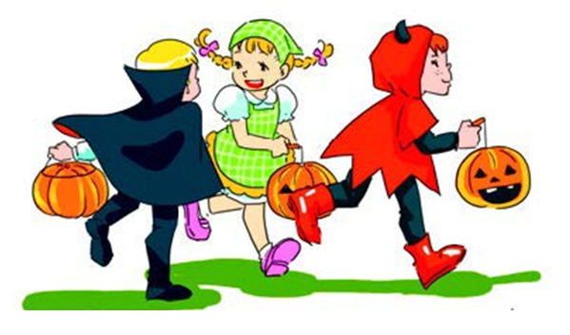


Halloween Day

Slide 9
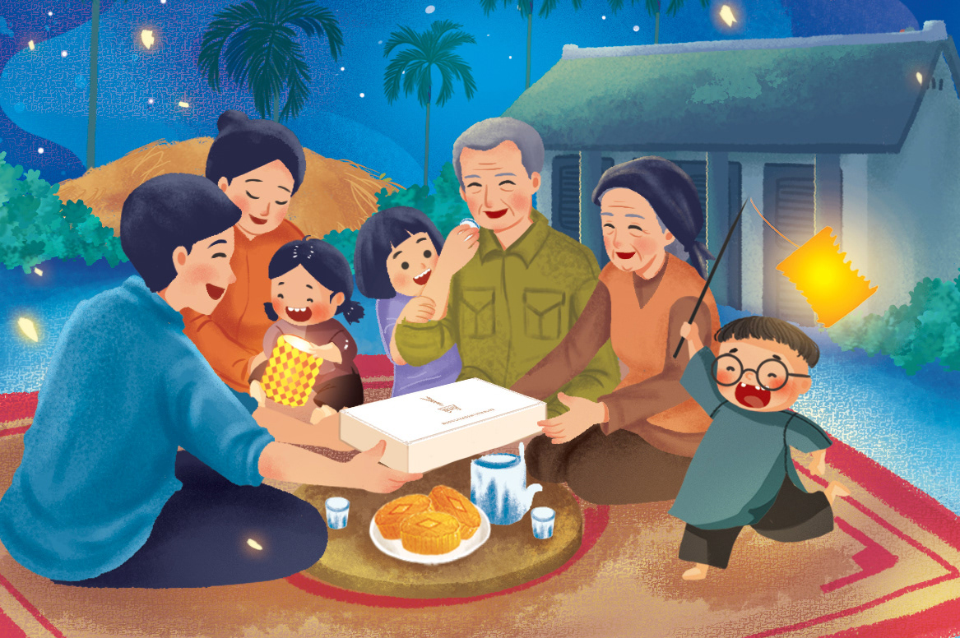


Mid-Autumn Festival

Slide 10
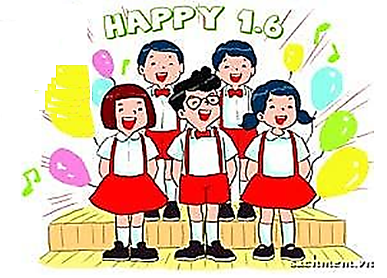


Children’s Day

Slide 11
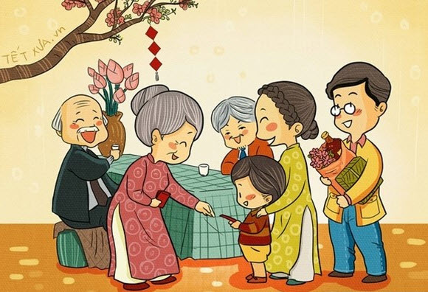


Tet

Slide 12
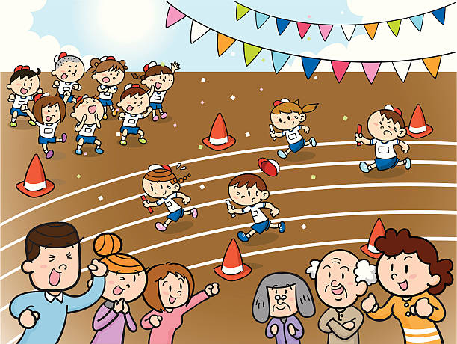


Sports Day

Slide 13

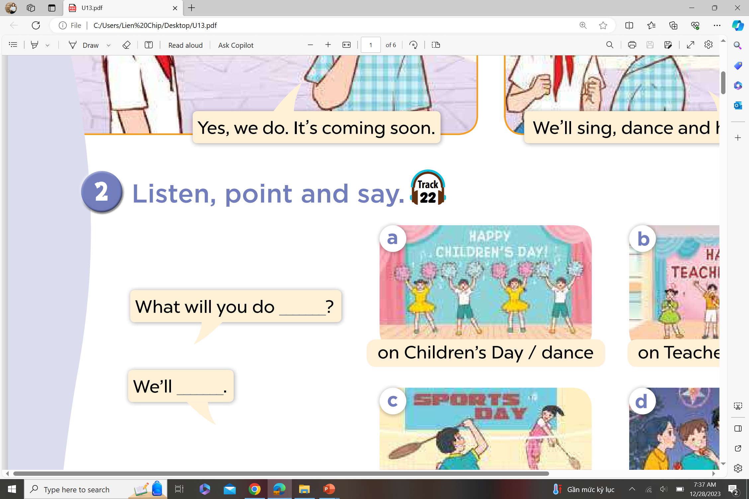

Ask and answer.

Slide 14
02
Activity 1
Listen and tick or cross.

Slide 15
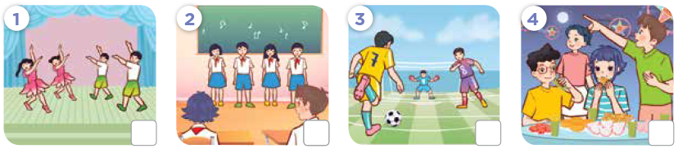
Look! What will they do?

Slide 16


Listen and tick or cross.

Slide 17
Listen and repeat.

Slide 18
03
Activity 2
Read and complete.

Slide 19
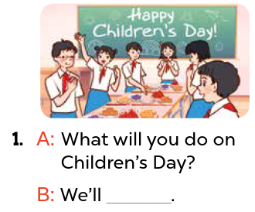
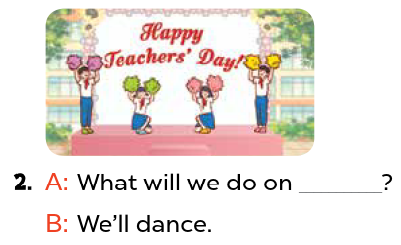
Read and complete.
Teachers’ Day
have a party

Slide 20
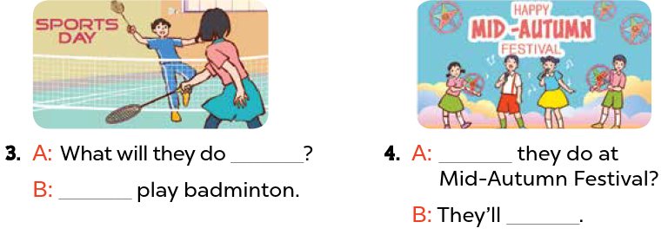
Read and complete.
on Sports Day
What will
We’ll
sing and dance

Slide 21
Activity 3
04
Listen, complete and sing.

Slide 22
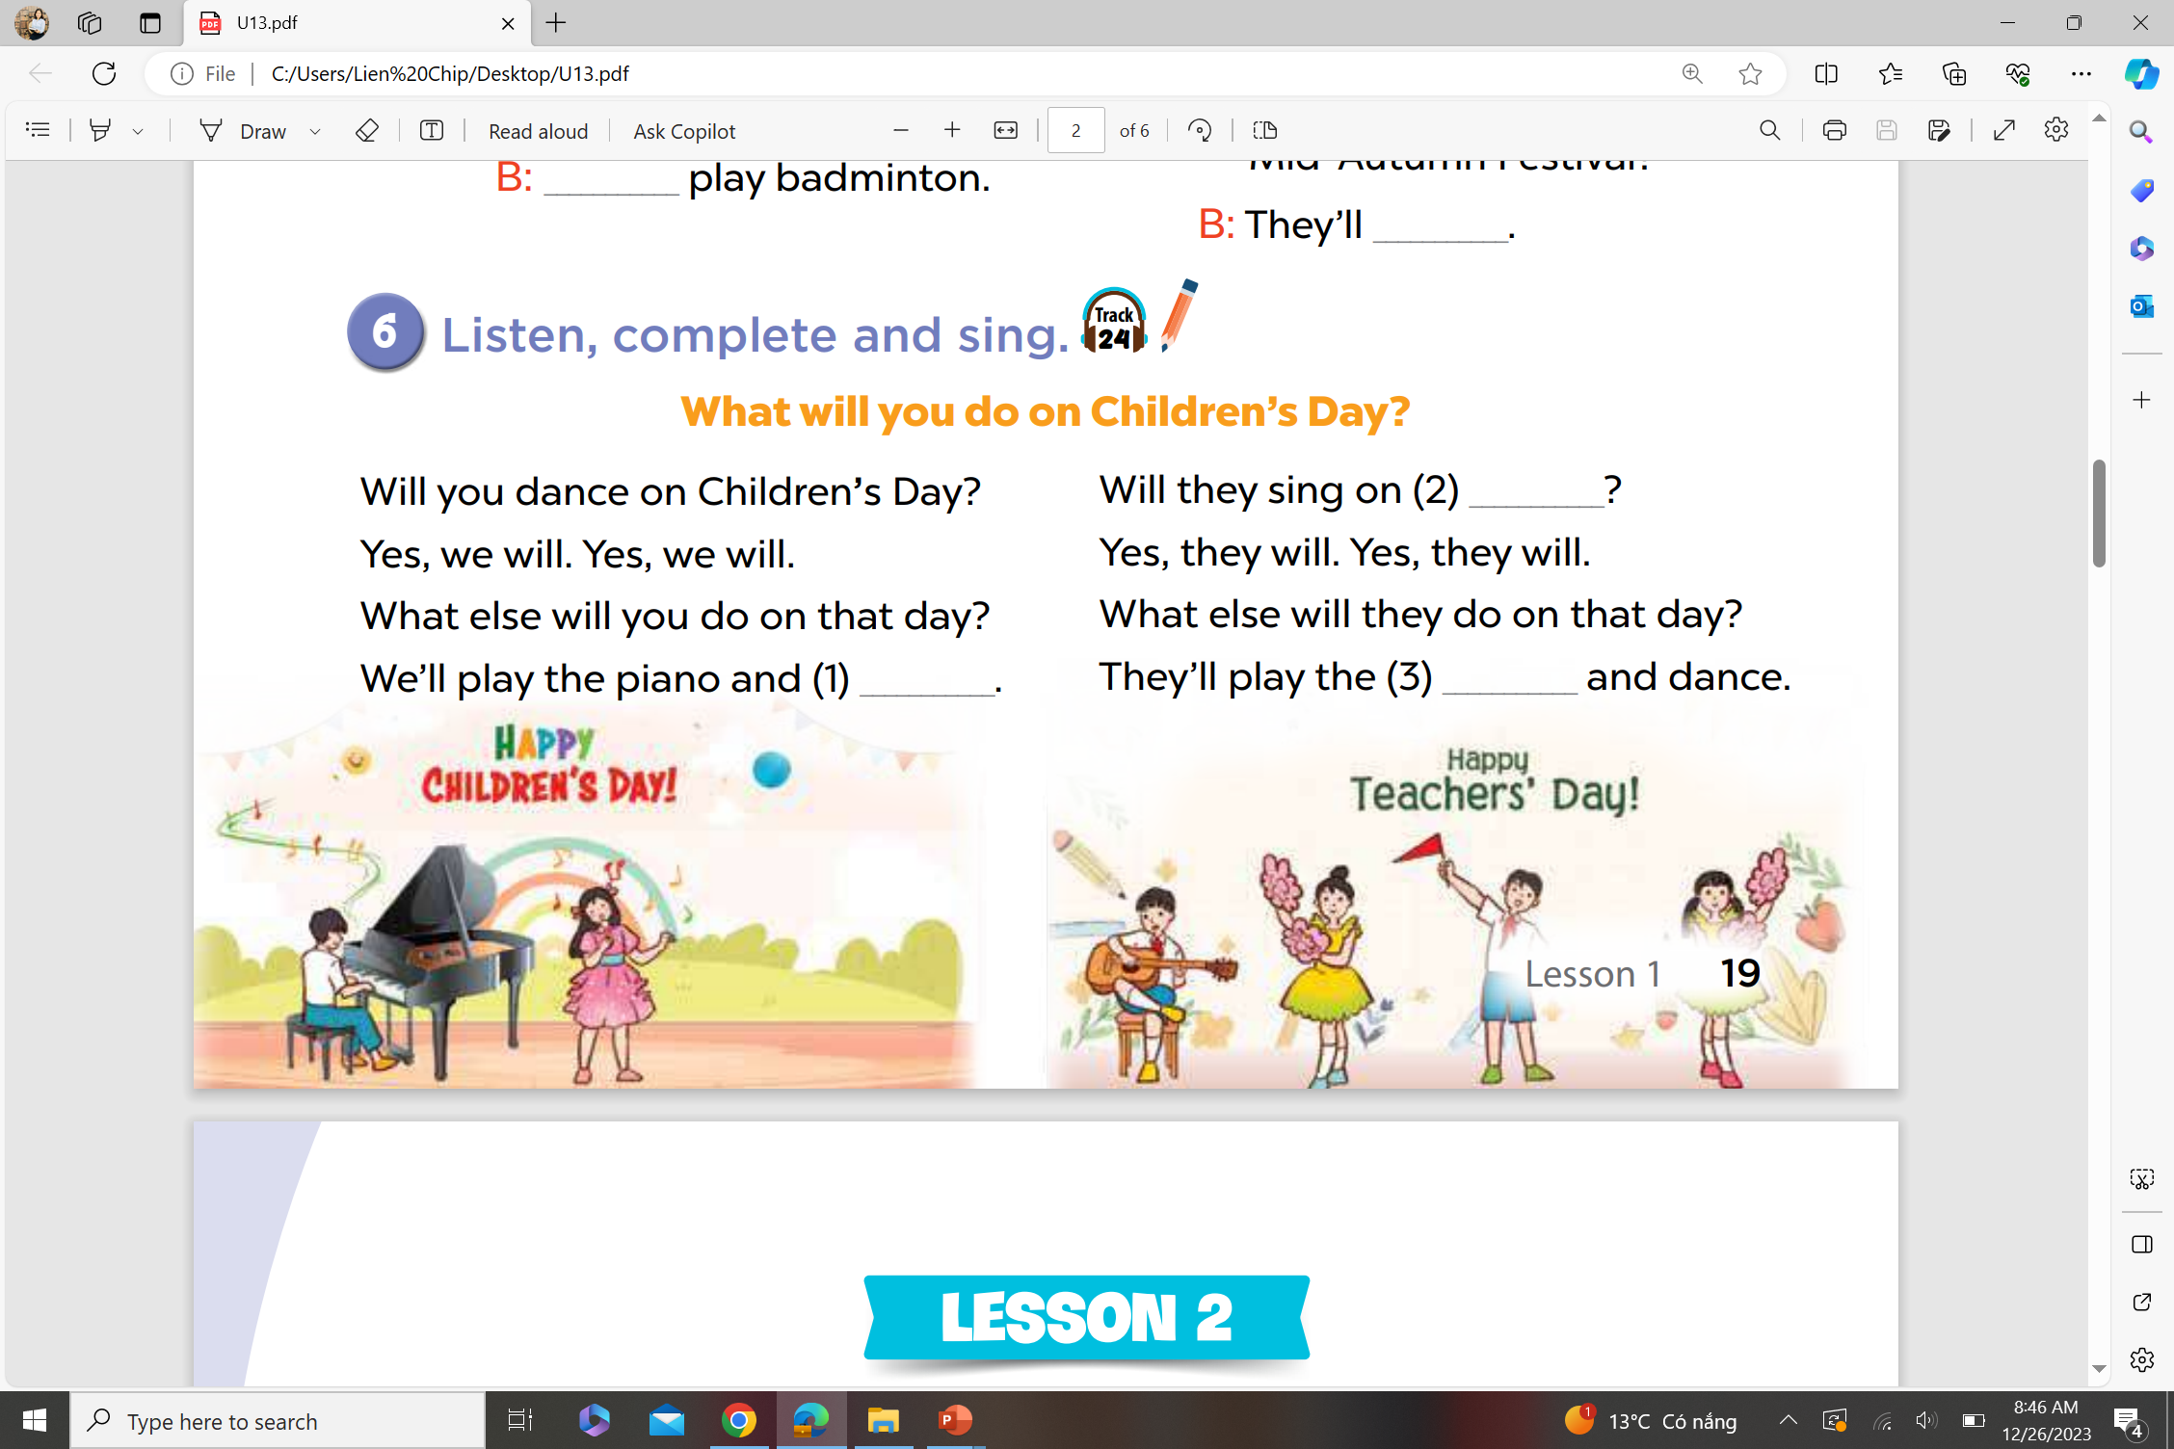
Listen, complete and sing.
Teachers’ Day
sing
guitar

Slide 23
Fun Corner
05
Look, read and choose.

Slide 24


.................. will you do on
Christmas Day?
What
A. When
B. What
C. Who

Slide 25
What .................. you do on
Children’s Day?
will
A. are
B. do
C. will

Slide 26
What will you do at Mid–Autumn Festival? – We’ll .................. a party.
have
A. have
B. has
C. to have

Slide 27
What will you do ..................
Mid–Autumn Festival?
at
A. at
B. on
C. in

Slide 28
What will you do ..................
Halloween Day?
on
A. in
B. on
C. at

Slide 29
What will you do on Sports Day?
- We’ll .................. badminton.
play
A. to play
B. plays
C. play

Slide 30
What will you do on Teachers’ Day?
- We’ll ...................
sing
A. sings
B. singing
C. sing

Slide 31
Website: hoclieu.vn
Fanpage: https://www.facebook.com/tienganhglobalsuccess.vn/

