Slide 1
Tiếng Anh 2
Giáo viên: Tô Thị Hà
Lớp dạy: 1A1, 1A2, 1A3
Đơn vị công tác: Trường TH Hưng Đạo

Slide 3

FUN TIME 3
Period 1

Slide 4

Table of contents
01
Warm-up and Review
Activity 1.Trace and colour.
Then point and say.
02
03
Activity 2. Let’s play.
04
Fun corner and Wrap-up

Slide 5


01
Warm-up and Review

Slide 6


HIDDEN PICTURES
GAME

Slide 7


What’s this picture?
clock

Slide 8

What’s this picture?
mop

Slide 9

What’s this picture?
pot

Slide 10

What’s this picture?
mango

Slide 11

What’s this picture?
monkey

Slide 12
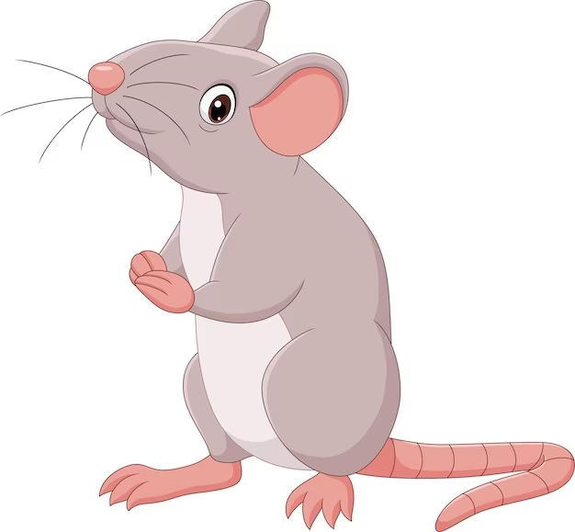
What’s this picture?
mouse

Slide 13


Very Good!

Slide 14
02
Activity 1. Trace and colour.
Then point and say.

Slide 15

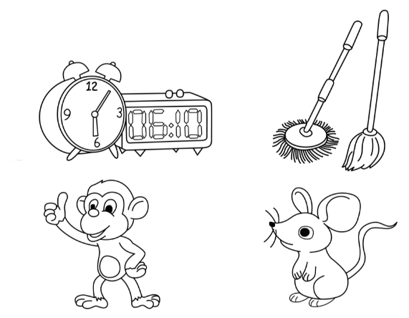
Trace and colour. Then point and say.
1
2
3
4

Slide 16
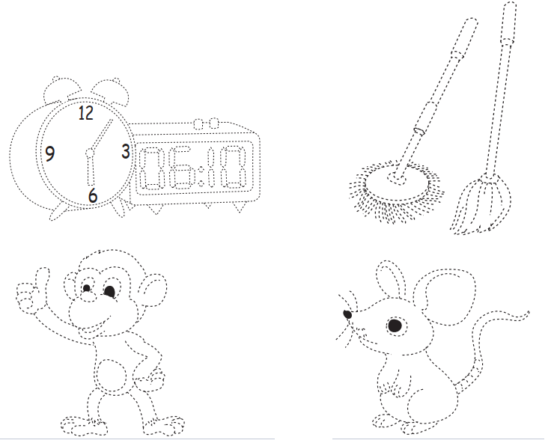







































Trace and colour. Then point and say.
1
clocks

Slide 17











Trace and colour. Then point and say.
2
mops

Slide 18

























Trace and colour. Then point and say.
3
monkey

Slide 19

















Trace and colour. Then point and say.
4
mouse

Slide 20

1
2
clocks
mops
3
4
monkey
mouse

Slide 21
03
Activity 2. Let’s play.

Slide 22
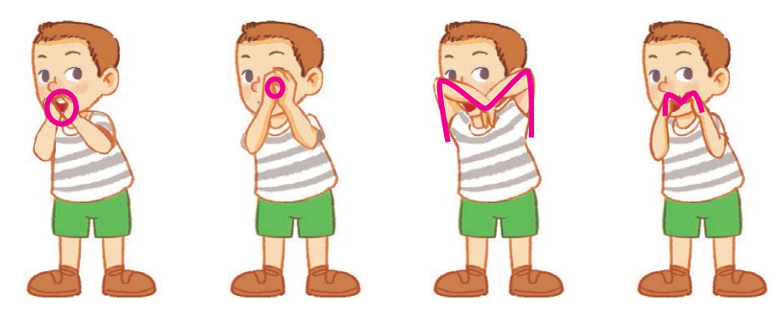
Let’s play.
Simon says

Slide 23

Let’s play.
Simon says

Slide 24

Let’s play.
Simon says

Slide 25

Let’s play.
Simon says

Slide 26

Let’s play.
Simon says

Slide 27
Let’s play.
Simon says

Slide 28
04
Fun corner and wrap-up

Slide 29
Wrap-up
m
/m/
o
/ɒ/

Slide 30


Slide 31

Pass the ball!
That’s a __.
That’s a __.

Slide 32
Website: hoclieu.vn
Fanpage: https://www.facebook.com/tienganhglobalsuccess.vn/

