Slide 1
Tiếng Anh 1
Giáo viên: Hoàng Thị Hồng
Lớp dạy: 1A4, 1A5, 1A6
Đơn vị công tác: Trường TH Hưng Đạo

Slide 2


Slide 3

FUN TIME 3
Period 2

Slide 4

Table of contents
01
Warm-up and Review
02
Activity 3.Match and say.
03
Activity 4. Let’s play.
04
Fun corner and Wrap-up

Slide 5


01
Warm-up and Review

Slide 6


Stop The Bus!
GAME

Slide 7


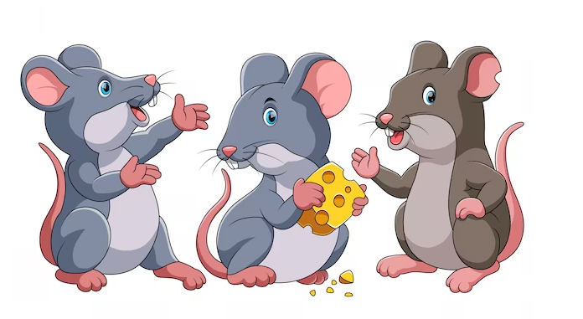

Notes:
Nháy vào hình ảnh bus stop lần 1 để dừng xe. Nháy lần 2 để hiện vỗ tay

Slide 8


Slide 9
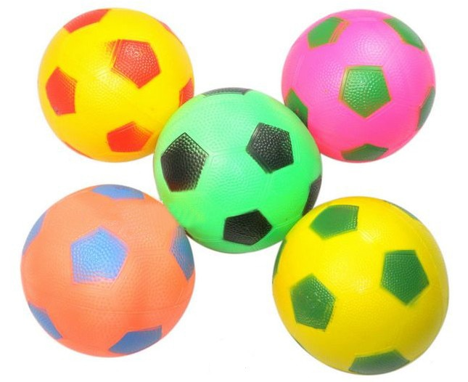

Slide 10


Slide 11


Slide 12
Very Good!

Slide 13
02
Activity 3. Match and say.

Slide 14




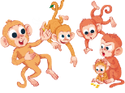
Match and say.
1.
five monkeys
a
2.
three clocks
b
3.
two locks
c
4.
four pots
d

Slide 15
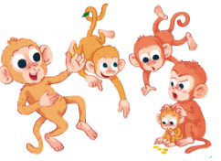
four pots
two locks
three clocks
five monkeys

Slide 16
03
Activity 4. Let’s play.

Slide 17

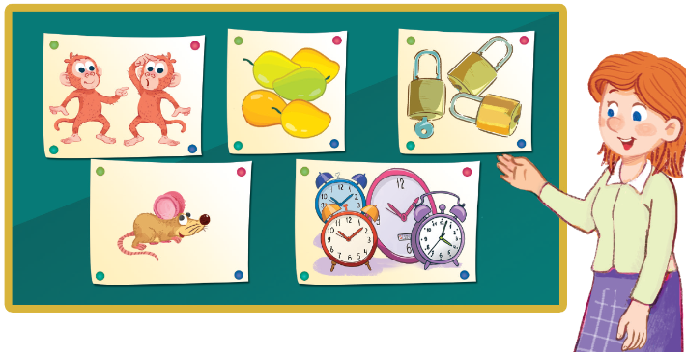
Let’s play.

Slide 18

Kim’s game

Slide 19

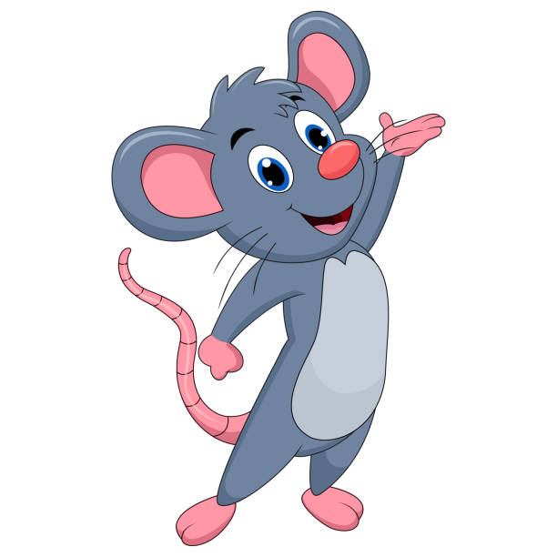
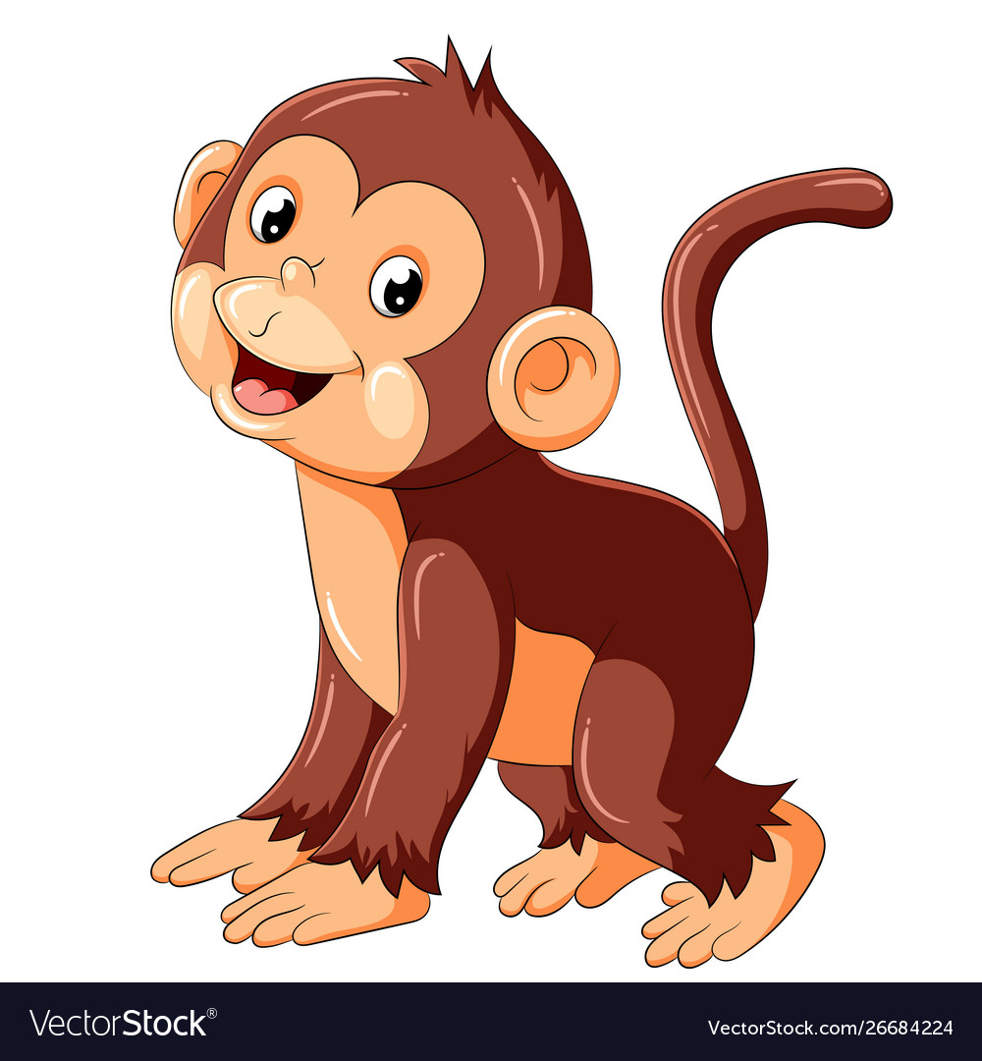
Kim’s game
Team Monkey
Team Mouse

Slide 20




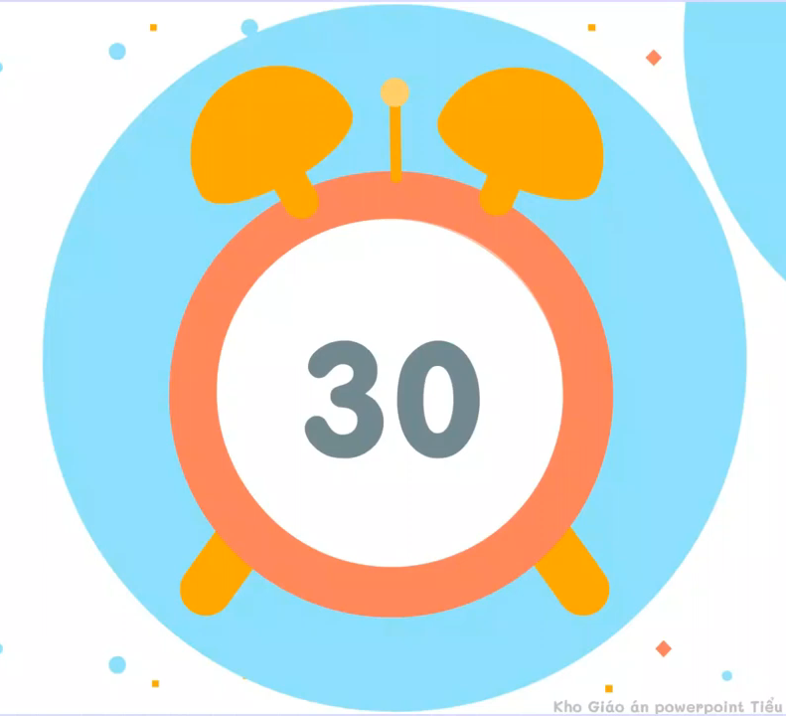
1
2
3
4
5
6
five mangos
Notes:
Sau khi hết 30 giây từ khoá xuất hiện, HS chọn 1 ô chữ, nếu chọn đúng ô chữ biến mất.

Slide 21
1
2
3
two monkeys
4
6
five mangos

Slide 22
1
3
two monkeys
three
locks
4
6
five mangos

Slide 23
1
two monkeys
three locks
four clocks
4
6
five mangos

Slide 24
four clocks
two monkeys
three locks
one mouse
4
6
five mangos

Slide 25
four clocks
two monkeys
three locks
one bus
6
one mouse
five mangos

Slide 26

Summary
Point
Point
Notes:
GV nháy vào biểu tượng của đội chơi để tính điểm cho các đội. Mỗi lần nháy 1 ngôi sao xuất hiện.

Slide 27

Win!

Slide 28

two monkeys
five mangos
three locks
one mouse
four clocks

Slide 29
04
Fun corner and Wrap-up

Slide 30



Answer the questions.
How many mangos?
Four mangos.

Slide 31

Answer the questions.
How many hats?
Five hats.

Slide 32

Answer the questions.
How many clocks?
One clock.

Slide 33
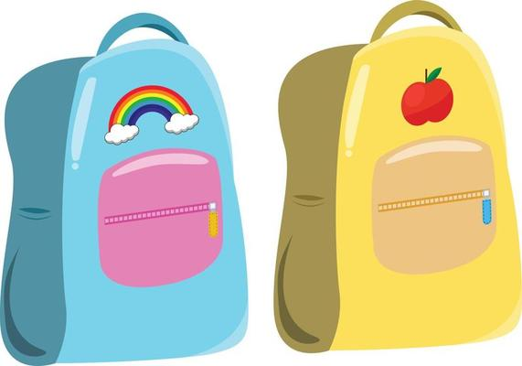
Answer the questions.
How many bags?
Two bags.

Slide 34
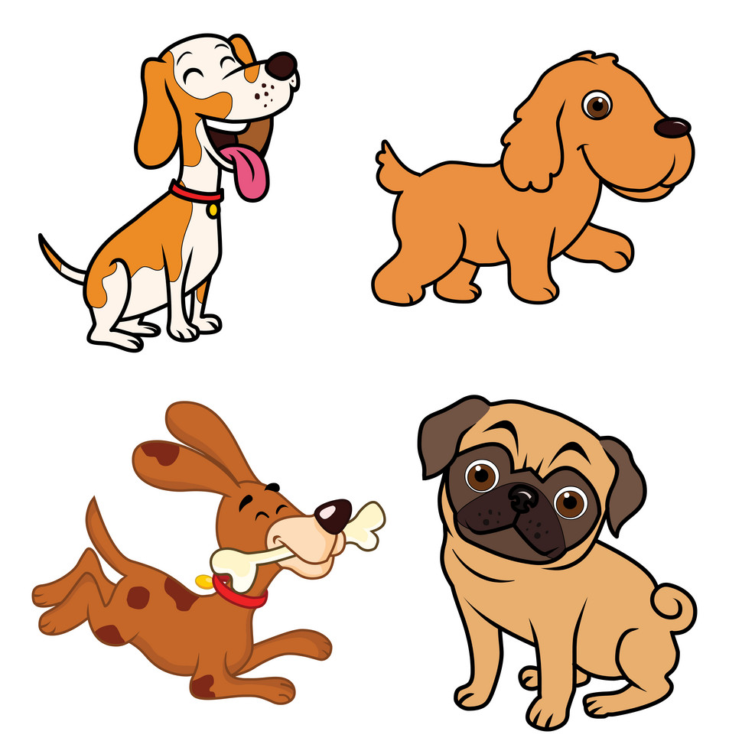
Answer the questions.
.
How many dogs?
Four dogs

Slide 35

Answer the questions.
How many fishs?
Three fish.

Slide 36
Very Good!

Slide 37
Website: hoclieu.vn
Fanpage: https://www.facebook.com/tienganhglobalsuccess.vn/

