Slide 1
Tiếng Anh 2
Giáo viên: Lê Thị Minh Hiếu
Lớp dạy: 2A1, 2A4, 2A5
Đơn vị công tác: Trường TH Hưng Đạo

Slide 2


Slide 3







Unit 13:
In the maths class
Lesson 1

Slide 4










Class Rules

Slide 5







Rule 1
Listen to
your friend
talking in front.

Slide 6








Rule 2
Raise your hand
if you have a question.

Slide 7







Rule 3
Wait for
your turn.

Slide 8









Table of Contents
  Warm-up and review.
  Listen and repeat.
  Point and say.
  Fun corner and wrap-up.

Slide 9




Warm-up and Review.

Slide 10







COUNT WITH ME

Slide 11

1
one

Slide 12

2
two

Slide 13

3
three

Slide 14
4
four

Slide 15

5
five

Slide 16

6
six

Slide 17
7
seven

Slide 18

8
eight

Slide 19

9
nine

Slide 20

10
ten

Slide 21
Listen and repeat.

Slide 22
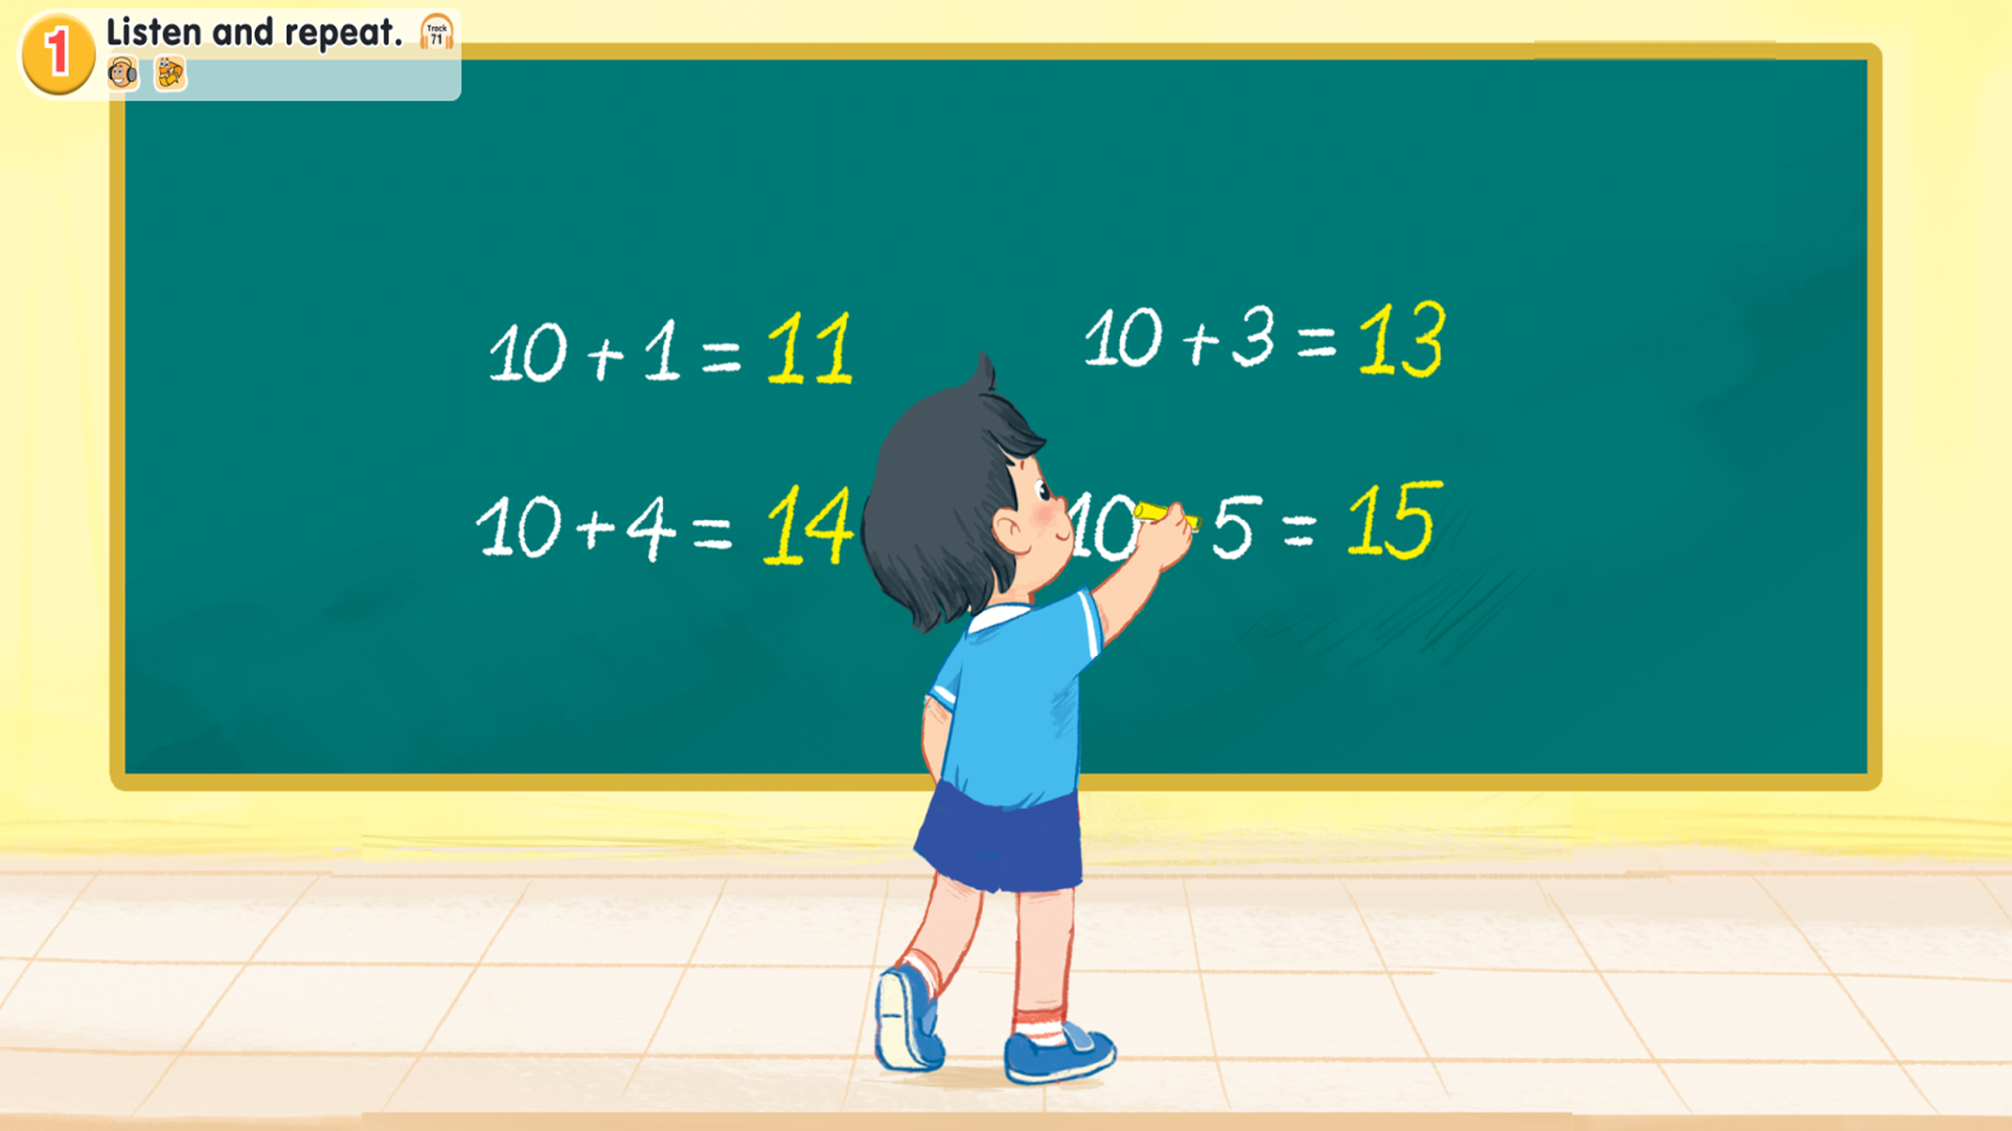
Look and say.
Notes:
Step 1: Draw pupils’ attention to the picture (say “Look at the picture.”). Ask questions to help them identify the context (see Input).

Slide 23

1.Listen and repeat.
Notes:
Step 2: Have pupils point to the letter N/n (say “Point to the letter N.”). Explain that the name of the letter N/n is different to its sound (say “Listen. /en/ /n/.”).
Step 3: Play the recording of the name and sound of the letter N/n and encourage pupils to repeat (say “Listen and repeat.”). Do this several times, with pupils repeating both individually and in chorus. Correct their pronunciation if necessary, and praise them when their pronunciation is good.

Slide 24
1.Listen and repeat.
eleven
Notes:
Step 4: Have pupils look at the number 11 (say “Look at the number eleven”). Then have them point to the word eleven (say “Point to the word eleven.”). Draw their attention to the colour of the letter n (say “Look at the colour of the letter n. It is red.”).
Step 5: Play the recording of eleven and encourage pupils to repeat (say “Listen and repeat.”). Do this several times, with pupils repeating both individually and in chorus. Correct their pronunciation if necessary, and praise them when their pronunciation is good.

Slide 25
1.Listen and repeat.
eleven
thirteen
fourteen
fifteen
Notes:
Step 6: Repeat Steps 4 and 5 for thirteen, fourteen and fifteen.
Step 7: Play the recording in full and encourage pupils to repeat the name and sound of the letter N/n, eleven, thirteen, fourteen and fifteen both individually and in chorus.

Slide 26
Point and say.

Slide 27
2. Point and say.
Notes:
Step 1: Have pupils point to the letter N/n and correctly pronounce its name and sound (say “Point to the letter N. Say /en/. Now say /n/.”).

Slide 28
2. Point and say.
eleven
thirteen
fourteen
fifteen
Notes:
Step 2: Have pupils point to and correctly pronounce eleven (say “Point to eleven. Say eleven.”). Do this several times, with pupils repeating both individually and in chorus. Correct their pronunciation if necessary, and praise them when their pronunciation is good.
Step 3: Repeat Step 2 for thirteen, fourteen and fifteen.

Slide 29
Work in pairs.
eleven
thirteen
fourteen
fifteen
Notes:
Step 4: Put pupils into pairs or groups for further practice of Steps 1 to 3. Go around the class to offer help or correct pupils’ pronunciation, if necessary.

Slide 30
Fun corner and wrap-up.

Slide 31


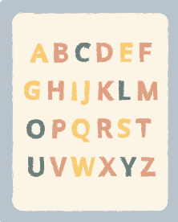




NUMBER RACE GAME

Slide 32
NUMBER RACE GAME
eleven
thirteen
fourteen
fifteen

Slide 33
THANK YOU FOR PLAYING!

Slide 34

Website: hoclieu.vn
Fanpage: https://www.facebook.com/tienganhglobalsuccess.vn/

