Slide 1
Tiếng Anh 2
Giáo viên: Lê Thị Minh Hiếu
Lớp dạy: 2A1, 2A4, 2A5
Đơn vị công tác: Trường TH Hưng Đạo

Slide 2



2

Slide 3






Unit 11
IN THE PLAYGROUND
Lesson 3

Slide 4










Class Rules

Slide 5



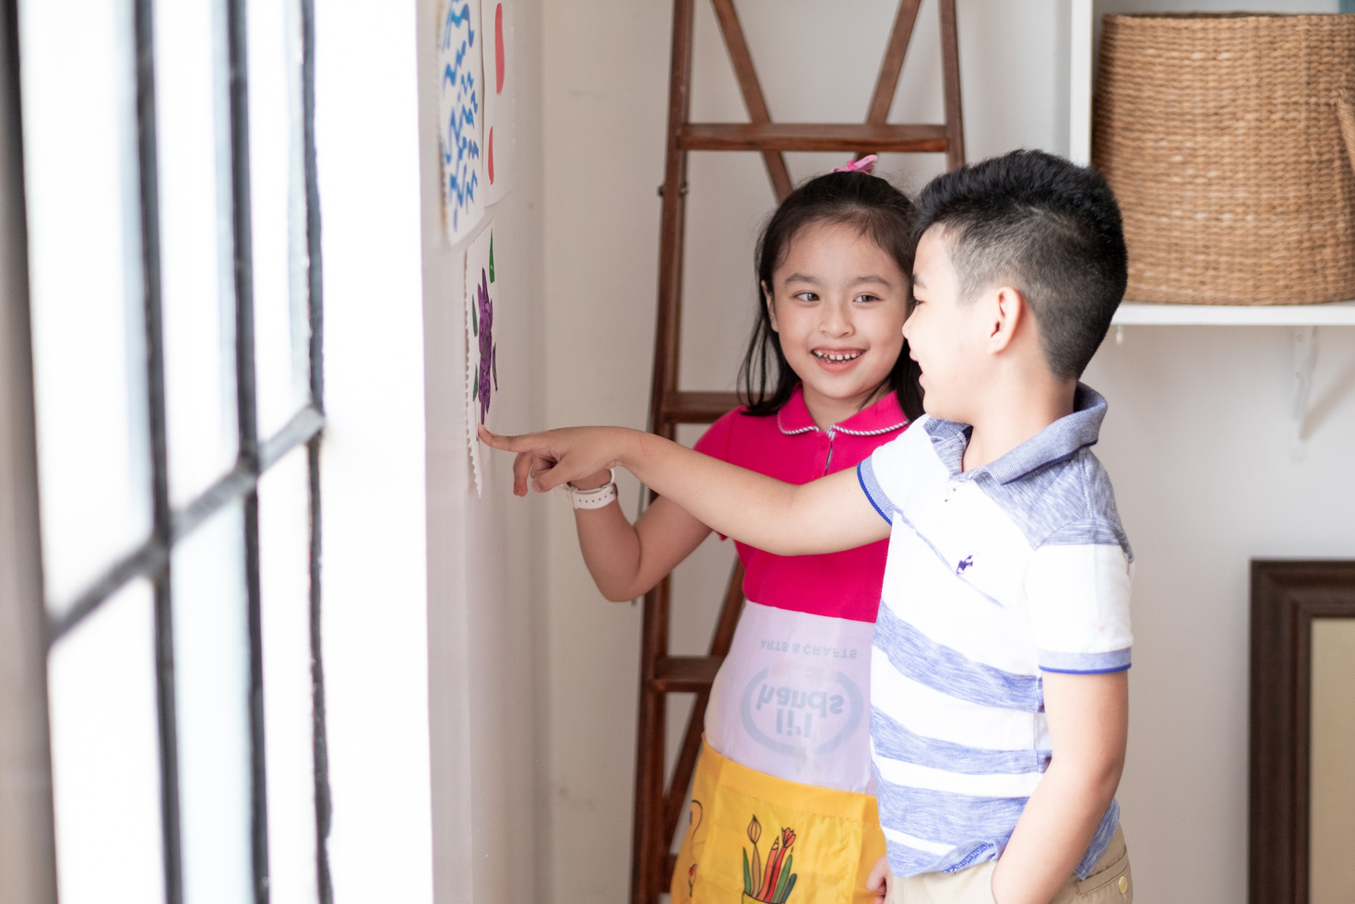



Rule 1
Listen to
your friend
talking in front.

Slide 6






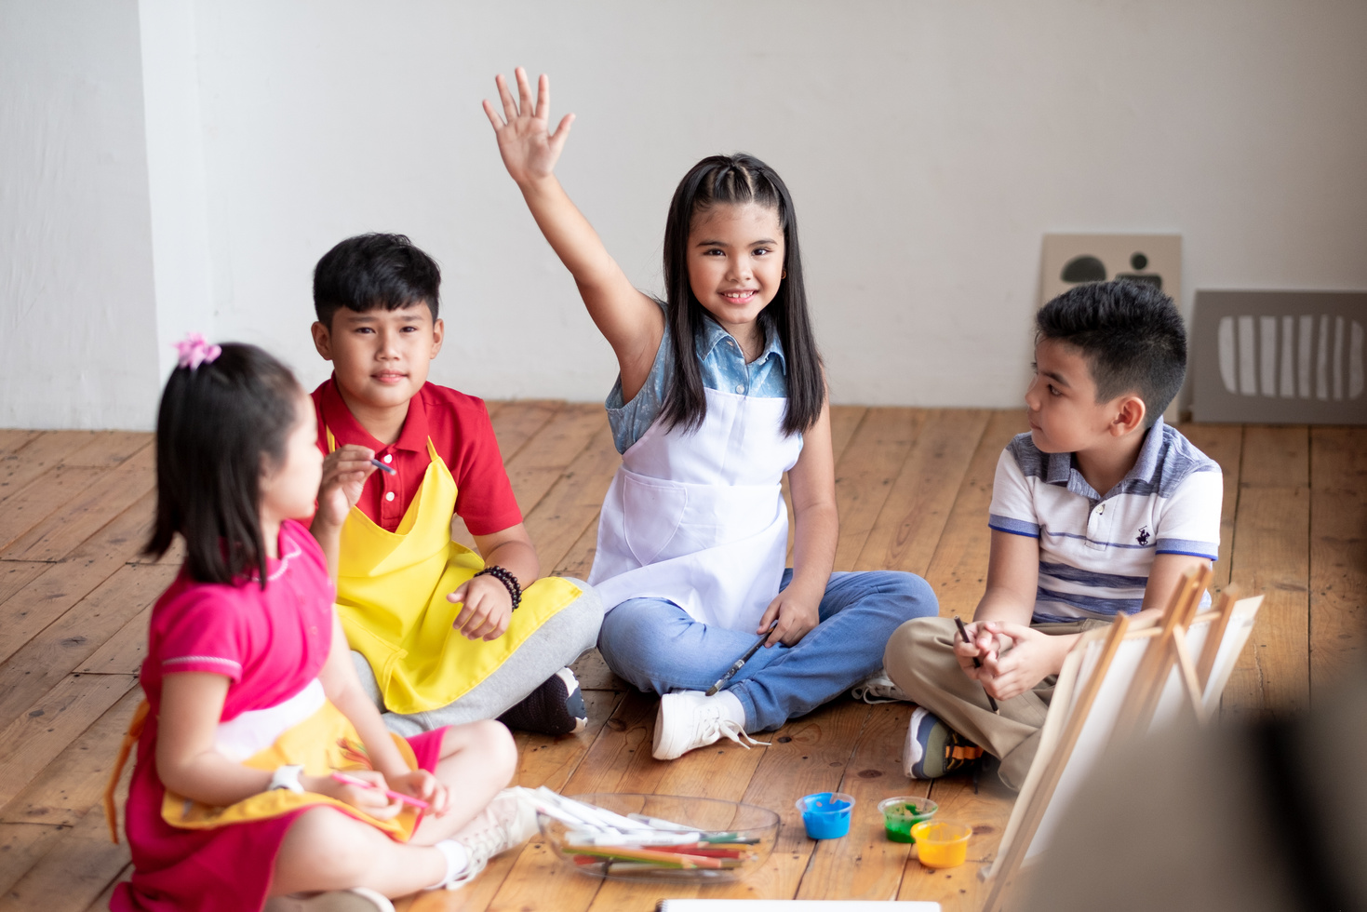

Rule 2
Raise your hand
if you have a question.

Slide 7




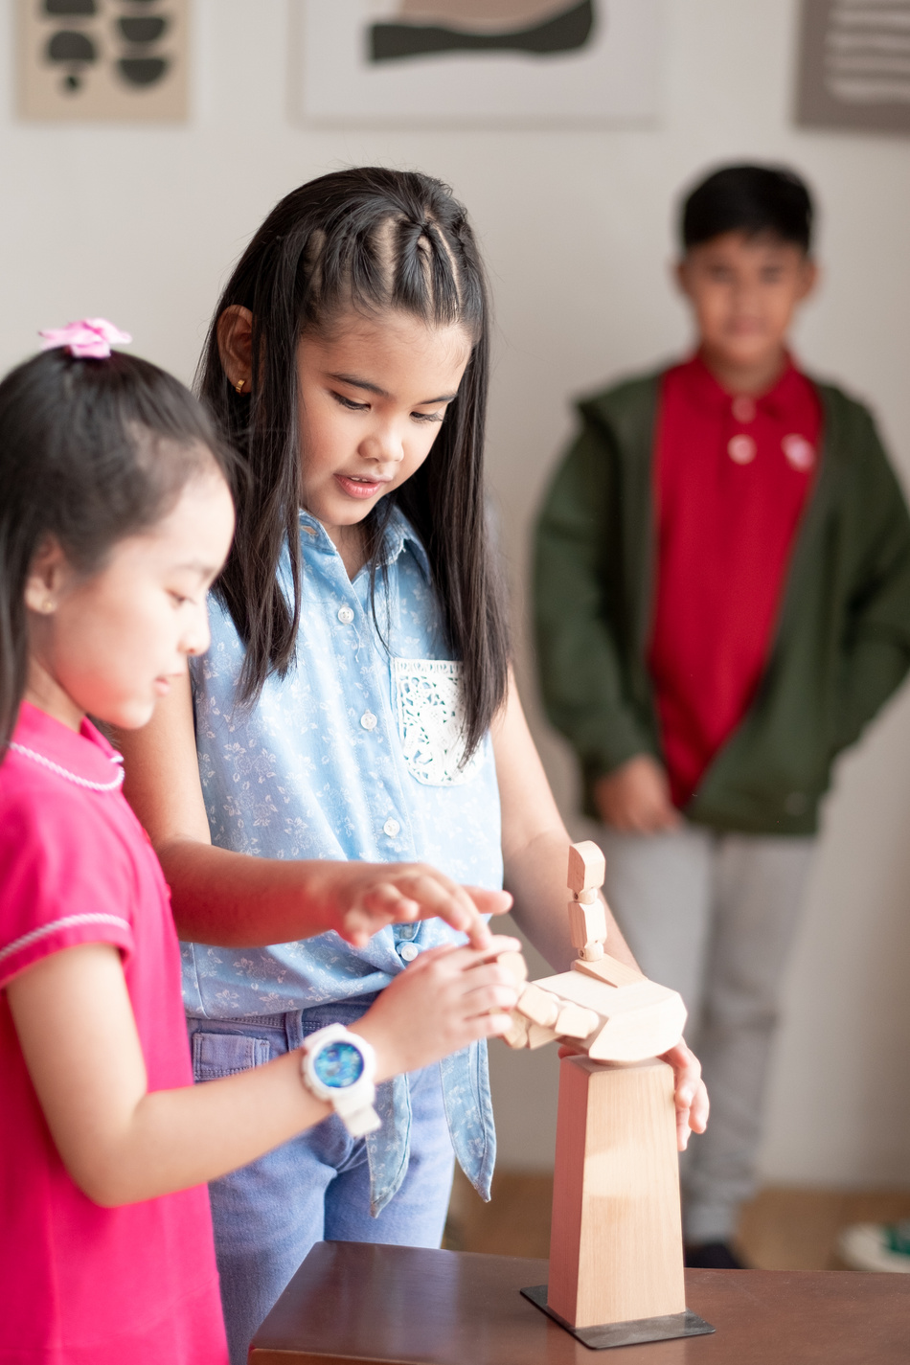


Rule 3
Wait for
your turn.

Slide 8
TABLE OF CONTENTS
Warm-up and review.
2. Activity 6: Listen and repeat.
3. Activity 7: Let’s talk.
4. Activity 8: Let’s sing.
5. Fun corner and wrap-up.

Slide 9
01
Warm-up
and review.

Slide 10



Game
Choose the correct answer.

Slide 11



a. sliding
b. driving a car.
c. riding a bike.

Slide 12

a. sliding
b. riding a bike.
c. driving a car.

Slide 13

a. driving a car.
b. riding a bike.
c. sliding

Slide 14
02
Activity 6
Listen and repeat.

Slide 15
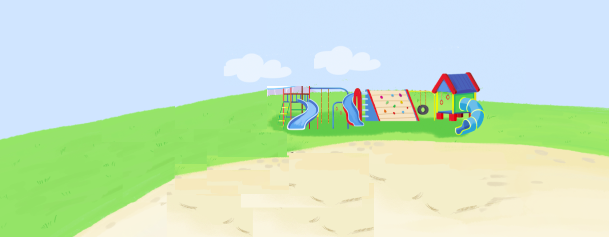






Listen and repeat.
They're driving cars.

Slide 16
03
Activity 7
Let’s talk.

Slide 17



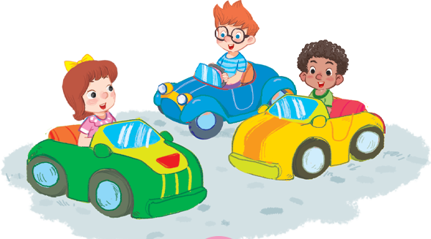


Let’s talk.
They're
a
b
c

Slide 18
They're
driving cars.
a

Slide 19
sliding.
They're
b

Slide 20
They're
riding bikes.
c

Slide 21
04
Activity 8
Let’s sing.

Slide 22

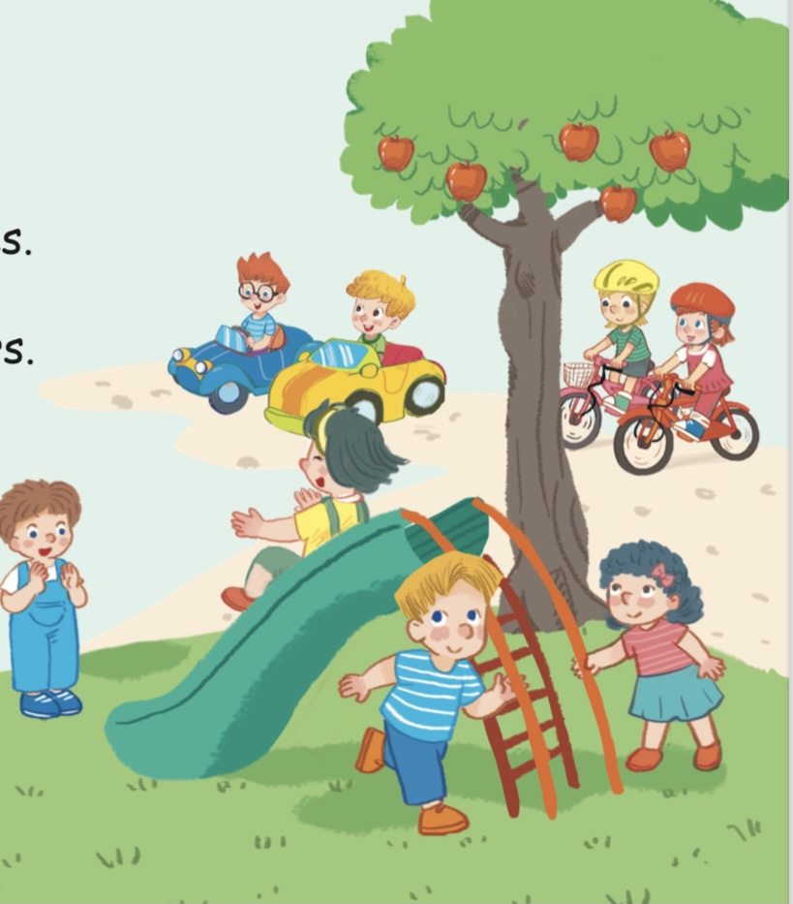

Let’s sing!
Now, sing!
Riding bikes, riding bikes.
They’re riding bikes.
Driving cars, driving cars.
They’re driving cars.
Sliding, sliding, sliding.
They’re sliding.
In the playground.
Notes:
Click từng dòng để nghe từng câu.
Click loa màu vàng để nghe cả bài.
Click loa màu xám để bật nhạc cho học sinh hát theo.

Slide 23
05
Fun corner
and wrap-up.

Slide 24
Game
Rolling the dice

Slide 25
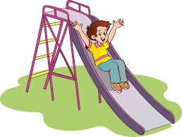




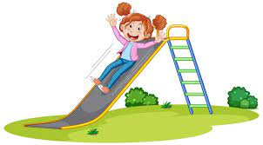
1
1
3
3
2
2
6
4
6
4
5
5

Slide 26
Game
Lucky gifts

Slide 27




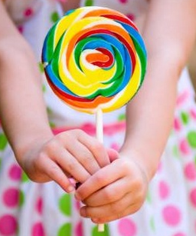

Lucky gifts
3
1
2
Notes:
Bấm vào số …có câu hỏi…………..Bấm vào mũi tên để về lại slide Lucky gifts và bấm tiếp vào hộp quà để nhận quà

Slide 28
Look at the picture and
say the action.

Slide 29
Look at the picture and
say the action.

Slide 30
Look at the picture and
say the action.

Slide 31

CONGRATULATIONS!

Slide 32






Goodbye!
See you soon!

Slide 33




Website: hoclieu.vn
Fanpage: https://www.facebook.com/tienganhglobalsuccess.vn/

