Slide 1
Tiếng Anh 2
Giáo viên: Lê Thị Minh Hiếu
Lớp dạy: 2A1, 2A4, 2A5
Đơn vị công tác: Trường TH Hưng Đạo

Slide 3









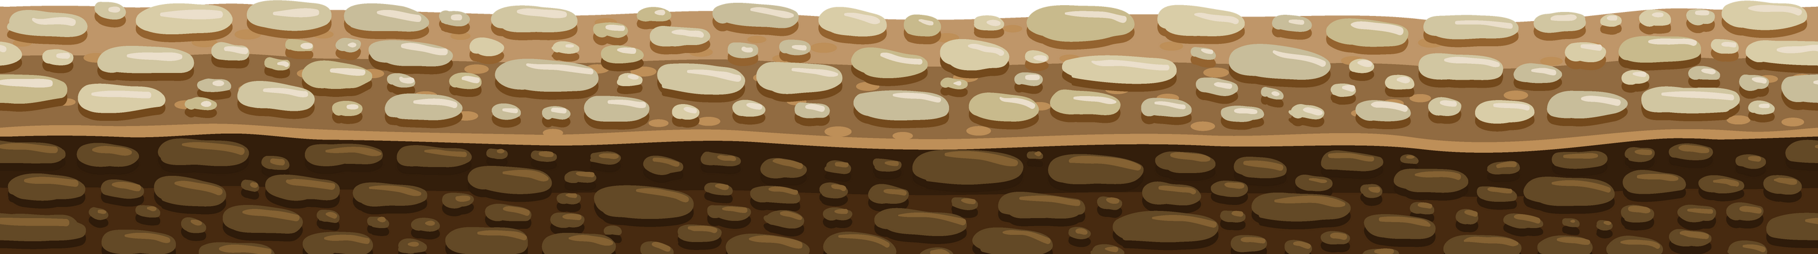
Unit 12:
At the café
Lesson 3

Slide 4












TABLE OF CONTENTS
  Warm-up and review.
  Listen and repeat.
  Let’s talk.
  Let’s sing.
  Fun corner and wrap-up.

Slide 5






Warm-up and Review.

Slide 6















Quiz Time

Slide 7





Choose the correct letter.
gr_pes
a

Slide 8


Order the letters.
k a c e
cake

Slide 9




Look and choose.

Slide 10
Thank you
For
Playing!

Slide 11
Listen and repeat.

Slide 12


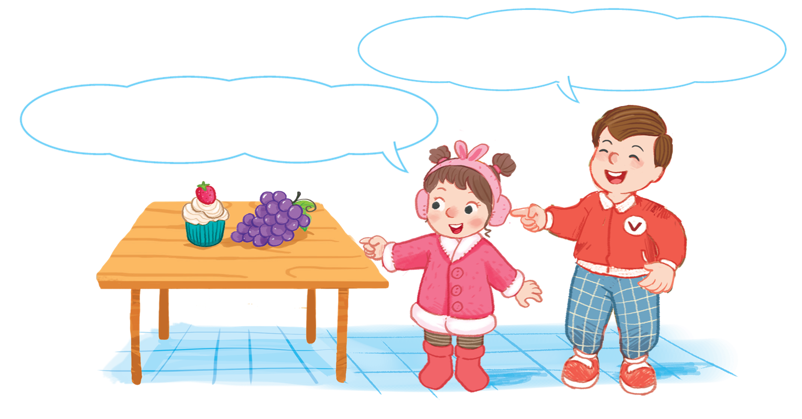


Look and say.

Slide 13

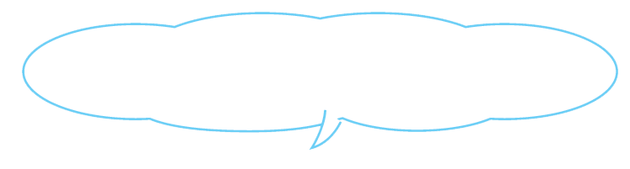
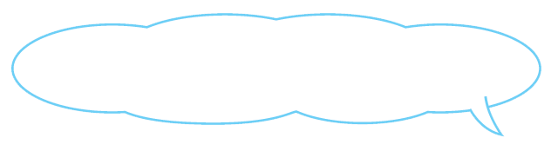
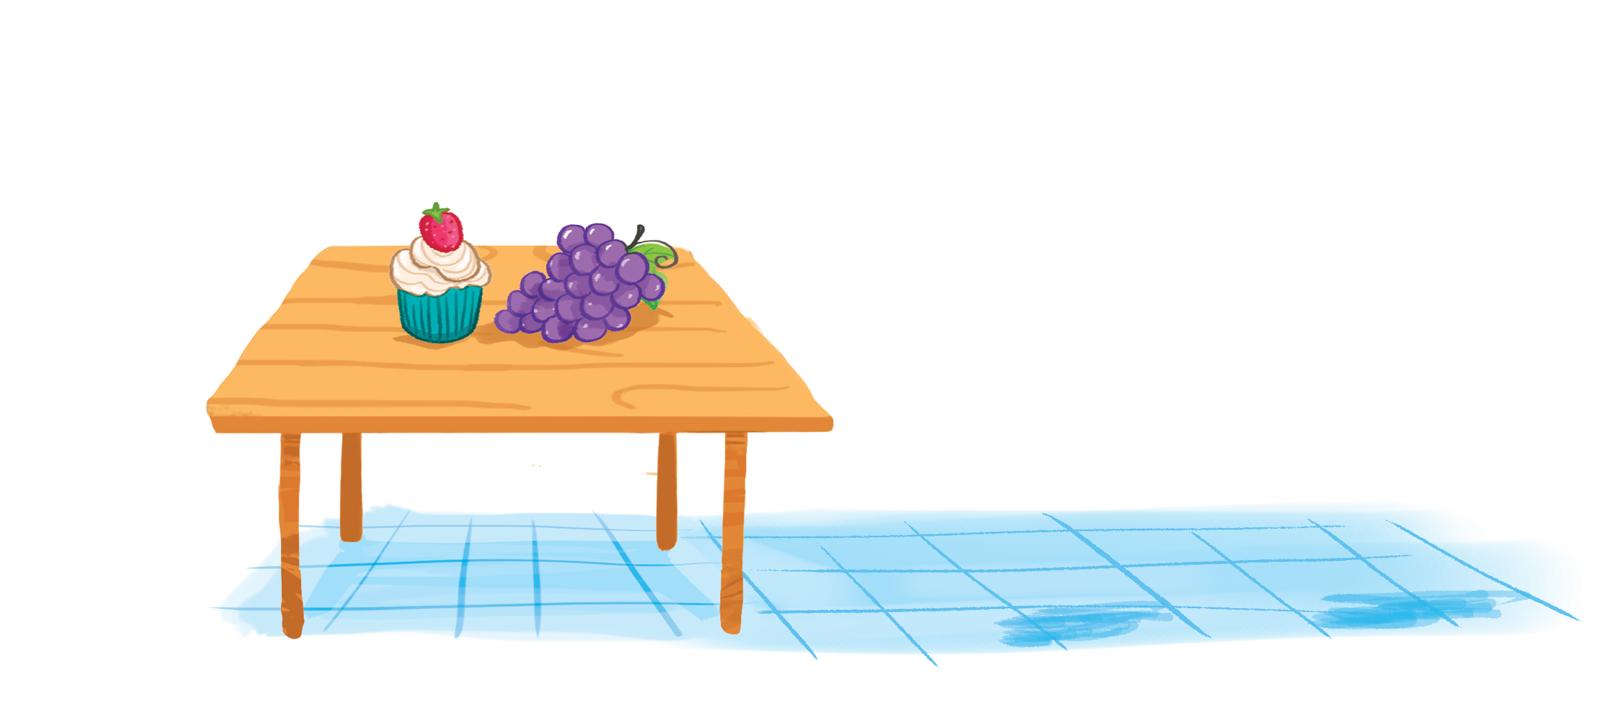
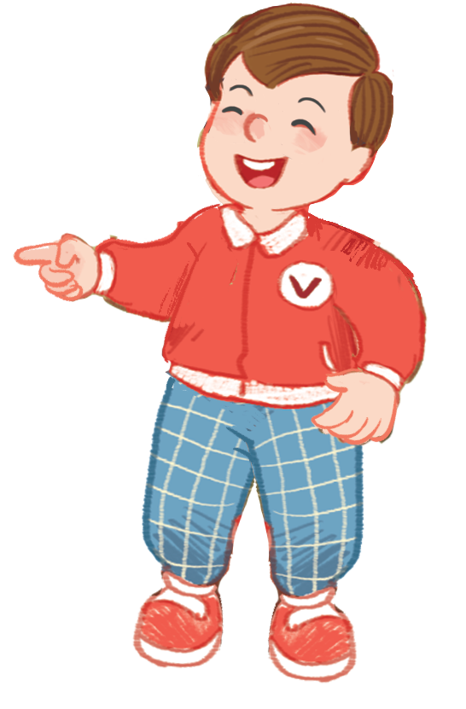
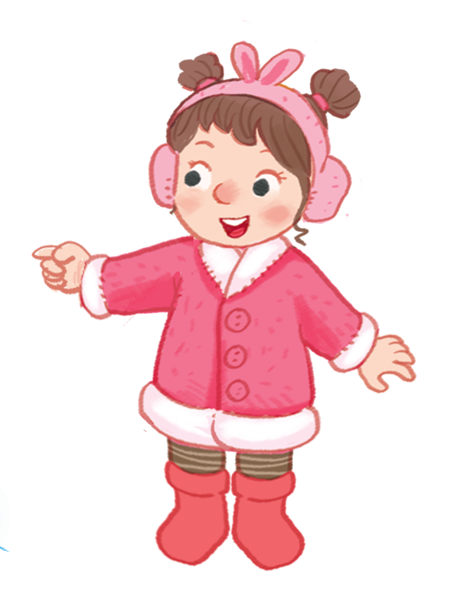
6. Listen and repeat.
The grapes are on the table.
The grapes are on the table.
The grapes are on the table.
The grapes are on the table.
The cake is on the table.
The cake is on the table.
The cake is on the table.
The cake is on the table.

Slide 14
Let’s talk.

Slide 15


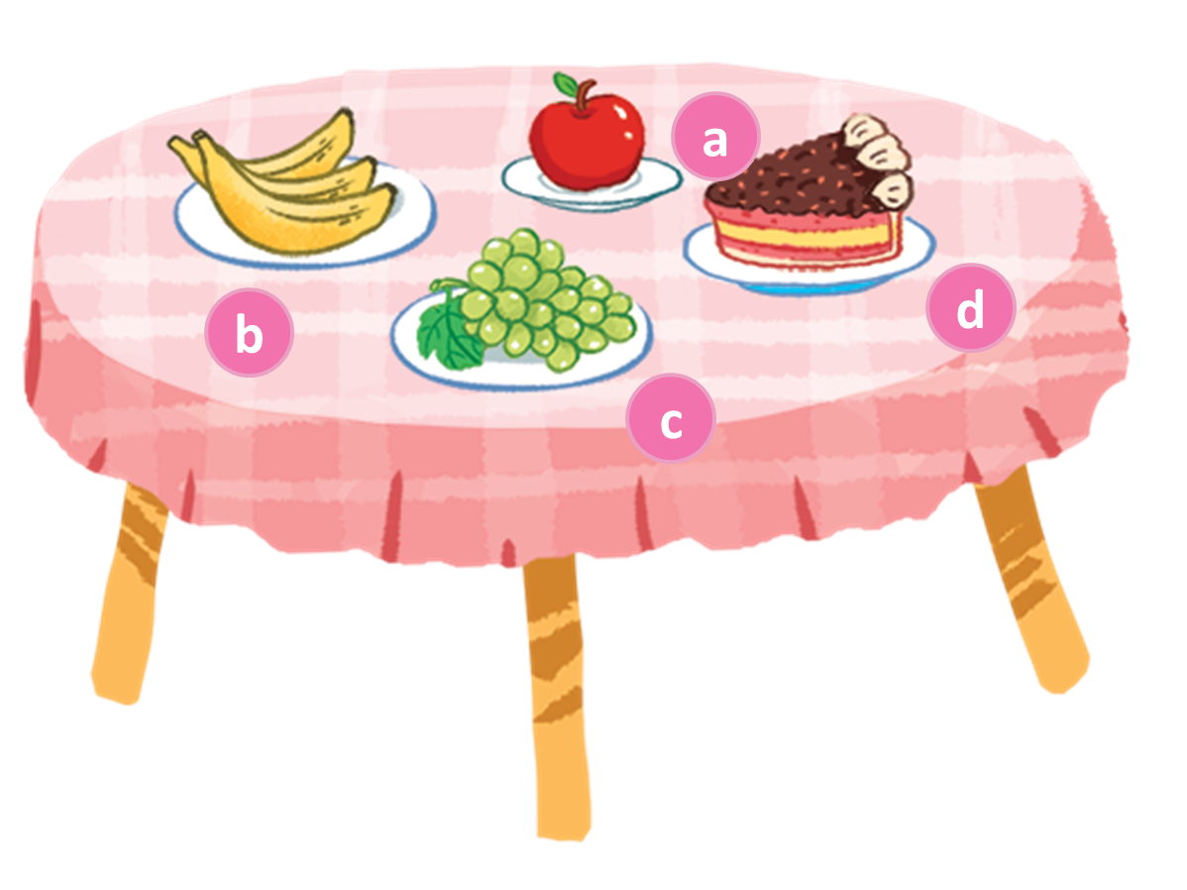


Look and say.
Notes:
Look at the table and say the food on the table

Slide 16
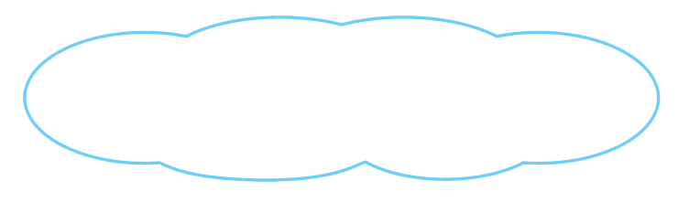
7. Let’s talk.
The apple is on the table.
The cake is on the table.

Slide 17
7. Let’s talk.
The bananas are on the table.
The grapes are on the table.

Slide 18
7. Let’s talk.
The apple is on the table.
The cake are on the table.

Slide 19
Let’s sing.

Slide 20
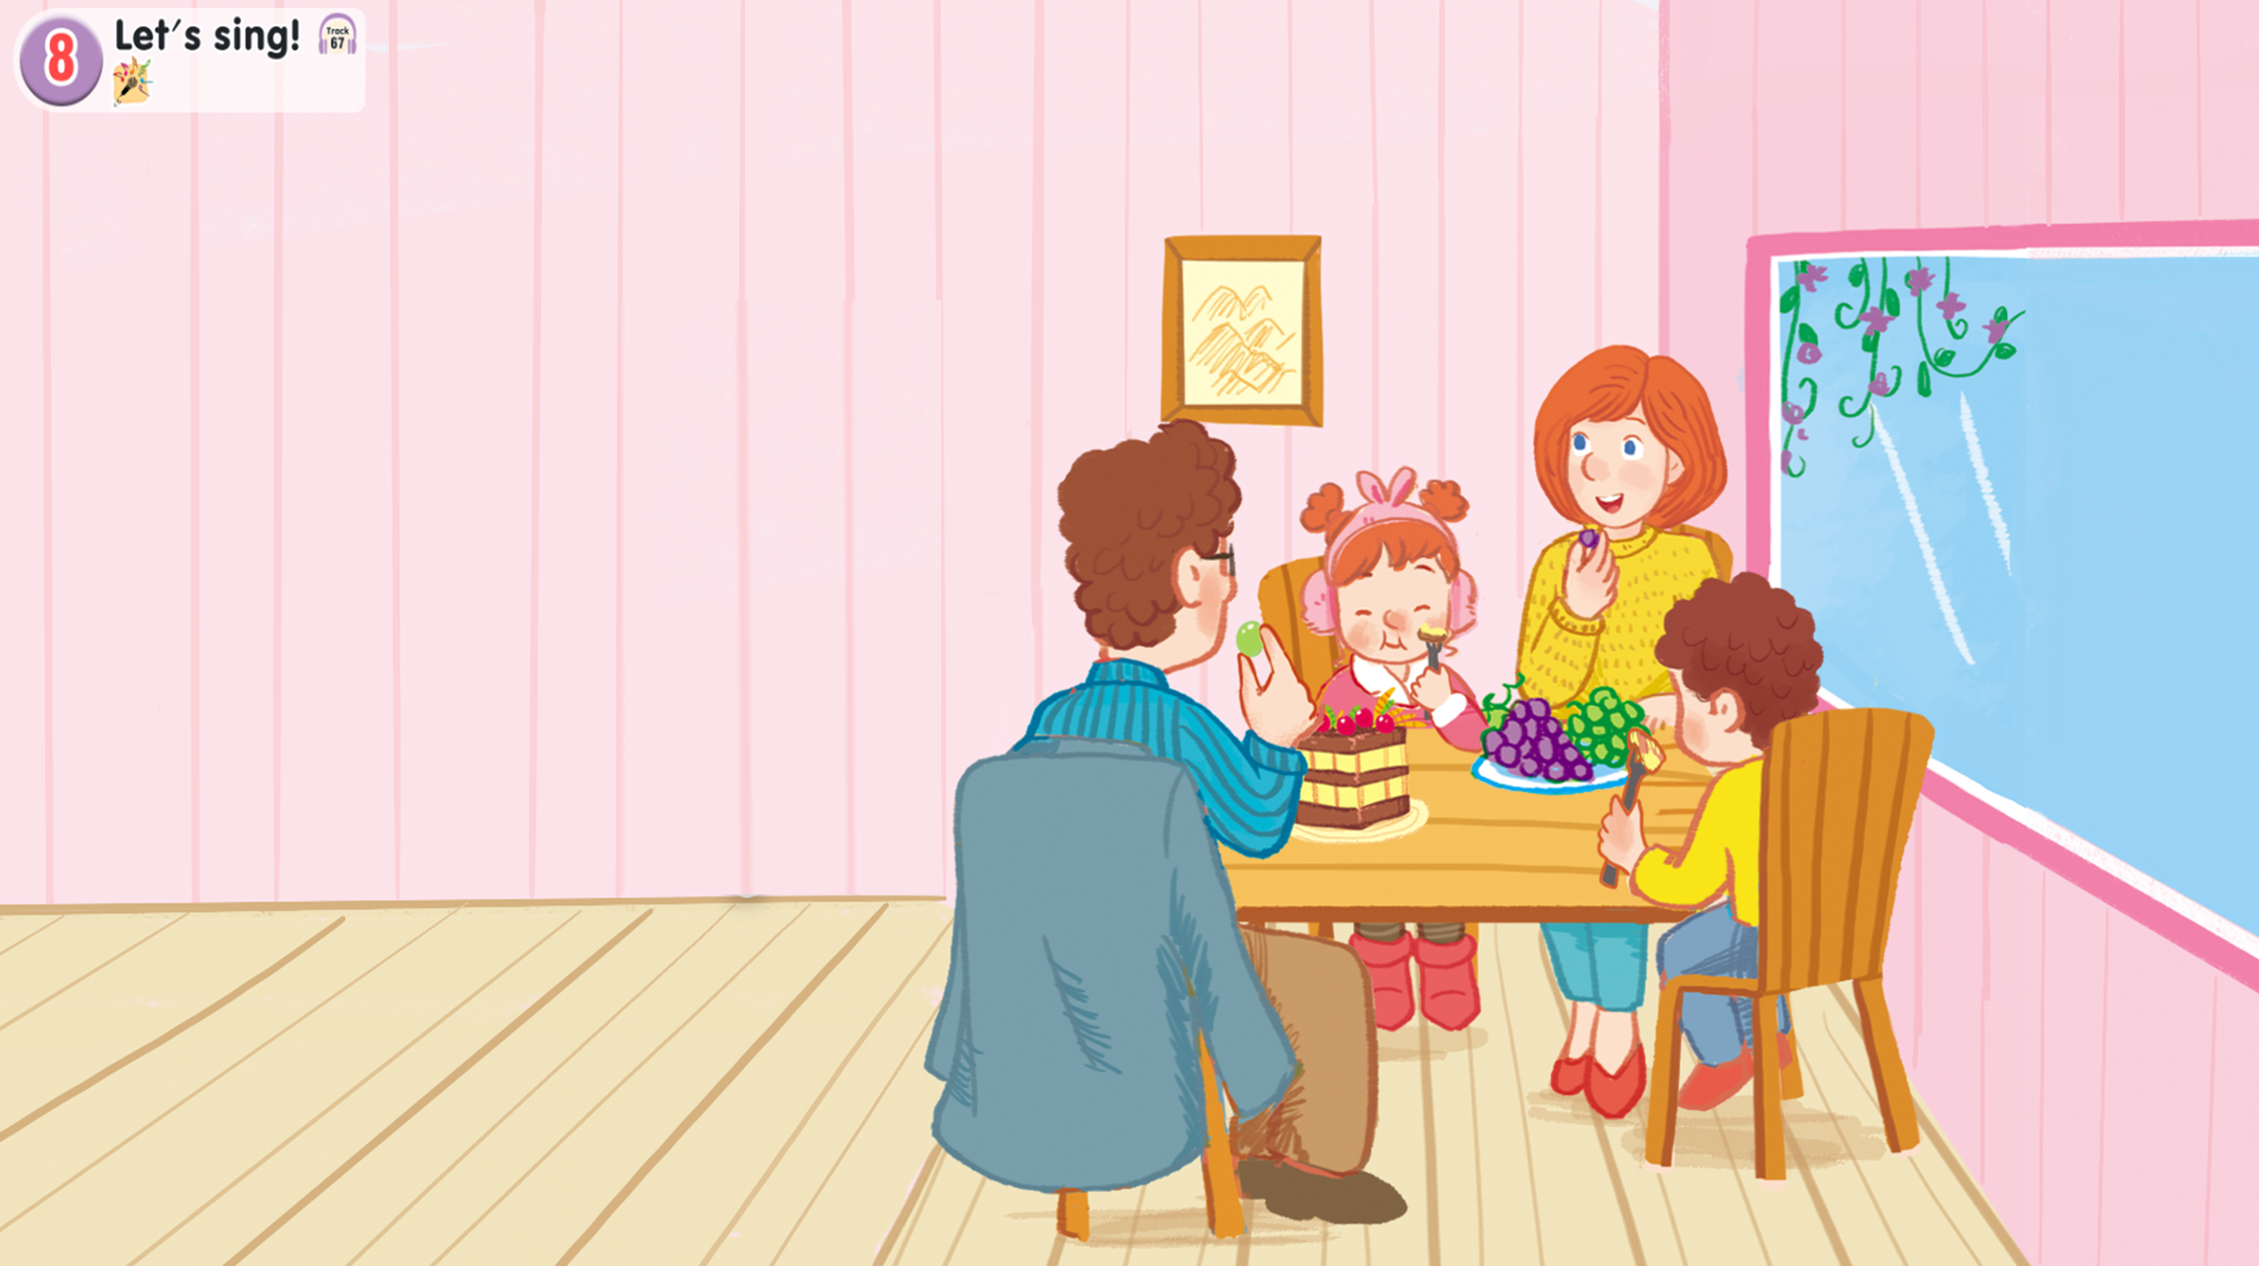
Look and say.

Slide 21

Watch a video song.

Slide 22
8. Let’s sing.
Look at the cake.
Look at the cake.
Look at the cake.
Look at the cake.
The cake is on the table.
The cake is on the table.
The cake is on the table.
The cake is on the table.
Look at the grapes.
Look at the grapes.
Look at the grapes.
Look at the grapes.
The grapes are on the table.
The grapes are on the table.
The grapes are on the table.
The grapes are on the table.
We’re having a cake.
We’re having a cake.
We’re having a cake.
We’re having a cake.
We’re having grapes.
We’re having grapes.
We’re having grapes.
We’re having grapes.

Slide 23
Work in groups.
Look at the cake.
Look at the cake.
The cake is on the table.
The cake is on the table.
Look at the grapes.
Look at the grapes.
The grapes are on the table.
The grapes are on the table.
We’re having a cake.
We’re having a cake.
We’re having a cake.
We’re having grapes.
We’re having grapes.

Slide 24
Fun corner and wrap-up.

Slide 25







GAME
SECRET BOXES

Slide 26








Notes:
Click the leaf on the right to continue the next slide

Slide 27




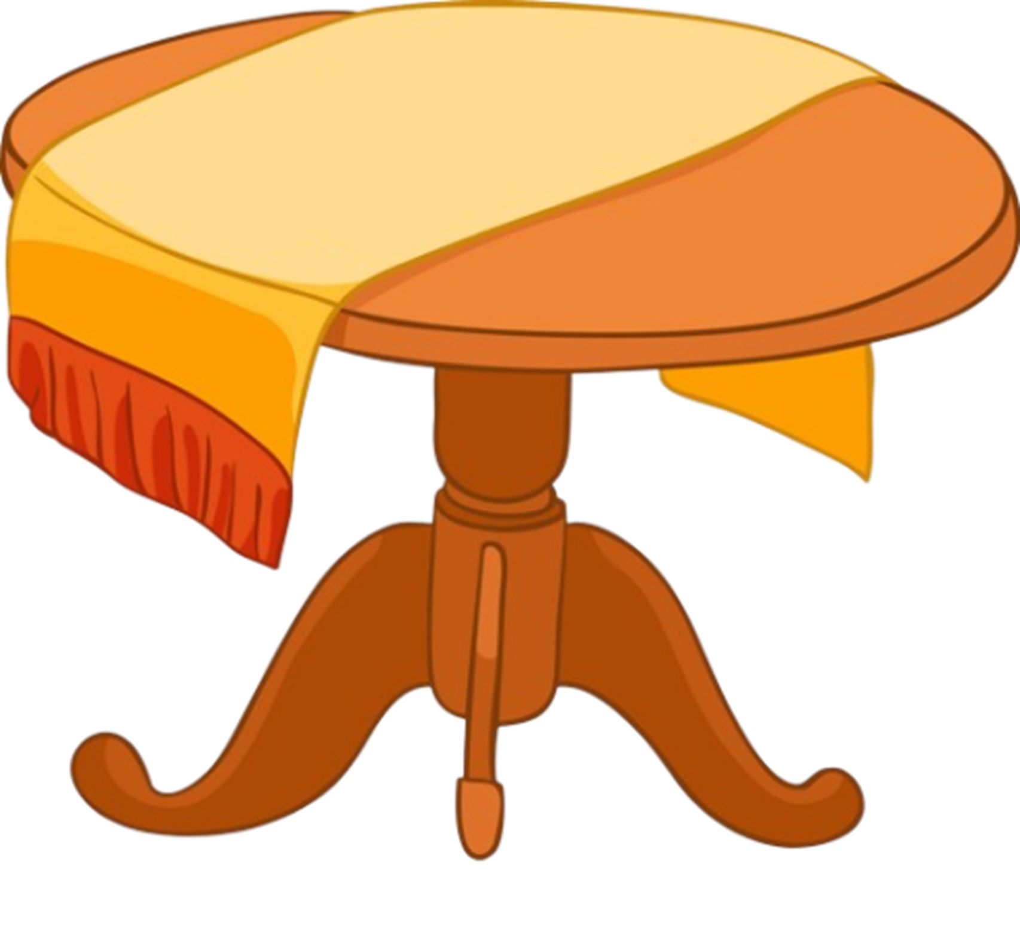

Put the words in order.
on
are
table.
the
grapes
The
The
grapes
are
on
the
table.
BACK

Slide 28

Put the words in order.
the
apple
The
table.
on
is
The
apple
is
on
the
table.
BACK

Slide 29

Put the words in order.
table.
The
the
cake
is
on
The
cake
is
on
the
table.
BACK

Slide 30

Put the words in order.
bananas
on
table.
the
The
are
The
bananas
are
on
the
table.
BACK

Slide 31
THANK YOU FOR PLAYING!

Slide 32
Website: hoclieu.vn
Fanpage: https://www.facebook.com/tienganhglobalsuccess.vn/

