Slide 1
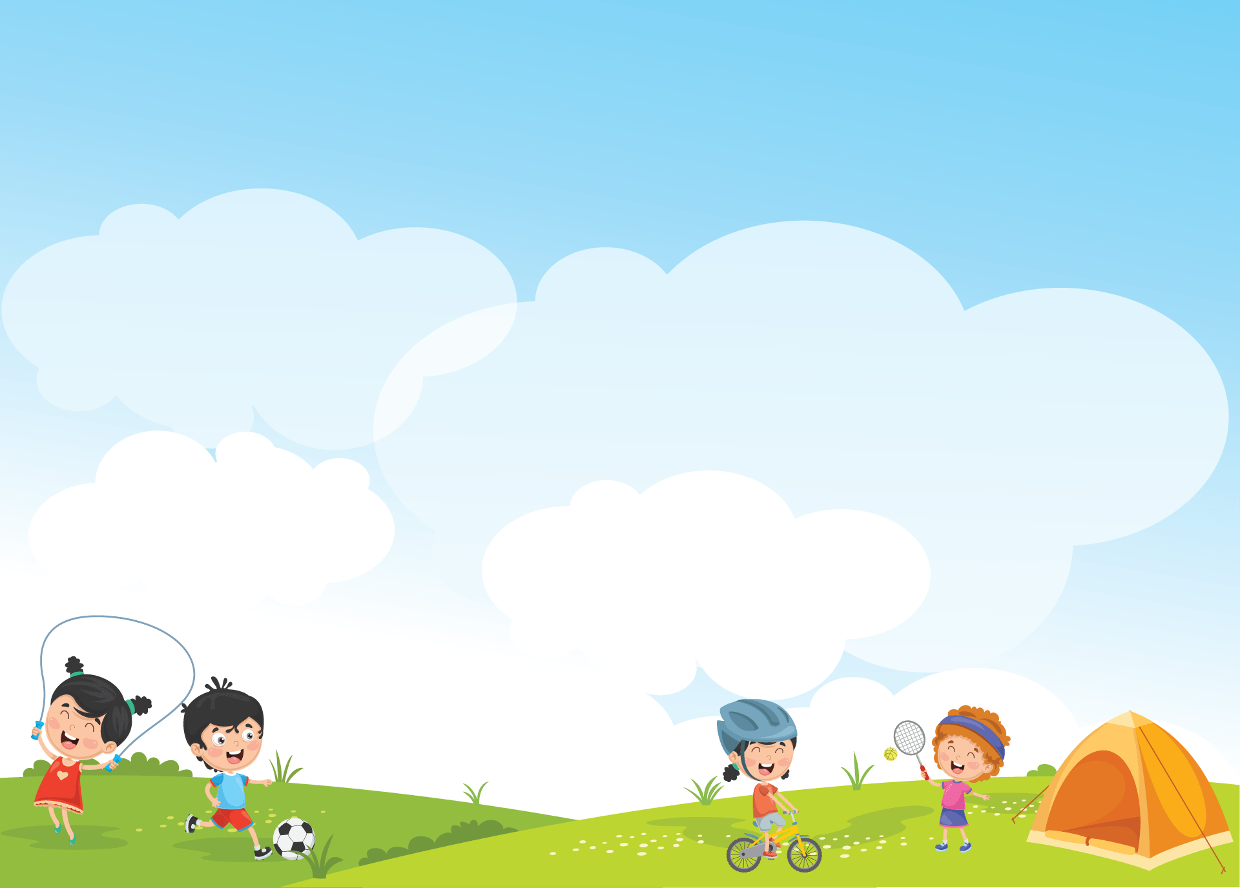


Giáo viên: Đồng Thị Như Quỳnh
Lớp dạy: 5A5, 5A6, 5A7
Đơn vị công tác: TRƯỜNG TIỂU HỌC HƯNG ĐẠO

Slide 2




Unit 15
OUR
HEALTH
Lesson 1 (4, 5, 6)

Slide 3



01
Warm-up and Review

Slide 4



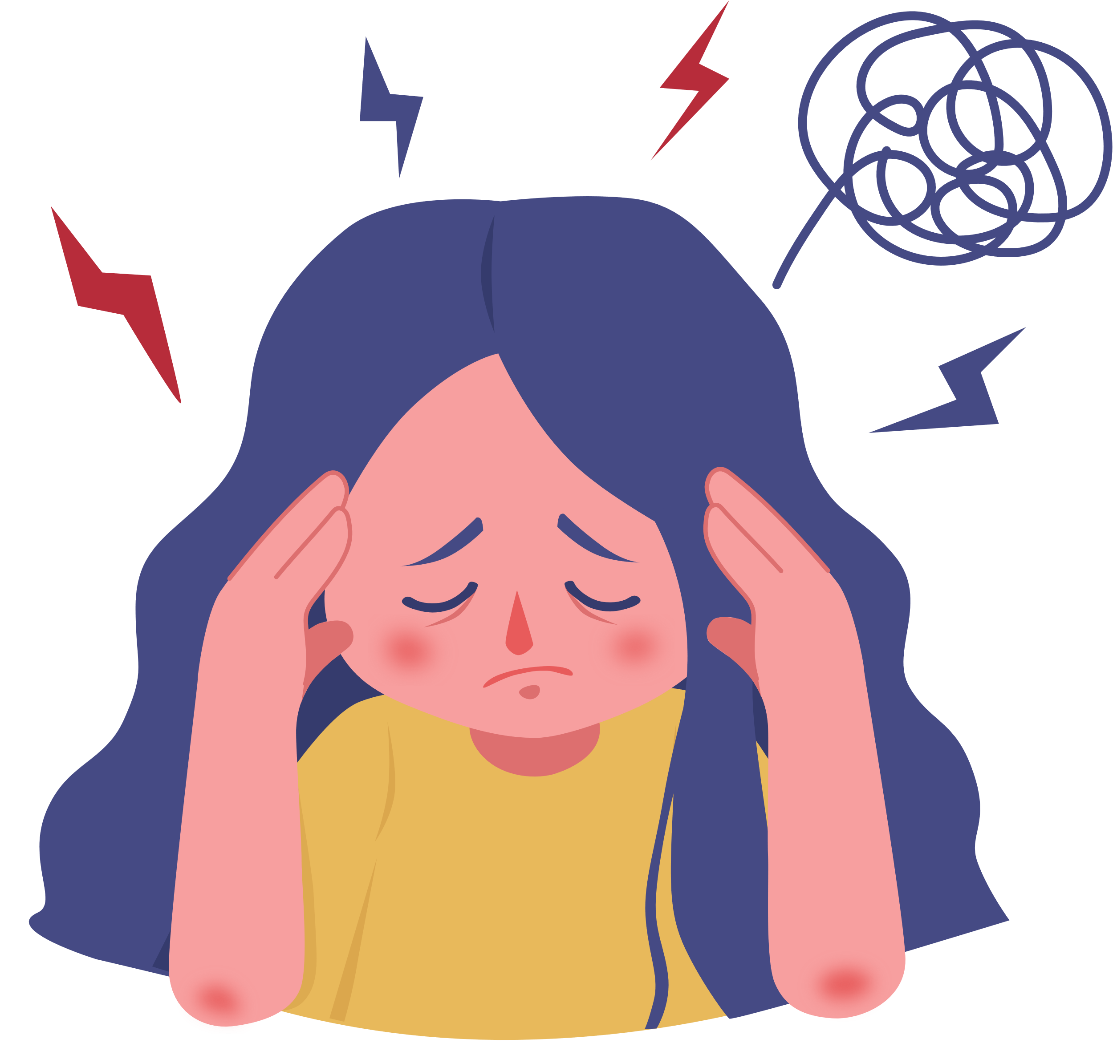
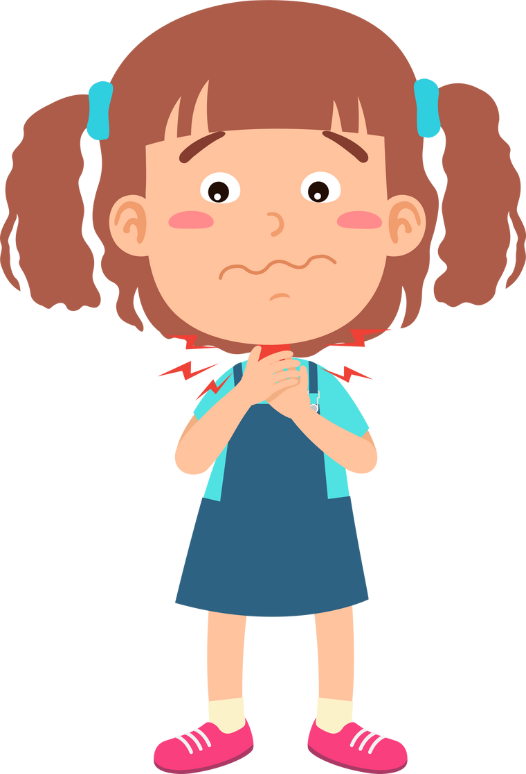
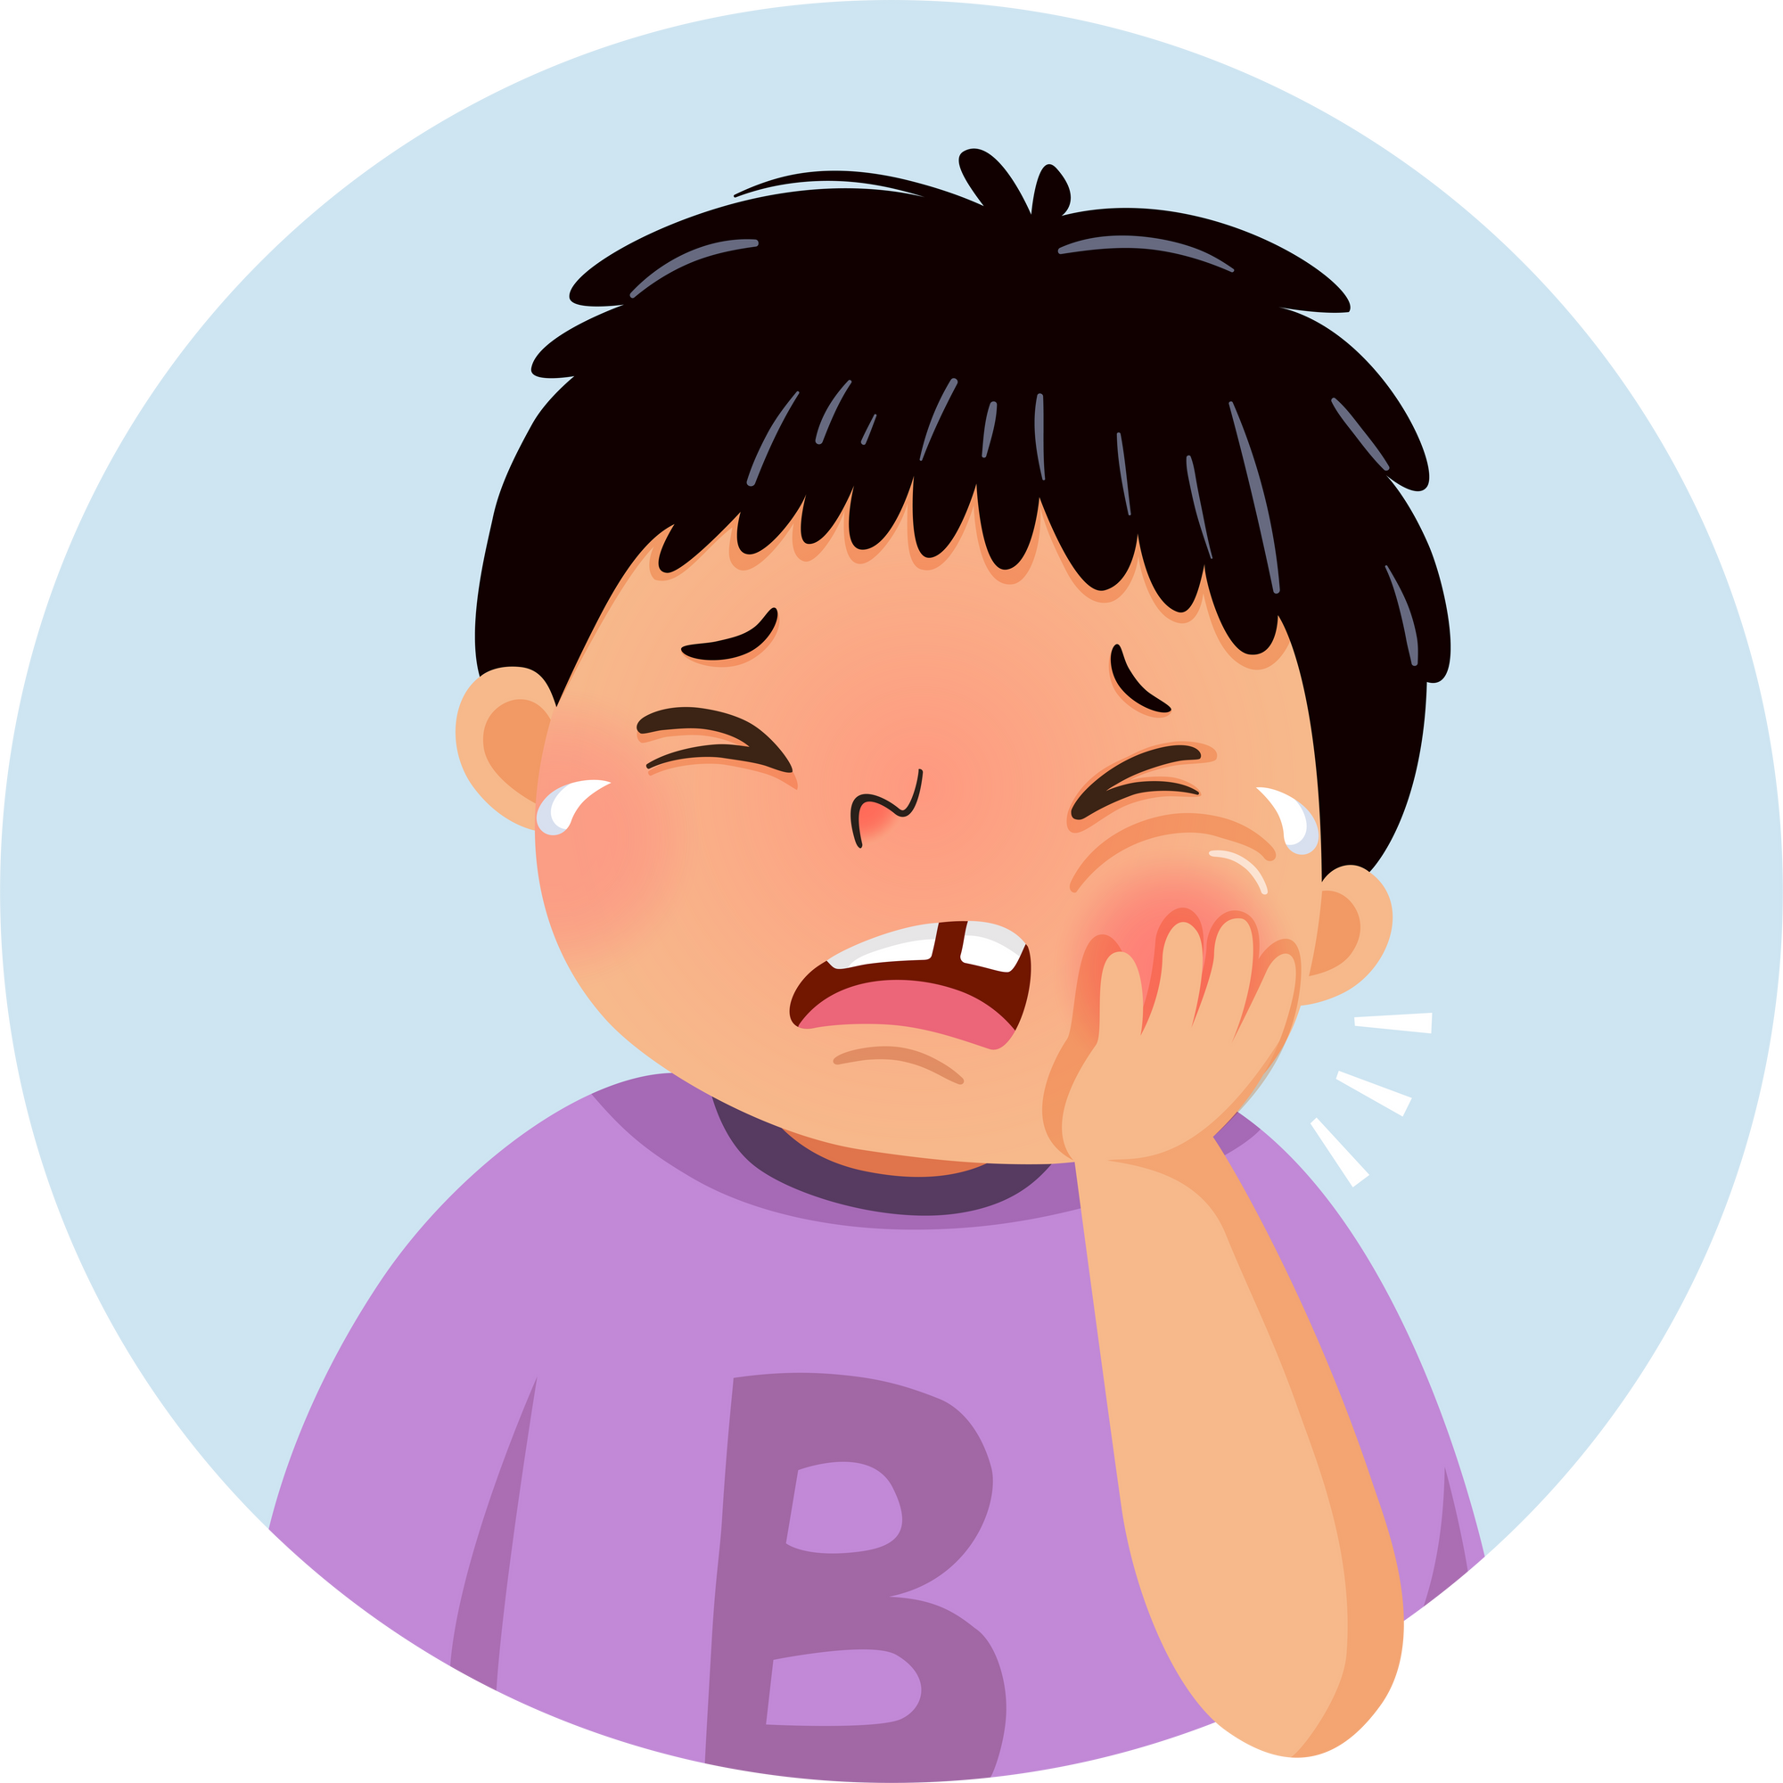
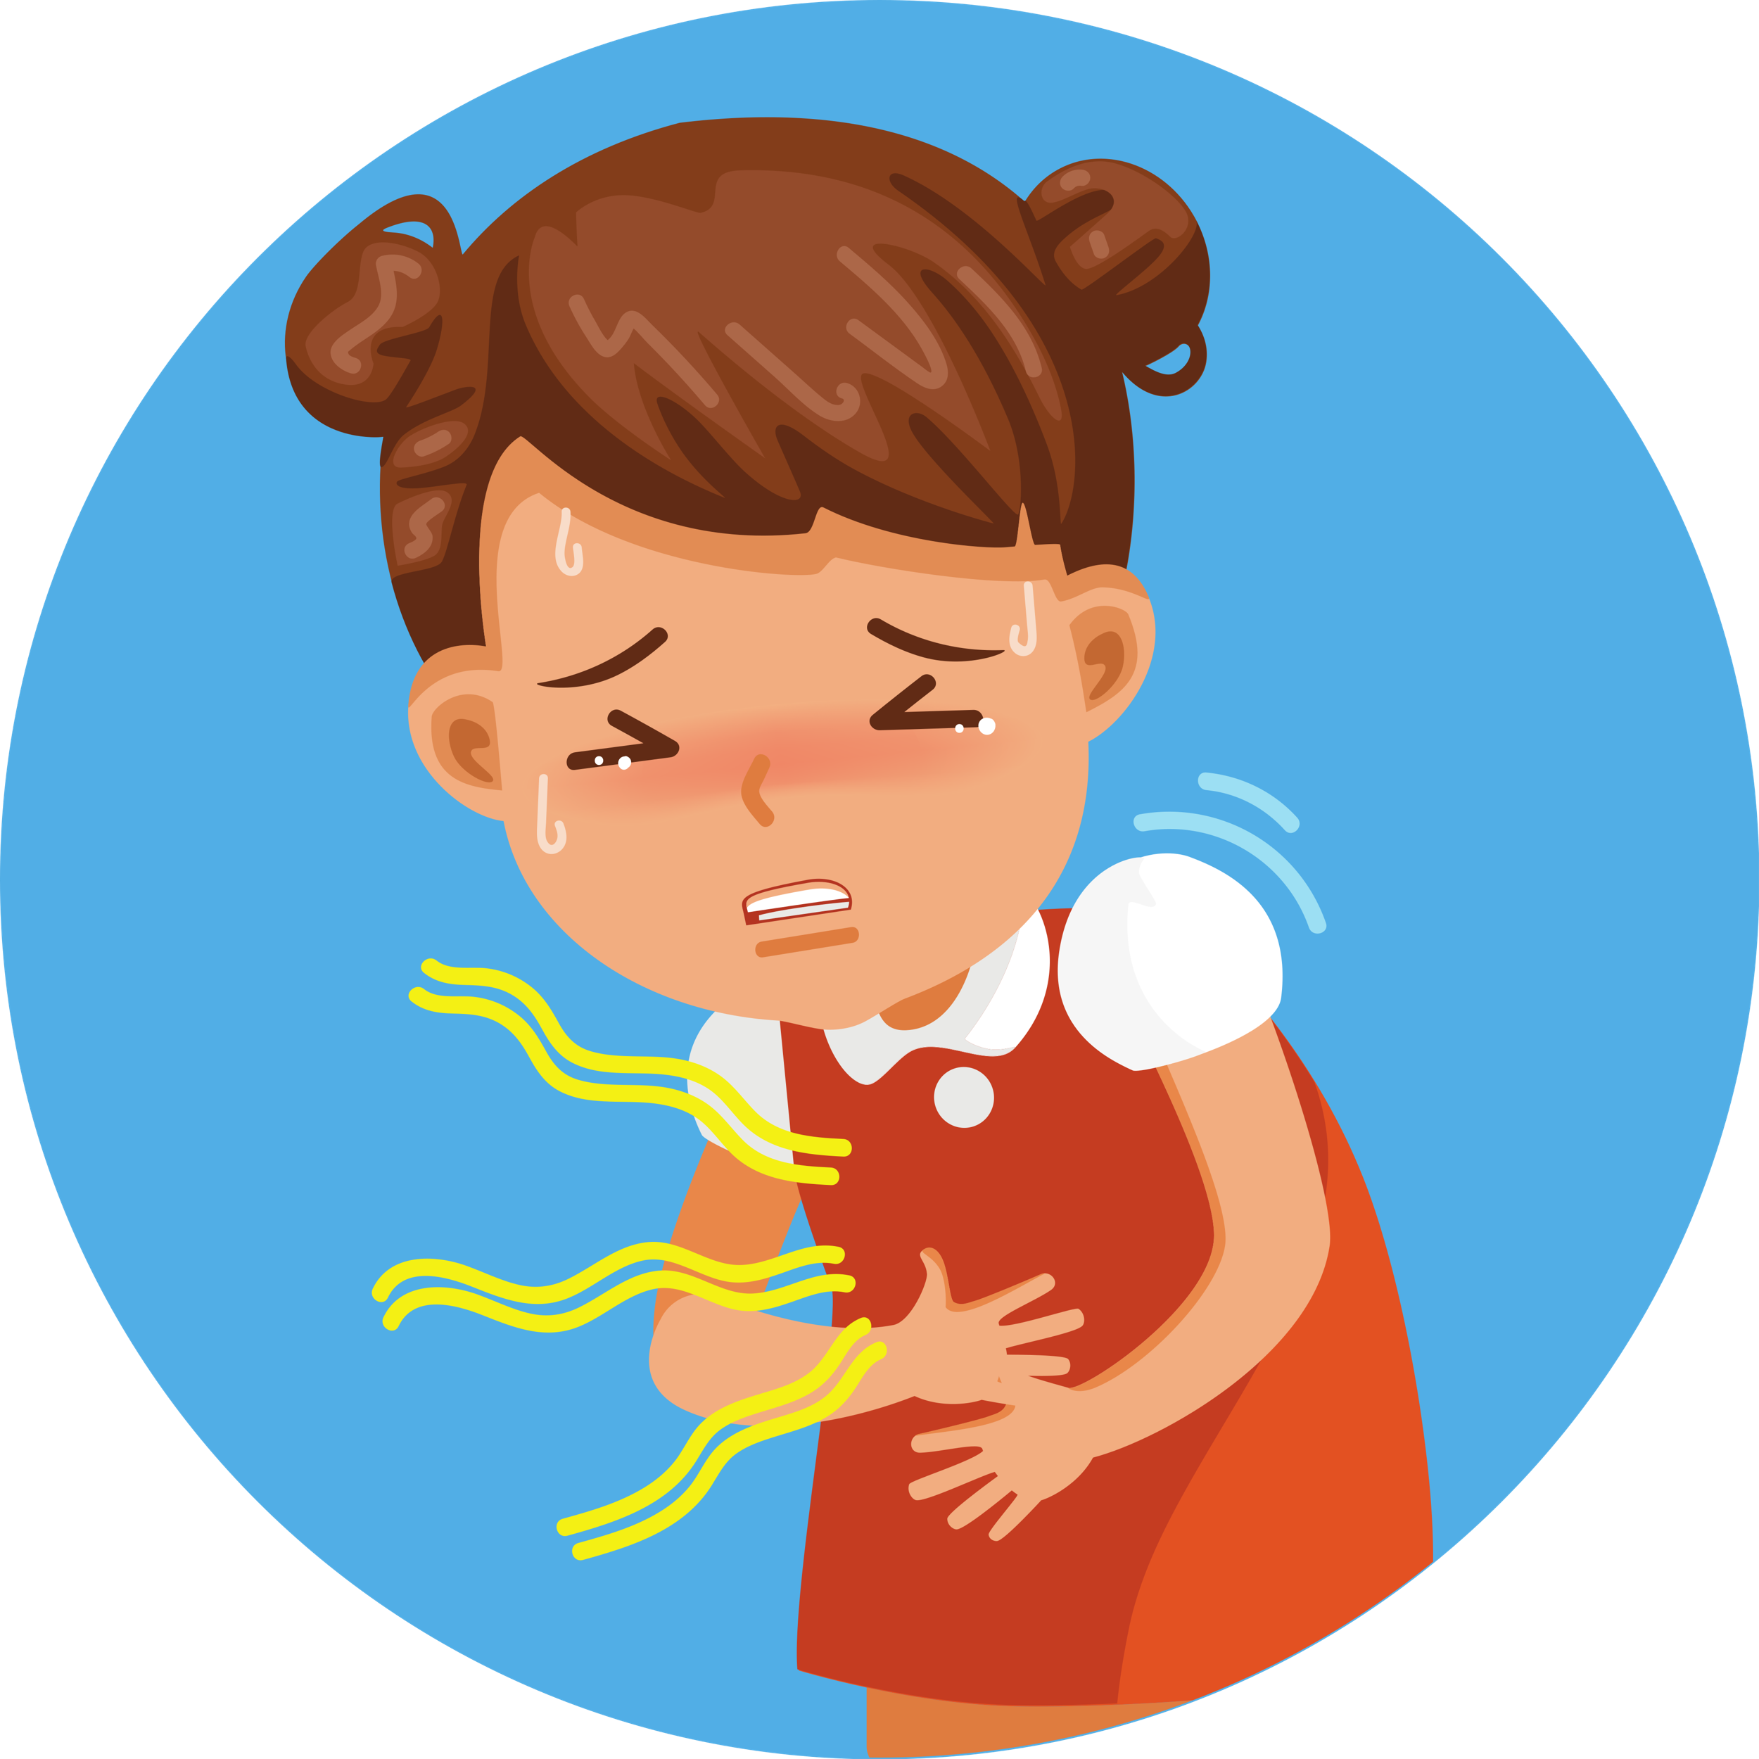
Let’s play Matching Game!

Slide 5


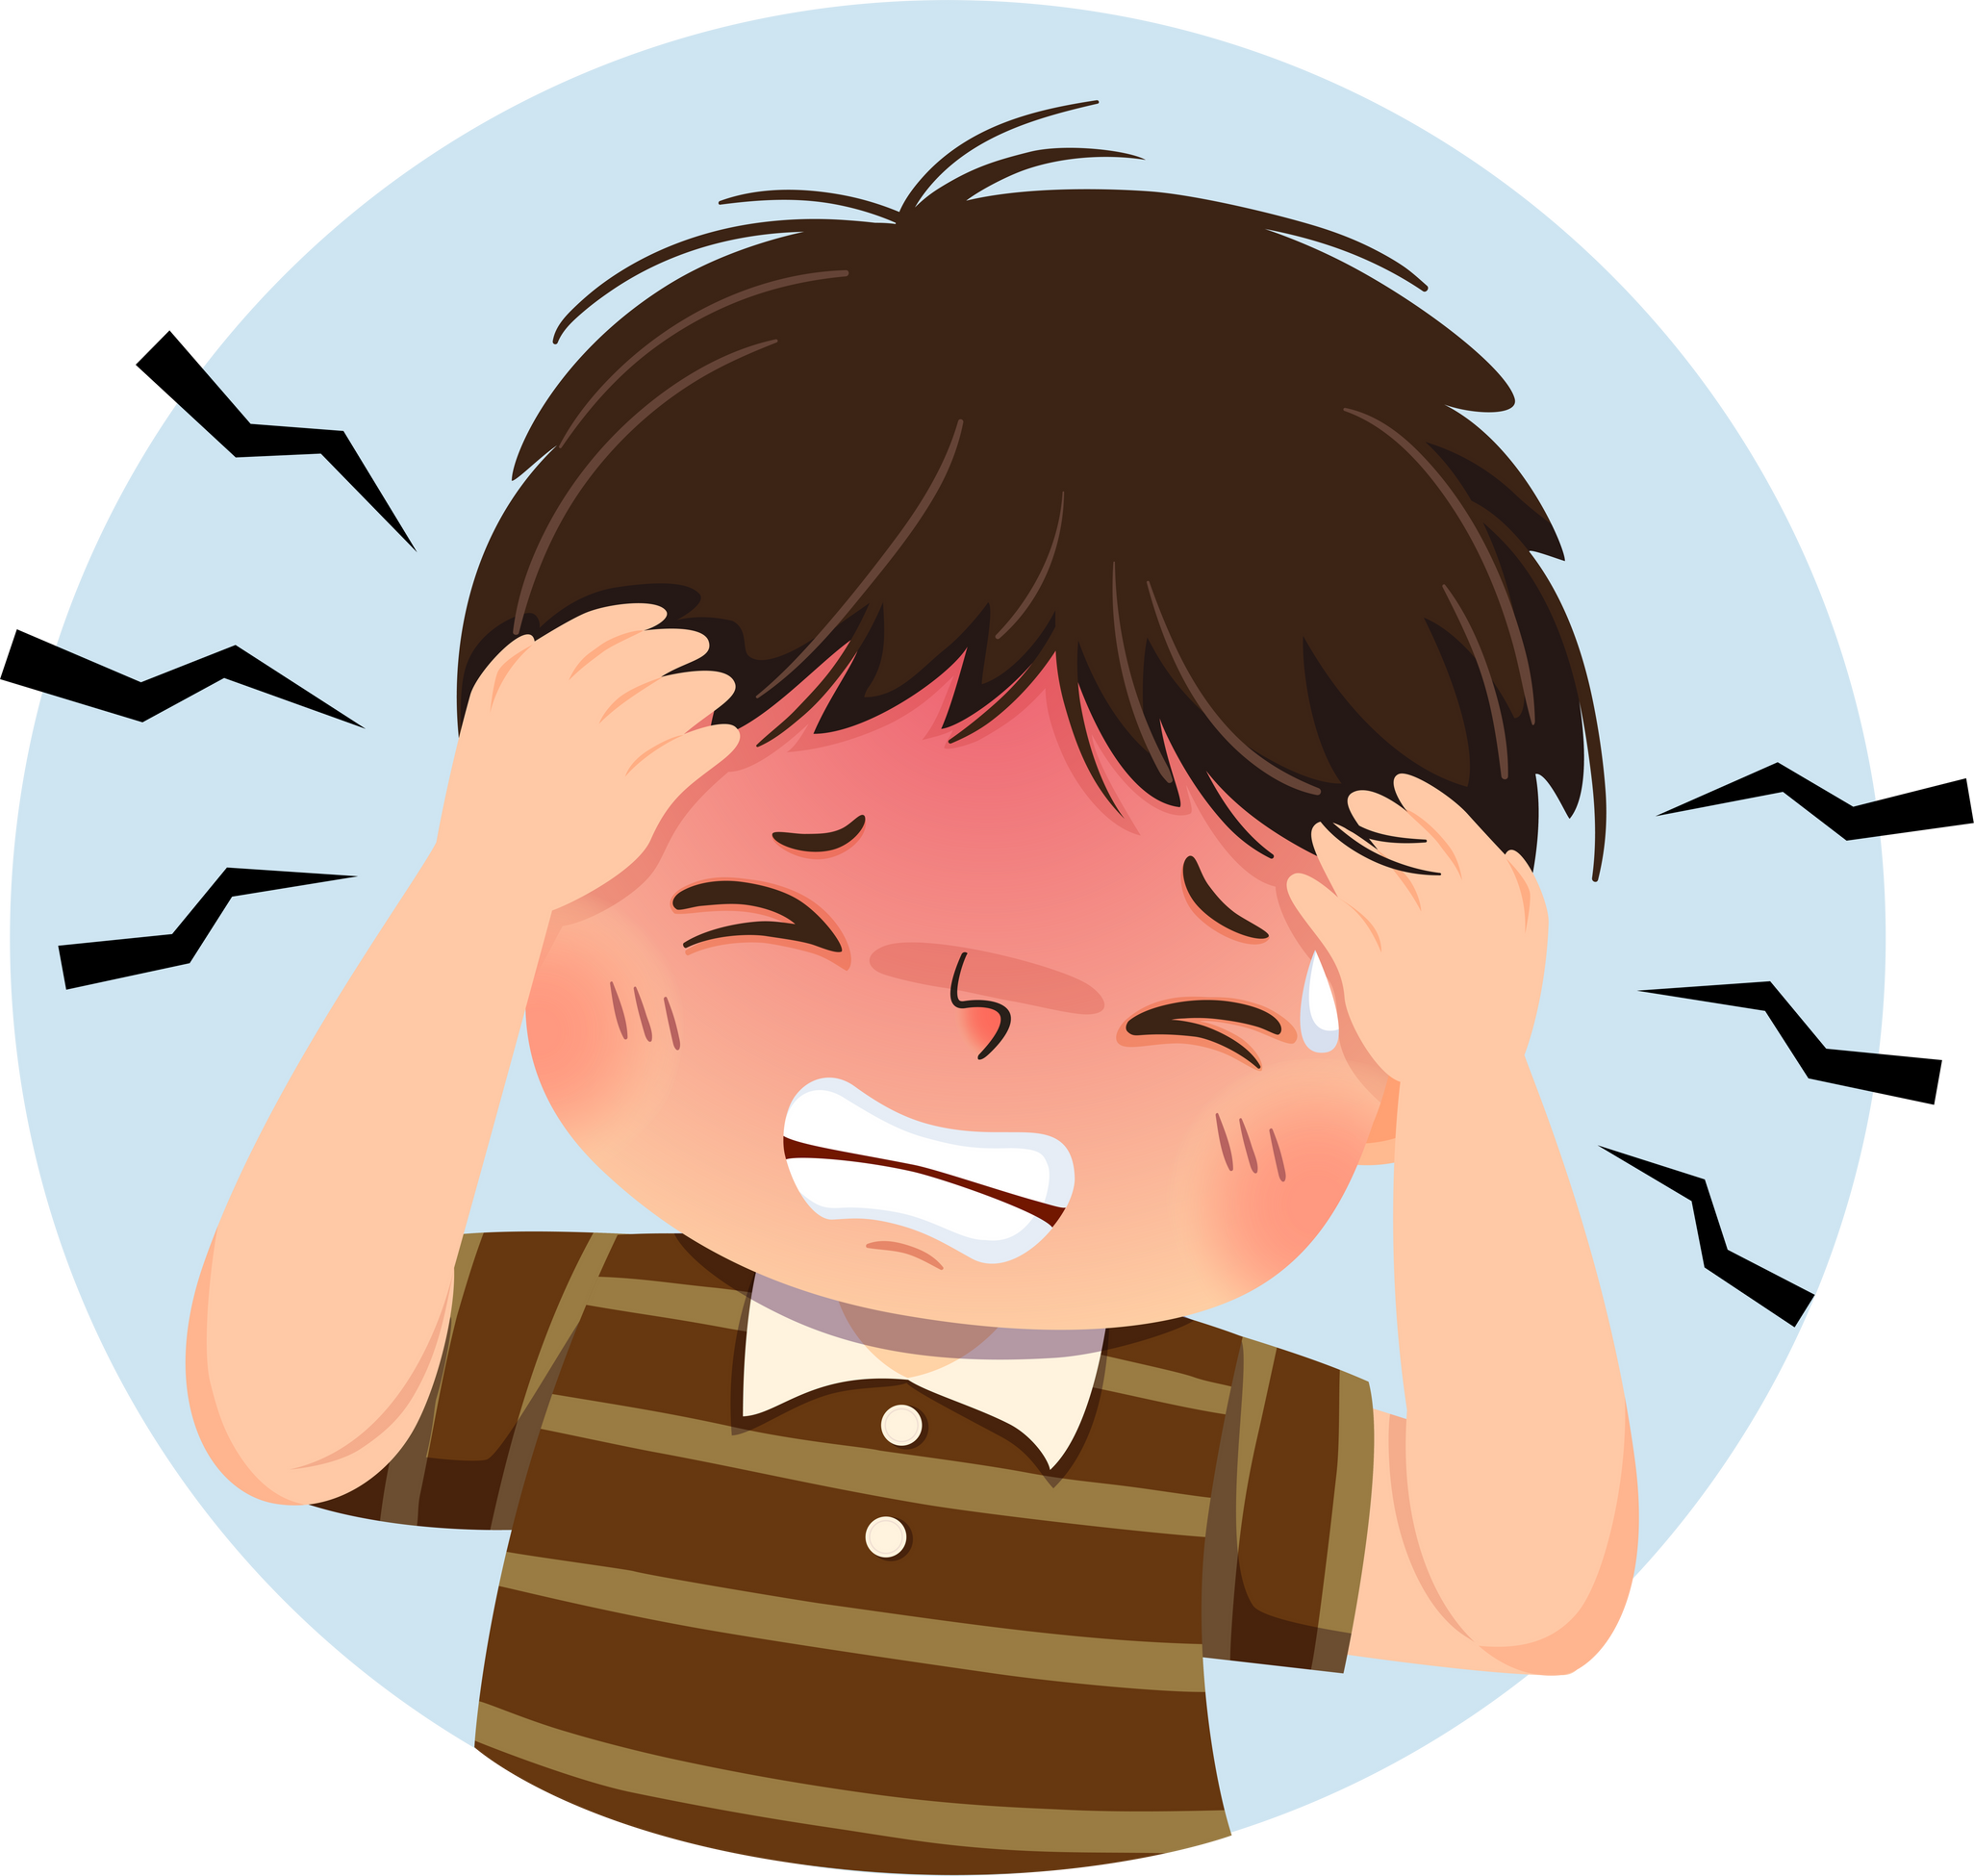
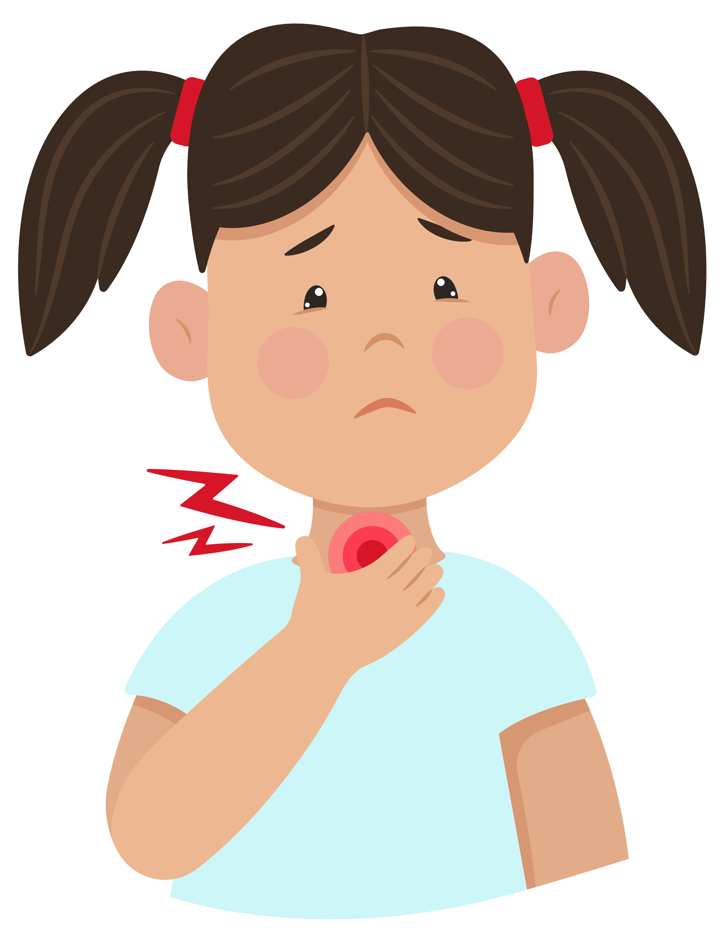
A
1
2
headache
cough
B
3
4
runny nose
sore throat
C
5
6
toothache
backache
D
7
8
stomach
ache
earache

Slide 6



Score Board
Use this to keep track of the points! Copy and paste the token for every point a player receives.
Team 1
Team 2

Slide 7



THANK YOU
FOR PLAYING!

Slide 8
02
Activity 4
Listen and number.

Slide 9


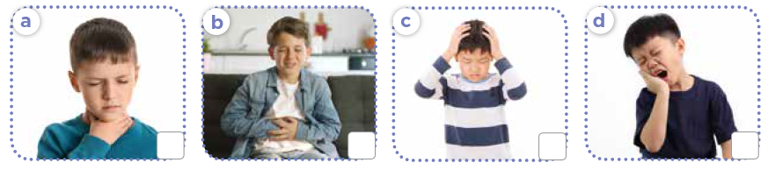



Look and answer.
Notes:
Step 1: Have pupils look at Activity 4. Ask them How many pictures are there? And What health problems can you see in each picture? Explain that they will write numbers 1 - 4 in the box of the picture in the order they hear.

Slide 10
Listen and number.
1
Notes:
Step 2: Play the recording of the first dialogue. Ask pupils to find the correct picture and write number 1 in the box. Check their answers and give feedback.

Slide 11
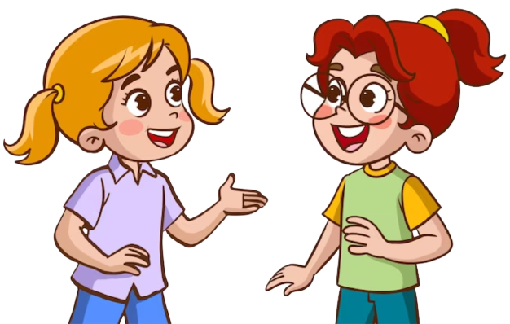
Look and number.
1
Notes:
Step 3: Play the other recordings. Ask pupils to work individually, then work in pairs for their peer-checks. Go around the class and give support if necessary.

Slide 12
Look and number.
3
1
2
4
Notes:
Step 4: Check the answers as a class. Correct the answers, if necessary.
*Key: a. 3, b. 1, c. 2, d .4

Slide 13




Slide 14
03
Activity 5
Read and complete.

Slide 15

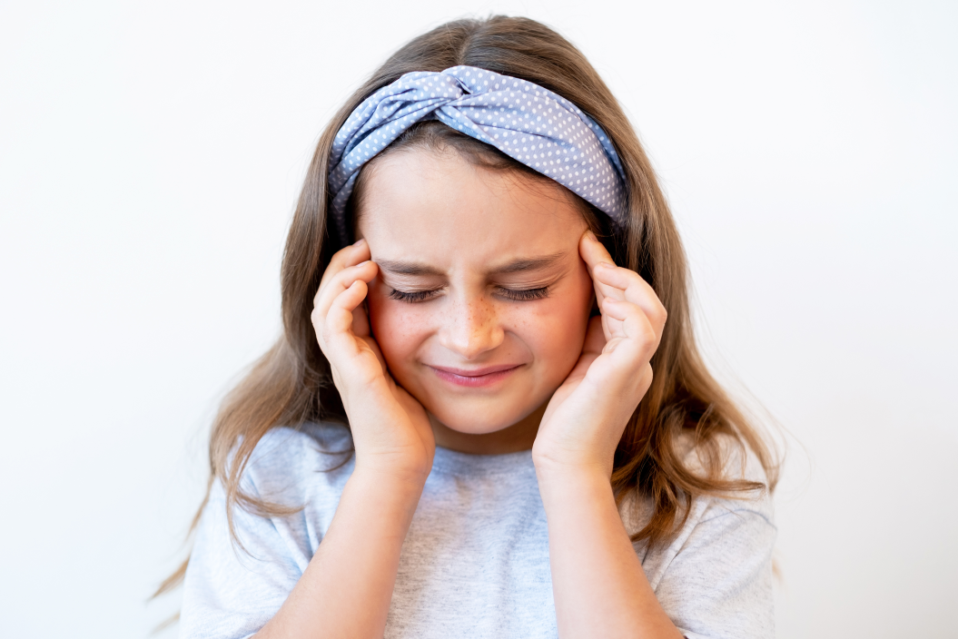
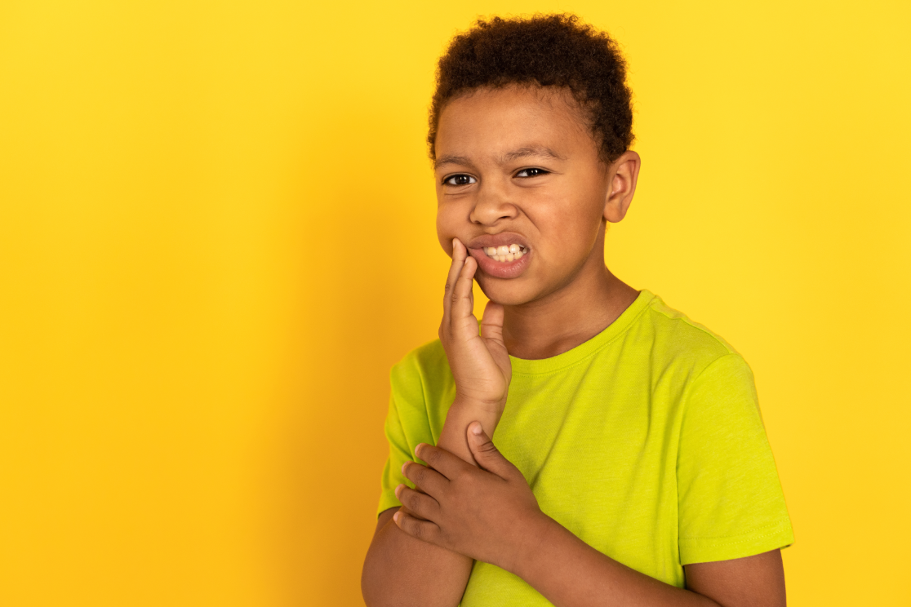
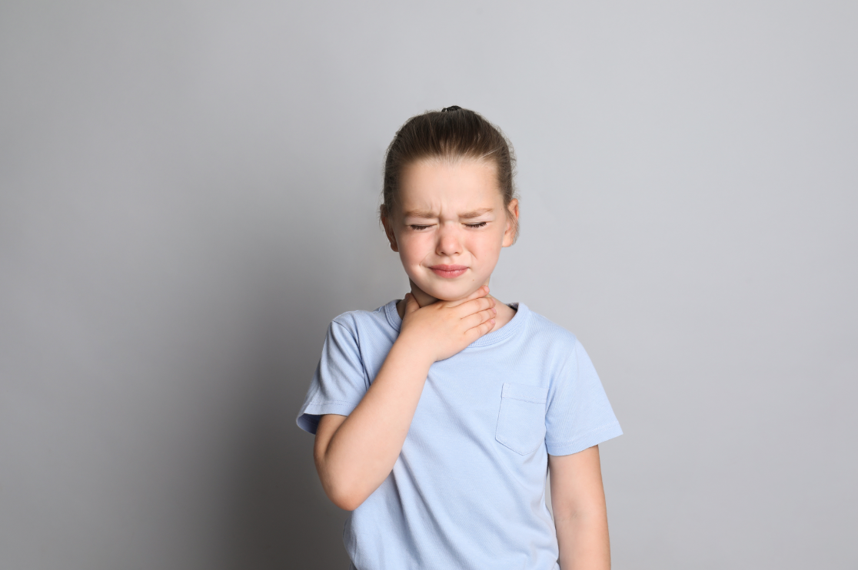
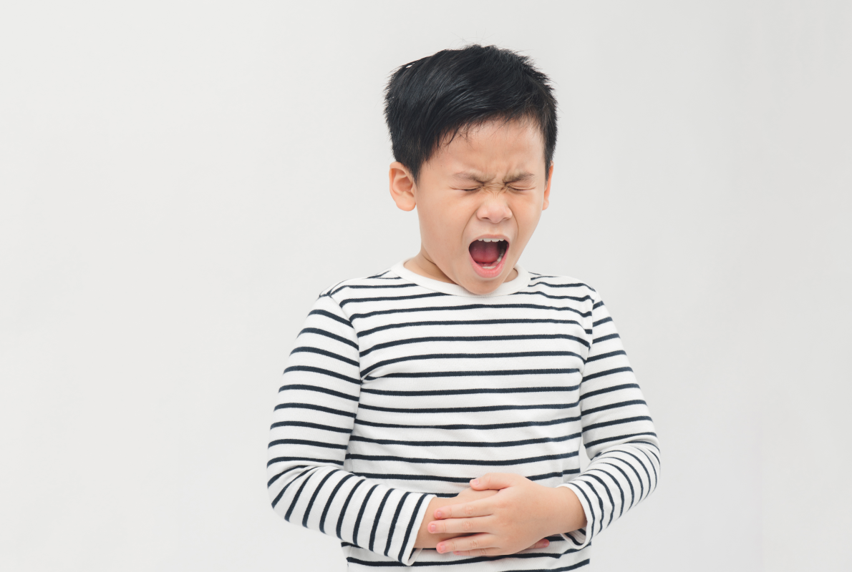
Look and say.
a headache
toothache
a sore throat
a stomach ache
Notes:
Step 1: Ask pupils to look at the pictures and identify the health problems that the characters have.

Slide 16
Read and complete.
1. I feel tired. I have a _________________ .
headache
Notes:
Step 2: Have pupils read the sentences in Question 1. Ask them what is missing in the sentence. Ask them to complete the gap by finding the information from the picture. Give the correct answer.

Slide 17
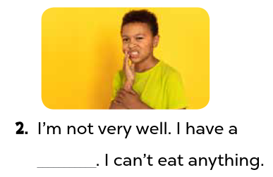
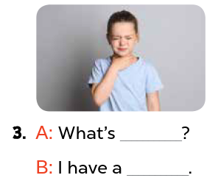
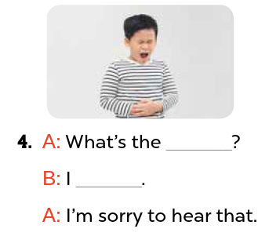
Read and complete.
Notes:
Step 3: Ask pupils to do the other questions in the same way individually, then in pairs for their peer-checks. Go around and give support if necessary.

Slide 18
Read and complete.
2. I’m not very well.
I have a _____________ . I can’t eat anything.
toothache
Notes:
Step 4: Ask two pupils and two pairs to read the sentences aloud. Give feedback and corrections if necessary.

Slide 19
Read and complete.
3.
A: What’s ______________?
B: I have a ______________.
the matter
sore throat
Notes:
Step 4: Ask two pupils and two pairs to read the sentences aloud. Give feedback and corrections if necessary.

Slide 20
Read and complete.
4.
A: What’s the __________?
B: I _____________________.
A: I’m sorry to hear that.
matter
have a stomach ache
Notes:
Step 4: Ask two pupils and two pairs to read the sentences aloud. Give feedback and corrections if necessary.

Slide 22
04
Activity 6
Let’s sing.

Slide 23

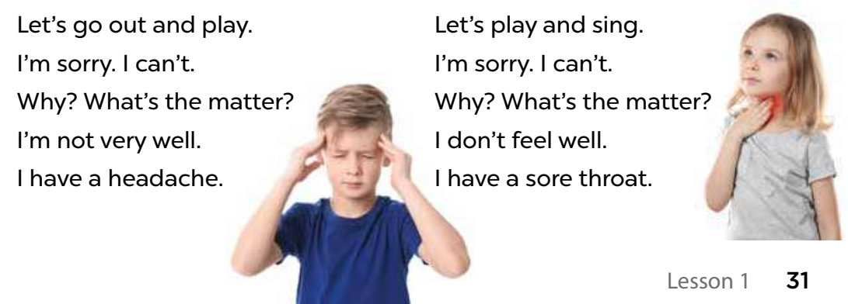

Read and give gestures.
Notes:
Step 1: Have pupils read the lyrics to familiarise themselves with the language. Check comprehension and give feedback.

Slide 24

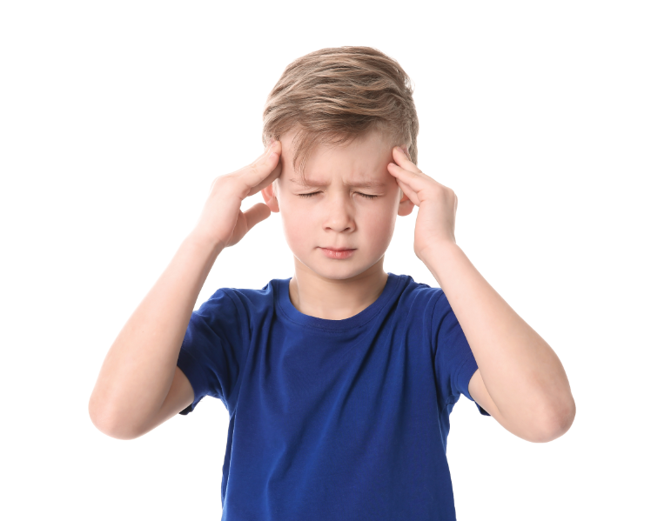
Listen and point.
Let’s go out and play.
I’m sorry. I can’t.
Why? What’s the matter?
I’m not very well.
I have a headache.
Notes:
Step 2: Have pupils listen to the entire song, direct their attention to the pronunciation.

Slide 25
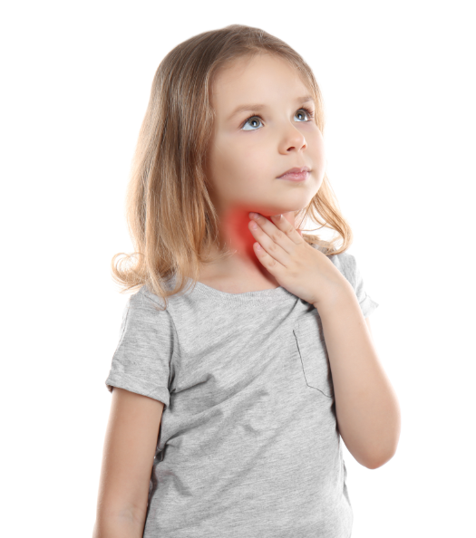
Listen and point.
Let’s play and sing.
I’m sorry. I can’t.
Why? What’s the matter?
I don’t feel well.
I have a sore throat.
Notes:
Step 2: Have pupils listen to the entire song, direct their attention to the pronunciation.

Slide 26
Listen and repeat.
Let’s go out and play.
I’m sorry. I can’t.
Why? What’s the matter?
I’m not very well.
I have a headache.
Notes:
Step 3: Play the recording of the song once or twice for pupils to listen and repeat, line after line.

Slide 27
Listen and point.
Let’s play and sing.
I’m sorry. I can’t.
Why? What’s the matter?
I don’t feel well.
I have a sore throat.
Notes:
Step 3: Play the recording of the song once or twice for pupils to listen and repeat, line after line.

Slide 28

Sing and clap your hands.
Notes:
Step 4: When pupils feel confident and get familiar with the tune and melody, ask them to sing the entire song while clapping their hands.

Slide 29





Let’s sing altogether !!!!
Notes:
Step 5: Invite a few groups to the front of the class to sing the song. The class may sing along to reinforce the activity.

Slide 31
05
Fun corner and Wrap-up

Slide 32



Lucky
Gift
Boxes
Let’s open them!

Slide 33







Notes:
Click the gift box to link to the Question slide.
Click the opened box to end to game.

Slide 34


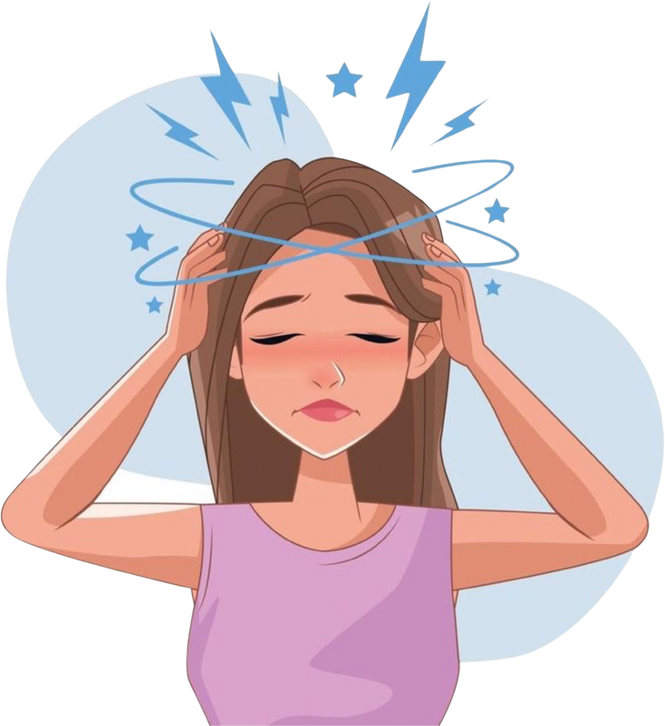
What’s the matter?
I have a headache.
Notes:
Click the flower next to the answer to back to the Gift boxes slide.

Slide 35

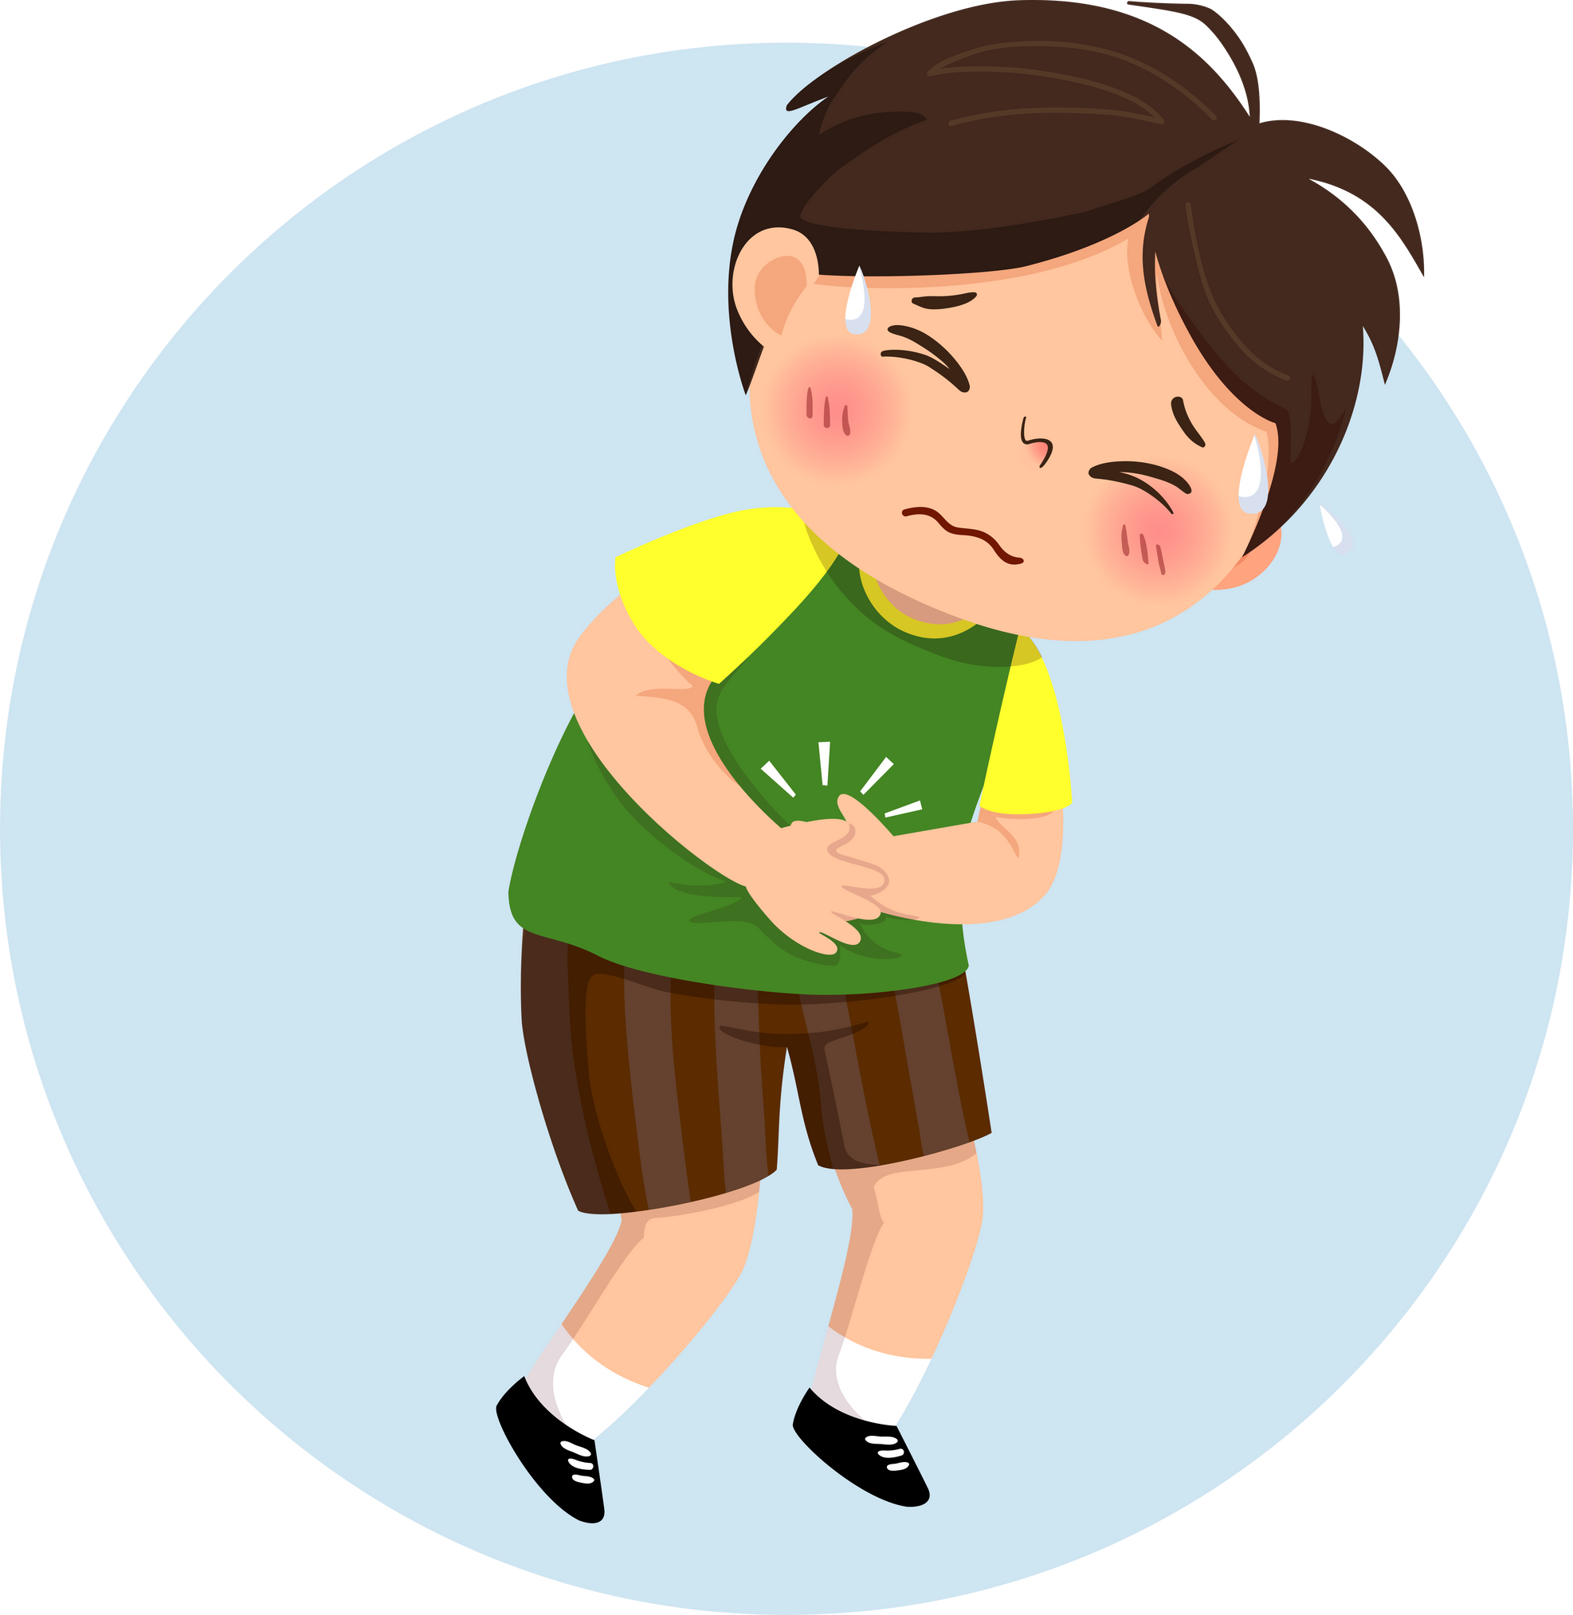
What’s the matter?
I have a stomach ache.
Notes:
Click the flower next to the answer to back to the Gift boxes slide.

Slide 36
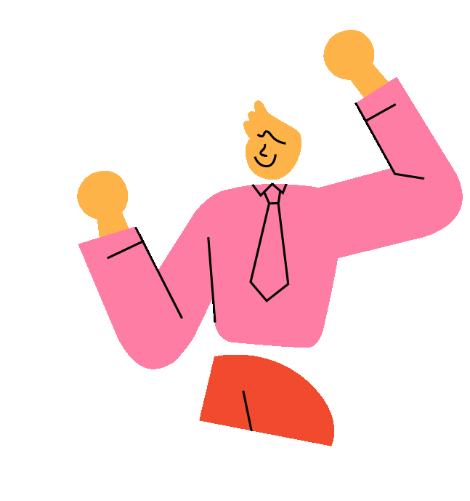
double scores!
Notes:
Click the flower next to the answer to back to the Gift boxes slide.

Slide 37
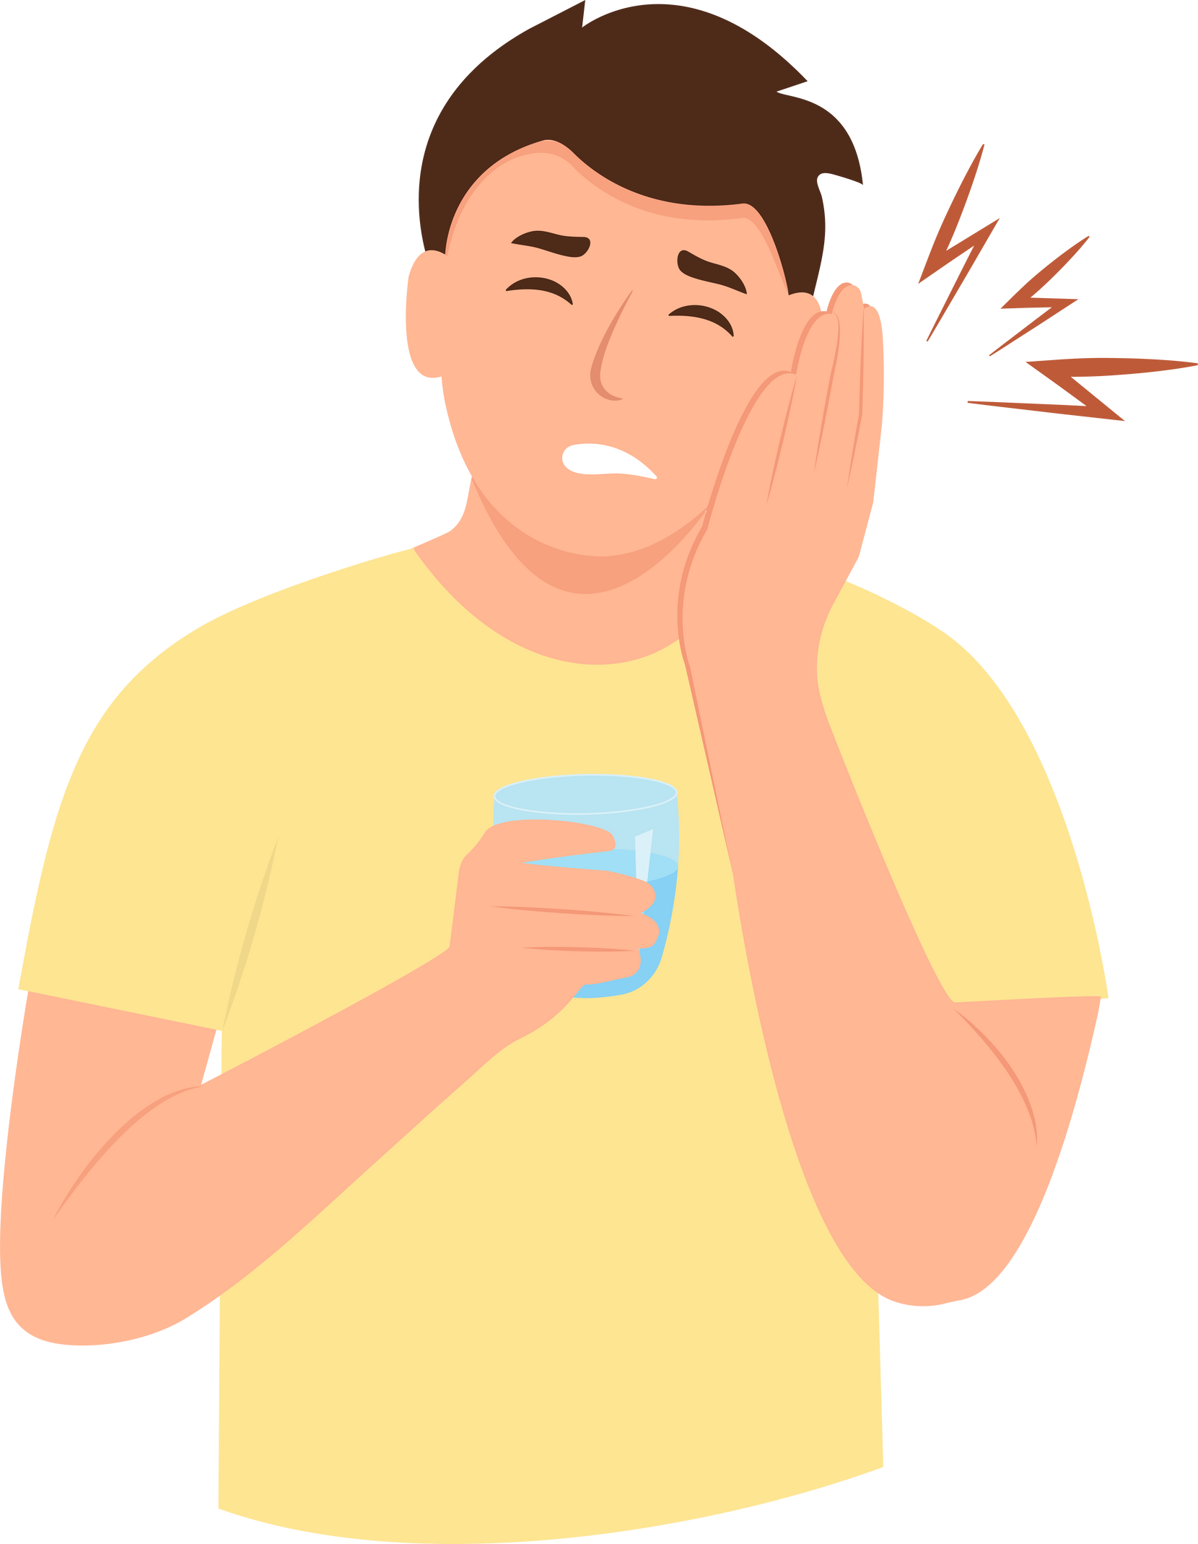
What’s the matter?
I have a toothache.
Notes:
Click the flower next to the answer to back to the Gift boxes slide.

Slide 38

Notes:
Click the flower next to the answer to back to the Gift boxes slide.

Slide 39
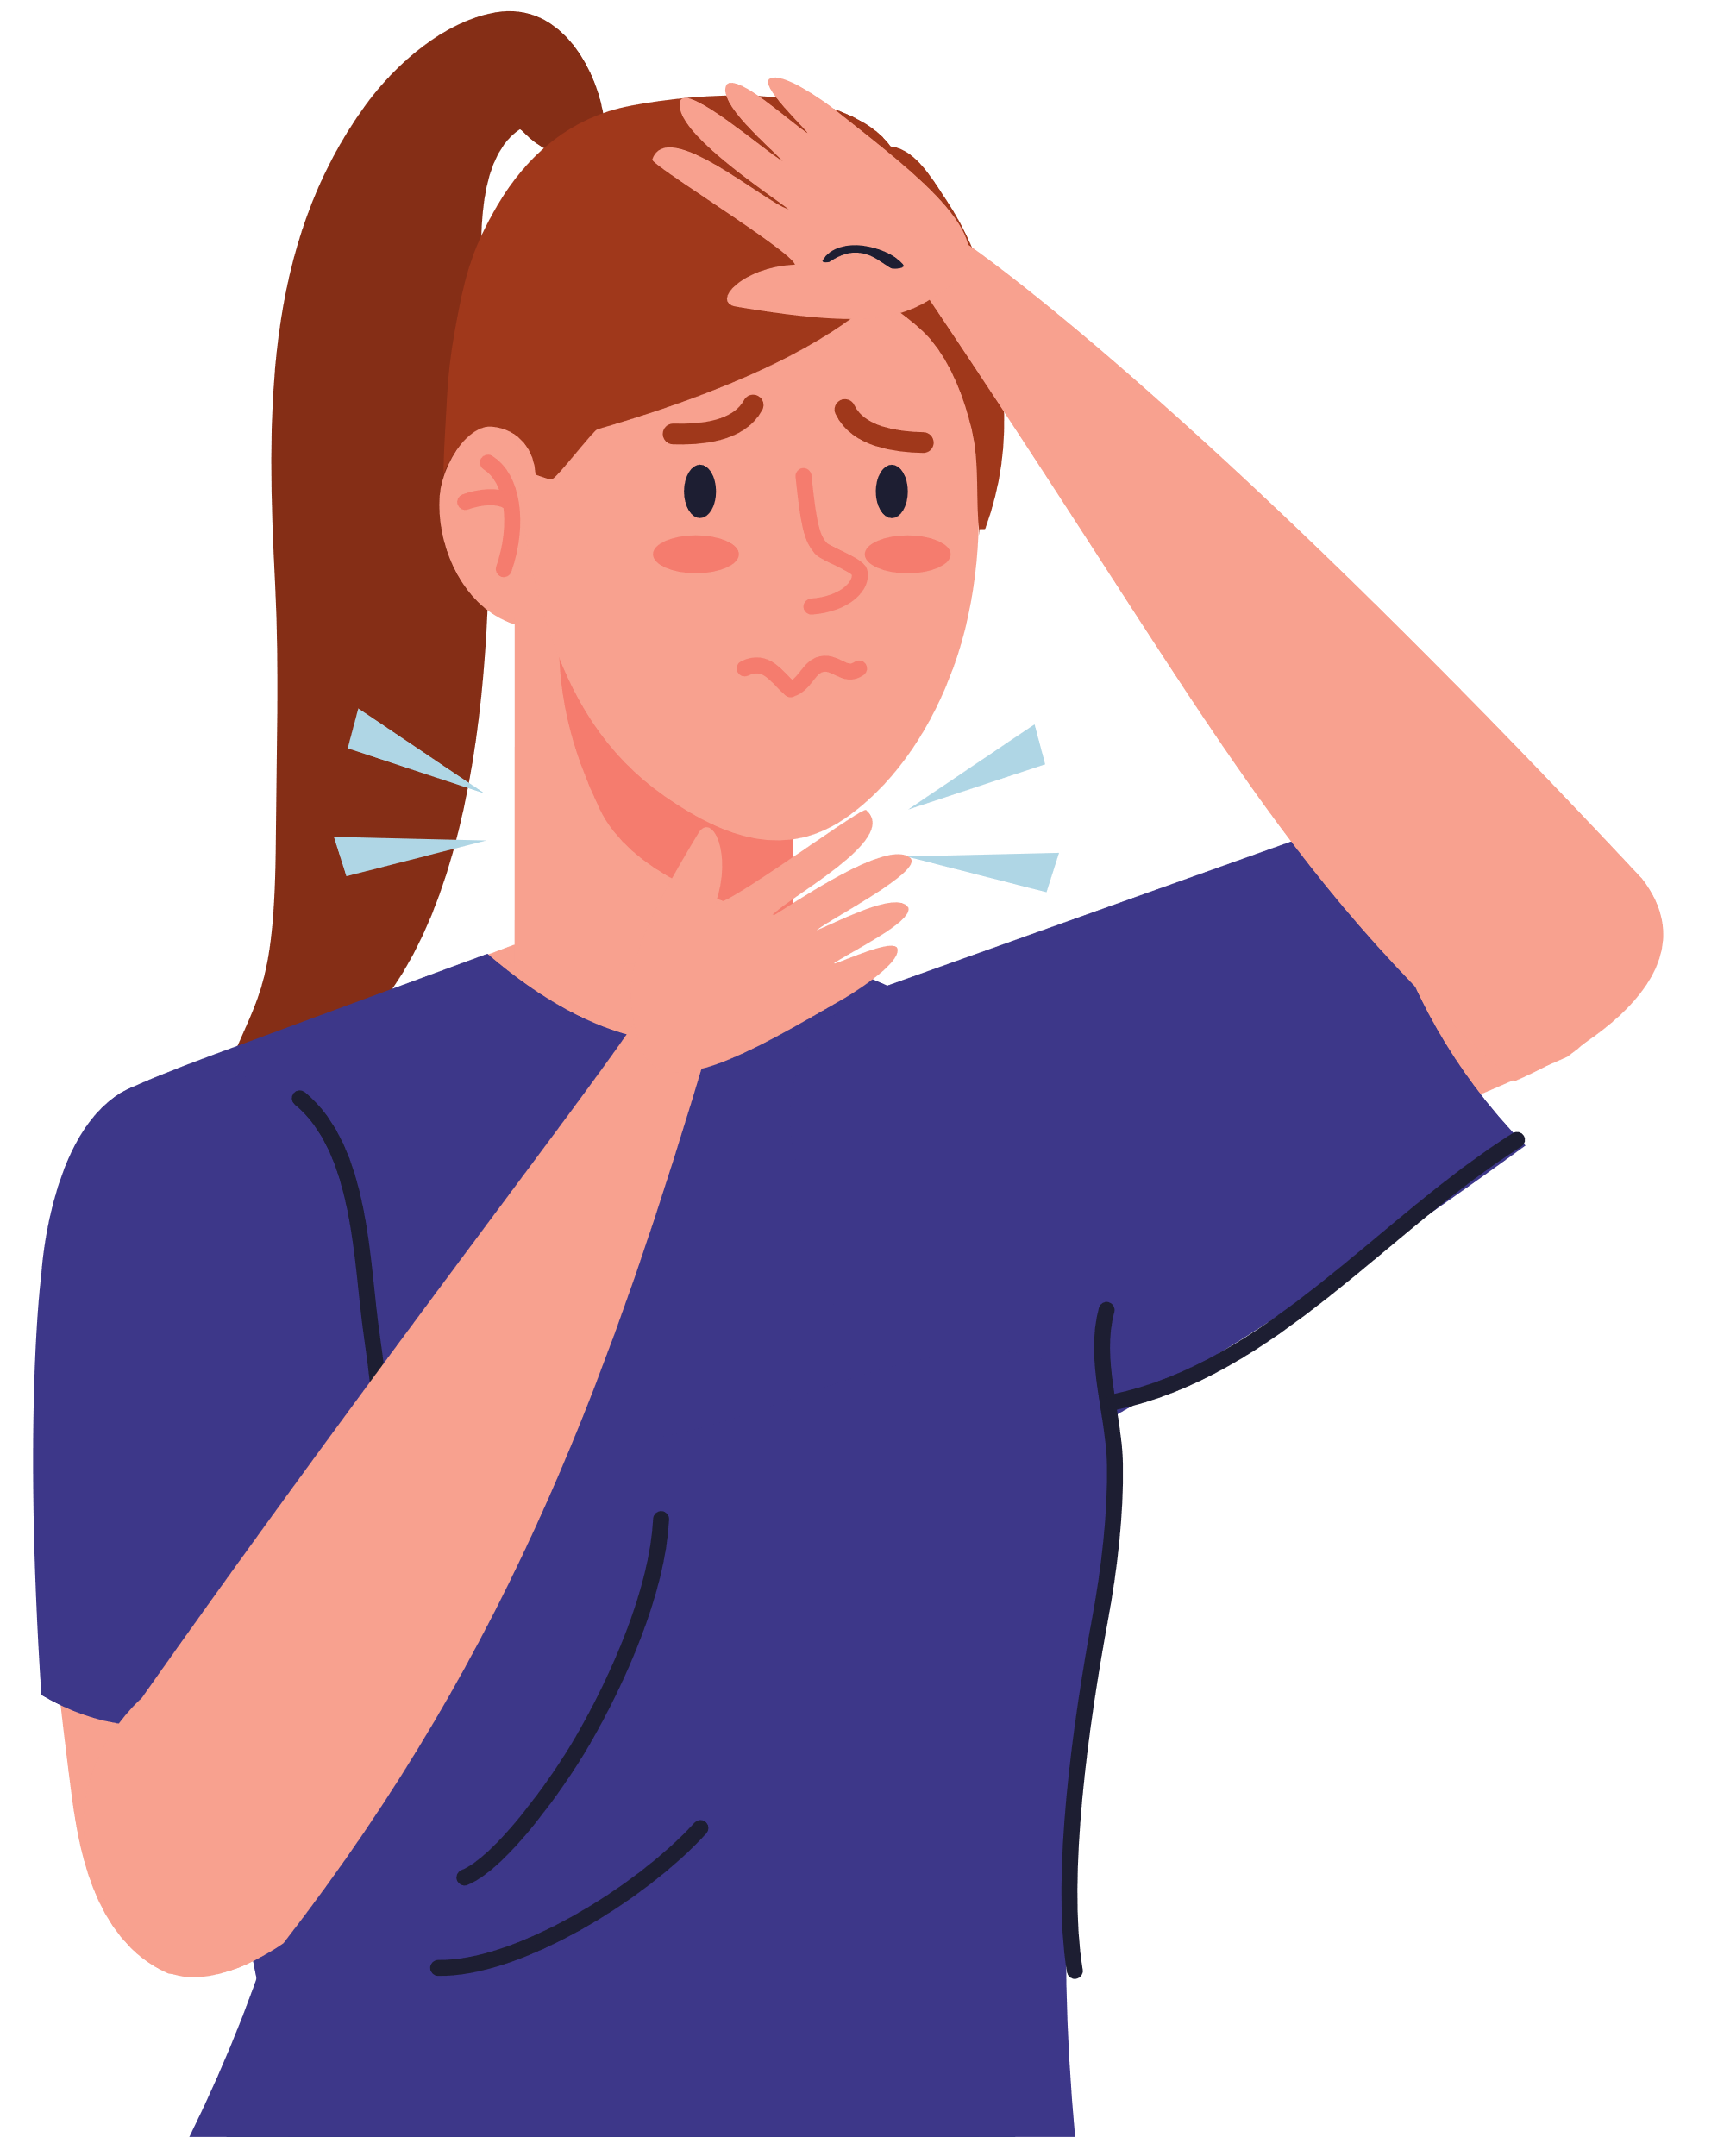
What’s the matter?
I have
a sore throat.
Notes:
Click the flower next to the answer to back to the Gift boxes slide.

Slide 41
Website: hoclieu.vn
Fanpage: https://www.facebook.com/tienganhglobalsuccess.vn/

