Slide 1
Tiếng Anh 2
Giáo viên: Lê Thị Minh Hiếu
Lớp dạy: 2A1, 2A4, 2A5
Đơn vị công tác: Trường TH Hưng Đạo

Slide 3






Unit 13:
In the maths class
Lesson 2

Slide 4









Table of Contents
  Warm-up and review.
  Listen and chant.
  Listen and tick.
  Write and say.
  Fun corner and wrap-up.

Slide 5




Warm-up and Review.

Slide 6




MATHS QUIZ

Slide 7





+
?
=
A
B
✗
C
✗
✓
ten
nine
eight

Slide 8

+
=
?
A
✗
B
✗
C
✓
fifteen
fourteen
eleven

Slide 9






+
=
?
A
B
✗
C
✗
✓
fifteen
fourteen
thirteen

Slide 10



+
?
=
A
✗
B
✗
C
✓
fourteen
eleven
thirteen

Slide 11



+
?
=
A
✗
B
C
✗
✓
thirteen
fourteen
fifteen

Slide 12

Thank you for Playing!

Slide 13
Listen and chant.

Slide 14
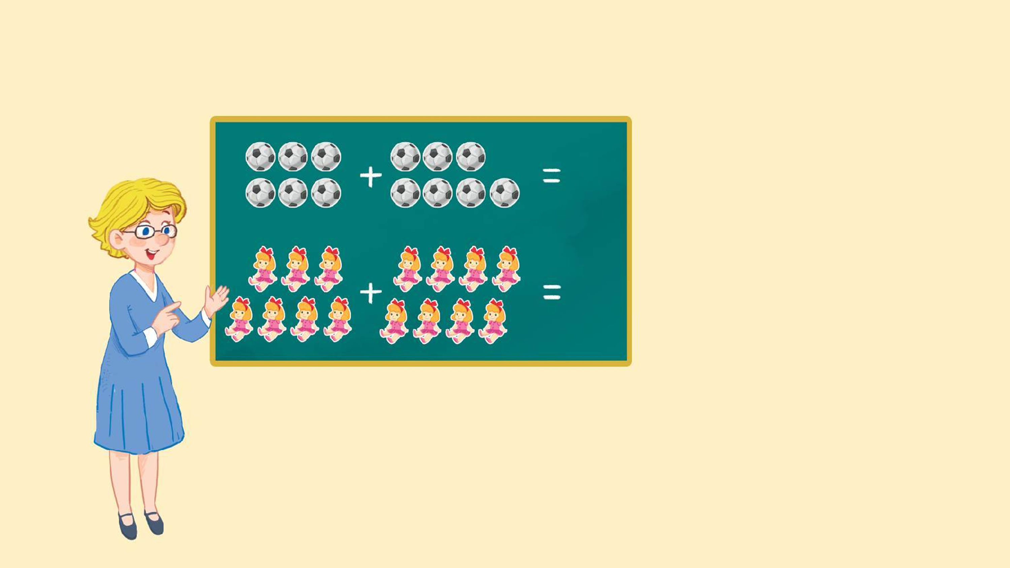
Look and say.
13
thirteen
15
fifteen

Slide 15


Watch a video.

Slide 16

3.Listen and chant.
N, n, eleven.
N, n, eleven.
N, n, eleven.
N, n, eleven.
N, n, thirteen.
N, n, thirteen.
N, n, thirteen.
N, n, thirteen.
How many balls?
How many balls?
How many balls?
How many balls?
Eleven or thirteen.
Eleven or thirteen.
Eleven or thirteen.
Eleven or thirteen.
N, n, fourteen.
N, n, fourteen.
N, n, fourteen.
N, n, fourteen.
N, n, fifteen.
N, n, fifteen.
N, n, fifteen.
N, n, fifteen.
How many dolls?
How many dolls?
How many dolls?
How many dolls?
Fourteen or fifteen.
Fourteen or fifteen.
Fourteen or fifteen.
Fourteen or fifteen.

Slide 17
Work in teams.
N, n, eleven.
N, n, thirteen.
How many balls?
Eleven or thirteen.
N, n, fourteen.
N, n, fifteen.
How many dolls?
Fourteen or fifteen.

Slide 18
Listen and tick.

Slide 19

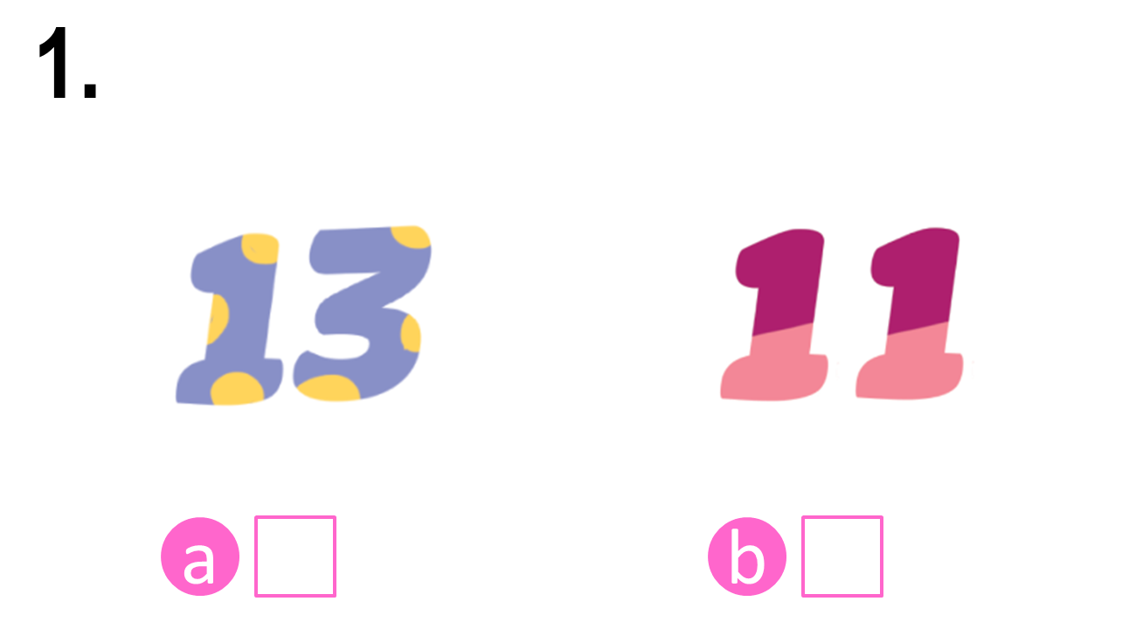
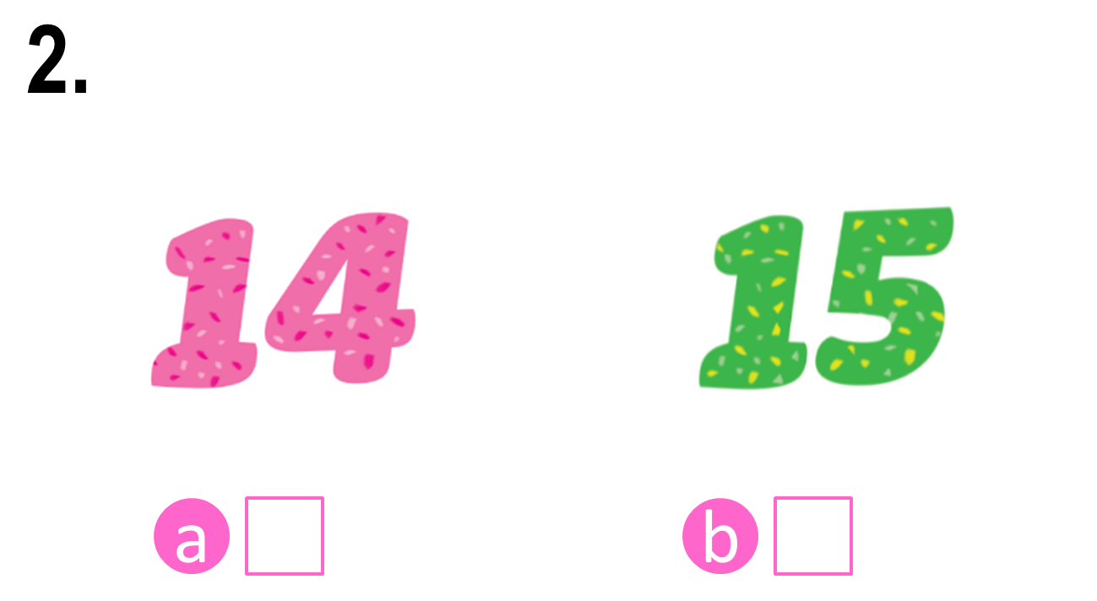


Look and say.

Slide 20
4. Listen and tick.

Slide 21
Check the answers.

Notes:
Step 3: Check the answers by asking “a or b?” When pupils answer correctly, confirm by saying “1a. Can you see the number thirteen?”/ “2b. Can you see the number fifteen?” and encourage them to repeat.

Slide 22
Check the answers.


Slide 23
Write and say.

Slide 24







Look and say.
eleve__
thirtee__
fourtee__
fiftee__

Slide 25
5. Write and say.
eleve__
thirtee__
fourtee__
fiftee__

Slide 26
Check the answers.
n
n
n
n
eleve__
thirtee__
fourtee__
fiftee__

Slide 27
Say the words.
n
n
n
n
eleve__
thirtee__
fourtee__
fiftee__

Slide 28
Fun corner and wrap-up.

Slide 29



Matching Game

Slide 30
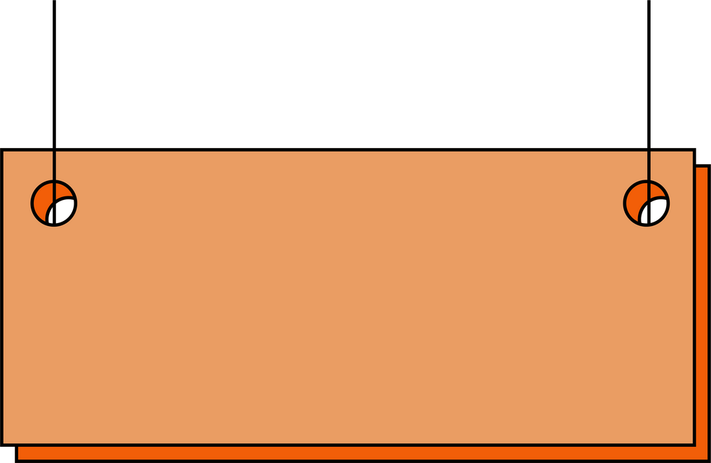





1
2
3
4
eleven
fourteen
fifteen
thirteen
A
B
C
D

Slide 31

Thank you
for
playing!

Slide 32
Website: hoclieu.vn
Fanpage: https://www.facebook.com/tienganhglobalsuccess.vn/

