Slide 1
Tiếng Anh 2
Giáo viên: Hoàng Thị Hồng
Lớp dạy: 2A3
Đơn vị công tác: Trường TH Hưng Đạo

Slide 3






Unit 13:
In the maths class
Lesson 3

Slide 4









Table of Contents
  Warm-up and review.
  Listen and repeat.
  Let’s talk.
  Let’s sing.
  Fun corner and wrap-up.

Slide 5




Warm-up and Review.

Slide 6









Game
MISSING LETTERS

Slide 7




What are missing letters?
F
O
_
_
T
E
E
N
I
R
A
R
U
R

Slide 8
What are missing letters?
_
_
F
T
E
E
N
F
I
T
I
S
I

Slide 9
What are missing letters?
T
_
_
R
T
E
E
N
K
I
H
I
R
I

Slide 10
What are missing letters?
E
L
E
V
_
_
E
L
E
M
E
N

Slide 11
THANK YOU
FOR
PLAYING!

Slide 12
Listen and repeat.

Slide 13

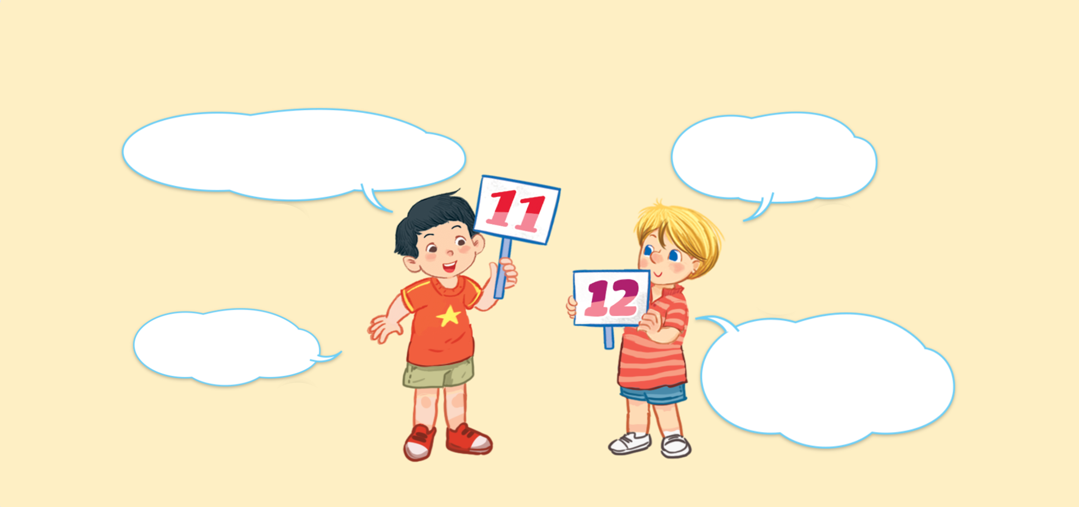


Look and say.
What number is it?
What number is it?
What number is it?
What number is it?
It’s eleven.
It’s eleven.
It’s eleven.
It’s eleven.
It’s twelve.
It’s twelve.
It’s twelve.
It’s twelve.
What number is it?
What number is it?
What number is it?
What number is it?

Slide 14

6. Listen and repeat.
What number is it?
What number is it?
What number is it?
What number is it?
It’s eleven.
It’s eleven.
It’s eleven.
It’s eleven.
It’s twelve.
It’s twelve.
It’s twelve.
It’s twelve.
What number is it?
What number is it?
What number is it?
What number is it?

Slide 15
Let’s talk.

Slide 16








Look and say
What number ______?
.
______.
a
b
c
d

Slide 17
7. Let’s talk.
What number ______?
.
______.
a
b
c
d

Slide 18
Work in pairs.
What number ______?
.
______.
a
b
c
d

Slide 19
Let’s sing.

Slide 20

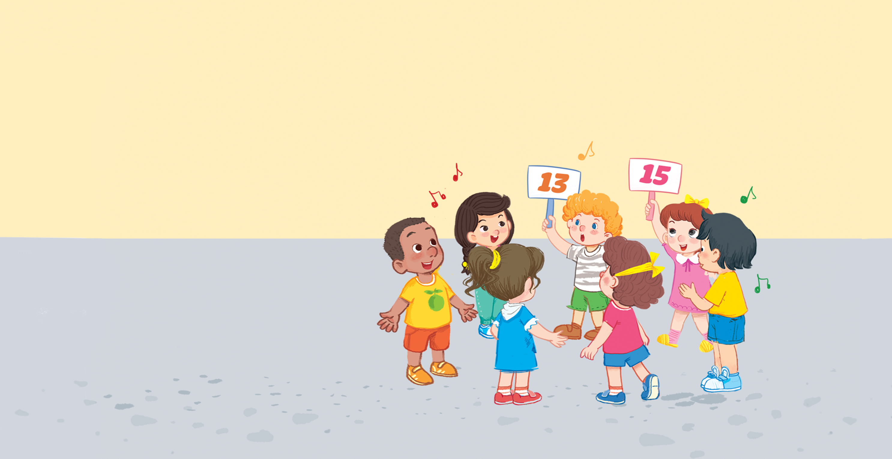


Look and say.

Slide 21

Watch a video song.
Notes:
Step 2: Play the recording of the song to familiarise pupils with the rhythm and melody (say “Listen.”).

Slide 22
8. Let’s sing.
What number is it?
What number is it?
What number is it?
What number is it?
Eleven, twelve or thirteen.
Eleven, twelve or thirteen.
Eleven, twelve or thirteen.
Eleven, twelve or thirteen.
It’s thirteen.
It’s thirteen.
It’s thirteen.
It’s thirteen.
What number is it?
What number is it?
What number is it?
What number is it?
Thirteen, fourteen or fifteen.
Thirteen, fourteen or fifteen.
Thirteen, fourteen or fifteen.
Thirteen, fourteen or fifteen.
It’s fifteen.
It’s fifteen.
It’s fifteen.
It’s fifteen.

Slide 23
Work in groups.
What number is it?
Eleven, twelve or thirteen.
It’s thirteen.
What number is it?
Thirteen, fourteen or fifteen.
It’s fifteen.
Notes:
Step 5: Have pupils work in groups to make up actions for the song. Invite a few groups to perform the song for the class.

Slide 24
Fun corner and wrap-up.

Slide 25




PLAY TIME
Bingo

Slide 26



B
I
N
G
O
11
1
7
✗
13
15
8
9
10
4

Slide 27

Thank You
For Playing!

Slide 28
Website: hoclieu.vn
Fanpage: https://www.facebook.com/tienganhglobalsuccess.vn/

