Slide 1



Giáo viên: Đồng Thị Như Quỳnh
Lớp dạy: 5A5, 5A6, 5A7
Đơn vị công tác: TRƯỜNG TIỂU HỌC HƯNG ĐẠO

Slide 2

Unit 16
Seasons and the weather
Lesson 3 (1, 2, 3)

Slide 3


01
Warm-up and Review

Slide 4


Slide 5


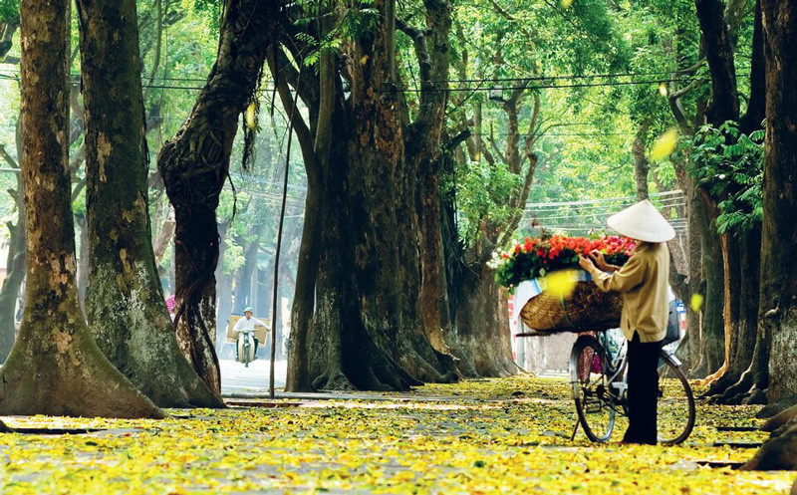
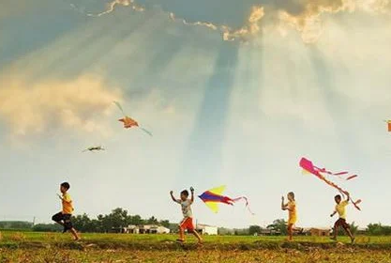
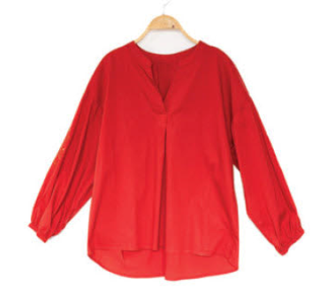
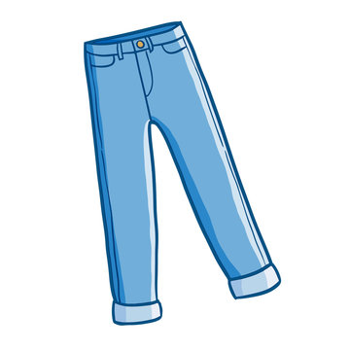
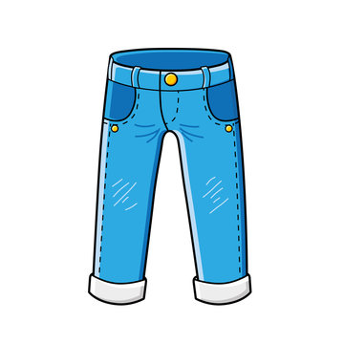


Matching pairs.

Slide 6
02
Listen and repeat.

Slide 7


Listen and repeat.
It’s cloudy in autumn.

Slide 8
Listen and repeat.
I wear jeans in winter.

Slide 9
Listen and repeat.
It’s cloudy in autumn.
I wear jeans in winter.

Slide 10
Listen and repeat.
It’s cloudy in _____.
I wear ____ in winter.

Slide 11
03
Listen and repeat.
Pay attention to the intonation.

Slide 12
Read.
1. It’s humid in spring.
2. Dresses are perfect for today.
3. I wear trousers in summer.
4. Jackets are good for winter.

Slide 13
Listen and repeat.
Pay attention to the intonation.
1. It’s humid in spring.

Slide 14
Listen and repeat.
Pay attention to the intonation.
2. Dresses are perfect for today.

Slide 15
Listen and repeat.
Pay attention to the intonation.
3. I wear trousers in summer.

Slide 16
Listen and repeat.
Pay attention to the intonation.
4.Jackets are good for winter.

Slide 17
Listen and repeat.
1. It’s humid in spring.
2. Dresses are perfect for today.
3. I wear trousers in summer.
4. Jackets are good for winter.

Slide 18
04
Activity 3. Let’s chant.

Slide 19



Let’s chant.
It’s hot in summer.
I wear shorts.
You wear a dress.
And you wear a hat.
We like summer outfits.
It’s cold in winter.
I wear a jumper.
You wear trousers.
We wear scarves outside.
We like winter clothes.

Slide 20


Let’s chant.
It’s hot in summer.
I wear shorts.
You wear a dress.
And you wear a hat.
We like summer outfits.
It’s cold in winter.
I wear a jumper.
You wear trousers.
We wear scarves outside.
We like winter clothes.

Slide 21
05
Fun corner and Wrap-up

Slide 22

Whisper
Game

Slide 23


Team 1
Whisper Game
Team 2
Round 1
Round 2
Round 3
Round 4
Notes:
GV ghi điểm cho HS bằng cách nháy vào tên team. Mỗi lần nháy 1 ngôi sao xuất hiện.

Slide 24


Slide 25
Website: hoclieu.vn
Fanpage: https://www.facebook.com/tienganhglobalsuccess.vn/

