Slide 1
Tiếng Anh 2
Giáo viên: Lê Thị Minh Hiếu
Lớp dạy: 2A1, 2A4, 2A5
Đơn vị công tác: Trường TH Hưng Đạo

Slide 3






REVIEW 3
Period 1 – Phil and Sue

Slide 4


TABLE OF CONTENTS
1.
Warm-up and review.
2.
Listen and repeat.
3.
Look again and circle.
4.
Fun corner and wrap-up.

Slide 5


Warm-up
and review.
1

Slide 6











LUCKY FLOWERS
Notes:
Click the flowers to link to the Question slides.
Click the tree to end the game.

Slide 7







grapes
Notes:
Click the red flower to back to the Flower slide.

Slide 8

cake
Notes:
Click the red flower to back to the Flower slide.

Slide 9

table
Notes:
Click the red flower to back to the Flower slide.

Slide 10

riding
Notes:
Click the red flower to back to the Flower slide.

Slide 11

Notes:
Click the red flower to back to the Flower slide.

Slide 12

yogurt
Notes:
Click the red flower to back to the Flower slide.

Slide 13

yo-yos
Notes:
Click the red flower to back to the Flower slide.

Slide 14





Thank you
for playing!

Slide 15

2
Listen
and repeat.

Slide 16





LOOK and ANSWER.

Slide 17

LOOK and ANSWER.

Slide 18
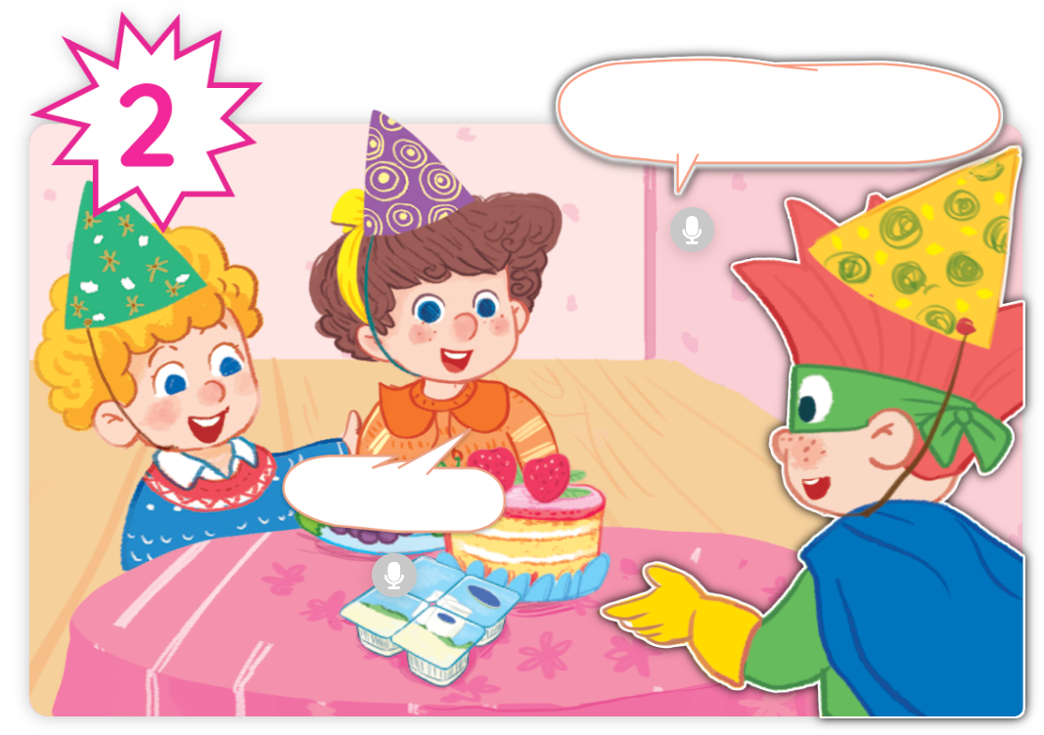
LOOK and ANSWER.

Slide 19
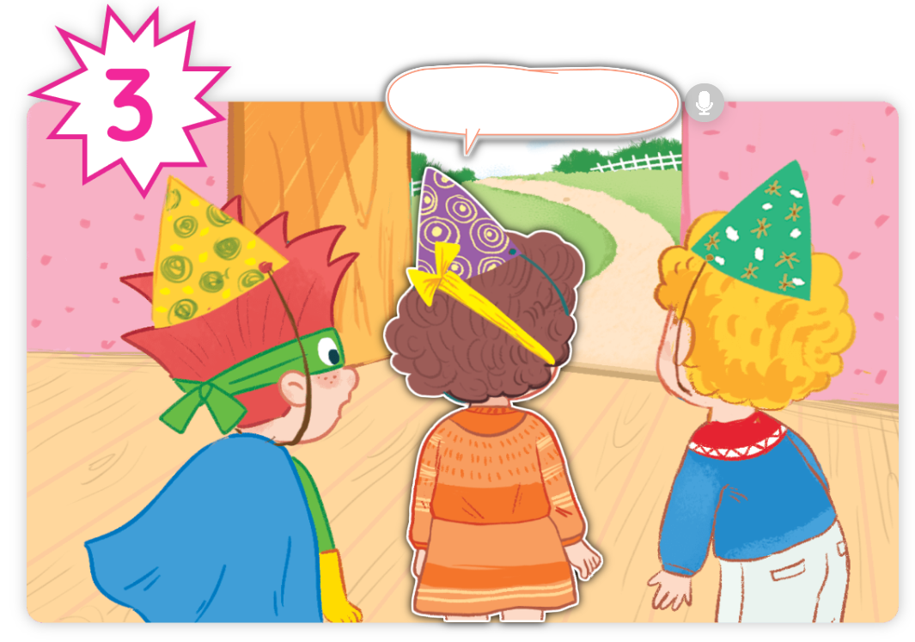
LOOK and ANSWER.

Slide 20
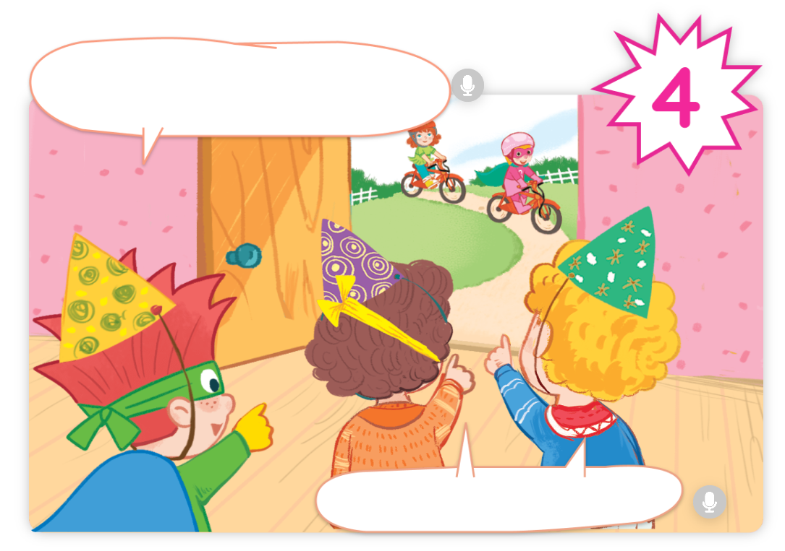
LOOK and ANSWER.

Slide 21


LISTEN and REPEAT.

Slide 22



LISTEN and REPEAT.

Slide 23


LISTEN and REPEAT.

Slide 24

LISTEN and REPEAT.

Slide 25


LISTEN and REPEAT.

Slide 26
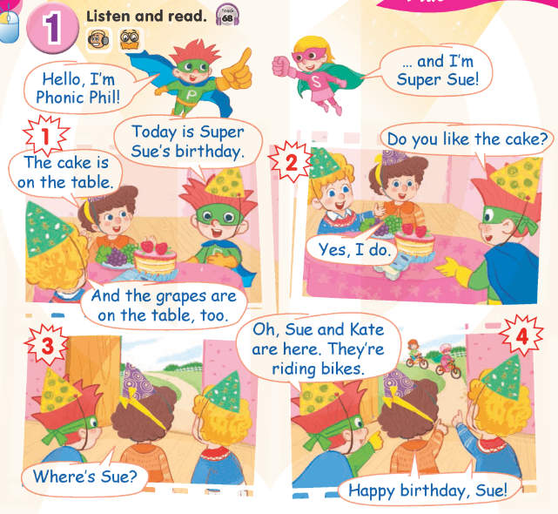

Work in pairs.

Slide 27
Good Job!

Slide 28
3
Look again
and circle.

Slide 29
Point and say.
grapes

Slide 30
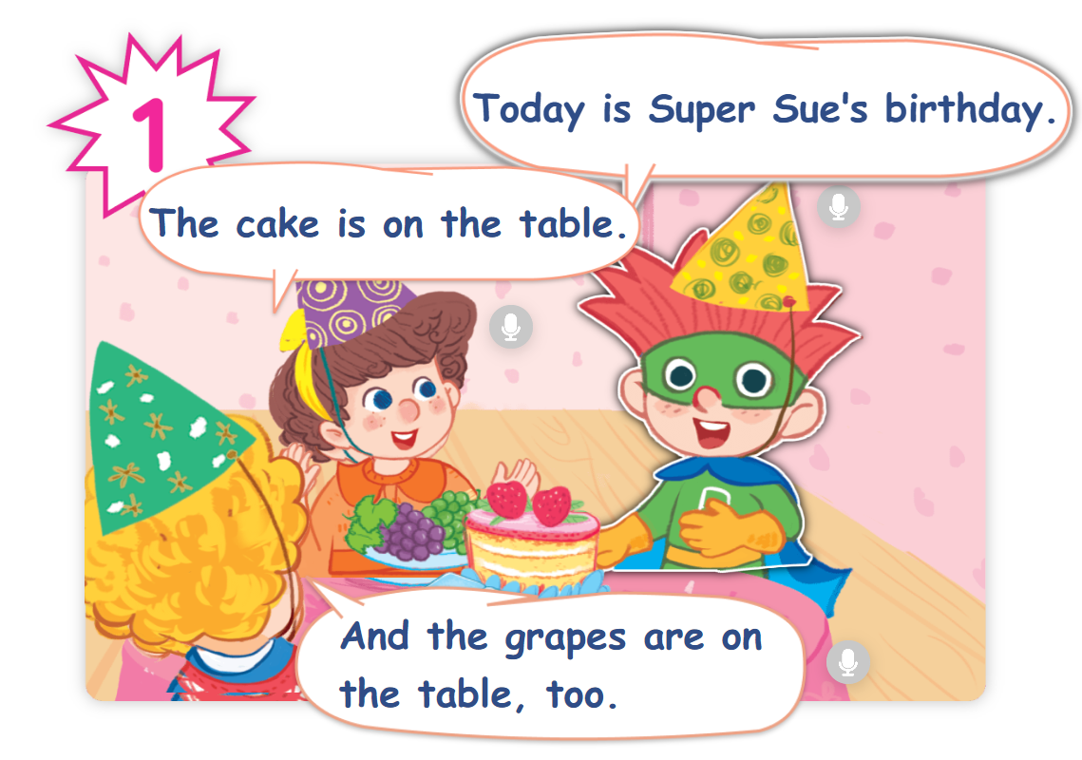
Find “grapes” in the story.

Slide 31
Point and say.
yogurt

Slide 32
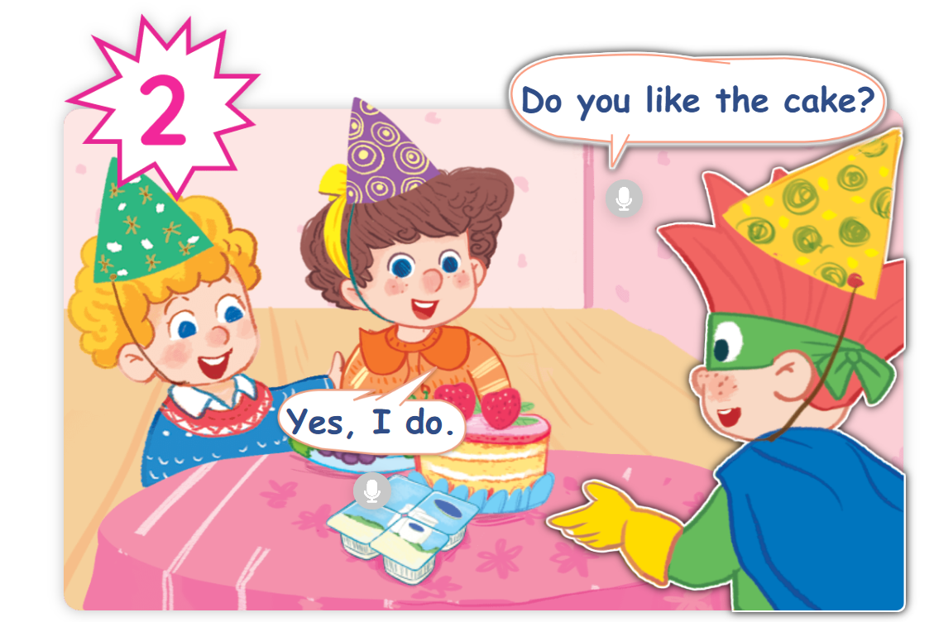
Find “yogurt” in the story.

Slide 33
Point and say.
cake

Slide 34
Find “cake” in the story.

Slide 35
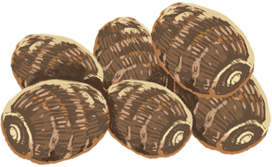
Point and say.
yams

Slide 36
Find “yams” in the story.
✗

Slide 37
Point and say.
riding

Slide 38
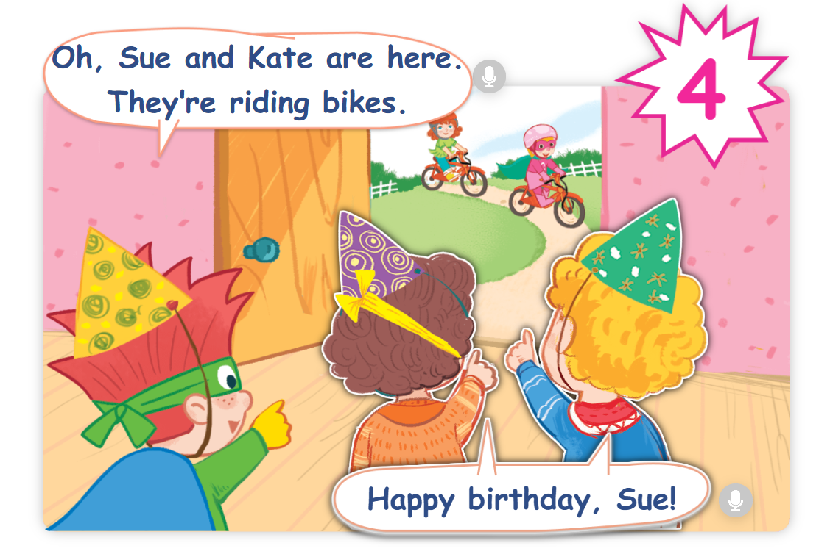
Find “riding” in the story.

Slide 39

Point and say.
sliding

Slide 40
Find “sliding” in the story.
✗

Slide 41

Point and say.
zoo

Slide 42
Find “zoo” in the story.
✗

Slide 43

Point and say.
zebra

Slide 44
Find “zebra” in the story.
✗

Slide 45
Good Job!

Slide 46
4
Fun corner
and wrap-up.

Slide 47










Spell it!
Game

Slide 48



Are You
Ready?

Slide 49



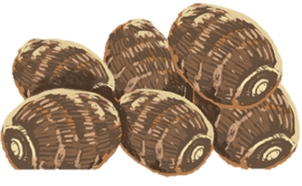



Question 1
A
Y
M
S

Slide 50
Answer
yams

Slide 51

Question 2
D
l
N
S
L
I
G

Slide 52
Answer
sliding

Slide 53

Question 3
D
I
G
R
I
N

Slide 54
Answer
riding

Slide 55

Question 4
G
O
U
Y
R
T

Slide 56
Answer
yogurt

Slide 57

Question 5
E
P
G
R
A
S

Slide 58
Answer
grapes

Slide 59

Question 6
A
K
E
C

Slide 60
Answer
cake

Slide 61


Thank you
for Playing!

Slide 62
Website: hoclieu.vn
Fanpage: https://www.facebook.com/tienganhglobalsuccess.vn/

