Slide 1



Giáo viên: Đồng Thị Như Quỳnh
Lớp dạy: 2A2
Đơn vị công tác: TRƯỜNG TIỂU HỌC HƯNG ĐẠO

Slide 2






REVIEW 3
Lesson 2 (1, 2, 3)

Slide 3


TABLE OF CONTENTS
1.
Warm-up and review.
2.
Listen and tick or cross.
3.
Listen and circle.
4.
Write and say.
5.
Fun corner and wrap-up.

Slide 4


Warm-up
and review.
1

Slide 5




Magic bag
Notes:
Click to play the music. After a while, the music will stop and the picture will appear.

Slide 6


Game: MAGIC BAG
g
r
a
p
e
s

Slide 7

Game: MAGIC BAG
t
a
b
l
e

Slide 8

Game: MAGIC BAG
d
r
i
v
i
n
g

Slide 9

Game: MAGIC BAG
z
e
b
r
a

Slide 10

Game: MAGIC BAG
s
l
i
d
i
n
g

Slide 11

Game: MAGIC BAG
y
o
y
o
s

Slide 12

Thank
you!

Slide 13

2
Listen and tick or cross.

Slide 14







POINT and SAY.

Slide 15
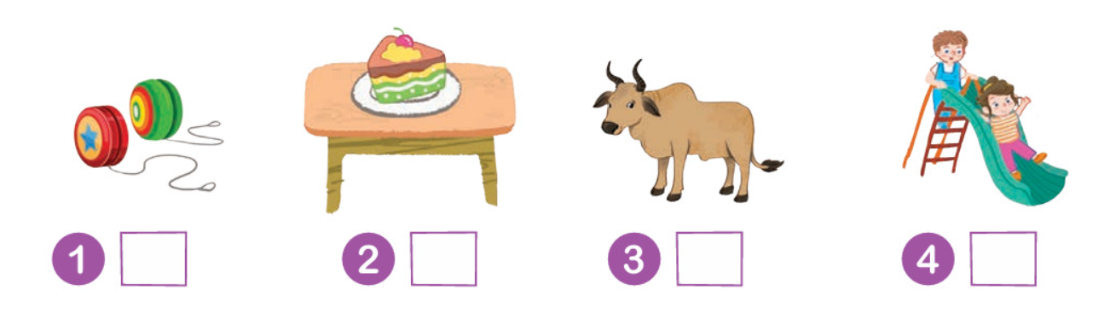
LISTEN and TICK or CROSS.

Slide 16
LISTEN again.

Slide 17







Let’s check.
Work in pairs.

Slide 18
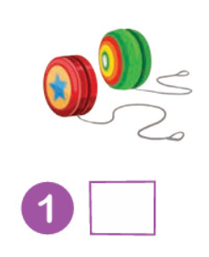
Let’s CHECK.
✓

Slide 19
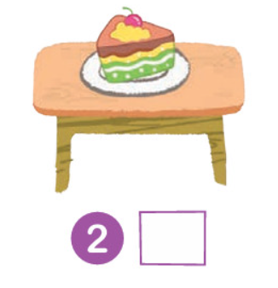
Let’s CHECK.
✓

Slide 20
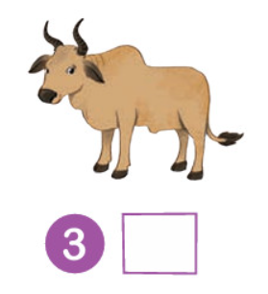
Let’s CHECK.
✗

Slide 21
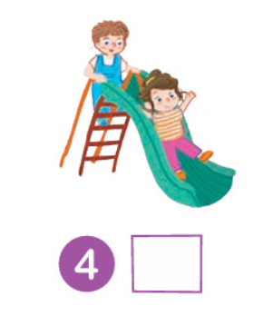
Let’s CHECK.
✗

Slide 22
Good Job!

Slide 23
3
Look
and circle.

Slide 24

Point and say.
a
i

Slide 25

Point and say.
y
a

Slide 26

Point and say.
y
z

Slide 27

Point and say.
i
z

Slide 28
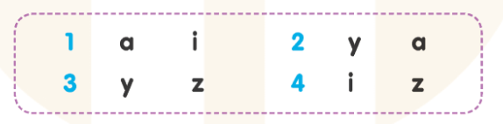
LISTEN and CIRCLE.

Slide 29
LISTEN again.

Slide 30
Let’s check.
Work in pairs.

Slide 31
Let’s CHECK.
a
i

Slide 32
Let’s CHECK.
y
a

Slide 33
Let’s CHECK.
y
z

Slide 34
Let’s CHECK.
i
z

Slide 35
Good Job!

Slide 36
4
Write
and say.

Slide 37

Point and say.

Slide 38
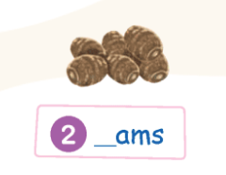
Point and say.

Slide 39
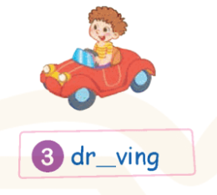
Point and say.

Slide 40
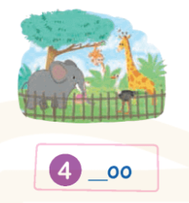
Point and say.

Slide 41
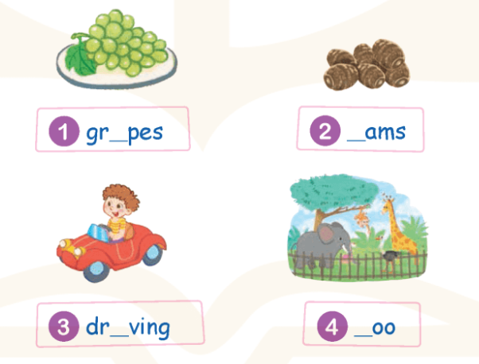
LOOK and WRITE.

Slide 42
Let’s check.
Work in pairs.

Slide 43
WRITE and SAY.
gr_ pes
a

Slide 44
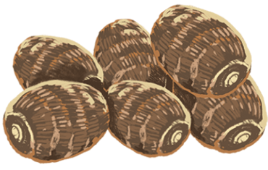
WRITE and SAY.
y
_ams

Slide 45
WRITE and SAY.
dr_ving
i

Slide 46

WRITE and SAY.
_oo
z

Slide 47
Good Job!

Slide 48
5
Fun corner
and wrap-up.

Slide 49









GAME

Slide 50






What can you see?
The cake is on the table.

Slide 51


What can you see?
The grapes are on the table.

Slide 52

What can you see?
The bananas are on the table.

Slide 53

What can you see?
The apple is on the table.

Slide 54


Slide 55
Good Job!

Slide 56
Website: hoclieu.vn
Fanpage: https://www.facebook.com/tienganhglobalsuccess.vn/

